Slide 1


Listening and Ways to Improve It.
Libyan International Medical University
Faculty of Business Administration
By: Marwan Fouad Abed Eloshipi
ID: 3782
Email: marwan_3782@limu.edu.ly

Slide 2
TABLE OF CONTENTS
01
03
04
02
Here you could describe the topic of the section
Listening
Methods to Improve Listening
Introduction
Definition
Conclusion
Reflection
05
References
02

Slide 3
Learning Objectives
Hopefully at the end of this presentation you’ll be able to:
Define listening.
List ways to improve your listening understanding.
03

Slide 4

01
Listening
Introduction
Definition
04

Slide 5
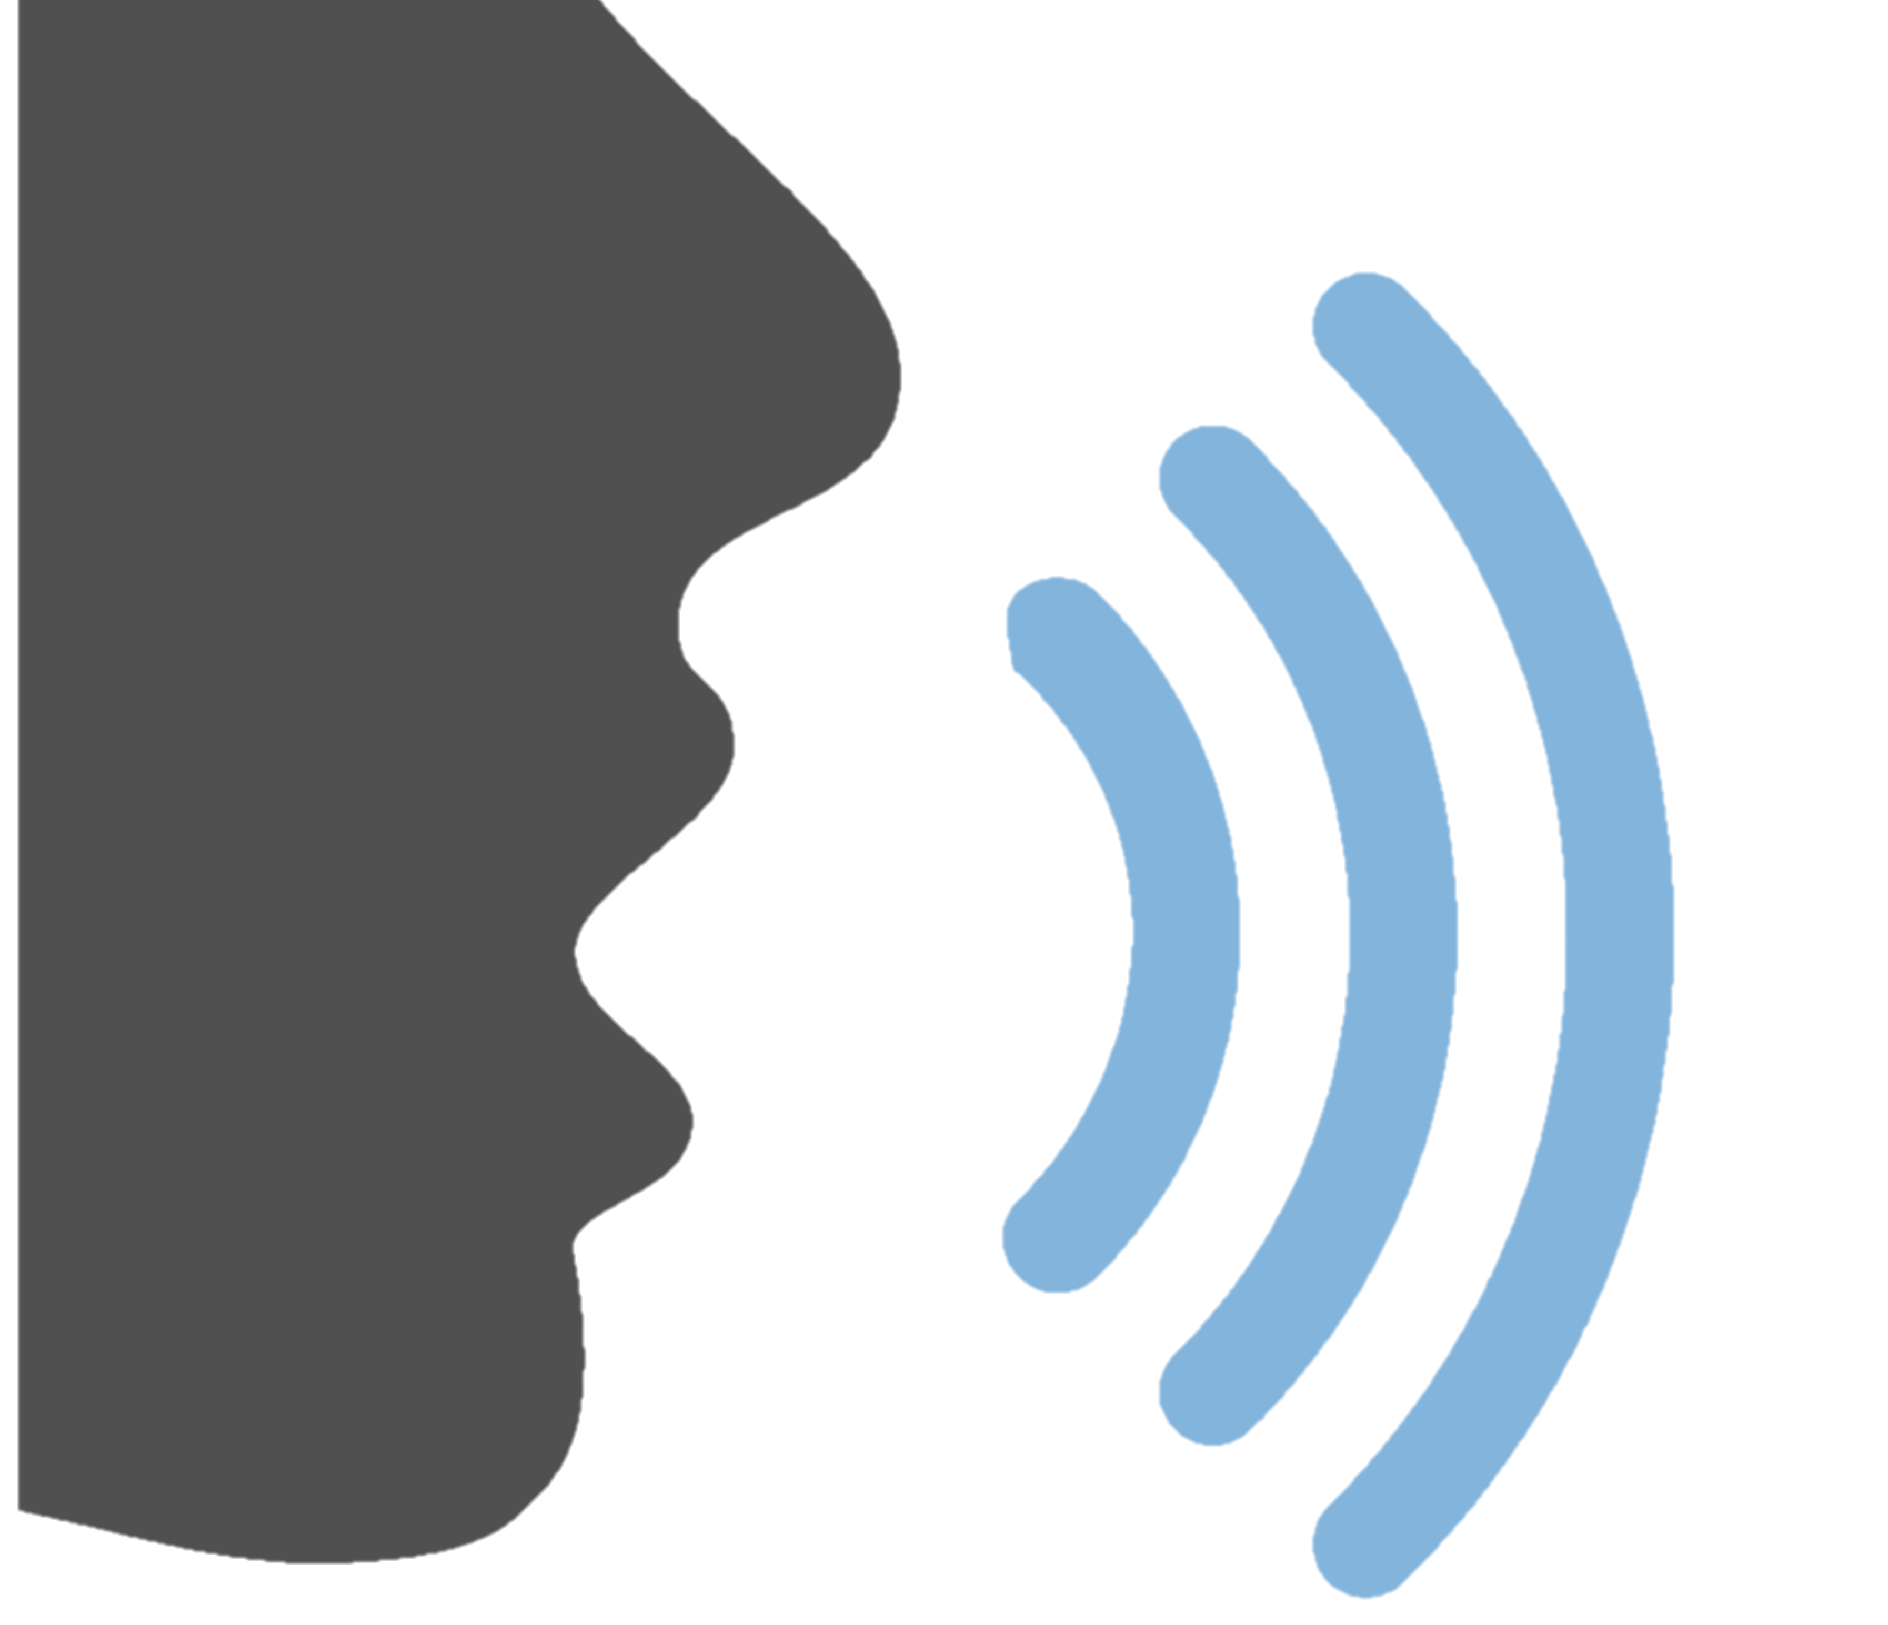
—Epictetus
Introduction
“We have two ears and one mouth so that we can listen twice as much as we speak.”
Time people spend listening
55%
05

Slide 6
Listening - Definition
Listening Is defined as the process of receiving, understanding, remembering, analyzing, and reacting to verbal messages [spoken or written] and/or non-verbal messages.
The study of Listening has traditionally focused on spoken words (Emmert, 1994; Brownell, 2010, Worthington & Fitch-Hauser, 2012).
Effective communication depends on listening. Without the ability to listen effectively messages are easily interpreted.
06

Slide 7
Listening - Definition
What is listening?
Being quiet while someone is talking.
Listening with ears.
Hearing words.
Listening to just words is not enough; great listeners pay attention to the non-verbal cues of the speaker, and hear with their mind.
07

Slide 8
02
Methods to Improve Listening
08

Slide 9
Methods to Improve Listening
Maintain eye contact with the speaker
You should be focused, paying attention to the speaker, and limiting any unnecessary distractions.
Provide the speaker with your undivided attention and make an effort to look at them. This provides them with a nonverbal cue that you are interested in what they are saying.
Visualize what the speaker is saying
You should try to imagine and conjure up images of what the speaker is talking about to help save the information.
09

Slide 10
Methods to Improve Listening
Limit judgment
You should not criticize the speaker in your mind while they are talking, even if the message triggers you. Try to avoid thinking about negative and judgmental comments.
Listen with an open mind and understand that the speaker is giving their pov.
Don’t interrupt
The human body can not send and receive messages at the same time effectively. Therefore if someone is delivering their message, wait for them patiently to finish before responding.
Interrupting sends the wrong message to the speaker.
10

Slide 11
Methods to Improve Listening
Wait for a pause to ask questions
You may not understand everything someone says to you. It is best to wait until they pause or stop speaking to ask them for clarification.
Pay attention to non-verbal cues
Verbal and non-verbal communication are sync with each other.
You can learn a lot of things about someone through their body language and tone of voice when they are speaking.
Listening includes paying attention to nonverbal cues. It helps you to make inferences based on what a person means when they are talking to you.
11

Slide 12
Conclusion
In conclusion, listening is the process of receiving, constructing meaning from, and responding to verbal and/or non-verbal messages. Improving your listening skills improves your interpersonal communication.
12

Slide 13
Reflection
In my opinion, effective communication depends on having effective listening abilities. Being a good listener can help you build stronger bonds with other people, make better decisions, and come to swift agreements with others.
13

Slide 14
References
Library management system | Perpustakaan Universitas bakrie. (n.d.). Retrieved November 8, 2022, from https://slims.bakrie.ac.id/repository/f7d4f28f39e8b9d8cb794f6c4eb9cb0f.pdf.
10 ways to improve your listening skills (with examples). (n.d.). Retrieved November 29, 2022, from https://www.indeed.com/career-advice/career-development/how-to-improve-listening-skills.
Business communication :basic concepts and skills - UJ. (n.d.). Retrieved November 29, 2022, from https://www.uj.edu.sa/Files/1001210/Subjects/Chapter%205%20Listening%20Skills%20%20.pdf.
14

Slide 15
THANKS!
Do you have any questions?

