Slide 1
THE BREAST
Haitham R. Elmehdawi
2020

Slide 2
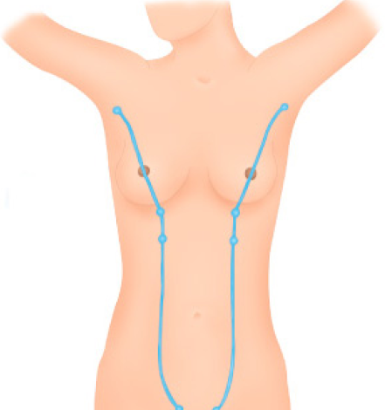
Breast Embryology
It’s a modified sweat gland of ectodermal origin.
develops along the milk line that extends from the axilla to the inguinal region.
Milk line of schultz

Slide 3
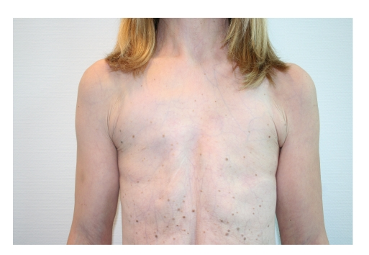
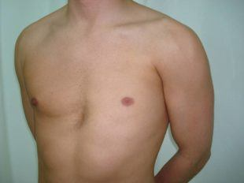
Breast Embryology
Amastia
Amazia
    Complete absence of breast tissue , nipple and areola .
    nipple and areola are present but the breast tissue is absent .

Slide 4
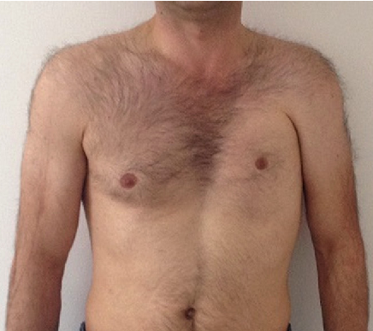
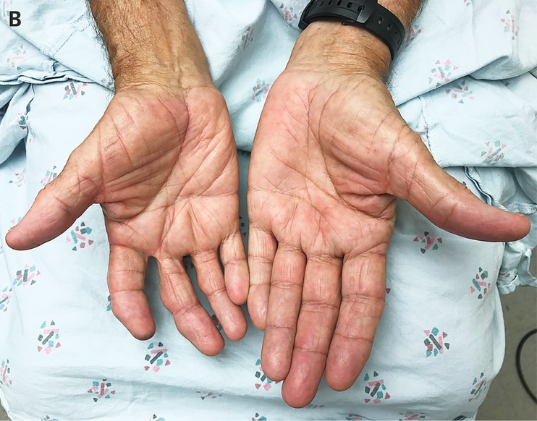
Breast Embryology
Poland’s syndrome
Amazia
Absence of pectorals major
Absence of costal cartilage
Absence of ribs
brachysyndactyly

Slide 5
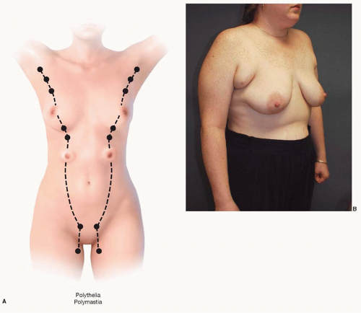
Breast Embryology
Polymastia
Most common in the axilla
Associated with
  Turner syndrome
  Fleischer's syndrome .

Slide 6
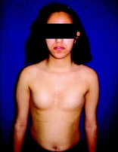
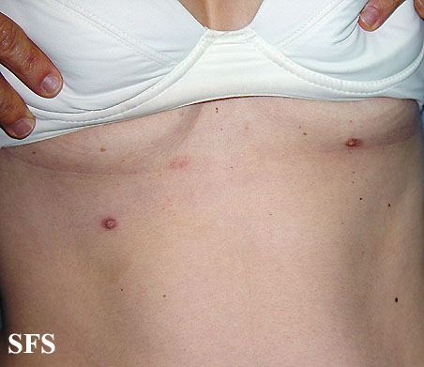
Breast Embryology
Athelia
polythelia

Slide 7
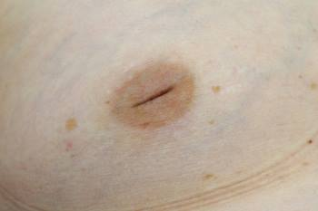
Breast Embryology
Congenital Nipple retraction

Slide 8
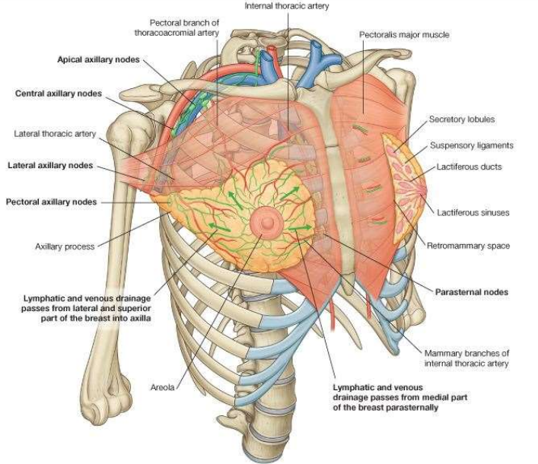
Breast Anatomy

Slide 9
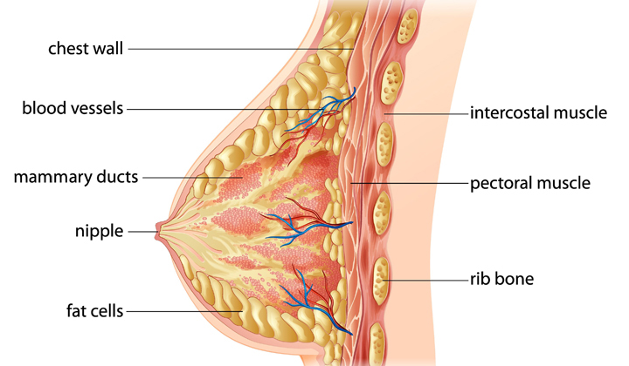
Breast Anatomy

Slide 10
Breast Anatomy
It extending from the 2nd to the 6th ribs(mid-clavicular line) & from the lateral border of the sternum to the anterior axillary line.
2/3 rests on pectoralis major
1/3 on serratus anterior
while its lower medial edge just overlaps the upper part of external oblique muscle.
Axillary tail:
it pierces the deep fascia and enter the axilla.
All breast tissue lies in subcutaneous area , except the Axillary tail, its in close relation to Axillary vessels.

Slide 11
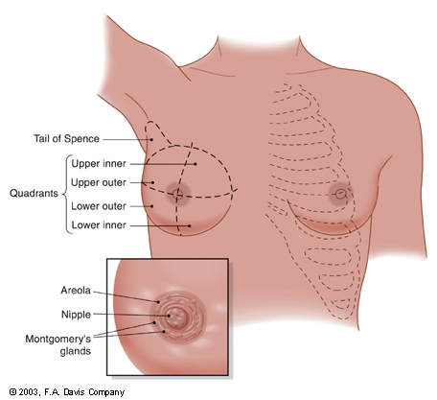
Breast Anatomy

Slide 12
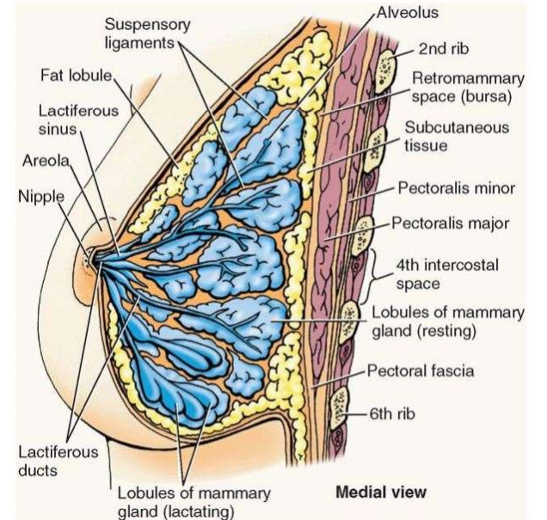
Breast Anatomy
MICROSCOPIC ANATOMY OF THE BREAST:
      Glandular epithelium: Milk producing tissue.
(2) Fibrous stroma and supporting structures.
suspensory ligament of Cooper
(3) Fat (Adipose).

Slide 13
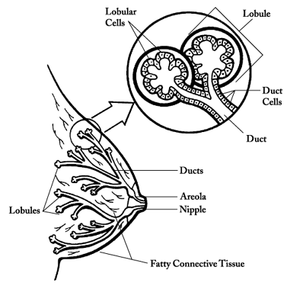
Breast Anatomy
Glandular epithelium :
The breast is composed of 15 to 20 lobes
each composed of several lobules.
Which empty via ductules into a lactiferous duct.
lactiferous duct contains ampulla near its ends and open onto the tip of the nipple

Slide 14
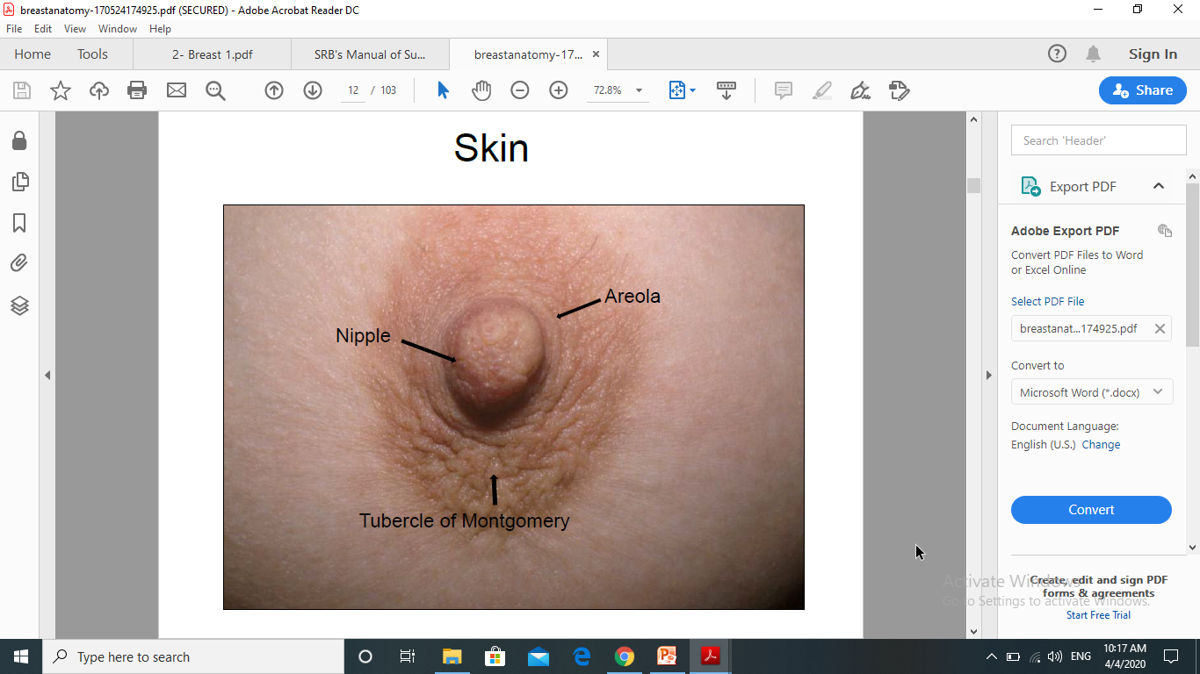
Breast Anatomy
Nipple is located at the level of 4th intercostal space.
It is pierced by 15-20 lactiferous ducts.
It has rich sensory nerve endings.
Nipple is supplied by 4th intercostal nerve.
Areola is circular pigmented area around the nipple.
It is rich in modified sebaceous glands which enlarge during pregnancy and lactation as Montgomery tubercles.

Slide 15
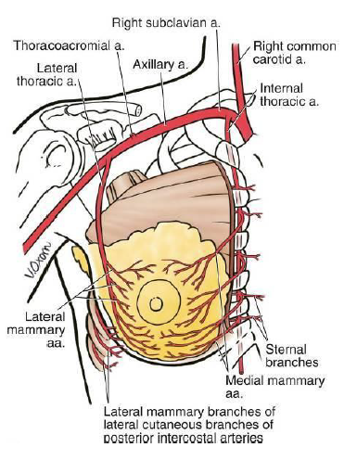
Breast Anatomy
Arterial supply:
lateral thoracic A
Internal thoracic A (internal mammary)
Intercostal arteries A

Slide 16
Breast Anatomy
The venous drainage:
Veins of the breast follow the course of the arteries
    The axillary vein is responsible for the majority of venous drainage.
    The intercostal vein drained in to azygos vein .

Slide 17
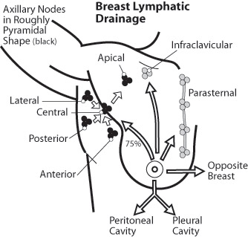
Lymphatic drainage of the breast
Axillary LN 85%
Internal mammary LN
  ( parasternal LN ) 10 %
Others 5%
  Supraclavicular
  Sub diaphragmatic
  sub peritoneal
  Opposite breast

Slide 18
Lymphatic drainage of the breast
Axillary LN 20–30 in number
Anterior deep to pectorals major along the lower border of pectorals minor.
Posterior along the subscapular vessels.
Lateral along the axillary vein.
Central embedded in the axillary fat.
Apical all the other axillary nodes drain into it behind the clavicle at the apex of the axilla
Rotter's interpectoral

Slide 19
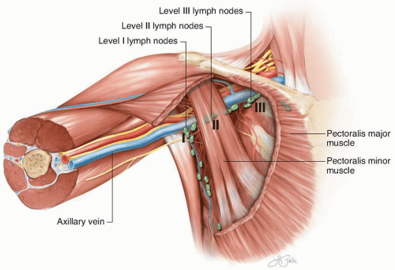
Lymphatic drainage of the breast
Axillary LN level ( Berg’s level )

Slide 20
Diseases of the breast

Slide 21
Diseases of the breast
Congenital
Traumatic
Cystic
Inflammatory
fibrocystic
Neoplasm
Nipple discharge
Breast
Nipple
Fat necrosis
Hematoma
Acute
Acute lactational mastitis
Non lactational mastitis
Chronic
Chronic mastitis
Chronic duct ectasia
Benign
Intraductal papiloma
Fibroadenoma
Malignant
Ductal Ca.
Lobular Ca.

Slide 22
TRAUMATIC FAT NECROSIS
It may be due to either direct or indirect trauma
(trauma may not be noticed many times).
Pathogenesis
Capillary ooze causes triglyceride in the fat to dissociate into fatty acids.
It combines with calcium from the blood resulting in saponification which causes inflammatory reaction
Clinical Features
Painless swelling in the breast which is smooth, hard, nontender and adherent to breast tissue.
It is nonprogressive, nonregressive.
Differential Diagnosis
Carcinoma breast.

Slide 23
BREAST CYSTS
It may be develop from glandular and duct ( acinar ) or in the stroma ( intra acinar ).
Cyst may be microscopic or macroscopic.
It is common after the age of 35 years up to menopause.
Cyst size varies with menstruation due to influence of ovarian hormones.
Cysts can be multiple (50%).
Often bilateral.
Risk of breast cancer in breast cyst is very less (0.1%).

Slide 24
BREAST CYSTS
Clinical Features
  Smooth
  Soft
  fluctuant
  often transilluminating
  well-localised swelling .

Slide 25
BREAST CYSTS
Differential Diagnosis
  intra acinar cyst
        Traumatic ( blood cyst )
        Inflammatory ( abscess )
        Neoplastic ( degenerative cancer )
        Parasitic ( hydatid cyst )
        Skin ( sebaceous cyst, lymph cyst )
        In the nipple (Montgomery cyst )
  Acinar cyst
        Fibrocystic disease ( cyst of bloodgood )
        Retention cyst ( duct papilloma )
        Galactocele ( milk cyst )

Slide 26
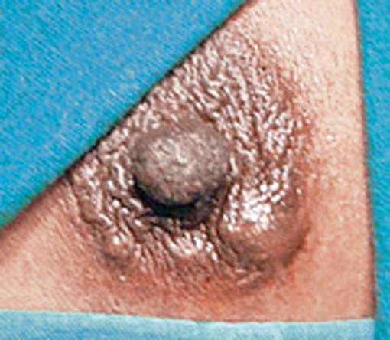
BREAST CYSTS
Treatment
Aspiration & cytology
It needs excision if
    Rapid refilling.
    Residual mass.
    Bloody aspiration.
    Positive cytology .

Slide 27
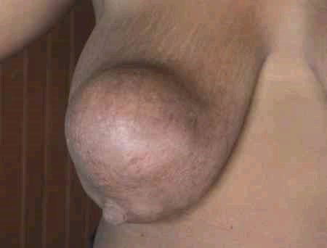
BREAST CYSTS
GALACTOCELE
  Seen in lactating women.
  Occurs during cessation of lactation.
  Often up to 10 months after lactation.
  It contains milk and epithelial debris within.
  It is a retention cyst in subareolar region attaining large size.

Slide 28
Diseases of the breast
Congenital
Traumatic
Cystic
Inflammatory
fibrocystic
Neoplasm
Nipple discharge
Breast
Nipple
Fat necrosis
Hematoma
Acute
Acute lactational mastitis
Non lactational mastitis
Chronic
Chronic mastitis
Chronic duct ectasia
Benign
Intraductal papiloma
Fibroadenoma
Malignant
Ductal Ca.
Lobular Ca.

Slide 29
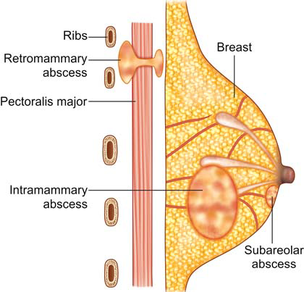
INFLAMMATORY BREAST DISEASES
MASTITIS
    Subareolar.
    Intramammary.
    Retromammary (submammary).

Slide 30
INFLAMMATORY BREAST DISEASES
MASTITIS
Staph. aureus—most common
Precipitating factors
    Cracked nipple
    Retracted nipple
    Improper cleaning of the nipple
    Inadequate milk sucking by baby or milk expression causing stasis
    Infection from the mouth of the baby
    Haematoma getting infected
    Can be from haematogenous spread

Slide 31
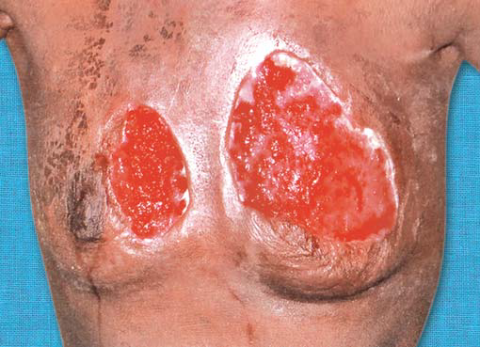
INFLAMMATORY BREAST DISEASES
Subareolar Mastitis
It is common in non lactating women.
It results from an infected gland of Montgomery or a furuncle of the areola.
Clinical features
Red, inflamed, edematous areola with a tender swelling underneath.
Nipple retraction may develop.

Slide 32
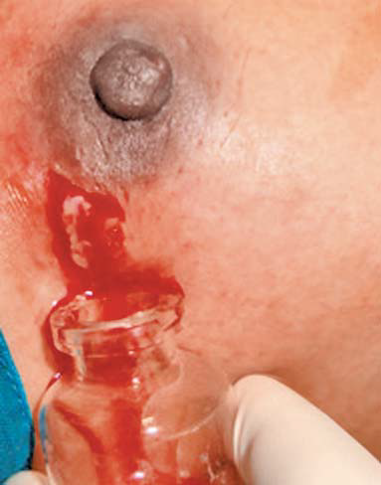
INFLAMMATORY BREAST DISEASES
Subareolar Mastitis
Differential diagnosis
  Paget’s disease of the nipple.
Treatment
  Antibiotics
  pus is drained by making a subareolar incision.

Slide 33
INFLAMMATORY BREAST DISEASES
Intramammary Mastitis
      Acute lactational mastitis & abscess
      Acute Non lactational mastitis of the breast
      chronic mastitis

Slide 34
INFLAMMATORY BREAST DISEASES
Acute lactational mastitis & abscess
Commonly seen in lactating women.
Usually up to 6 months of lactation period.
Staphylococcus aureus causes clotting of milk in the blocked duct and multiply.
Initially it begins in one quadrant but later involves entire breast.
It is difficult to differentiate initial stage of mastitis (stage of cellulitis) from stage of breast abscess formation.

Slide 35
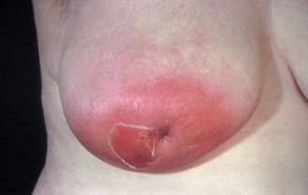
INFLAMMATORY BREAST DISEASES
Clinical features
Continuous throbbing pain.
high grade fever.
Diffuse redness, tenderness .
Purulent discharge from the nipple.
Fluctuation (10%).
Differential diagnosis:
Inflammatory carcinoma of breast.

Slide 36
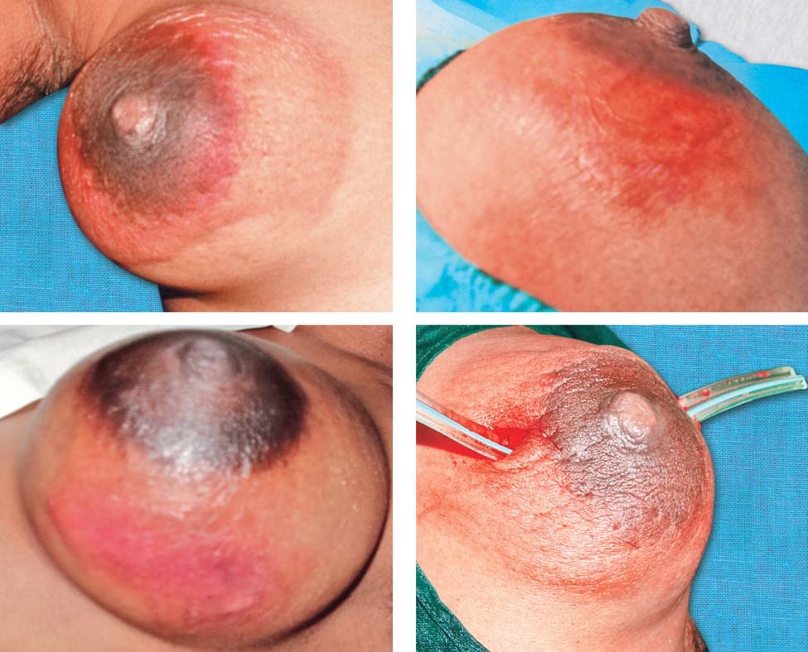
INFLAMMATORY BREAST DISEASES
Treatment:
Antibiotics.
Repeated US guided aspirations can be tried which avoids surgery and scar.
Drainage under general anaesthesia, a counter incision may be needed.

Slide 37
INFLAMMATORY BREAST DISEASES
Acute Non lactational mastitis of the breast
Infected heamatoma.
Traumatic mastitis.
Mastitis of mumps.
Mastitis of puberty in male.
Mastitis neonatorum
  Witch’s milk is secretion of milk in both male and female infants due to maternal hormonal effects in foetus.
  It lasts up to three weeks after child birth.

Slide 38
INFLAMMATORY BREAST DISEASES
Chronic mastitis
Chronic breast abscess
    TUBERCULOSIS OF THE BREAST
    ANTIBIOMA
Palsma cell mastitis ( DUCTECTASIA )

Slide 39
INFLAMMATORY BREAST DISEASES
DUCTECTASIA
It is dilatation of lactiferous ducts.
periductal inflammation contains plasma cells.
Clinical Features
    Greenish discharge or creamy/paste like from the nipple.
    Indurated mass under the areola which is often tender.
    Retraction of nipple ( late)
    May present as mastalgia.
    Axillary nodes may be palpable as nonspecific.
Treatment
Antibiotics
Cone excision of involved major ducts
modified breast ductal system excision.

Slide 40
INFLAMMATORY BREAST DISEASES
MONDOR’S DISEASE
spontaneous thrombophlebitis of the superficial veins of the breast and anterior chest wall.
Unknown cause.
It is often a self-limiting disease without any recurrence, complication or deformity.

Slide 41
Diseases of the breast
Congenital
Traumatic
Cystic
Inflammatory
fibrocystic
Neoplasm
Nipple discharge
Breast
Nipple
Fat necrosis
Hematoma
Acute
Acute lactational mastitis
Non lactational mastitis
Chronic
Chronic mastitis
Chronic duct ectasia
Benign
Intraductal papiloma
Fibroadenoma
Malignant
Ductal Ca.
Lobular Ca.

Slide 42
FIBROCYSTIC DISEASE
Other names
FIBROCYSTADENOSIS
MAMMARY DYSPLASIA
CYCLICAL MASTALGIA WITH NODULARITY
Aberration of Normal Development and Involution
(ANDI)

Slide 43
FIBROCYSTIC DISEASE
Commonest breast disorders .
It is common in upper and outer quadrant.
includes variety of benign breast disorders occurring at different periods of reproductive periods in females.
It is an estrogen dependent condition.

Slide 44
FIBROCYSTIC DISEASE
Microscopic changes
Adenosis : No. of acini
Epitheliosis : No. of ductal epithelium
Fibrosis : fibrous tissue replacing fat & elastic tissue causing sclerosing adenosis .
Cyst formation : multiple retention cyst
bluedome cyst of Bloodgood.

Slide 45
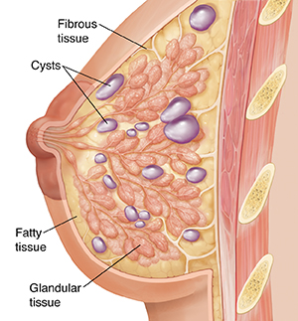
FIBROCYSTIC DISEASE
Classification
Nonproliferative
  moderate hyperplasia of ductal luminal cells , no life time risk for cancer.
Proliferative without atypia
(severe hyperplasia)
Proliferative with atypia
  is risk factor for breast cancer , often mimics carcinoma insitu .

Slide 46
FIBROCYSTIC DISEASE
Clinical Features
Presentation is during menstruating age group as
  a bilateral, painful, diffuse, granular, tender, swelling.
cyclical mastalgia.
It subsides during pregnancy, lactation and after menopause.
Discharge from the nipple when present will be serous or occasionally greenish.
enlargement of axillary lymph nodes can occur(20%).

Slide 47
FIBROCYSTIC DISEASE
Treatment
Conservative line of management is preferred. Reassurance, avoid caffeine, chocolate, salt.
Medical
    Oil of evening primrose used in moderate pain.
    Danazol—interferes with FSH and LH used in severe cases.
    Bromocriptine—lowers prolactin.
    Tamoxifen—is an antiestrogenic drug.
    NSAIDs—oral and topical.
Surgery
    Excision of the cyst or localised excision of the diseased tissue.
    Subcutaneous mastectomy with prosthesis placement—only in severe, persistent disease.

Slide 48
Diseases of the breast
Congenital
Traumatic
Cystic
Inflammatory
fibrocystic
Neoplasm
Nipple discharge
Breast
Nipple
Fat necrosis
Hematoma
Acute
Acute lactational mastitis
Non lactational mastitis
Chronic
Chronic mastitis
Chronic duct ectasia
Benign
Intraductal papiloma
Fibroadenoma
Malignant
Ductal Ca.
Lobular Ca.

Slide 49
NIPPLE DISCHARGES
Physiological
A clear, serous discharge may be in pregnancy .
A milky discharge occurs in lactating woman.
Pathological
Milky , Galactorrhea.
A blood-stained discharge may be caused by a duct papilloma or carcinoma.
Greenish discharge or creamy/paste like is usually due to duct ectasia.
Purulent discharge occurs in infection

Slide 50
BENIGN BREAST TUMOURS
DUCT PAPILLOMA
It is the most common cause of bloody discharge from nipple
It is usually single, from a single lactiferous duct
It blocks the duct causing ductal dilatation
It is may be part of epitheliosis in fibrocystic disease .
Single papilloma is not premalignant , But multiple papillomas in many ducts can be pre malignant.
Peripheral papilloma should be differentiated from invasive papillary carcinoma.

Slide 51
BENIGN BREAST TUMOURS
Clinical Features
Blood stained discharge from the nipple is common..
Retroareolar mass may be palpable .
Injection of contrast into the duct (Ductography ) show filling defect .
Treatment
  Microdochectomy

Slide 52
BENIGN BREAST TUMOURS
FIBROADENOMA
It is a benign encapsulated tumour occurring commonly in young females of 15-25 years age group.
it is considered as hyperplasia of a single lobule of the breast (classified under ANDI).
It is the most common benign tumour of the breast below 30 years of age in females.
Incidence is 15% of palpable breast lumps.
It is common in blacks and Negroes.
It is bilateral in 20% of cases. 20% are multiple.

Slide 53
BENIGN BREAST TUMOURS
Clinical Features
It presents as a painless swelling in one of the quadrants, which is smooth, firm, nontender, well-localised and moves freely within the breast tissue (mouse in the breast).
Giant fibroadenoma is > 5cm .
Treatment
Fibroadenoma which is small (< 3 cm)/single/age < 30 years can be left alone with regular follow-up with USS.
surgical excision if large, multiple, recurrent , or anxiousness patient .

Slide 54
BENIGN BREAST TUMOURS
PHYLLODES TUMOUR
CYSTOSARCOMA PHYLLODES/SEROCYSTIC DISEASE OF BRODIE.
They show a wide spectrum of activity, varying from almost a benign condition (85%) to a locally aggressive and sometimes metastatic tumour (15%).
Large capsulated area with cystic spaces and cut surface shows soft, brownish, cystic areas.
It contains cystic spaces with leaf like projections, hence the name (Phyllodes—Greek—leaf-like).

Slide 55
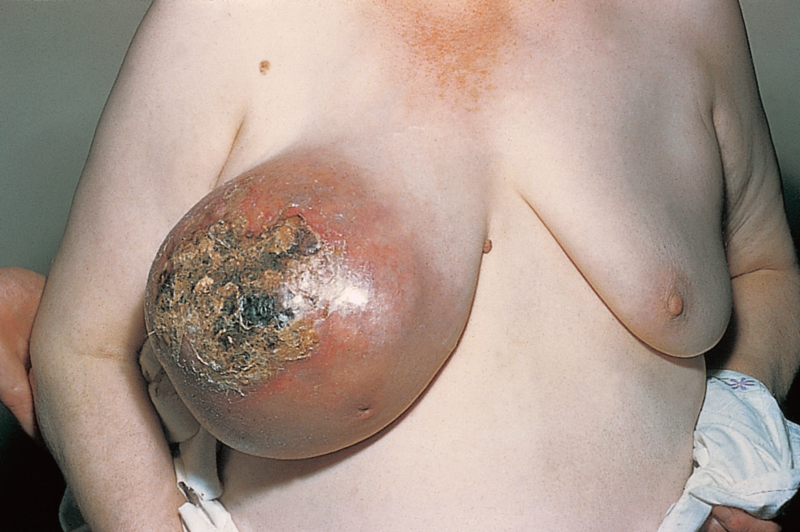
BENIGN BREAST TUMOURS
PHYLLODES TUMOUR

Slide 56
BENIGN BREAST TUMOURS
Clinical Features
They occur in premenopausal women (30-50 years).
It is usually unilateral, grows rapidly to attain a large size with bosselated surface.
Swelling is smooth, nontender, soft, fluctuant with necrosis of skin over the summit due to pressure.
Tumour grows rapidly; undergoes necrosis at various places; causes cystic areas.
Recurrence is common
Treatment
Excision or subcutaneous mastectomy is done..

Slide 57
THE MALE BREAST
Gynecomastia
Causes :
1. Physiological : Newborns, Pubertal , Senescent ( age >50yrs), Pseudogynaecomastia (obesity ).
2. Drugs:
Estrogen, digoxin, thiazides, phenothiazines, phenytoin, theophylline, cimetidine , spironolactone, methyldopa,

Slide 58
THE MALE BREAST
Pathological :
    Hepatic disease.
    Renal failure.
    Malnutrition.
    Primary testicular failure
    Acquired testicular failure: mumps, leprosy, and irradiation.
    Secondary testicular failure:.
    Endocrine tumors: testicular, adrenal, pituitary.
    Non-endocrine tumors: bronchial carcinoma, lymphoma.

Slide 59

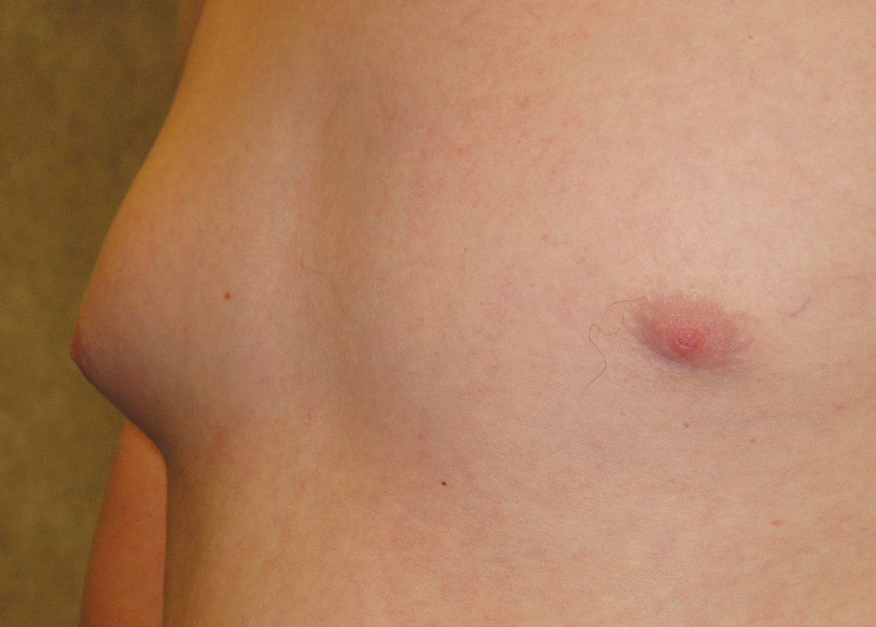
Unilateral gynaecomastia in a young male.

Slide 60

Bilateral gynaecomastia in a young male.

Slide 61
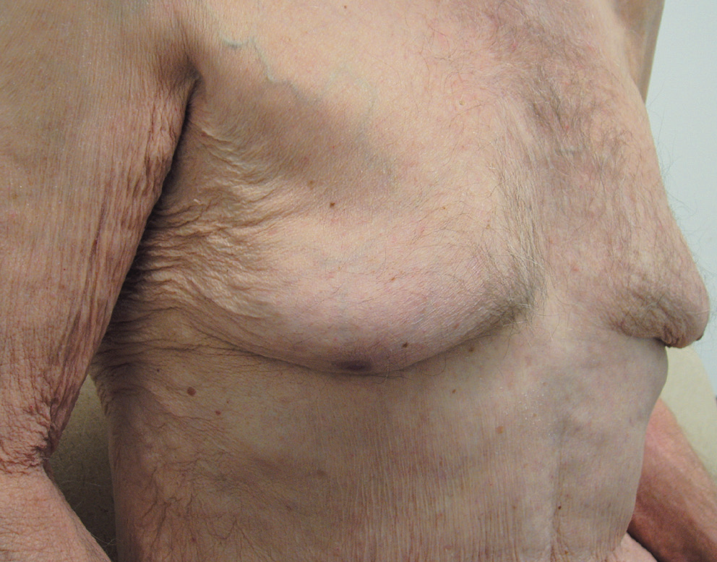
Bilateral gynaecomastia in an elderly male.

Slide 62
BREAST CARCINOMA
Breast cancer is the most common cancer in women worldwide.
It is 2nd common cancer after lung cancer in both sex.
Carcinoma breast is more common in developed, western countries.
It is more common after middle age, but can occur at any age group, after 20 years.

Slide 63
BREAST CARCINOMA
Risk factors
Family history for ca. Breast produces a 2—3 times higher risk .
Hereditary breast cancer (HBC).
    The breast cancer gene (brca) has two forms:
    BRCA-1 greatly increases the risk of ca. Breast (80%) & ca. Ovary (60%).
    Brca-2 breast cancer 60% ,ovarian cancer 40%.

Slide 64
BREAST CARCINOMA
Hormonal factor
    Age at menarche ( younger age increase the risk)
    Age at menopause ( menop. At age 55 doubles the risk ).
    No. of pregnancies (higher no. is protective ).
    Age at 1st pregnancy (if >30y double the risk compared to <20y at 1st pregnancy ).
    a nulliparous woman’s -risk is increased 2—3 times .
    breast feeding is protective .
    O.C.P use (high estrogen pills increase risk).
    Hormonal replacement therapy increase the risk.
    Oophorectomy in premenp. woman Greatly reduces the risk of Ca. breast .

Slide 65
BREAST CARCINOMA
A typical hyperplasia has a 3—6 times higher risk.
prior contralateral breast :
      previous adenocarcinoma increases the risk 2 times .
      previous lobular carcinoma occurs in 25- 50%
High socioeconomic status. (late menarche &1st pregnancy).
Diet – eating sat. fat, red meat , alcohol & obesity increases the risk.
age – risk increases with age , median age for ca. breast is 60y.
Radiation : doubles the risk.

Slide 66
BREAST CARCINOMA
Histological Classification of Breast Cancer
Ductal carcinoma: most common variant 90%.
    NONINVASIVE DUCTAL CA. INSITU .
    INVASIVE DUCTAL CA.
    Scirrhous ca. , Papillary ca., Medullary ca., Colloid ca ,Tubular ca.
Lobular carcinoma : 10% (25% B/L):
    NONINVASIVE LOBULAR CA. INSITU .
    INVASIVE LOBULAR CA.
Others:
    Paget’s disease of the breast
    Inflammatory ca (rare).

Slide 67
BREAST CARCINOMA
Paget’s disease
    Uncommon lesion involves the nipple .
    Histologically vacuolated cells (paget’s cells) are seen in the epidermis of the nipple & results in an eczematous dermatitis of the nipple .
    May be associated with an invasive component in the underlying ducts .
    Mammography should be performed to look for a mass.
    Mastectomy is the standard treatment , or local excision + radiotherapy .
    prognosis - 80% have a 10-year survival (if no masses is present & axillary nodes are not involved).

Slide 68
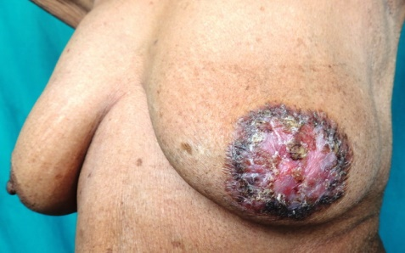
BREAST CARCINOMA
 | Paget’s disease | Eczema
1 | Unilateral | Bilateral
2 | Edges are distinct | Edges are indistinct
3 | Itching absent | Itching present
4 | Menopausal women | Occurs during the time of lactation
5 | Vesicles absent | Vesicles present
6 | Nipple is usually destroyed | Nipple is usually intact
7 | Underlying lump is usually present | No underlying lump

Slide 69
BREAST CARCINOMA
Inflammatory breast cancer
  Most aggressive type of carcinoma breast.
  It is 2% common.
  It mimics acute mastitis because of its short duration, pain, warmth and tenderness.
  Mammography may not show any finding except skin thickening.
  It rapidly metastasises to chest wall, bone and lungs.

Slide 70
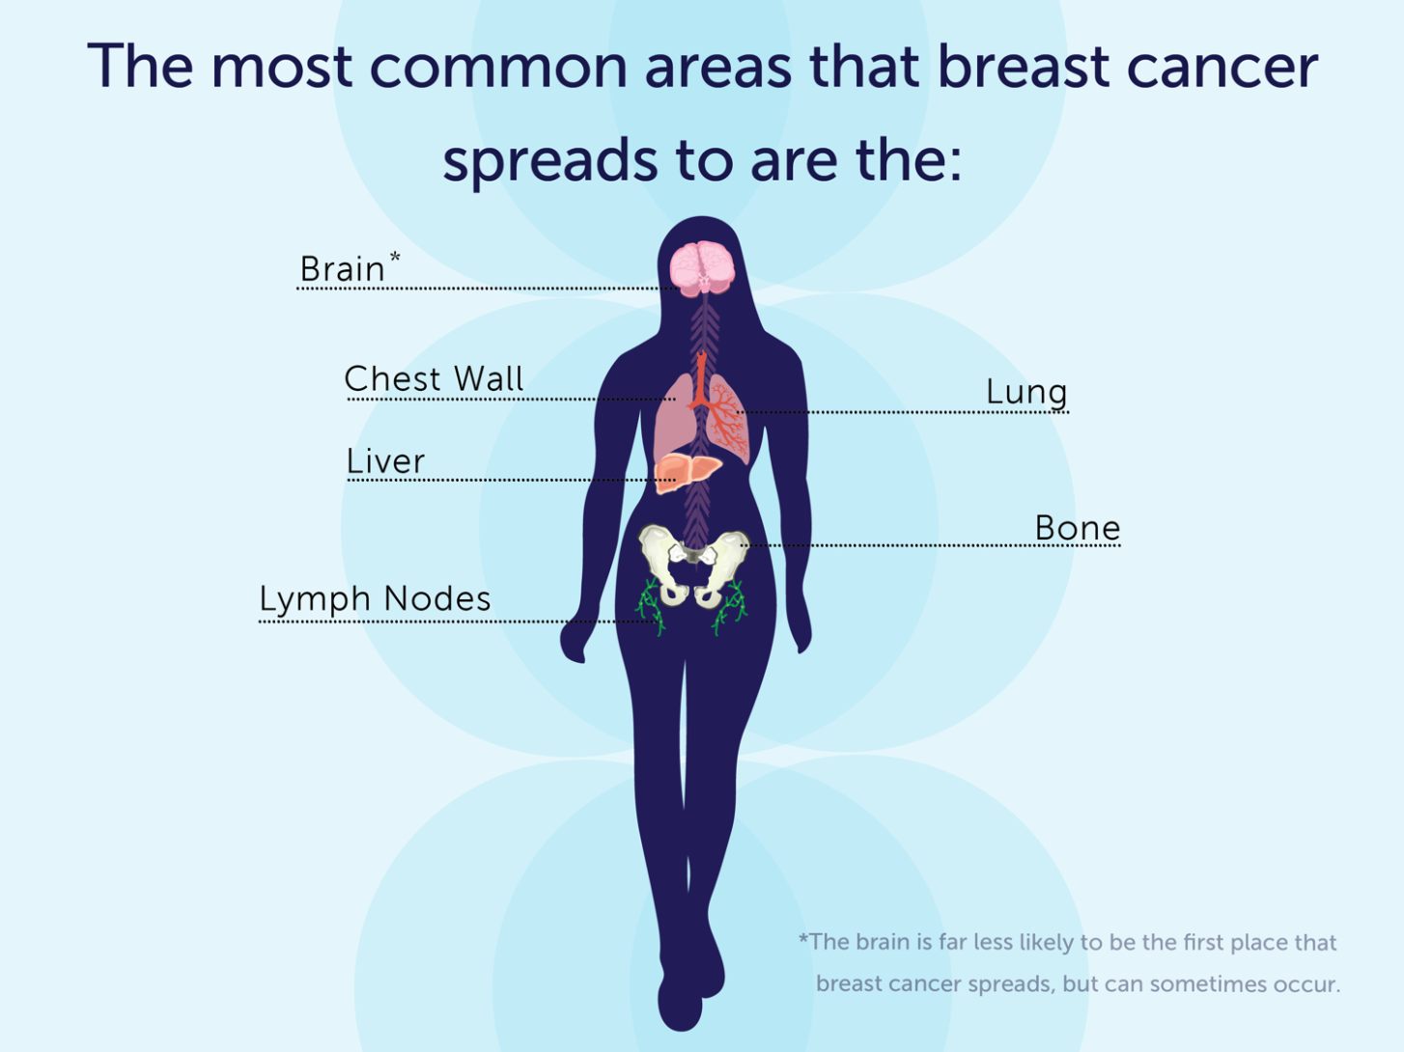
BREAST CARCINOMA

Slide 71
BREAST CARCINOMA
Clinical Features
Palpable mass: Presenting symptom in 85% of patients with carcinoma.
Most frequently in the upper outer quadrant 50-60%.
Hard, non-tender, irregular, immobile mass.
Skin changes: peau d’orange , Ulceration & dimpling.
Nipple: recent nipple retraction, Blood stained nipple discharge.
Late edema of the arm
Axillaery mass .
Metastatic features.

Slide 72

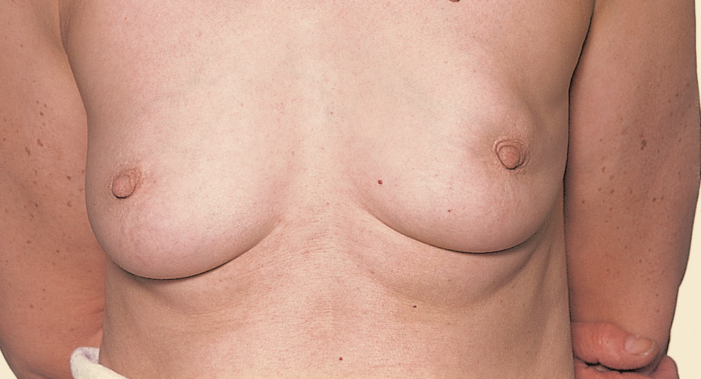
Displacement and deviation of the nipple.
The tumour can be seen just above the areola.

Slide 73
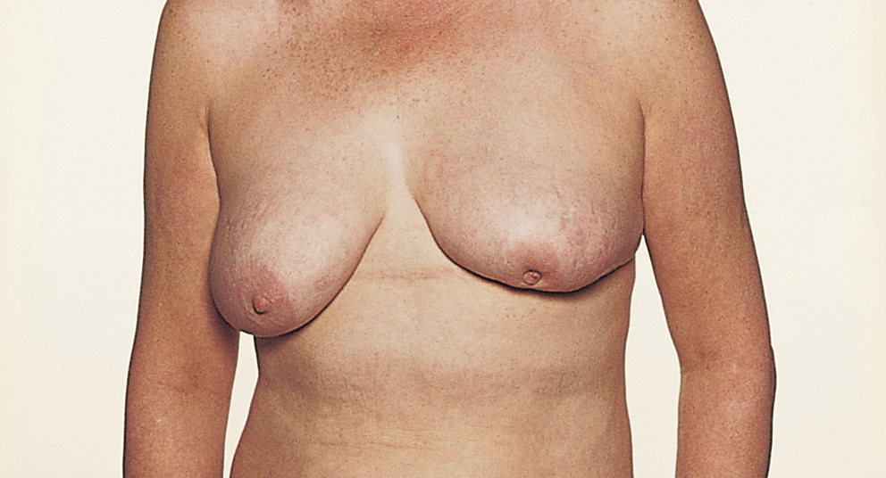
Retraction and displacement

Slide 74
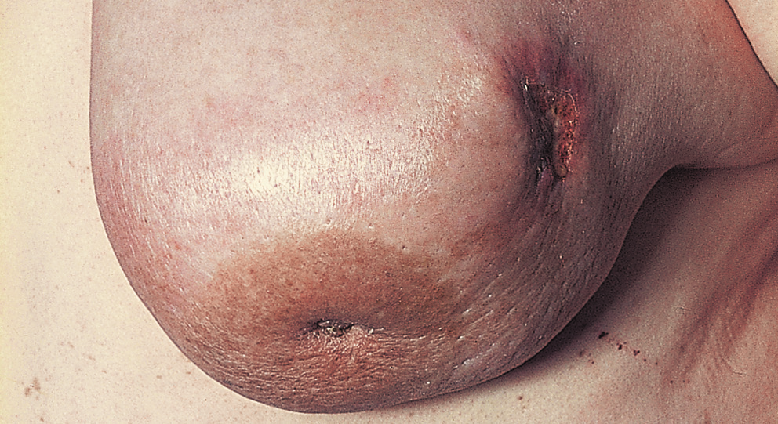
Retraction and peau d’orange:
This carcinoma has invaded the skin and ulcerated.
The skin of the lower part of the breast is oedematous and looks like
the skin of an orange.

Slide 75
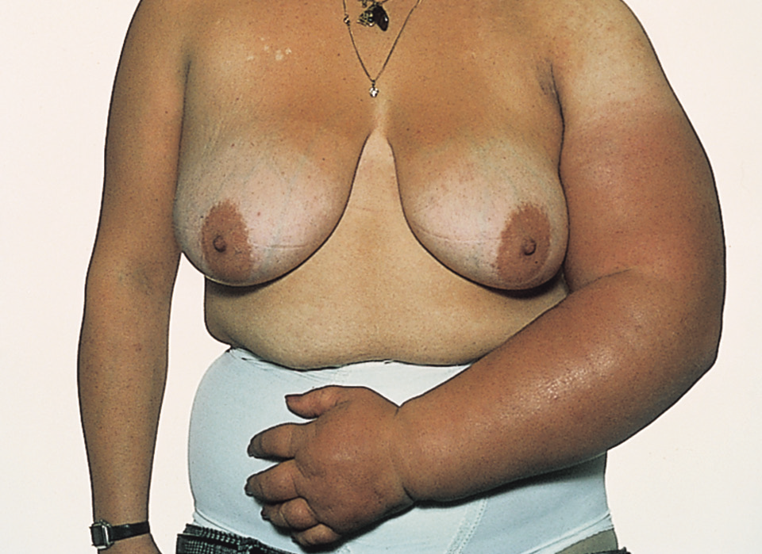
Secondary lymphoedema of the left arm caused by metastases in the lymph glands.

Slide 76
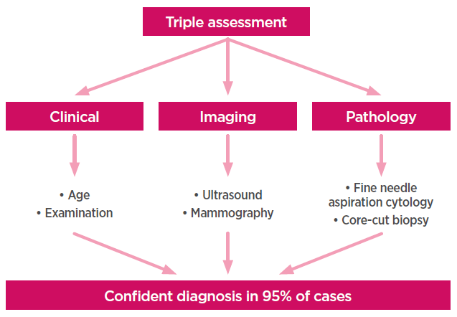
BREAST CARCINOMA
Diagnosis

Slide 77
BREAST CARCINOMA
Staging and Prognosis
The manchester system.
The TNM staging system
(tumour size , nodes, metastases)

Slide 78
BREAST CARCINOMA
The TNM staging system
Primary Tumor:
  T0 – No evidence of primary tumor
  Tis – CA in situ (LCIS / DCIS), Paget’s disease.
  T1 = Tumor < 2 cm. in greatest dimension
  T2 = Tumor > 2 cm. but < 5 cm.
  T3 = Tumor > 5 cm. in greatest dimension
  T4 = Tumor of any size with direct extension to chest wall or skin

Slide 79
BREAST CARCINOMA
The TNM staging system
Regional Lymph Nodes
  N0 = No palpable axillary nodes
  N1 = Metastases to movable axillary nodes
  N2 = Metastases to fixed, matted axillary nodes
Distant Metastases
  M0 = No distant metastases
  M1 = Distant metastases including ipsilateral supraclavicular nodes

Slide 80
The TNM staging system
stage | Tu.size | L.N status | Dist. Met. | 5-yr survival
stage 1 | T1 | N0 | M0 | 93%
Stage 2a | T1 T2 | N1 N0 | M0 M0 | 72%
Stage 2b | T2 T1 | N1 N2 | M0 M0 | 72%
Stage 3a | T1 T2 T3 T3 | N2 N2 N1 N2 | M0 M0 M0 M0 | 41%
Stage 3b | T4 | Any N | M0 | 41%
Stage 4 | Any T | Any N | M1 | 18%

Slide 81
BREAST CARCINOMA
Treatment
Cancer
Surgery
Chemotherapy
Radiotherapy
Hormone therapy
Immunotherapy

Slide 82
BREAST CARCINOMA
Surgery
1. Simple mastectomy:
Removal of all breast tissue, nipple-areolar complex and skin, with no dissection of the axilla.
2. Modified radical mastectomy:
Removal of all breast tissue, nipple—areolar complex, skin, level I and level II axillary nodes. Preserving the pectoral major.
4. Radical mastectomy (Halsted): (not done nowadays).
Removal of all breast tissue, nipple—areolar complex, skin, level I ,II,III axillary nodes and the pectorals major & minor muscle .

Slide 83
BREAST CARCINOMA
Breast conservation surgery (BCS):
      Wide local excision
      A quadrantectomy involves removing the entire segment of the breast which contains the tumor.
BCS + Axillary lymphadenectomy + Postoperative radiation therapy.
BCS + sentinel node biopsy + radiation therapy.

Slide 84
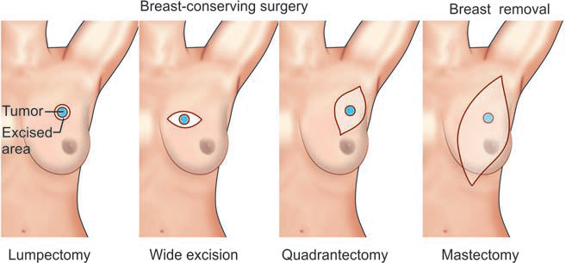
BREAST CARCINOMA

Slide 85
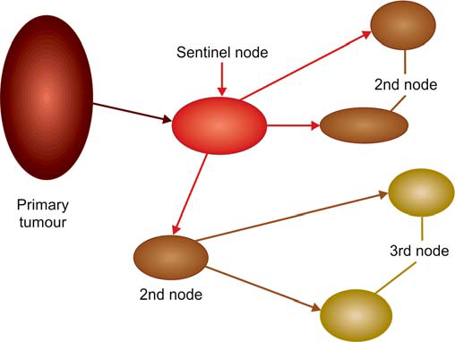
BREAST CARCINOMA
sentinel node biopsy

Slide 86
BREAST CARCINOMA
6. Reconstruction surgery
  A silicone gel or silicone with saline implant
  AUTOGENOUS TRANSPLANT:
  A musculocutanous flape
        The latissimus dorsi muscle ( LD flap).
        Transversus abdominis muscle (TRAM flap) .

Slide 87
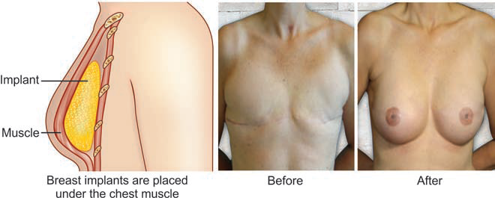
BREAST CARCINOMA
  A silicone gel or silicone with saline implant

Slide 88
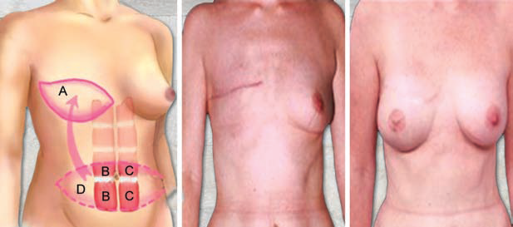
BREAST CARCINOMA
TRAM flap

Slide 89


