Slide 1


Oral cancer &Alcohol use
Masa Bodgaga
Num.2921
Block:PTS

Slide 2

Objectives
Define oral cancer
Outline the carcinogenic products in alcohol
Outline carcinogenic effect of ethanol
Discuss the effect of alcohol on oral microflora

Slide 3

Introduction
oral cancer ranks among the three most common types of cancer
due to the commodity of drinking alcohol, and the poor prognosis makes this neoplasm more dangerous cause it is asymptomatic
Notes:
Cancer is one of the major threats to public health in the developed world and increasingly in the developing world. Cancer is a silent epidemic that has not yet attracted major

Slide 4
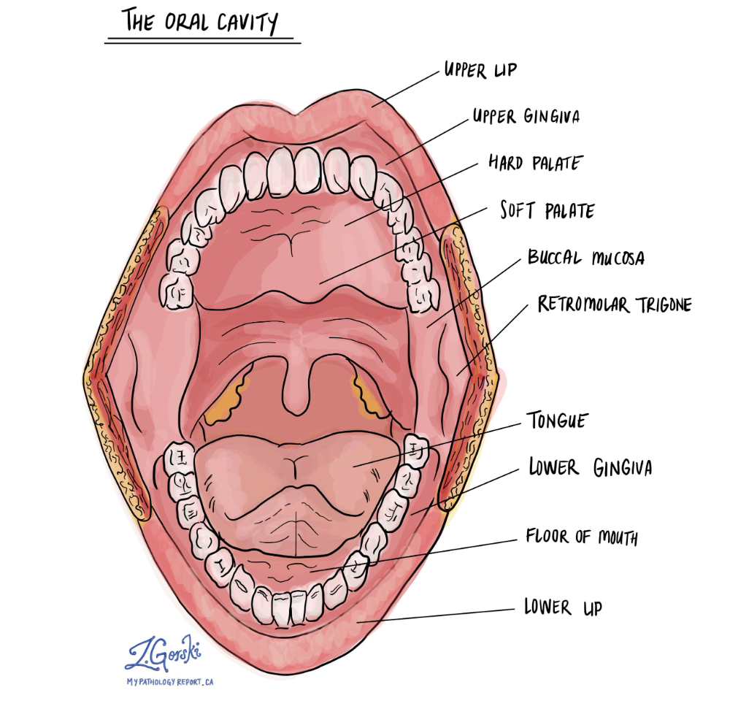
Oral cancer is defined as :
Malignant neoplasm which arise from squamous cell carcinoma , orginates from squamous cell lining the mucosal surface
Notes:
As I say the site where the neoplasms arise ex: lateral/ventral surfaces of the tounge , lips ,gingiva, buccal mucosa

Slide 5
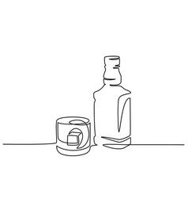
Carcenogenic products in alcohol
Alcohol
Methanol
Propanol
Ethanol

Slide 6
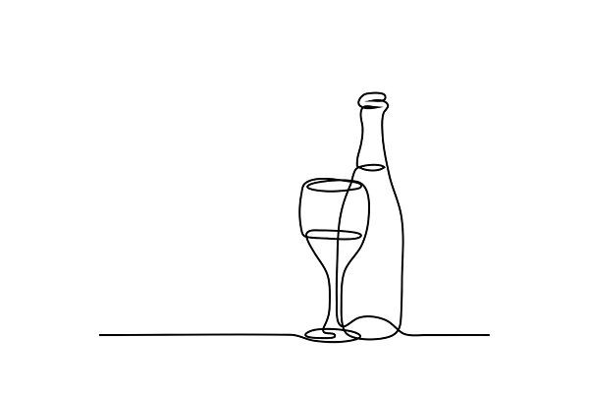
These toxins will effect the integrity of the mucosa via protein alcohol interactions
Over short term exposure
Ethanol will increase the permeability of the oral mucosa (of epithelial barriers)
Enhance penetration of carcinogens

Slide 7
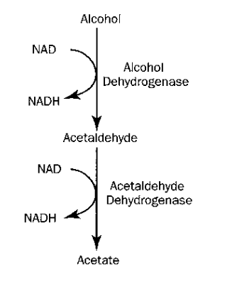
Ethanol metabolism
One of Ethanol’s metabolite is Acetaldehyde
The oxidation process in the liver via CYP2E1
ethanol metabolism contributes directly to free radical formation due to NADPH
7

Slide 8
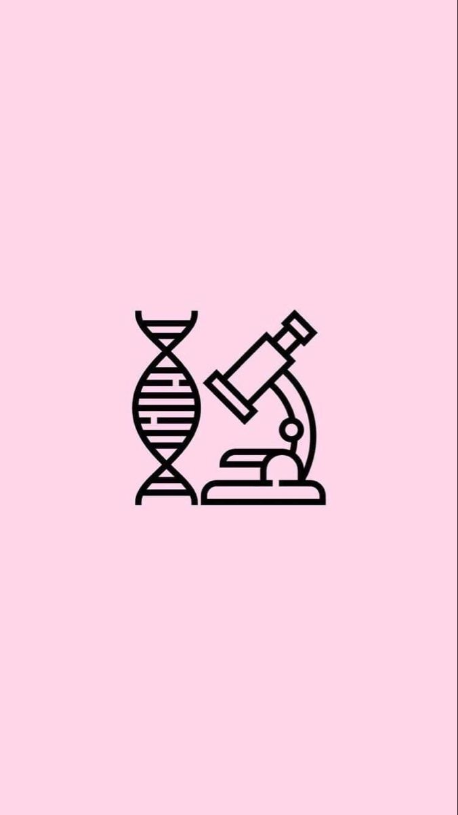
Oral Microflora
The health micro biome commonly consist of
Viridans streptoccoci
Staphylococcus
Niessieria
The biofilm of oral cancer tissue show increase in anaerobic bacteria especially Capnocytophaga
Notes:
Alongside approximately 51 other aerobs
The capnocytophaga has a high association with oral cancer

Slide 9
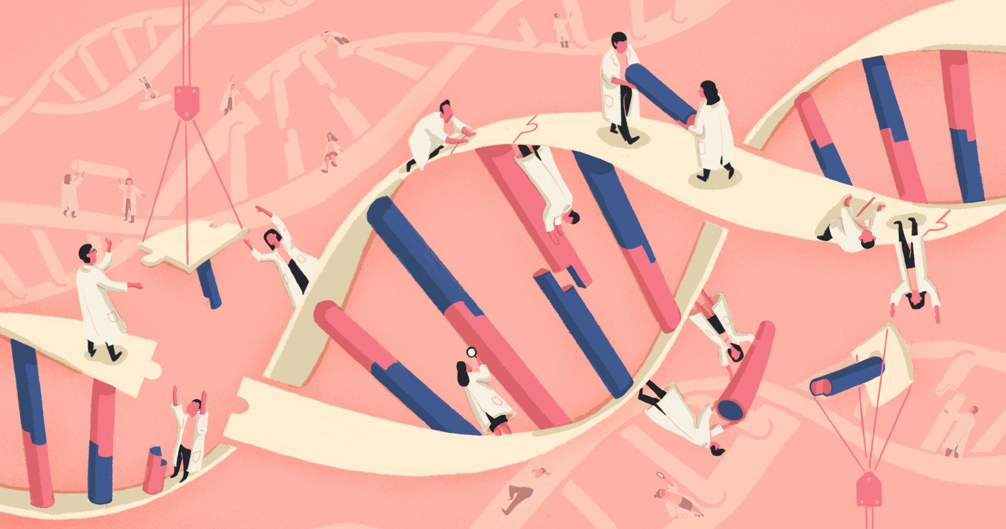
Chronic alcohol consumption
Increase basal cell nuclei size: which indicates to increase in DNA synthesis and imply a higher degree of vulnerability to mutation
Decrease epithelial thickness
Increase necleo-cytoplasm ratio
Notes:
Last point (in the oral lession associated with rissk developing OSCC)

Slide 10
Alcohol drinking became a commodity without understanding the risk factors
Awareness needs to be spread
The poor prognosis makes finding a solution difficult
CONCLUSION

Slide 11

References
Petersen PE. Oral cancer prevention and control – The approach of the World Health Organization. Oral Oncology [Internet]. 2009 Apr [cited 2019 Oct 29];45(4-5):454–60. Available from: https://www.who.int/oral_health/PEP%20WHO%20ORAL%20CANCER%20PREVENTION.pdf
O’Grady I, Anderson A, O’Sullivan J. The interplay of the oral microbiome and alcohol consumption in oral squamous cell carcinomas. Oral Oncology. 2020 Nov;110:105011
Petti S, Mohd M, Scully C. Revisiting the association between alcohol drinking and oral cancer in nonsmoking and betel quid non-chewing individuals. Cancer Epidemiology. 2012 Feb;36(1):e1–6.

Slide 12
Thank you

