Slide 1


Computer network
AHMED ALTARHONY

Slide 2
network
A network is a group of two or more computer systems linked together to exchange data and share resources, such as high-performance laser printers.
By use of network, people and businesses are able to communicate, collaborate and share resources

Slide 3
Advantages
Reduced hardware costs
  One device performing special task can be share among the network user or devices such as printer, storage devices ( reducing of using portable storage devices to transmits for exchange data from on devices to another ) common connection to internet ( all network devices access to same internet connection )
Application sharing
  Network let the user to share application installed in the network’s server ( for example an company that installed application to let users to order their demands of products so that salespeople receives their demands very easy and in organized way )

Slide 4
Advantages
Sharing information resources
  Network share information among the users in organized and easy access way so that specific aspect of information can be easily access without consuming time in searching
Centralized data management
  network can be a place of storing data which can be access by multiple users also provide backup and ensure the security and integrity of the data on the network with security software and password protection
Connecting people
  Make the work between people in different places organized and efficiency

Slide 5
Disadvantages
Lack of privacy
  Network membership can threaten your privacy. Network administrators can access your files and may monitor your network and Internet activities.
Security threats
  Because some personal and corporate information is inevitably stored on network servers, it is possible that others may gain unauthorized access to files, user names, and even passwords.
Loss of productivity
  Threats like viruses, hacking, sabotage, or a simple breakdown limit use of network resources or let to data lose which decrease the ability of produce work on time
Loss of autonomy
  The user of network is begin controlled by network administrator which impose restrictions on what software you can load onto network computers.

Slide 6
categories of networks
These categories are based on the size of the geographical region that a network spans.
Wide area network
  it is long-distance transmission media to link network devices or networks separated by few of miles or thousand of miles
  It is collection of local area networks linked with each other
  Internet is an example of wide area network
Local area network
  It is used to link networks or network devices that separated with small distance
  Links devices from different buildings or inside building links different floors
  University , schools , banks and companies use local area network
  A local area network (LAN) uses cables, radio waves, or infrared signals to link network devices
  It is owned or managed by single person (Network administrators) or organization

Slide 7
categories of networks
Metropolitan area network
  It is network that designed for city or town links different building in same city
  It bigger than LAN and smaller than WAN
  It is owned or managed by single government or organization
Personal area network
  It is network created within the range of an individual person maximum to 32 feet for exchanging data without interfere of network deceive such as router
  connection between a Bluetooth earpiece and a smartphone. can also connect laptops, tablets, printers, keyboards, and other computerized devices.
  PAN network connections can either be wired or wireless.
Home area network
  It is a network contained within a user’s home that connects a person’s digital devices such as computers , printer , smartphones , smart TV
  It is bigger than PAN smaller than LAN
  It use router or switch to links network devices with each other by (wired or wireless ) means

Slide 8
Peer-to-peer
Peer-to-peer network is a collections of devices linked with each other (wired or wireless) without server that acts as centralized network management
Each user manage has own files , disk usage , directories and peripherals devices that other users of network can access
It often used for home or small businesses network
It does not require NOS (network operating system)
become slow as number of user increase
Security is not strong due to the lack of hierarchy among the participants
Tracking shared files in network is confusing

Slide 9
Client/server network
It is collection of users or clints with one or more server providing services to clients
Some common servers on a client/server network include those that provide e-mail, file storage, and database storage, and facilitate communication with other networks, including internet
corporate or university uses LAN client/server network
A client can be any device type PC, Mac, desktop, notebook, or even a handheld
That connected to network via modem physical or wireless connection contains software enable it send request to server
It work with any size of LAN layout does not slow down with heavy users

Slide 10
Virtual private network
VPN is virtual network that act as interface between the public network (internet ) and intranet network ( LAN network for company)
VPN provides making data accessible to authorized users in remote locations through the use of secure, encrypted connections and special software

Slide 11
LAN topology
The physical layout of a LAN is called its network topology or how network devices are physical arranged in network
There three types BUS, RING and STAR
BUS TOPOLOGY
  Network devices are attracted to common cable or pathway called bus
  At end of bus there is special connector called terminator used to end the circuit or bus
  networks devices can transmits data at same time
  If two devices tries to transmits data at same time each will wait random period of time then attempts to retransmit again
  Bus has length and number of network devices restrictions
  It simple , reliable and simple to expand
  Provides contention management technique to solve contention (collision) problem

Slide 12
LAN topology
STAR TOPOLOGY
  it links network devices in star shape with centralized device such as switch , hub or central computer
  Network devices can be expanded very easily just by connect to switch or hub
  Also provides use of contention management technique to solve contention (collision) problem
  itis ideal for office buildings, computer labs, and WANs.
  The down side of a star topology is that the loss of the hub, switch, or central computer, caused by a power outage or virus invasion, can bring down the entire network.
RING TOPOLOGY
  Network devices are linked in circular wiring arrangement
  provides a unique way to prevent collisions A special unit of data called a token travels around the ring network devices can not transmit data unit they receive taken unit
  It uses within a division of a company or on one floor of a multi-floor office building.

Slide 13
PROTOCOLS
protocols (standards or rules) that enable network-connected devices to communicate with each other.
Protocols may be implemented by hardware, software, or a combination of the two
They are fixed, formalized exchanges that specify how two dissimilar network components can establish a communication.
single network may use dozens of protocols.
The complete package of protocols that specify how a specific network functions is called the network’s protocol suite.
LAN protocols are distinguished by their capability to efficiently deliver data over shorter distances through various mediums, such as copper cabling.

Slide 14
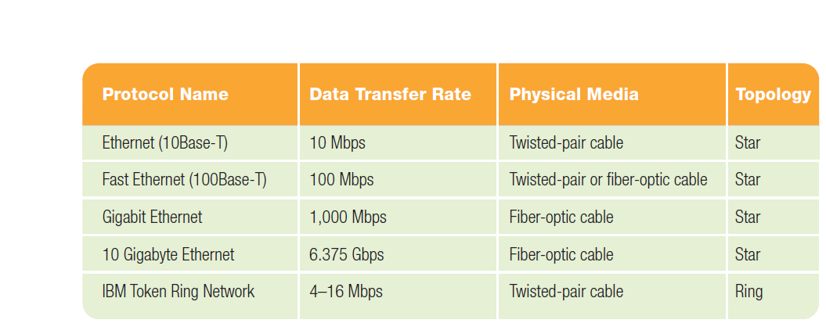
LAN PROTOCOLS
LAN protocols are distinguished by their capability to efficiently deliver data over shorter distances through various mediums, such as copper cabling and fiber optical .

Slide 15
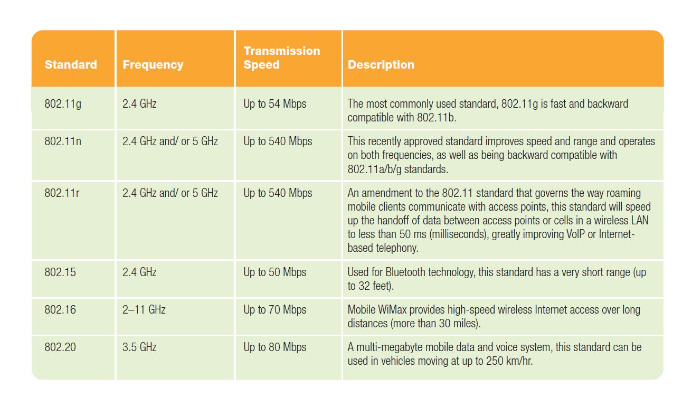
Wireless LAN PROTOCOLS
WIFI is collections of standards uses waves instead of wires
WIFI identify the speed , frequency used and which standard should be used for specific purpose
WIFI needs access point or central server to access internet communicates across distance
Wireless routers contain a wireless access point inside the router

Slide 16
Circuit switching
Circuit switching is a method of implementing a network connection in which two network nodes establish a dedicated communications channel (circuit)
The circuit guarantees the full bandwidth of the channel and remains connected for the duration of the communication session

Slide 17
Packet switching
packet switching is a method of grouping data that is transmitted over a network into packets. Packets are made of a header and a content of data . Data in the header is used by networking hardware to direct the packet to its destination, where the payload is extracted and used by application software.

Slide 18
Special components
HUB
that joins multiple computers together in a single network but does not manage the traffic between the connections, which usually results in frequent collisions.
SWTICH
Switches are more intelligent than hubs.
passing data packets along the network, a switch contains software that inspects the source and target of a data package and attempts to deliver it to that destination.
By doing this, a switch condenses band Width and has better performance than a hub.
Switches and hubs only move data between nodes within a single network.
ROUTER
that is used to connect two or more networks.
Routers also have the capability to inspect the source and target of a data package and determine the best path to route data or locate alternative pathways so that the data reaches its destination

Slide 19
Special components
ROUTER
that is used to connect two or more networks.
Routers also have the capability to inspect the source and target of a data package and determine the best path to route data or locate alternative pathways so that the data reaches its destination
WIRELESS ACCESS POINT
A wireless access point, also known as an AP or WAP, is a node on a network that acts as a receiver and transmitter of wireless radio signals between other nodes on a network.
AWAP can also act as a joint or bridge connecting wireless nodes to a wired network

