Slide 1


Libyan International Medical University Faculty of Applied Medical Science Choose Health 1
By: Shahd Dayri
Roll No: 3404
Year 1 – 2021-2022
Date: 4-6-2022

Slide 2
Objectives:
What is Cigarette Smoking
Effect of Tobacco on The Lungs
Proportion of current daily smokers by age, 2020-21
Benefits of Quitting
2

Slide 3

Introduction
The tobacco epidemic is one of the biggest public health threats the world has ever faced, killing more than 8 million people a year around the world.
All forms of tobacco are harmful, and there is no safe level of exposure to tobacco.
3

Slide 4

Cigarette Smoking
Cigarette smoking increases risk for death from all causes in men and women.
Harms nearly every organ of the body, causes many diseases, and reduces the health of smokers in general.
4

Slide 5
MYTH or FACT
“Smoking does not hurt anyone else but me”
MYTH FACT
There is no safe level of second – hand smoke, Every on is at risk even if you don’t smoke
5

Slide 6
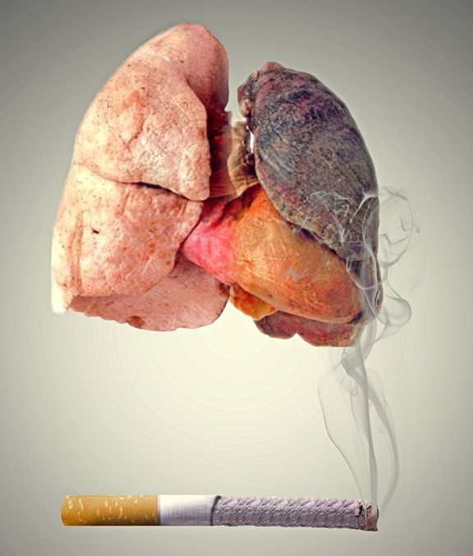
Effect of Tobacco on The Lungs
What does smoking do to my lungs?
Damage the airways
Worsen quality of life
Cause death
6

Slide 7
Proportion of current daily smokers by age, 2020-21
%
Age (Yrs) 7

Slide 8
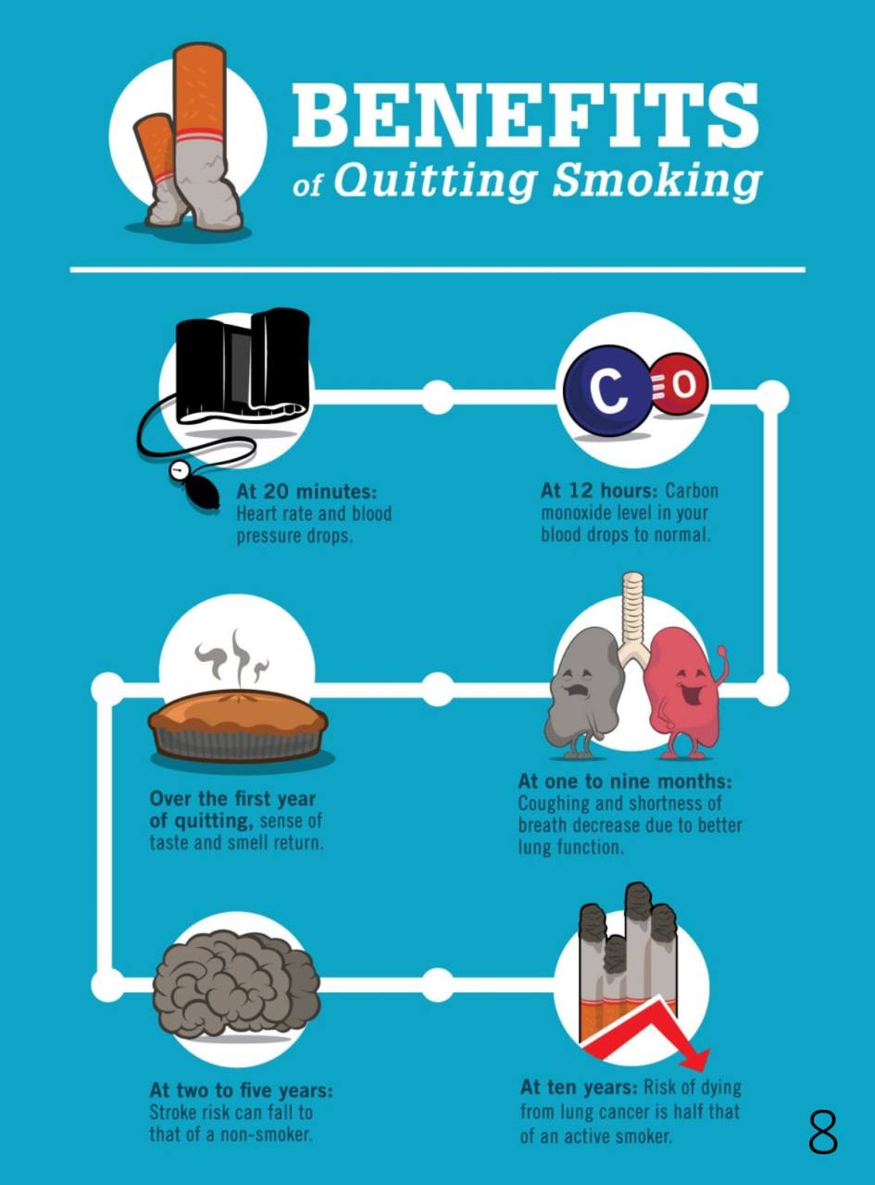
Benefits of Quitting

Slide 9
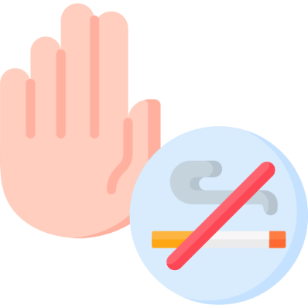
Conclusion:
Cigarette smoking and second-hand smoke cause disease, disability, and death.
Quitting smoking improves your health. No matter how old you are or how long you have smoked.
Benefits of quitting start straight away , After only a few weeks without smoking your risk begin to reduce
9

Slide 10


Slide 11

References list:
Tobacco. (2022). Retrieved 12 May 2022, from https://www.who.int/news-room/fact-sheets/detail/tobacco
Smoking and the lungs - European Lung Foundation. (2022). Retrieved 12 May 2022, from https://europeanlung.org/en/information-hub/factsheets/smoking-and-the-lungs/
Smoking, 2020-21 financial year. (2022). Retrieved 12 May 2022, from https://www.abs.gov.au/statistics/health/health-conditions-and-risks/smoking/latest-release#:~:text=Key%20statistics%2061.2%25%20of%20people%20aged%2018%20years,vaping%20device%20at%20least%20once%20in%20their%20lives
11

Slide 12

Thank you!
12

