Slide 1


Libyan International
Medical University
Faculty of
Business Administration
Knowledge Management
Module: Management Information System
Instructor: Dr. Salwa Aghili
Presented & prepared by:
Shahed Bushiha (2354)
Shahed Eldarrat (2418)
Sara Elmograbi (955)
Boushra Hweidi (2674)
Notes:
Download more minimal templates here: https://crmrkt.com/GK9Dwa

Slide 2
11.1
Introduction.
Why knowledge Management is important.
Important dimensions of knowledge.
The knowledge management value chain.
Types of knowledge management systems
11.2
Enterprise-wide knowledge management system.
Knowledge Network system.
Collaboration and social tools and learning management system.
Contents
11.3
Knowledge Workers & Knowledge Work.
Roles Of Knowledge Workers.
Examples Of Knowledge Work Systems.
Functions Of Knowledge Work Systems.
11.4
Intelligent Techniques.
Types Of Intelligent Techniques.
Fuzzy Logic Systems.
Capturing Knowledge: Expert Systems.
Conclusion.
Notes:
Download more minimal templates here: https://crmrkt.com/GK9Dwa

Slide 3

Introduction
Knowledge management refers to the set of business processes developed in an organization to create, store, transfer, and apply knowledge.
Knowledge residing in the minds of employees that has not been documented is called tacit knowledge, whereas knowledge that has been documented is called explicit knowledge.

Slide 4

Why knowledge Management is Important ?
Accumulating, storing, and effectively sharing knowledge allows creating a culture that can significantly improve efficiency and employee happiness.
But ineffective knowledge management impacts the financial front and employee satisfaction levels.

Slide 5
Important Dimensions Of Knowledge
Finally, wisdom is thought to be the collective and individual experience of applying knowledge to the solution of problems. Wisdom involves where, when, and how to apply knowledge.
Wisdom
Knowledge
Information
Data
To transform information into knowledge, a firm must expend additional resources to discover patterns, rules, and contexts where the knowledge works.
To turn data into useful information, a firm must expend resources to organize data into categories of understanding
Notes:
Download more minimal templates here: https://crmrkt.com/GK9Dwa

Slide 6
The Most Important Dimensions Of Knowledge Are:
Knowledge is a firm asset:
Knowledge is situational:
Knowledge has different forms:
Knowledge has a location:
Knowledge may be applicable only in certain contexts or situations.
is an intangible asset requiring organizational resources.
craft, skills, procedures.
with individuals, social groups, is difficult to transfer or extract,

Slide 7
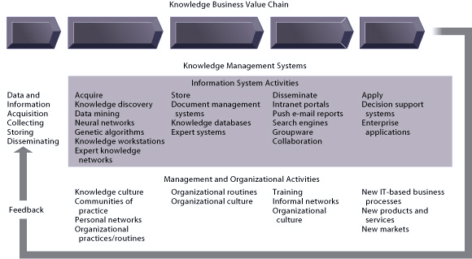
The Knowledge Management Value Chain
Notes:
Download more minimal templates here: https://crmrkt.com/GK9Dwa

Slide 8
The Knowledge Management Value Chain
There are five value-adding steps in the knowledge management value chain.
Each stage adds value to raw data and information as they are transformed into usable knowledge
by discovering patterns in corporate data or by using knowledge workstations .
In the format of storing documents , reports ,presentation
Developing online expert network.
Knowledge storage
documents, patterns, and expert rules must be stored so they can be retrieved and used by employees.
storage of a database.
Knowledge dissemination
knowledge and information dissemination in Portal, e-mail, instant messaging, and search engine technology.
Knowledge application
To provide a return on investment, organizational knowledge must become a systematic part of management decision making.
01
02
03
04
knowledge acquisition
05
Building Organizational and Management Capital:
Collaboration, Communities of Practice, and Office Environments.

Slide 9
Types Of Knowledge Management Systems
Enterprise Wide KMS
Intelligent
Techniques
Knowledge
Work system
These systems include :
capabilities for searching for information.
storing both structured and unstructured data .
locating employee expertise within the firm.
supporting technologies such as portals.
Knowledge management includes a diverse group of intelligent techniques, such as
Data mining .
Expert systems .
Neural networks .
Fuzzy logic .
Genetic algorithms .
And intelligent agents.
knowledge work systems such as :
Computer-aided design (CAD) .
Visualization .
Simulation .
Virtual reality systems.

Slide 10






Enterprise-Wide Knowledge Management System
Structured text documents
Decisions that are Semi structured
Firms must deal with three types of knowledge:
Emails
Voice mails
Reports
Presentations
Written down knowledge
Videos

Slide 11


Businesses Need To Organize And Structure
Structured
Semi structured
Structured knowledge is explicit knowledge found in formal papers and formal regulations developed by organizations after observing experts and their decision-making processes.
Experts estimate that at least 80% of a company's business material is semi structured or unstructured.
Including information in folders, messages, memoranda, proposals, e-mails, images, electronic slide presentations, and even movies created in various forms and stored in several locations.
Notes:
Download more minimal templates here: https://crmrkt.com/GK9Dwa

Slide 12


An Enterprise Content Management System
Unified Repository
Create/Capture
Tag
Store/Retrieve
Manage/Review
Distribute/Publish
Reports
Presentations
E-mails
Graphics
News feed
Memos
Employees profiles
Users

Slide 13


Addresses the problem that arises when the appropriate knowledge is not in the form on digital document.
Knowledge Network system:
It provides an online directory of corporate experts and their profiles with details about their abilities, self and experiences.
Notes:
Download more minimal templates here: https://crmrkt.com/GK9Dwa

Slide 14



Example:
Ask.com is a question answering focused e-business founded in 1996 by Garrett Gruener and David Warthen in Berkeley, California
Advantages:
What ever information that you need in Business or in your daily life will be available.
Notes:
Download more minimal templates here: https://crmrkt.com/GK9Dwa

Slide 15

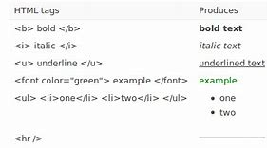




Collaboration and Social Tools and Learning Management System
By allowing users to add their bookmarks to Web pages on a public Web site and tag these bookmarks with keywords
social bookmarking makes it easier to search for and share information beyond the firm's knowledge resources.
Text and image tags can be used to organize and search for content.
Highlights to target a specific content
Notes:
Download more minimal templates here: https://crmrkt.com/GK9Dwa

Slide 16

Knowledge Workers &
Knowledge Work
The enterprise-wide knowledge systems provide a wide range of capabilities that can be used by many if not all workers and groups in an organization.
Knowledge workers may include researchers, designers, architects, scientists, and engineers who create knowledge and information for the organization.

Slide 17
Roles Of Knowledge Workers
1
Keeping the organization current in knowledge as it develops in the external world.
2
Work as internal consultants regarding their areas of knowledge, ongoing changes and opportunities.
3
Knowledge workers may include researchers, designers, architects, scientists, and engineers who create knowledge and information for the organization.

Slide 18
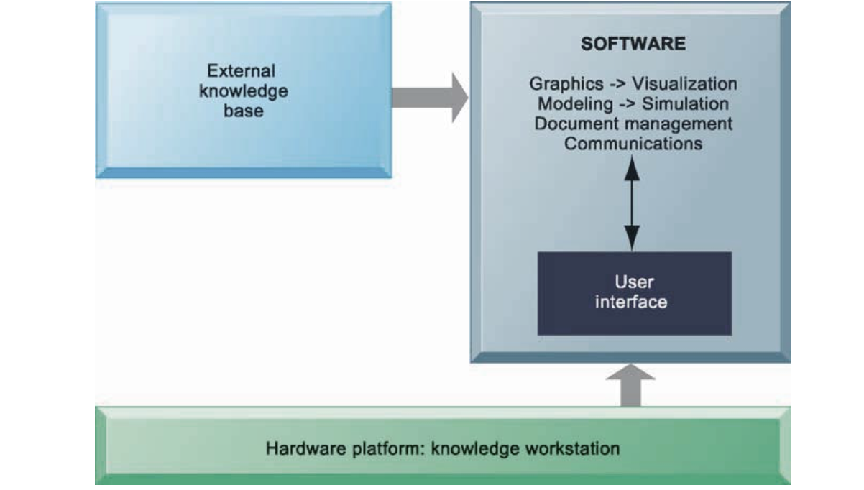
Roles Of Knowledge Workers
Knowledge workers also need highly specialized knowledge work systems with powerful graphics, analytical tools, communications and capabilities.
These systems should also give the worker quick and easy access to external databases.
Knowledge work systems require strong links to external knowledge bases in addition to specialized hardware and software.
Notes:
Download more minimal templates here: https://crmrkt.com/GK9Dwa

Slide 19
Examples Of Knowledge Work Systems
Virtual Reality Systems
CAD Systems
Investment Workstations

Slide 20
Cont.
Computer Aided Design (CAD):
It automates the creation and revision of designs, using computers and sophisticated graphics software.
CAD systems are able to supply data for 3D printing.
CAD systems improve the quality and precision of product design by performing much of the design and testing work on the computer.
Notes:
Download more minimal templates here: https://crmrkt.com/GK9Dwa

Slide 21
Virtual reality systems:
Have visualization, rendering, and simulation capabilities that go far beyond those of conventional CAD systems.
It uses Augmented reality (AR) that is a related technology for enhancing visualization.
Cont.
Investment Workstations:
Financial services install investment workstations that integrate a wide range of data from both internal and external sources, including contact management data, real-time and historical market data, and research reports.
Notes:
Download more minimal templates here: https://crmrkt.com/GK9Dwa

Slide 22
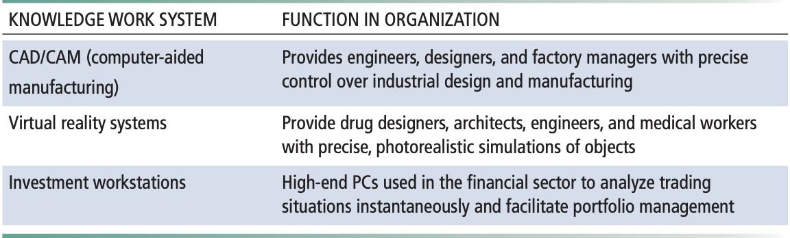
Functions Of Knowledge Work Systems
Notes:
Download more minimal templates here: https://crmrkt.com/GK9Dwa

Slide 23

Intelligent Techniques
Artificial intelligence and database technology offer a variety of clever ways for capturing individual and group knowledge and expanding an organization's knowledge base.
Notes:
Download more minimal templates here: https://crmrkt.com/GK9Dwa

Slide 24
Types Of Intelligent Techniques
Expert Systems
Neural Networks
Genetic Algorithms
Case-based reasoning, and fuzzy logic are used for capturing tacit knowledge.
Are used for generating solutions to problems that are too large and complex for human beings to analyze on their own.
Neural networks and data mining are used for knowledge discovery.
Notes:
Download more minimal templates here: https://crmrkt.com/GK9Dwa

Slide 25
Fuzzy Logic Systems
Fuzzy logic is a rule-based technology that can represent such imprecision by creating rules that use approximate or subjective values.
It can describe a particular phenomenon or process linguistically and then represent that description in a small number of flexible rules.

Slide 26

Capturing Knowledge:
Expert Systems
These systems capture the knowledge of skilled employees in the form of a set of rules in a software system that can be used by others in the organization.
Expert systems lack the breadth of knowledge and the understanding of fundamental principles of a human expert.

Slide 27
As a conclusion, knowledge management plays an important role in managing knowledge and information in an organization.
Knowledge management has been applied in various industries.
This knowledge including past, current and future knowledge is important for customer, stakeholder, workers and also students and teachers.
Conclusion
Notes:
Download more minimal templates here: https://crmrkt.com/GK9Dwa

Slide 28
References:
Laudon, Kenneth C., and Jane P. Laudon. Management Information Systems: Managing the Digital Firm, Global Edition. 15th ed., Harlow, Pearson Education Limited, 2017.
“Knowledge Management | Business Essay.” ESSAY SAUCE, www.essaysauce.com/free-essays/business/knowledge-management.php?fbclid=IwAR02wg0DkKYnySaltf5yCJZwyq8q0SC_B0_oIayotWnvHtE86xrW6mP_KYg. Accessed 13 Dec. 2021.
“What Is Intelligent Techniques | IGI Global.” Www.igi-Global.com, www.igi-global.com/dictionary/intelligent-techniques/59934?fbclid=IwAR2KmWCzNSilVpi5Sce9roE0gG3VfQuzOo8wjKkTP3EQOH_f1BNP_bFuqH8. Accessed 13 Dec. 2021.
Notes:
Download more minimal templates here: https://crmrkt.com/GK9Dwa

Slide 29
THANK YOU
Notes:
Download more minimal templates here: https://crmrkt.com/GK9Dwa

