Slide 1
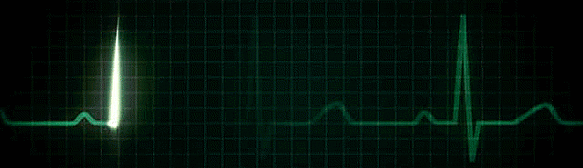
CORONARY ARTERY DISEASE
Dr. Zaki Bettamer
Zikoecho@yahoo.com
June 20, 2020

Slide 2
50 years old male K/C DM , HTN And smoker
C/O central ch. Pain , 3 wks duration, radiate to Lt. arm ↑ with Exercion & ↓ by rest, staying less than 15 min. no sweating , no vomiting.
O/E Normal
His ECG normal
CE: normal

Slide 3
Normal Myocardial
Balanced Oxygen Supply and Demand
Contractility
Oxygen
Supply
Heart Rate
Preload
Coronary
Blood Flow
Oxygen
Demand
Afterload

Slide 4
Myocardial Ischemia
Unbalanced Oxygen Supply and Demand
Reduced Coronary
Blood Flow
Oxygen
Supply
Contractility
Oxygen
Demand
Heart Rate
Preload
Afterload

Slide 5
Causes:
A) Decrease coronary blood flow by mechanical obstruction.
I-Atherosclerosis.
2-Coronary spasm.
3-Coronary thrombosis or embolism.
4- vasculitis Young female (SLE) & Young male ( Polyarteritis nodosa)
5- Syphilitic coronary osteal obstruction.
B) Decrease the flow of oxygenated blood to the myocardium.
1-Hypoxia / anaemia.
2-Hypotension and decreased COP.
C) Increased oxygen demand
-e.g left ventricular hypertrophy Hypertension or Aortic stenosis

Slide 6
CORONARY ARTERY DISEASE
Coronary artery disease is a chronic disease caused
by the gradual narrowing or/& occlusion of coronary
arteries usually due to atherosclerosis
Narrowed artery reduces oxygen supply to the
myocardium.
Ischemia (reduced blood & O₂ supply) often causes
chest pain or discomfort known as angina pectoris or
Myocardial Infarction due to complete blockage.

Slide 7
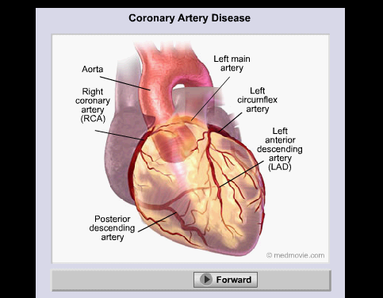
Coronary arterial system

Slide 8
Atherosclerosis
Deposition of lipids under the intima of arteries. Chronic process that develops in following stages over 30-40 years
Fatty streak
Fibrous plaque
Plaque inflammation , instability & Rupture

Slide 9
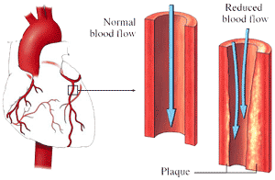
Atherosclerosis

Slide 10
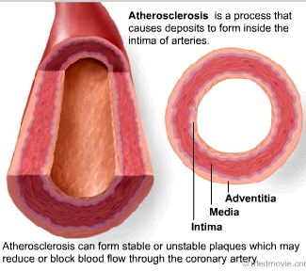

Slide 11
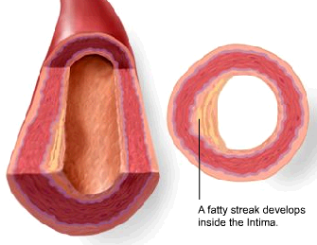

Slide 12
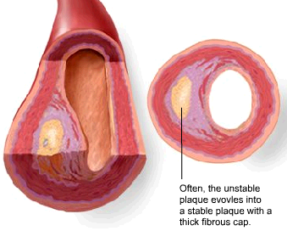

Slide 13
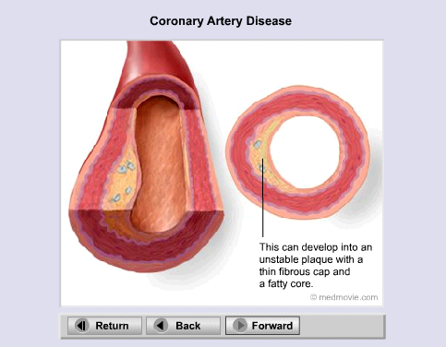

Slide 14


Slide 15
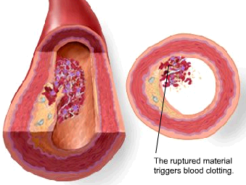

Slide 16
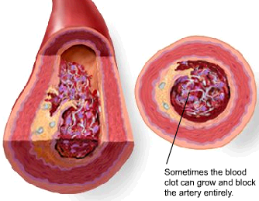

Slide 17
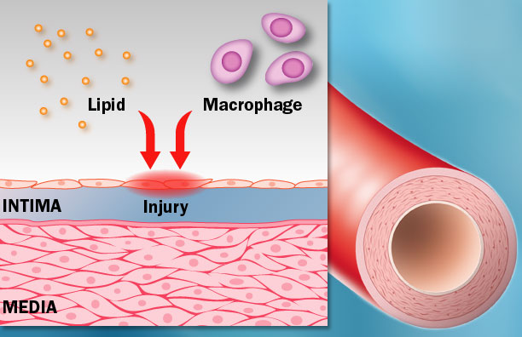
  Fatty streak:
  Injury to intimal endothelium
    Lipid deposits
    No obstruction

Slide 18
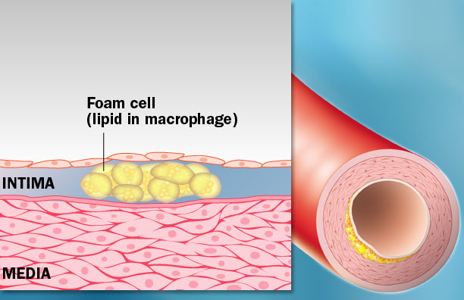
  Fibrous plaque:
  Plaque and thrombus formation
  Protrusion into arterial lumen
  Proliferation of smooth muscle cells
  Irreversible progression

Slide 19
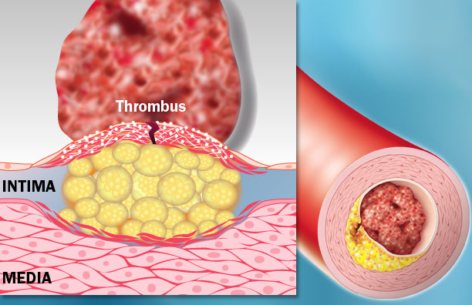
  Complicate lesion:
  Total occlusion
    Plaque calcification
    Plaque rupture
    Thrombus formation

Slide 20
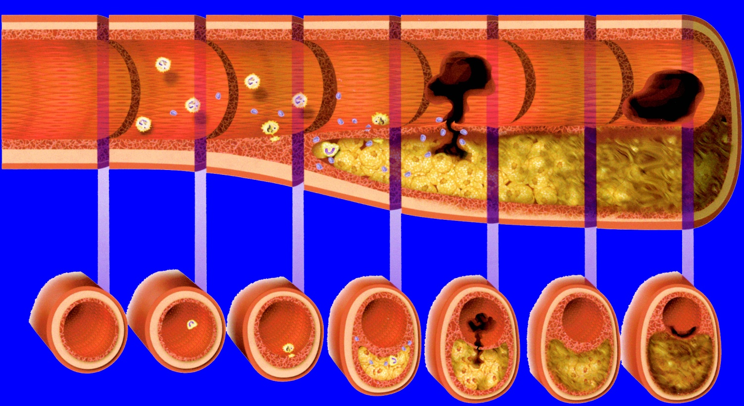

Slide 21
C.A.D.
• Is the most common form of heart disease.
• The single most important cause of premature
death in Europe.
• In UK 1 in 3 men and 1 in 4 women die from
CAD.

Slide 22
Clinical manifestations & pathology
Clinical problem
Stable angina:
Unstable angina:
Myocardial infarction:
Pathology
Fixed atheroma stenosis of Coronary artery.
Dynamic obstruction of coronary artery due to plaque rupture with thrombosis.
acute occlusion of coronary artery leads to myocardial necrosis.

Slide 23
Heart failure:
Arrhythmia:
Sudden death:
Myocardial dysfunction due to infarction/ ischemia.
Altered conduction due to ischemia.
Ventricular arrhythmia, asystole, or massive infarction.

Slide 24
ATHEROSCLEROSIS: HARMFUL CONSEQUENCES
Atherosclerosis causes decrease in lumen of arteries and thus decreases blood supply

Slide 25
Artery involved
Coronary
Cerebral carotid
Peripheral
Organ
Peripheral tissue
(sk muscle)
Heart
Brain
Condition
CAD
CVD
PVD/PAD
Symptoms
Angina
weakness
Intermittent claudication
Events
MI
stroke
gangren

Slide 26
Risk factors for Atherosclerosis &CAD
Modifiable
C. smoking
Dyslipidemia
DM
HTN
Physical inactivity
Obesity
Non modifiable
Age
Gender
Family history
Recent associations:
High Plasma homocysteine, High fibrinogen, High CRP Chlamydia pneumoniae.

Slide 27
The Cardiovascular Continuum
Risk factors
Diabetes, hypertension,
Smoking, hyperlipedimia
Atherosclerosis
Angina pectoris
Myocardial
infarction
Death
End-stage
heart disease
Myocardial scaring
Remodeling
Heart failure
Ventricular
dilation

Slide 28
Ischemic heart disease spectrum
Acute coronary syndrome ACS
Stable
angina
Unstable
angina
Non STE
MI
STEMI
Sudden
ischemic
death
Increasing disease severity

Slide 29
Presentation of IHD
1. Asymptomatic.
2. Sudden death.
3. Angina pectoris
4. Myocardial Infarction.
S. Heart failure.
6. Arrhythmia.

Slide 30
SYMPTOMS OF CAD
Chest pain (angina) : Patient may feel pressure or tightness in chest, as if someone is standing on chest.
Shortness of breath.

Slide 31
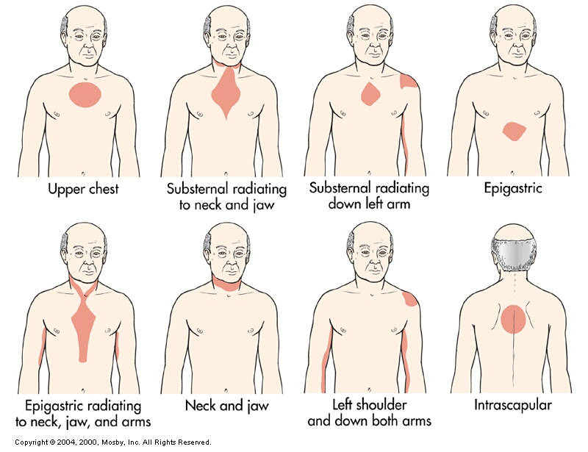
Location of Chest Pain

Slide 32
ANGINA PECTORIS
Principle symptom of CAD (IHD, CHD)
Sudden, severe & temporary chest pain caused by an inadequate supply of oxygen to the myocardium due to narrowing of the coronary artery
Pain may radiate to left arm or shoulder, back, neck or jaw
The symptoms usually last for few minutes and pain subsides on rest.
No permanent damage occurs
Angina may be is precipitated by exercise, cold, stress, heavy meal

Slide 33
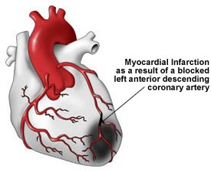
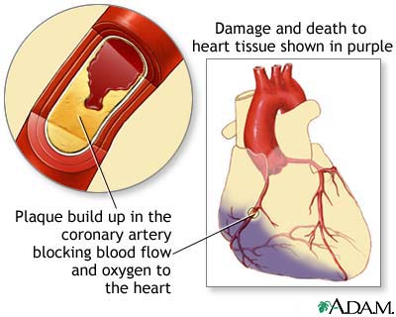
MYOCARDIAL INFARCTION
Myocardium : heart muscle
Infarction : death of the tissue (necrosis)
MI is death of the myocardial tissue due to complete blockade of coronary artery

Slide 34
ACUTE CORONARY SYNDROME
It is an umbrella term used to describe symptoms and signs occuring because of acute atherothrombosis in coronary artery due to unstable plaque with critical stenosis or complete occlusion
Is characterized by prolonged chest pain at rest
It is an emergency condition and patient has to be hospitalized

Slide 35
Classification of ACS
• STEMI of ACS
C.P + ST elevation/ LBBB + high Troponin (TNI)
• NSTEMI of ACS
C.P + ST depression/T inversion +high TNI
• Unstable angina
C.P + Abnormal /normal ECG +normal TNI

Slide 36
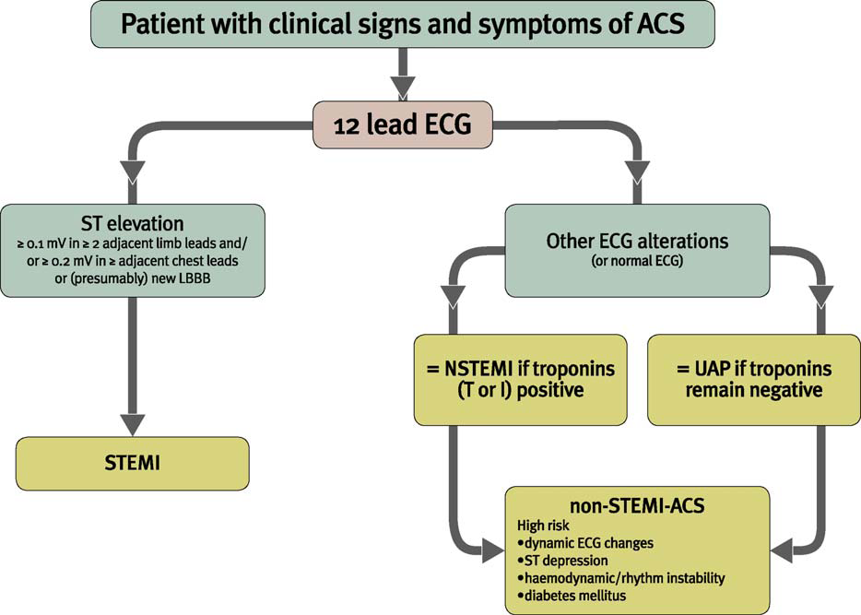
ACS Algorithm

Slide 37
Diagnosis of ACS
• Typical chest pain: Severe prolonged pain, not relieved by GTN.
• ECG changes
• Cardiac enzymes

Slide 38

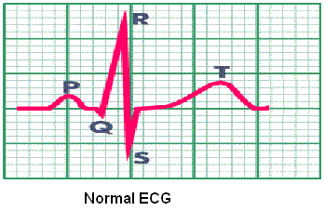
Investigations in CAD
ECG
Recording of electrical activity of the heart via electrodes attached to the skin
Net sum of depolarisation and repolarisation potentials of all myocardial cells
P-QRS-T pattern
P - atrial depolarisation
QRS - ventricular depolarisation
T - ventricular repolarisation

Slide 39
ECG
ST elevation M.I.:
Early changes- ST elevation.
Late changes – Q waves.
Non ST elevation M.I (NSTEMI):
ST /T wave depression.

Slide 40
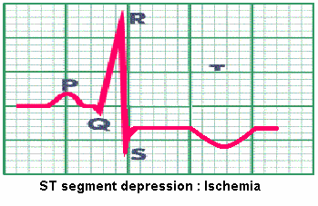
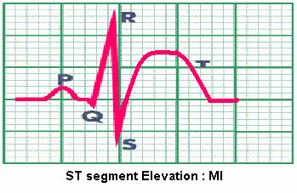
ECG ABNORMALITIES IN ISCHEMIA & MI
ECG (Electrocardiogram)

Slide 41
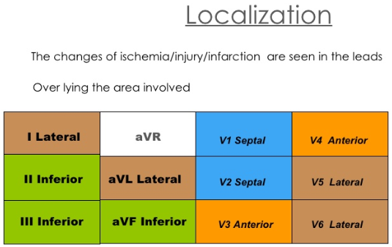

Slide 42
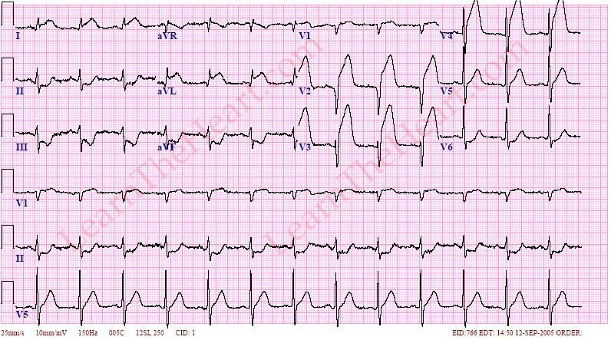
Acute STEMI (Anterior)

Slide 43
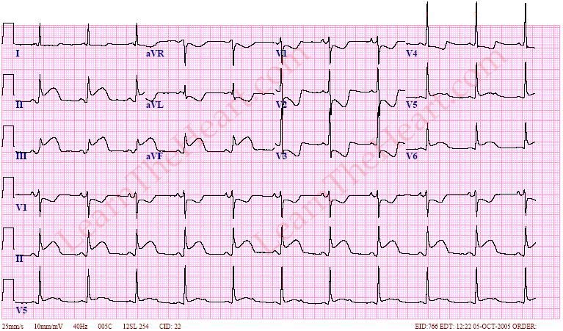
Acute STEMI (Inferior)

Slide 44
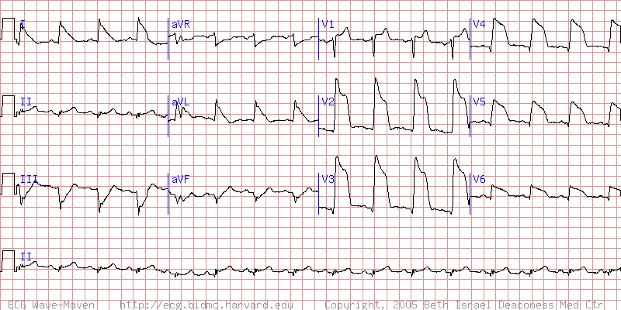
Acute STEMI (anteriorlateral)

Slide 45
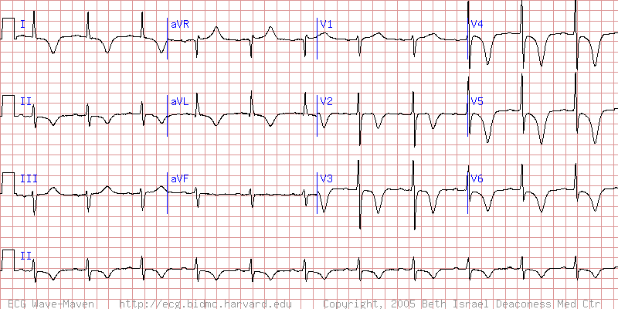
Acute Non-STEMI (anteriorlateral)

Slide 46
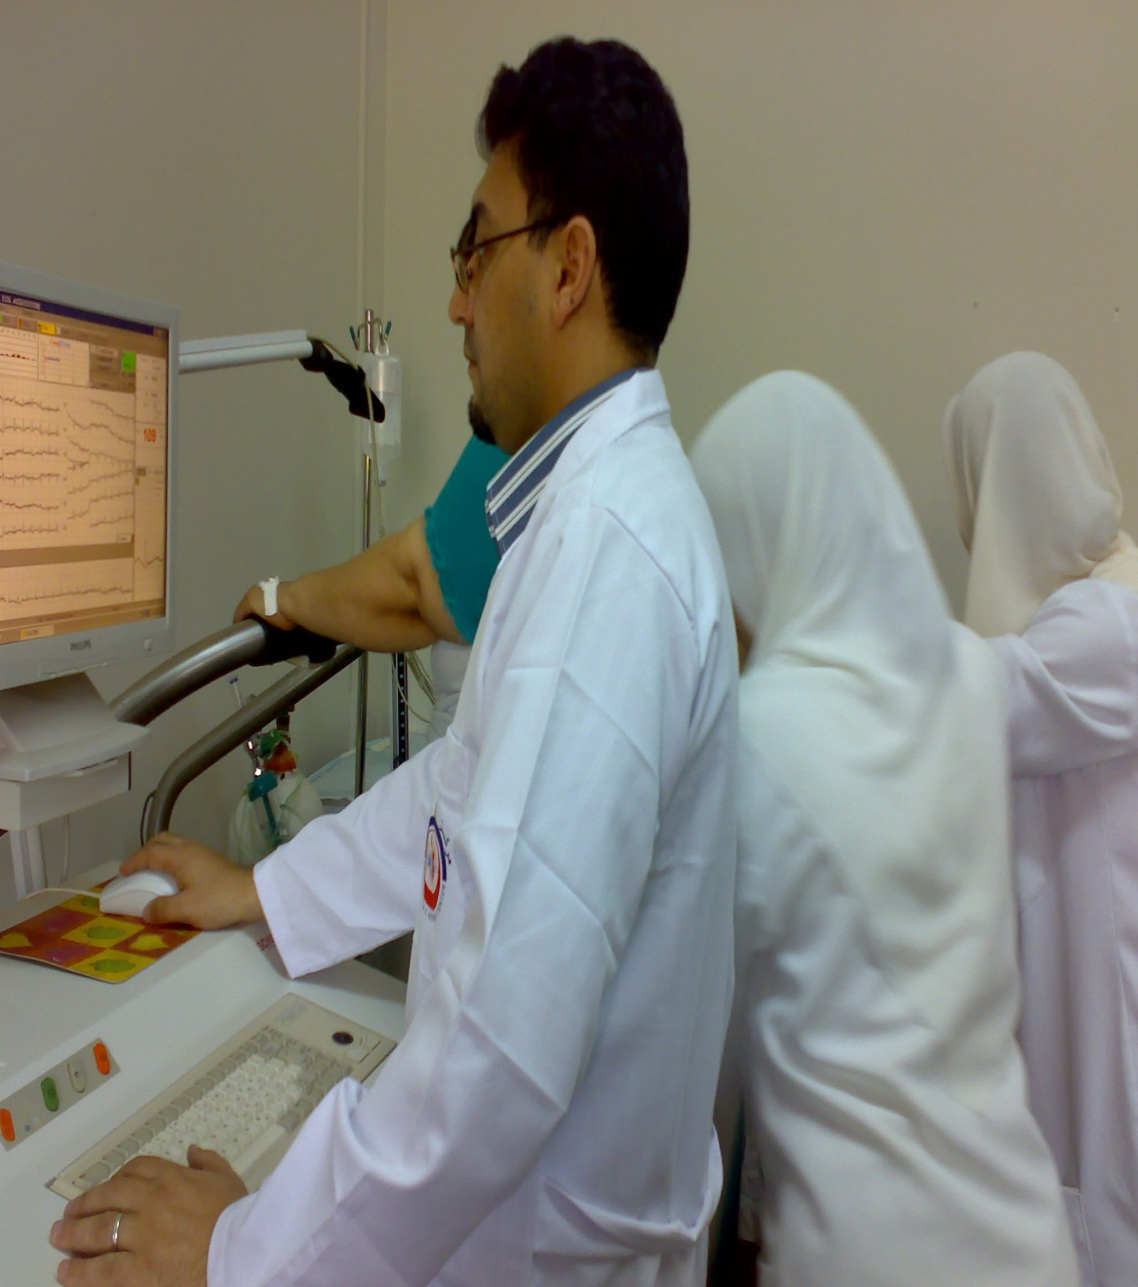
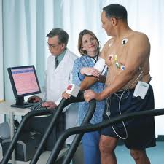
Exercise (stress) ECG

Slide 47
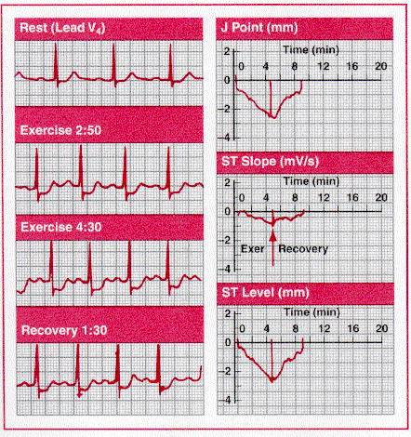
Exercise (stress) ECG
Maximum HR
  Male= 220-Age
  Female = 210-Age
Target HR
80-85% of MHR
High risk findings :
Fall in BP on exercise
Horizontal ST depression
Exercise induced arrhythmias
Low threshold for ischaemia

Slide 48
Cardiac scan
A (Thallium, Technetium)
Thallium IV Uptake by the heart
reflect coronary perfusion.
Thallium with exercise is more accurate.
The heart also can be stressed with dobutamine in patients unable to do exertion.

Slide 49
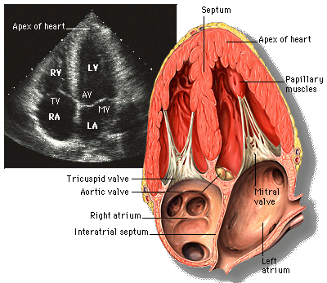
Echocardiography & dobutamine echo
To assess ventricular function (ejection fraction).
Also to detect wall motion abnormalities reflecting ventricular damage.
Dobutamine echo is very useful in diagnosis of IHD .

Slide 50
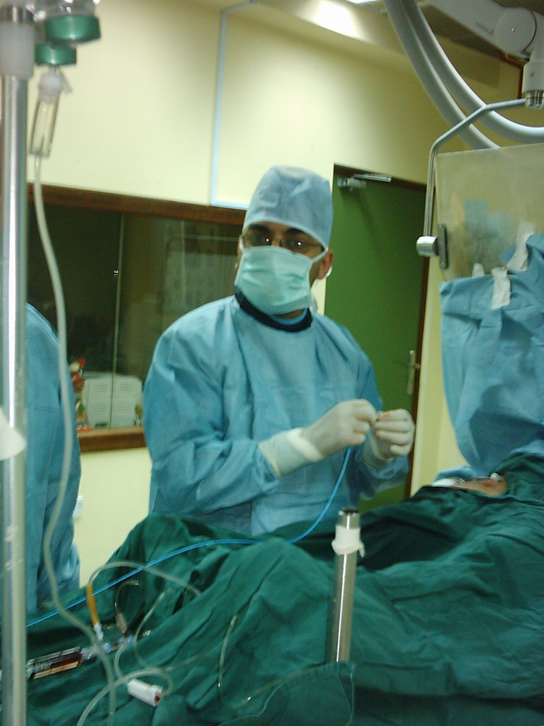
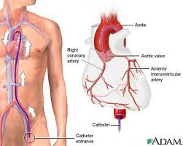
Cardiac Catheterization

Slide 51
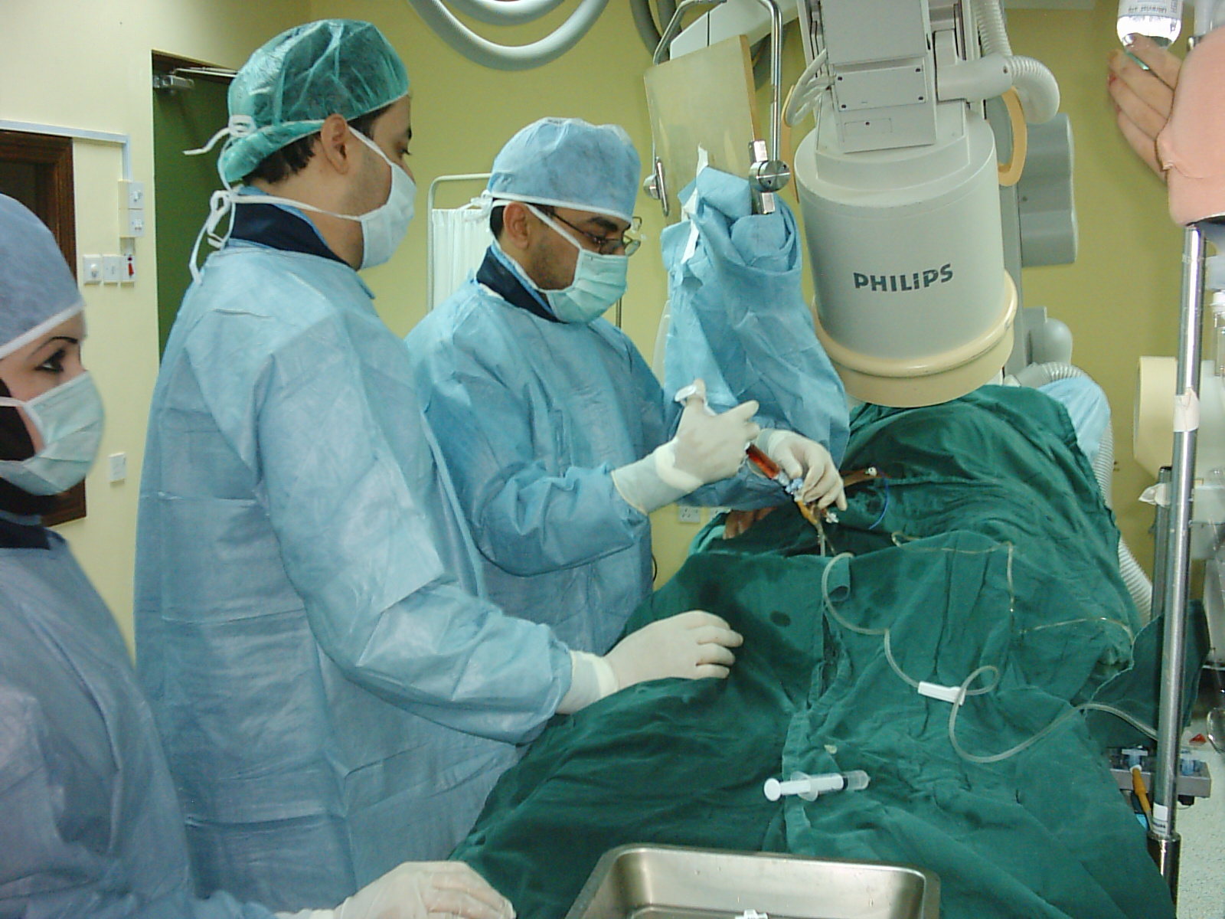

Slide 52
Coronary angiography
• Gold standard test.
• Invasive procedure with cannulation of Rt.
femoral artery.
• Gives detailed anatomical information of
coronary arteries.

Slide 53
Coronary angiography
A diagnostic procedure
Catheter’ refers to a long narrow rubber tube inserted through artery of leg & advanced upto the opening of coronary artery in aorta
‘A small amount of contrast material (dye) is injected through the catheter into coronary arteries

Slide 54
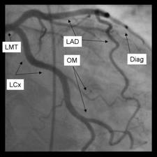
Coronary Angiography
Left Main Trunk
Left Anterior
Descending
Left Circumflex
Diagonal branch

Slide 55
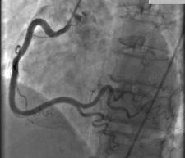
RCA
NORMAL RCA

Slide 56
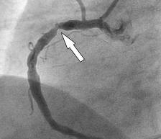
RCA
Stenosis RCA

Slide 57
Cardiac enzyme
Creatinine kinase isoenzyme MB (CK-MB).
• Start to raise 4 – 6 hours after start of chest pain. raise for 3-4 days.
• False +ve results trauma, I.M.injections,D.C.shock.
• Serum troponin I & T most sensitive test.
• TNI continue raised for upto 2 weeks.
• False +ve results in: renal failure, Myocarditis, pulmonary embolism.

Slide 58
TLC, ESR.
Normal/No tissue damage.
Lipid profile, S. Homocysteine, CRP & B. sugar

Slide 59
TREATMENT OF IHD
Life style modification
  Regular physical exercise
  Stop smoking
  Stop alcohol
  Dietary controls : weight control
    Restrict saturated fats

Slide 60
Pharmacological
  Antiplatelets Aspirin, clopidogril
  Statines
  Nitrates : short & long acting
  Beta Blockers
  CCBs
Interventional
  PCI
  CABG

Slide 61
Management of ACS
Management
ASA
Beta blocker
Nitrates
ST Elevation MI
Primary intervention
Thrombolytic therapy
Non ST Elevation MI and USA
LMWH
Platelet inhibitors
Role of catheterization

Slide 62
Early management of ACS
Immediate:
Oxygen.
I.V. access.
ECG monitor & 12 lead ECG.
Aspirin.
I.V. analgesia.
nitrate

Slide 63
Early TT. of STEMI
• STEMI need reperfusion:
Primary angioplasty.
Thrombolysis
• NSTEMI & unstable angina:
Low molecular weight heparin.
Antiplatelet TT. Aspirin & clopidogrel.
Coronary angiography.

Slide 64
NITRATES
Dilates veins & large arteries
Dilation of veins lead to reduction of the preload
Dilation of the arteries leads to reduction of the afterload
Coronary artery dilation

Slide 65
BETA BLOCKERS
  Reduces Myocardial Oxygen Demand
  ↓ Heart Rate
  ↓ Force of contraction
  Increases Coronary filling
  ↑ Diastolic time

Slide 66
CCBs
Block Calcium channels
Prevent entry of Ca++ ions
Myocardial Cell
Vascular smooth muscle
Coronary Artery
Peripheral arteriole
Decreased force of contraction
Coronary blood flow
PVR

Slide 67
Primary angioplasty
• More effective than thrombolysis in TT. of
STEMI.
• Death, reinfarction, & stroke reduced from 14
to 8%.
• Need specialised centers with experienced
operators to perform it within 90 minutes of
presentation.

Slide 68
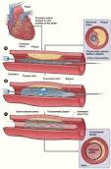
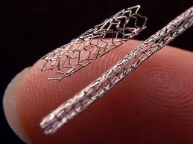
Coronary angiography (PCI)

Slide 69
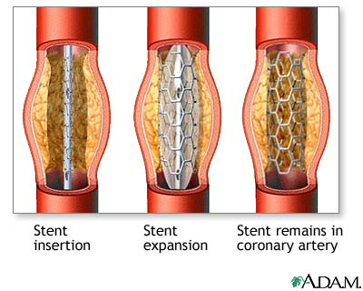
PCI with STENTING
Also known as
  .Balloon angioplasty
  Angioplasty
  .PCI (percutaneous coronary intervention)
Done in Cardiac Catheterization Laboratory (Cath Lab) by an interventional cardiologist

Slide 70
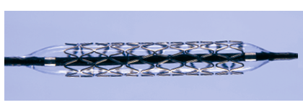

Slide 71
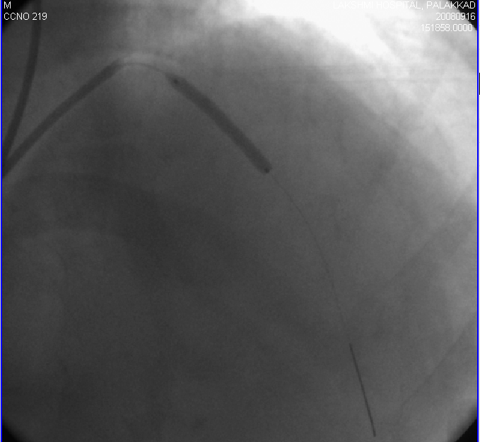

Slide 72
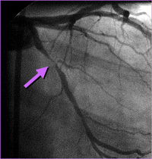
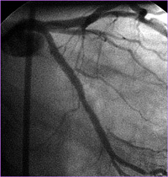
PTCA WITH STENTING
The arrow on the angiogram shows block in the artery.
Opening of the artery after stenting Opening of the artery after stenting

Slide 73
Thrombolytic therapy
• Prompt thrombolytic TT.(within 12 hours of
the onset of chest pain) reduce mortality in
patients with ST elevation MI.
• Not effective in NSTEMI & unstable angina.
• Complications of TT.
Hemorrhagic CVA.
Bleeding.

Slide 74
Contraindications or cautions:
  absolute contraindication
  Previous ICH
  Ischemic stroke within the last 3 months except acute ischemic stroke within 3 hours
  Malignant intracranial neoplasm
  Aortic dissection
  active bleeding excluding menses
  relative contraindication
  Major surgery within 3 weeks
  BP >180/110
  Pregnancy
  Concurrent warfarin therapy
  Active peptic ulcer disease

Slide 75
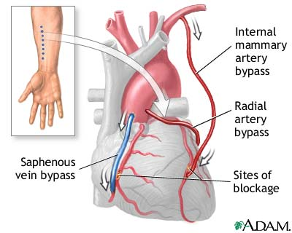
CABG
(Coronary Artery Bypass Graft Surgery)
(Done by CVTS in Cardiac OT)

Slide 76


