Slide 1
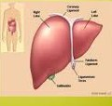
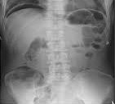

Radiographic anatomy of Gastrointestinal tract .
Dr. Nadia ezzawi
Gastroenterology department
BMC

Slide 2
objectives
To Know the structural, functional, and congenital abnormalities, inflammatory pathology, and neoplastic diseases of the structures of gut.
Understand the imaging approach in different GIT diseases.
To detect the complications , and treat them .

Slide 3
Evaluation by
Plain X ray abdomen
Barium study
Ultrasound abdomen
CT abdomen
ERCP( endoscopic retrograde cholengiopancreaticography)

Slide 4
Plain X ray
Plain abdominal X-rays not as useful as plain chest X-rays because of contrast factors
In abdomen, background is soft tissue/fluid density, and pathology is often of same density.
It is important to detect certain radio opaque lesions in the abdomen such foreign body , renal stones . Or perforation of viscous.

Slide 5
five densities on x ray may help :
Gas --- black
Fat ---- dark grey
Soft tissue/ fluid – light grey
Bone/ calcification / white
Metal ------ intense white

Slide 6
Indications
Bowel obstruction
Perforation
Renal pathology
Acute abdomen
Foreign body localization
Toxic mega colon
Aortic aneurysm
Control or preliminary films for contrast studies
Detection of calcification or abnormal gas collection

Slide 7
Common abdomen films
Antero-posterior- supine (KUB)
Antero-posterior- erect
Left lateral decubitus

Slide 8
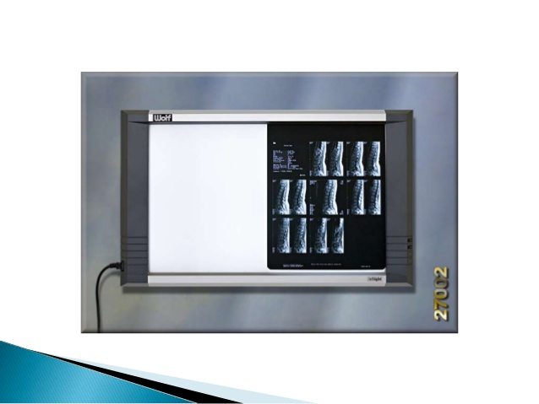
An x ray should be seriously inspected by uniform transmitted light coming through it i.e.: viewing box

Slide 9
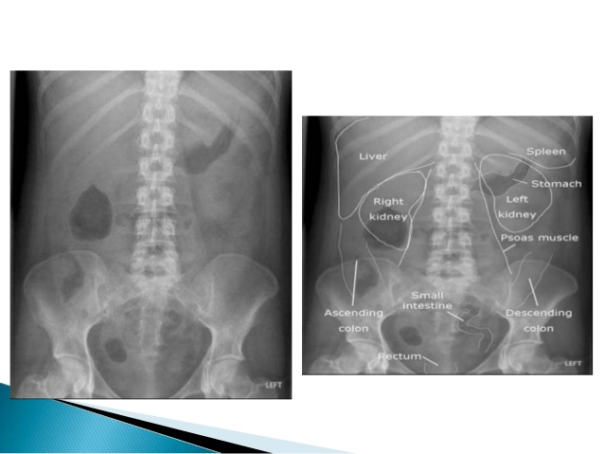

Slide 10
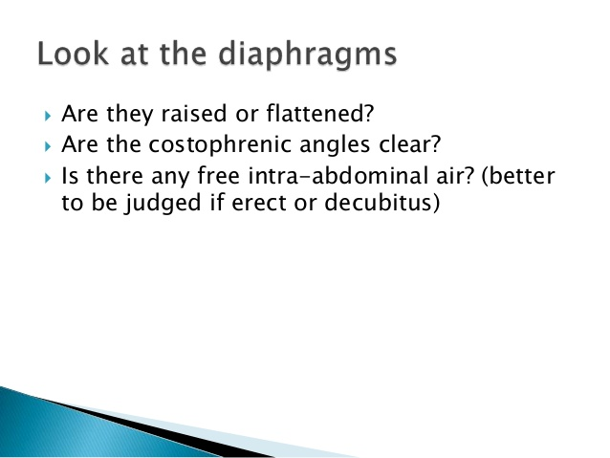
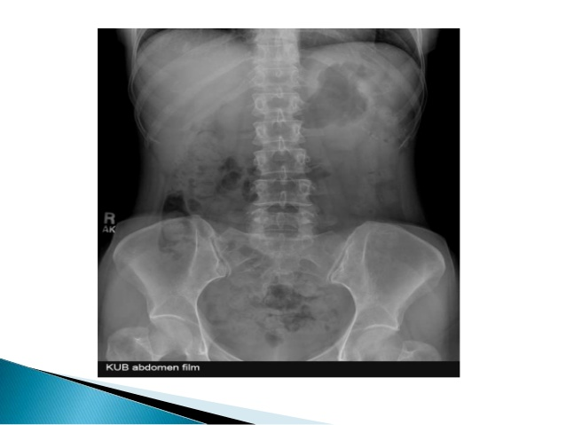

Slide 11
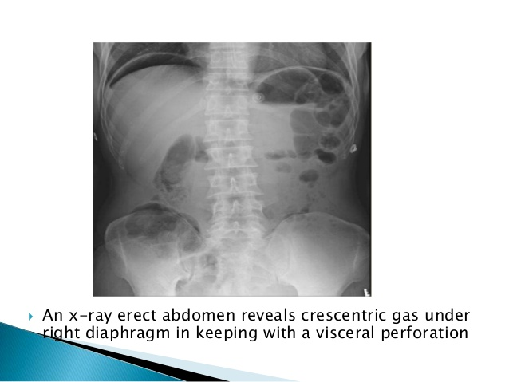

Slide 12
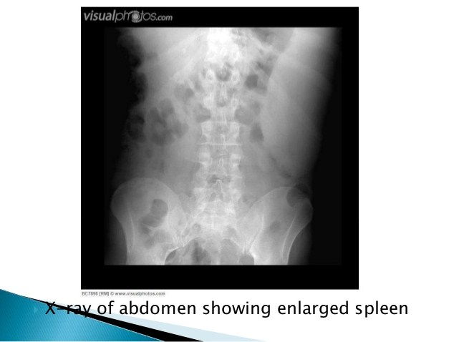
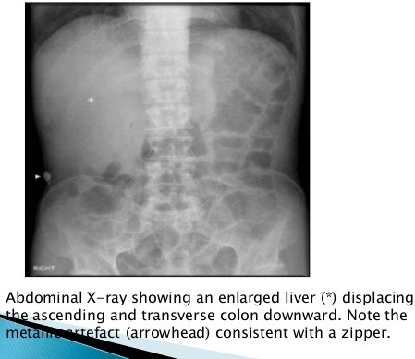
liver
spleen

Slide 13
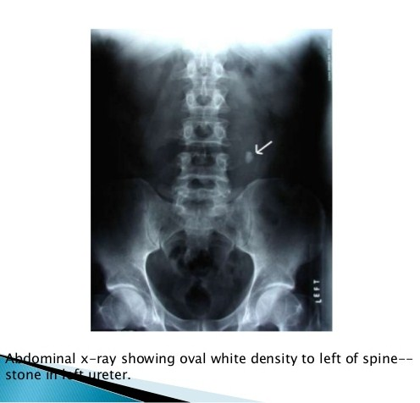
Kidneys

Slide 14
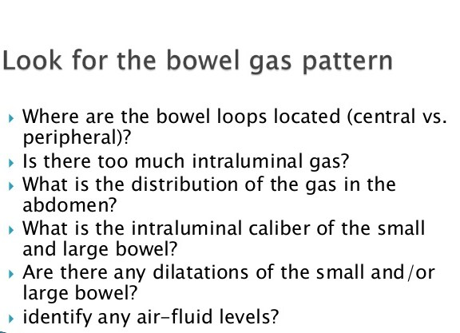

Slide 15
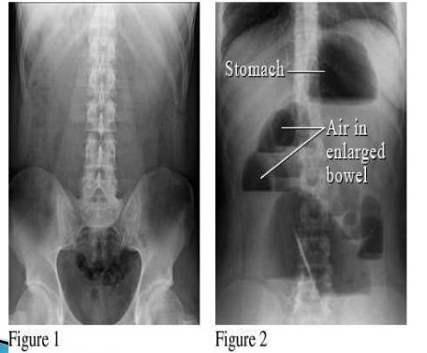

Slide 16
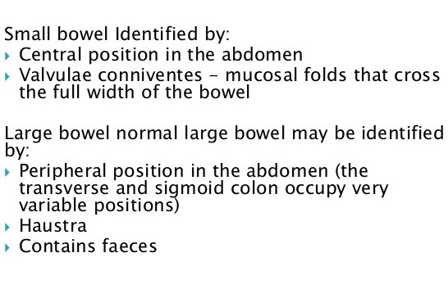

Slide 17
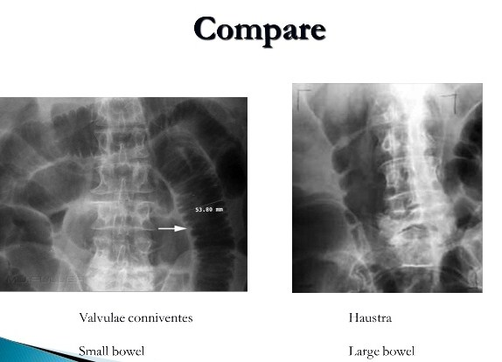

Slide 18
Barium study
Barium meal
Barium follow-through
Barium enema
The technique is to administer a contrast agent modifies the image to give more information .

Slide 19
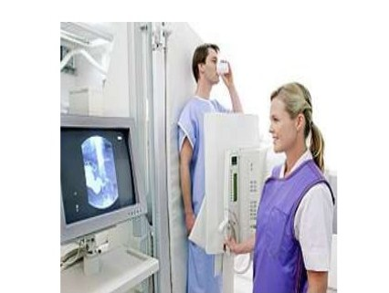
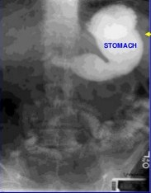
Upper GI oral barium contrast

Slide 20
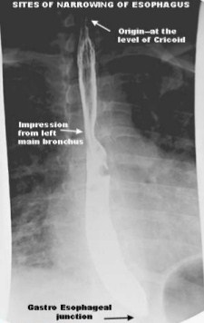
Barium swallow
It is a medical imaging procedure used to examine upper gastrointestinal tract , which include the esophagus and to a lesser extent the stomach.
The contrast used is barium sulfate .

Slide 21
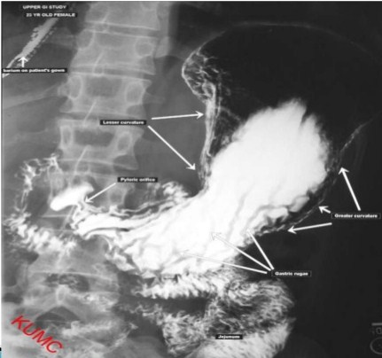
Barium meal
In a barium meal test , X-ray image are taken of the stomach and the beginning of duodenum

Slide 22
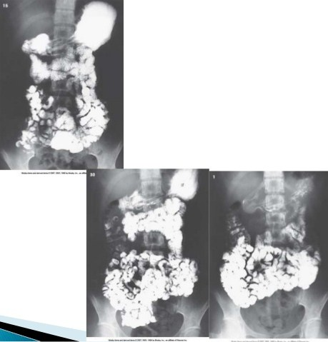
Barium meal and follow through
Reveal the small intestine .

Slide 23
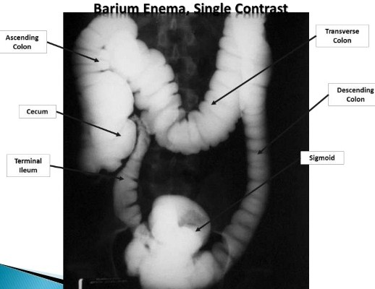
Barium enema
Single contrast study
The colon is filled with barium, which outlines the intestine and reveals large abnormalities.

Slide 24
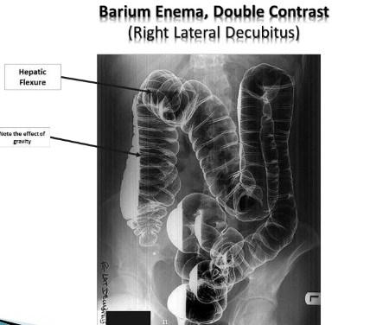
Double contrast with air
The colon is first filled with barium.
Then the barium is drained out, leaving only a thin layer of barium on the wall of the colon .
The colon is then filled with air. This provides a detailed view of the inner surface of the colon, making it easier to see narrowed areas (strictures), diverticula, or inflammation.

Slide 25
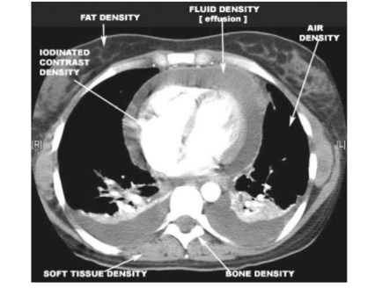
CT scan
Spatial resolution ability to resolve small objects in an image.
Contrast resolution ability to differentiate small density differences in an image .

Slide 26
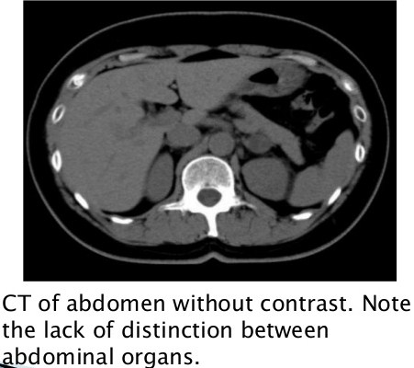
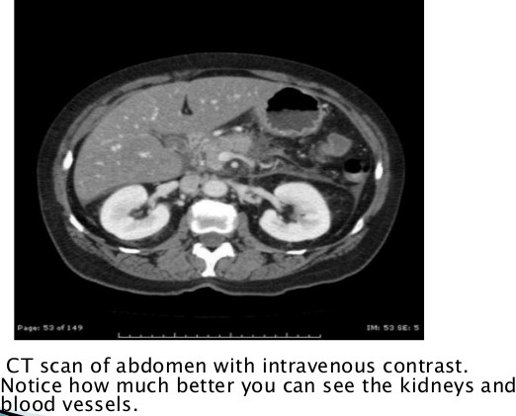

Slide 27
Uss of the abdomen
definition
A diagnostic technique in which high-frequency sound waves penetrate the body and produce multiple echoes; these echo patterns can be viewed as an image on a computer screen.
Frequency ranges used in medical Ultrasound imaging are 2 - 15 MHz
Diagnostic Medical applications in use since late 1950’s

Slide 28
ultrasound Language
Hyper-echoic = White
Hypo-echoic = Light Grey
An-echoic = Black

Slide 29
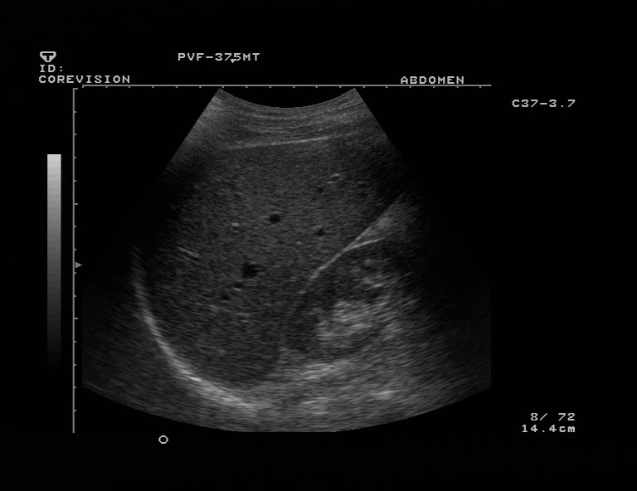
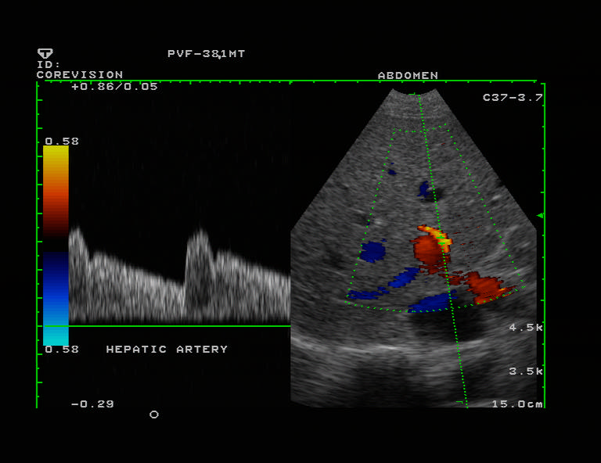
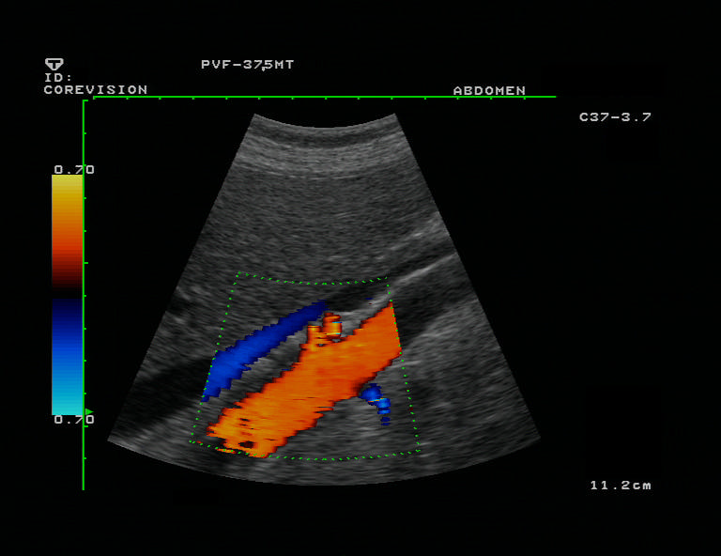
B- MODE.
DUPLEX
COLOR DOPPLER

Slide 30
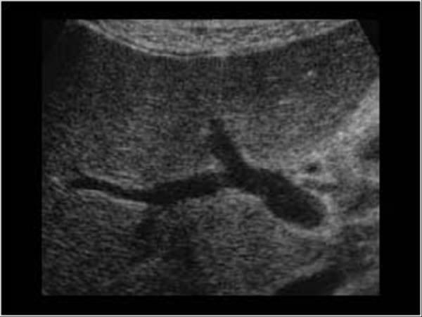
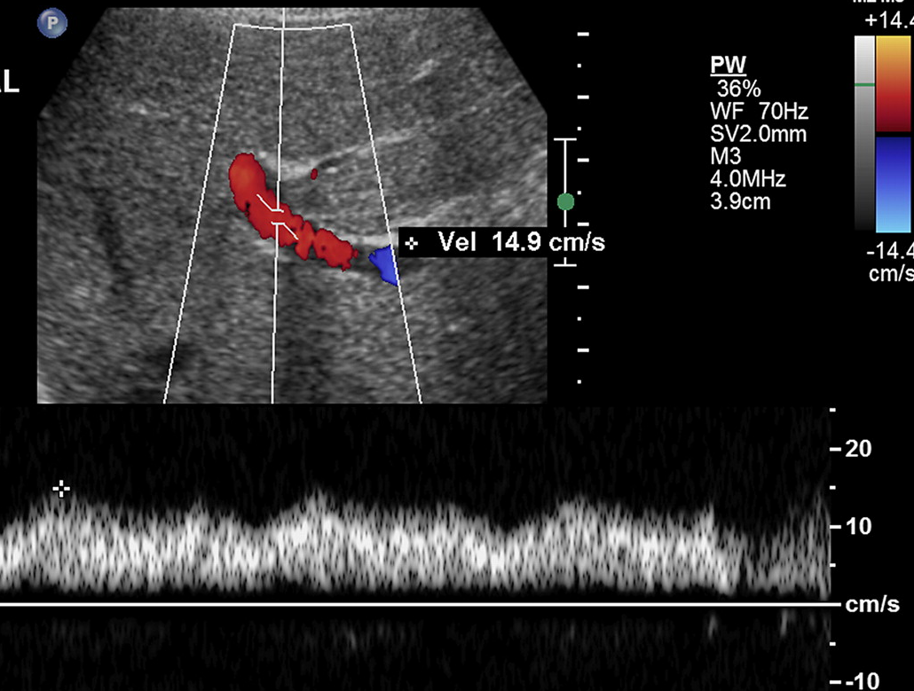
B- MODE
DUPLEX

Slide 31
USS uses
Cardiology
Echocardiography is an essential tool in cardiology, vavular heart disease.
Emergency Medicine:
for Trauma patient and acute abdomen.
Gastroenterology:
In abdominal sonography, the solid organs of the abdomen such as the pancreas, aorta, inferior vena cava, liver, gall bladder, bile ducts, kidneys, spleen and appendix.
Gynecology:
to assess female pelvic organs, uterus ovaries
Neonatology:
for basic assessment of intracerebral structural abnormalities, bleeds, ventriculomegaly or hydrocephalus.

Slide 32
Cont.
Neurology
for assessing blood flow and stenoses in the carotid arteries (Carotid ultrasonography)
Obstetrics:
sonography is commonly used during pregnancy to check on the development of the fetus.
Urology:
to study a patient's bladder, prostate or testes.
Musculoskeletal
For assessing tendons, muscles, nerves, ligaments, soft tissue masses, and bone surfaces
vascular system:
To assess patency and possible obstruction of arteries Arterial doppler, diagnose DVT venous doppler and determine extent and severity of venous insufficiency

Slide 33
advantages
Inexpensive
Easy and available
Safe and no radiation
disadvantages
Inability to penetrate gas or bone.
Operator dependent.
Less sensitive in some situations

Slide 34
Indications of liver and gall bladder US
Right upper quadrant pain.
Jaundice.
High liver function test.
Fever work up.
Screening for metastasis.

Slide 35
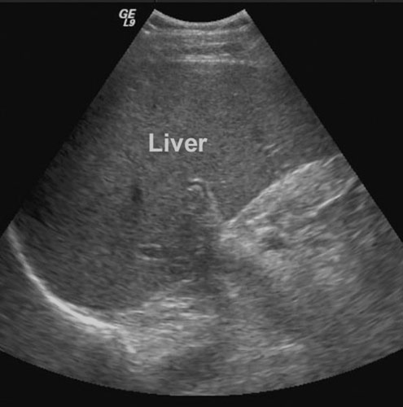
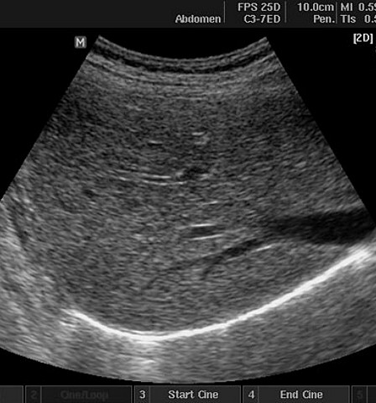
Normal liver appearance

Slide 36
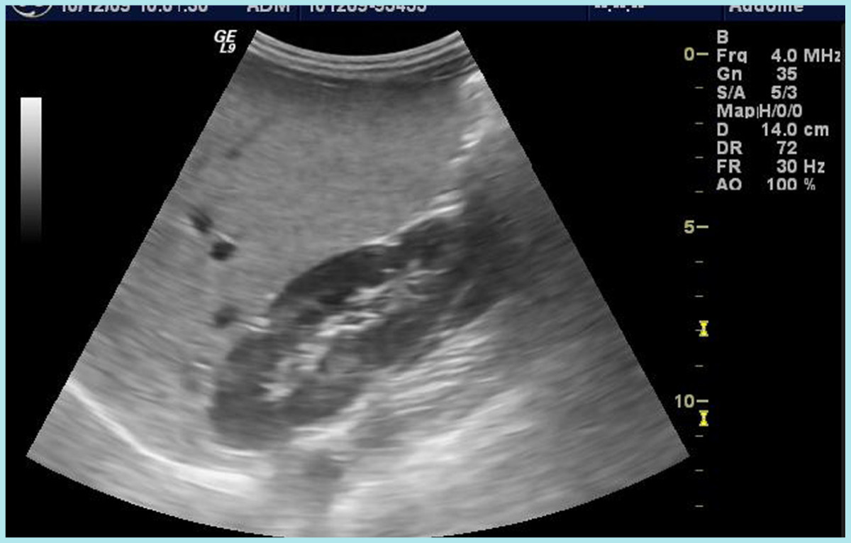
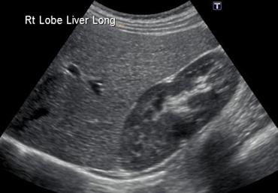
More then normal (more white)
Diffuse fatty infiltration
Normal

Slide 37
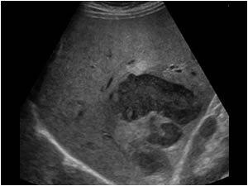
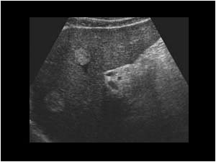
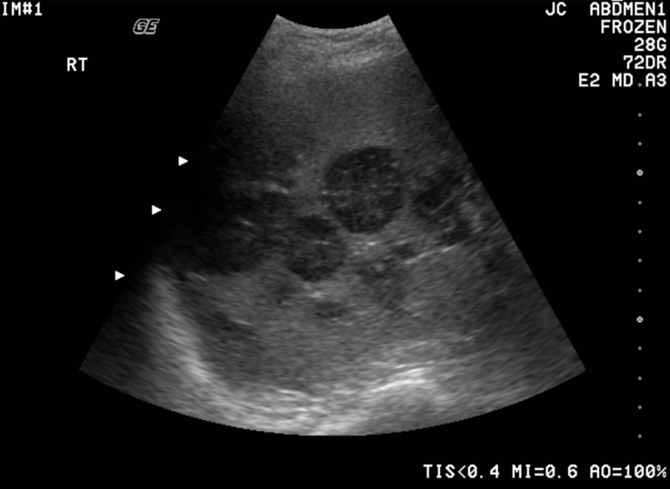
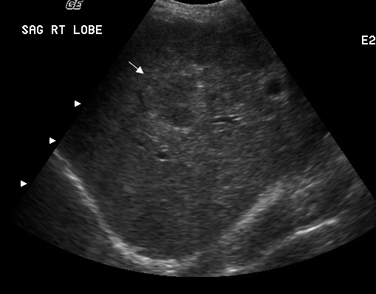
LIVER ABSCESS
HEMANGIOMAS
METASTASIS
HCC

Slide 38
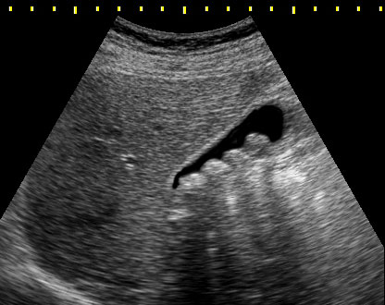
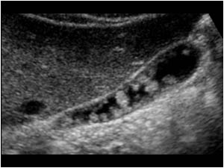
Intra-luminal pathology
Gall stone:
Acoustic shadowing
Polyps
No acoustic shadowing.

Slide 39
Endoscopic retrograde cholengiopancreatography (ERCP)
It is a technique that combines the use of endoscopy and fluoroscopy to diagnose and treat certain problems .
The duodenum
The papilla of vater
The bile ducts
The gall bladder and the pancreatic duct .

Slide 40
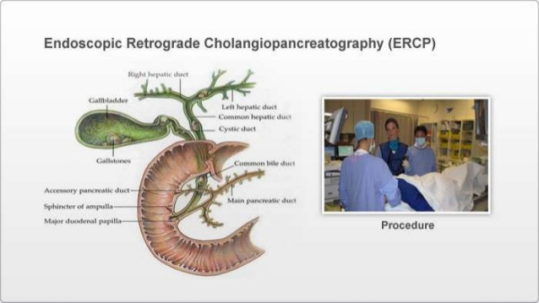

Slide 41
Indications
Diagnostic
Narrowing or blocking of bile or pancreatic duct due to :
Tumors
Gb stones
Inflammation (pancreatitis)
Scarring of the duct (sclerosis)
Pancreatic pseudocysts
Therapeutic:
Sphincterotomy
Stone removal
Stent placement
Balloon dilation
Tissue sampling ( biopsy)

Slide 42
