Slide 1

The Importance of Interpersonal Communication
Abdurrahman Alkilani / 3152
Abdurrahman_3152@limu.edu.ly

Slide 2
Table Of Contents
01
02
Introduction
What Are The Interpersonal Skills
03
04
Why Interpersonal Skills Are Important
Conclusion
05
References
1

Slide 3
01
Introudction
2

Slide 4
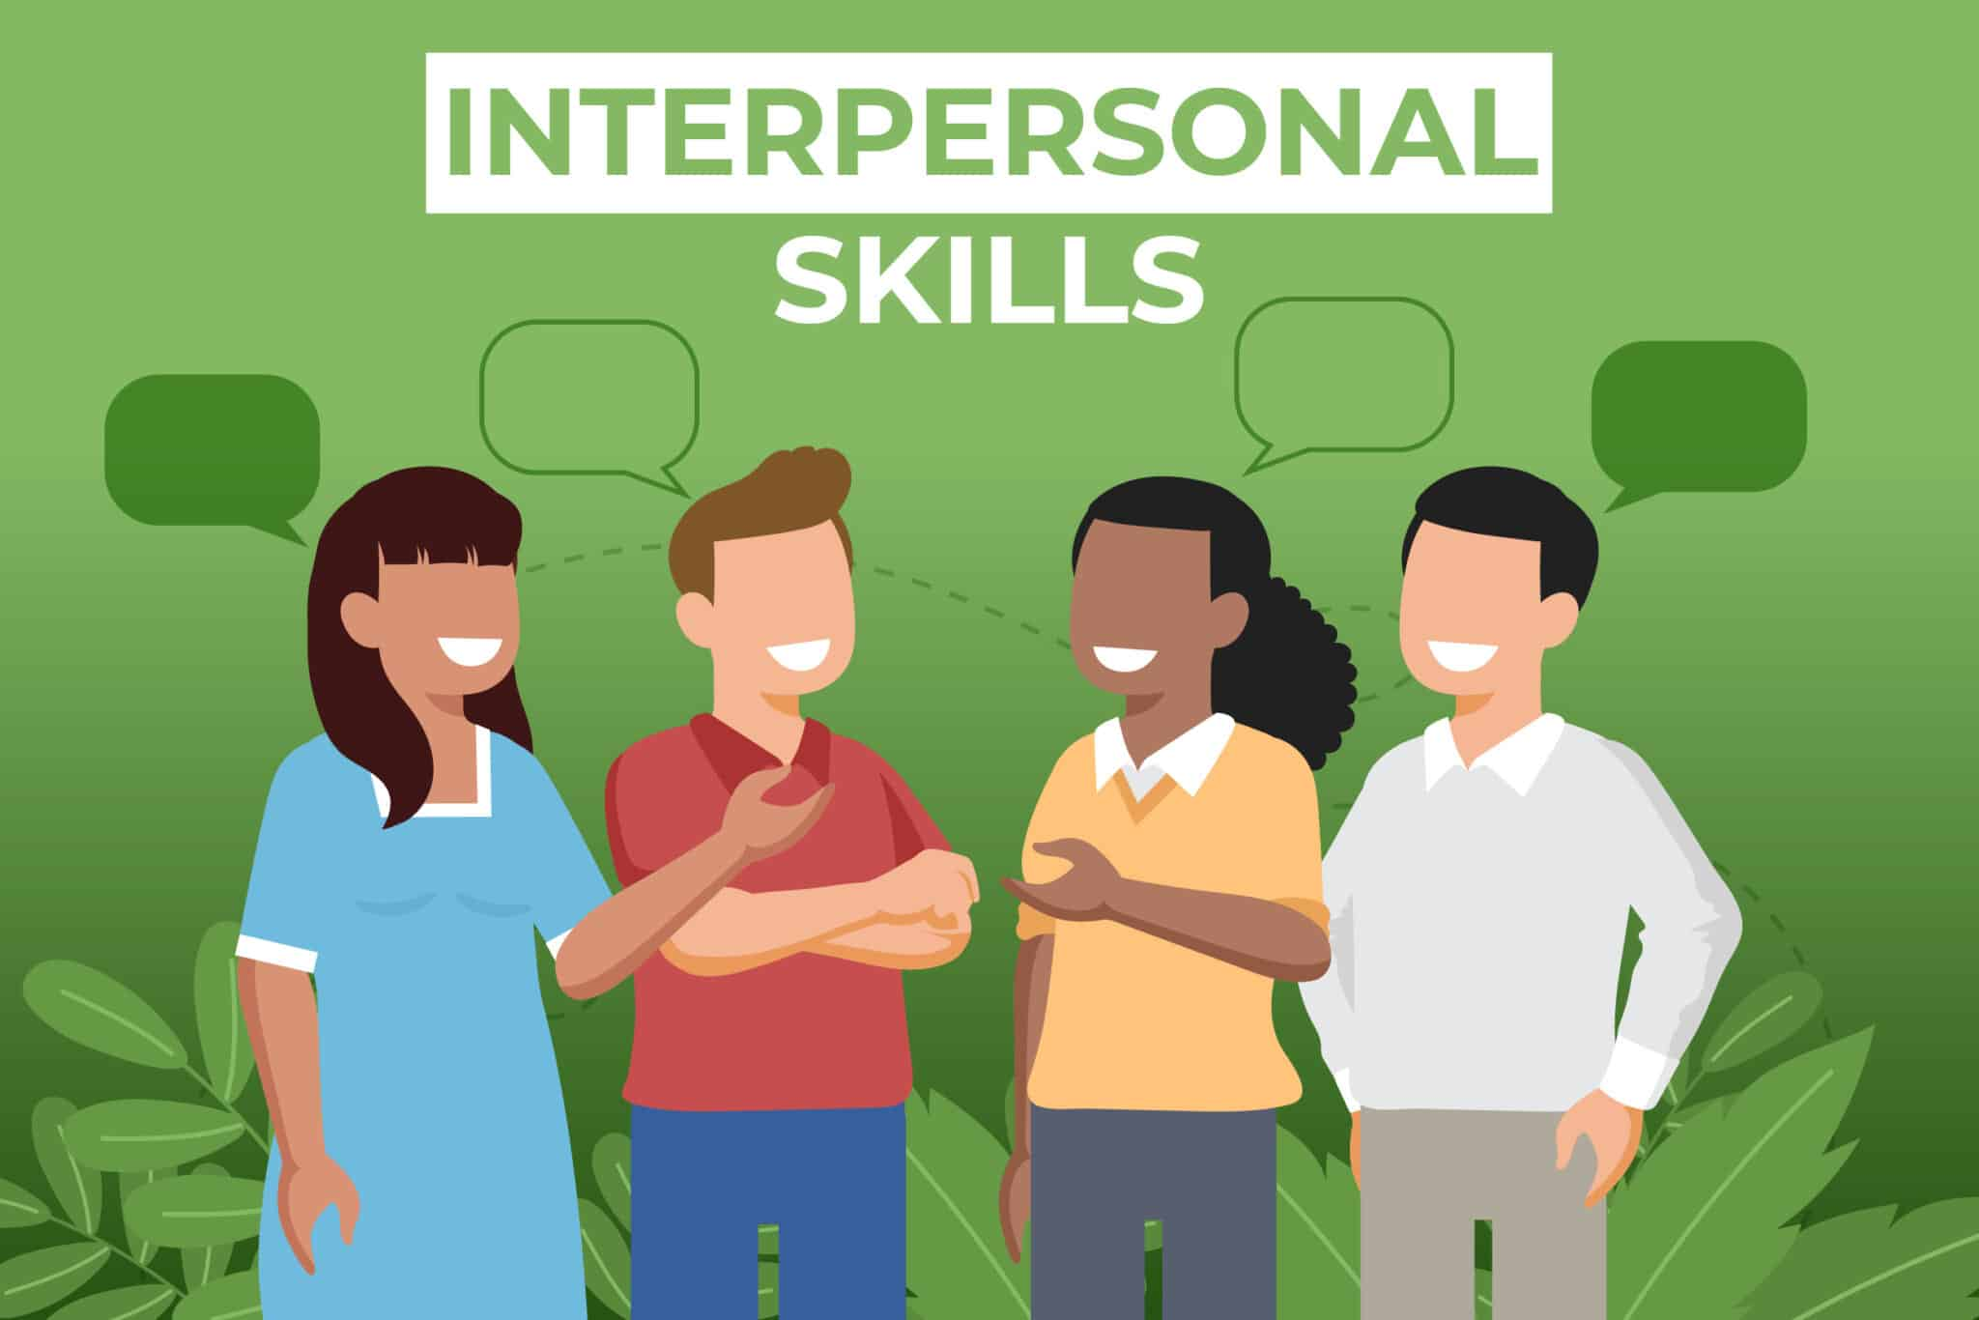
Introduction
Interpersonal communication is the process of sharing ideas and emotions verbally and nonverbally with another person. It allows us to interact with and understand others in our personal and professional lives.
3

Slide 5
02
What Are The Interpersonal Skills
4

Slide 6
What Are The Interpersonal Skills
Interpersonal skills also known as people skills are the talking skills you use to communicate with and understand others. You use these skills daily when interacting with people face-to-face. Examples:
Active listening.
Teamwork.
Responsibility.
Dependability.
Leadership.
Motivation.
Flexibility.
Patience.
Empathy.
Conflict resolution.
Negotiation.
5

Slide 7
03
Why Interpersonal Skills Are Important
6

Slide 8
Why Interpersonal Skills Are Important
Interpersonal skills are important for communicating and working with groups and individuals in your personal and professional life. People with strong interpersonal skills tend to build good relationships and can work well with others. They understand family, friends, coworkers and clients well.
Benefits of interpersonal skills:
Ability to solve problems.
Making good decisions.
Ability to understand others easily.
7

Slide 9
04
Conclusion
8

Slide 10
Conclusion
Interpersonal communication skills can help you be productive in the workplace, build strong and positive relationships with your colleagues and complete team projects smoothly and effectively.
The benefits of good interpersonal skills can affect the morale and productivity of your entire team or department.
9

Slide 11
References
Everything You Need To Know About the Importance of Interpersonal Communication at Work Various Authors ( March 19, 2021 )
https://www.indeed.com/career-advice/career-development/importance-of-interpersonal-communication
10

