Slide 1

Network Communcation
Information Technology
EHAB MOUSA - 4204
LIMU

Slide 2
OBJECTIVES
Define network communcations and their elements
Describe the characteristics and uses of each communcation model
List layers of the OSI model
Describe the functionalities of each layer of the OSI model
Difference between TCP/IP and osi model
Information Technology
LIMU

Slide 3
Define network communcations and their elements
Information Technology
The exchange of data or information between end-user devices over a network via the trasmittion medium.
It defines a set of protocols (rules and standards) that allow communication between devices regardless of their underlaying archeticture.
LIMU

Slide 4
Their elements
Nodes: These are the individual devices on the network, such as computers, printers, tablets, or smartphones. Each node has a unique identifier, like an IP address, that allows other devices to find it.
Communication Channels: This is the physical path over which data travels. Wired connections use cables, while wireless networks use radio waves.
Communication Protocols: These are the rules that govern how data is formatted, transmitted, and received. Protocols ensure that devices on the network can understand each other and that data arrives without errors. TCP/IP (Transmission Control Protocol/Internet Protocol) is a common protocol suite that underlies most internet communication.
Network Devices: These are specialized hardware components that help manage and direct network traffic. Examples include routers, switches, and firewalls. Routers direct data packets to their intended destinations, switches manage communication within a specific network segment, and firewalls provide security by filtering incoming and outgoing traffic.
Information Technology
LIMU

Slide 5
Describe the characteristics and uses of each communcation model
 | TCP/IP | OSI Model
Characteristics | Practical model with 4 layers: Application, Transport, Internet, and Network Access. Focuses on functionality and defines how data is routed and delivered. Protocol-dependent, uses specific protocols like TCP and IP. Simpler structure, easier to understand and implement. | Conceptual model with 7 layers: Application, Presentation, Session, Transport, Network, Data Link, and Physical. Provides a theoretical framework for understanding network communication. Protocol-independent, describes the functionalities at each layer without specifying protocols. More complex structure, useful for detailed analysis of network communication.
Uses | Foundation of the internet: TCP/IP is the dominant model used for internet communication. Provides reliable data transfer through protocols like TCP. Enables connectionless communication for simpler data exchange using IP. Widely used in various network applications and devices. | Standardization and troubleshooting: Helps understand issues at different communication stages. Teaching and reference: Provides a comprehensive breakdown of network communication principles. Developing new protocols: Reference model for creating protocols that can fit into the OSI framework.
Information Technology
LIMU

Slide 6
List layers of the OSI model
Information Technology
Application Layer
Presentation Layer
Session Layer
Transport Layer
Network Layer
LIMU
Data Link Layer
Physical Layer

Slide 7
Describe the functionalities of each layer of the OSI model
Information Technology
Layer 7
Application Layer Provides protocols for user applications to interact and exchange data. This is the layer that directly interfaces with the user and their software. Examples include web browsers, email clients, file transfer applications, and online games.
Layer 6
Presentation Layer Prepares data for the application layer by handling encryption, compression, and formatting. It ensures that data is presented in a way that can be understood by the receiving application, regardless of the underlying hardware or software differences.
Layer 5
Session Layer Establishes, manages, and terminates communication sessions between devices. This layer sets up connections, exchanges data, and tears down connections once communication is complete.
LIMU

Slide 8
Information Technology
Layer 4
Transport Layer Ensures reliable data delivery by breaking data into packets, sequencing them, and handling error correction. It guarantees that data arrives at the destination device in the correct order and without errors. Protocols like TCP (Transmission Control Protocol) operate at this layer.
Layer 3
Network Layer Routes data packets across the network by determining the best path for data to reach its destination. This layer is responsible for logical addressing and uses routing protocols to find the most efficient path for data packets to travel.
Layer 2
Data Link Layer Manages physical data transmission on the network media, including error detection and correction. This layer ensures reliable data transmission on a single physical link and detects any errors that may occur during transmission.
Layer 1
Physical Layer Responsible for the physical transmission of data bits over the network cable or wireless medium. This layer defines the electrical or optical specifications for transmitting data signals over the physical network media.
LIMU

Slide 9
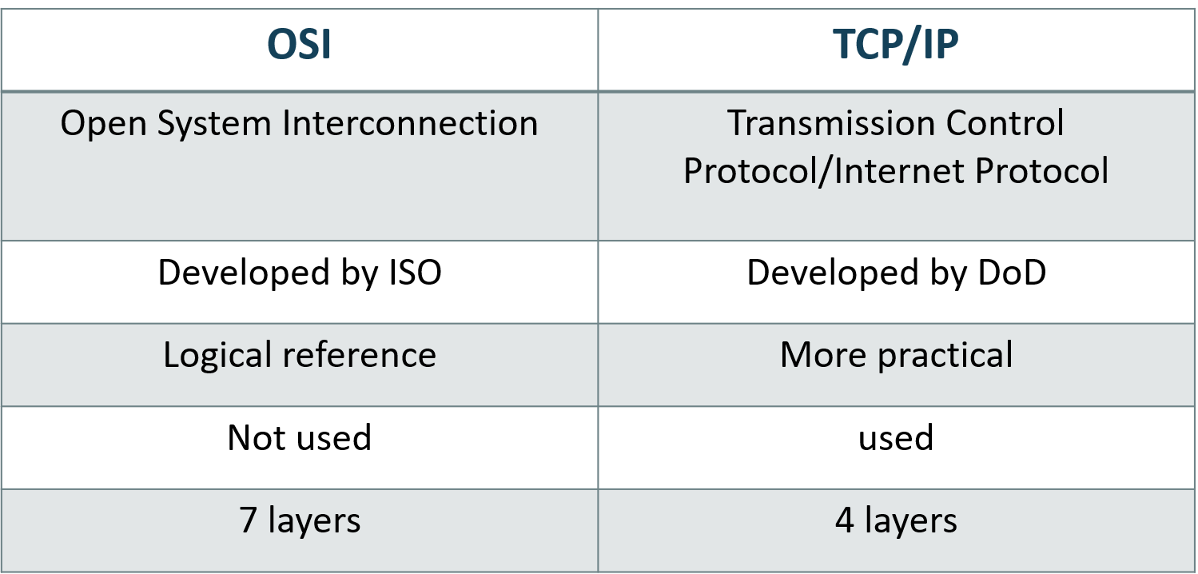
Difference between TCP/IP and osi model
Information Technology
LIMU

Slide 10

FOR YOUR TIME
Information Technology
THANKS
LIMU

