Slide 1


Libyan International Medical University Faculty of Business Administration
The Advantages of knowledge about Scientific Investigation
Name : Khadija Mohammed Bayou
ID:2847
Email: Khadija_2847@limu.edu.ly

Slide 2
Introduction.
Steps of scientific investigation
The importance of scientific investigation
Conclusion.
Questions.
References.
Contents

Slide 3
What is the scientific investigation?
Introduction
A scientific investigation is a plan for asking questions and testing possible answers.

Slide 4
Making Observations
Asking a Question
Forming a Hypothesis
Testing a Hypothesis
Results
Conclusion
Steps of scientific investigation

Slide 5
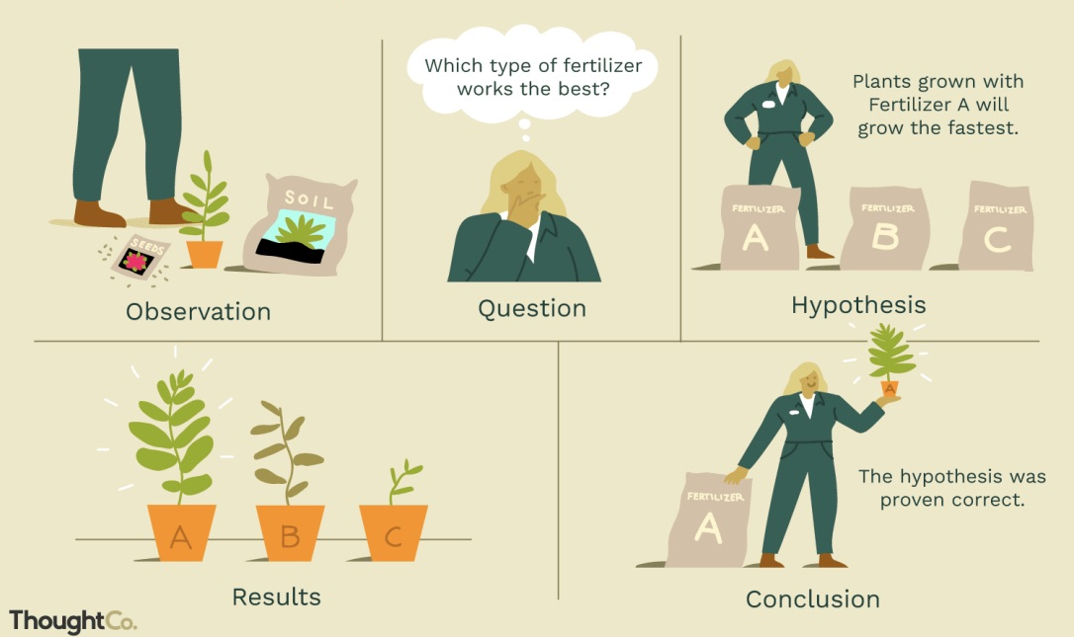

Slide 6

Even Children Use The Scientific Investigation.

Slide 7
We use it to gaining scientific knowledge.
Trains us to think critically and creatively.
Trains us to be more observant and more analytical.
Let us observe carefully and measure accurately.
also communicate effectively.
make inferences rationally and develop hypothesis logically.
The importance of scientific investigation.

Slide 8
Scientific investigation is a way to gaining scientific knowledge.
Observations often lead to questions.
The hypothesis is a key component of the scientific investigation.
The results are where you report what happened in the hypothesis testing.
Conclusion.

Slide 9

Questions
What is the scientific investigation?
Give me the first step of scientific investigation?

Slide 10
Illustration by J.R. Bee. ThoughtCo.
P. (2013, January 13). The Importance of Scientific Investigation.
References.

Slide 11


