Slide 1



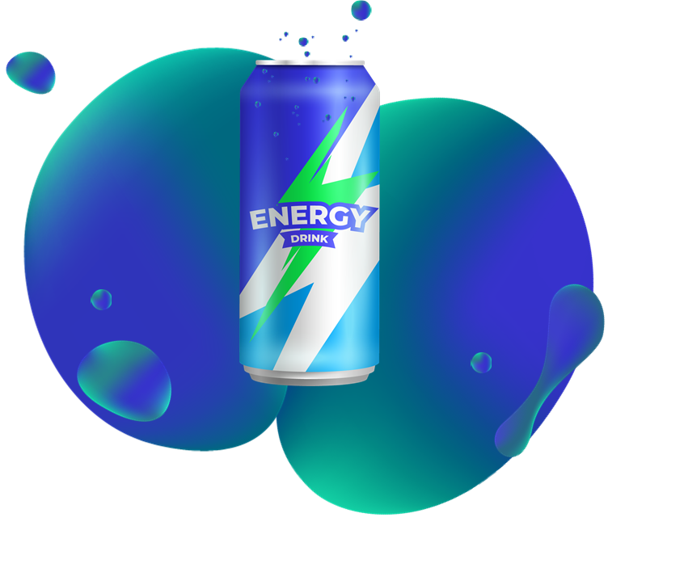
The effect of Energy Drinks on adolescent
Masoud alnaid
3013
2nd AMS

Slide 2

Objectives
Outline component of energy drinks .
What desirable effects of energy drink.
Outline the side effect of excessive use of energy drink.
List the natural alternative to energy drink.
1

Slide 3
Introduction
2

Slide 4
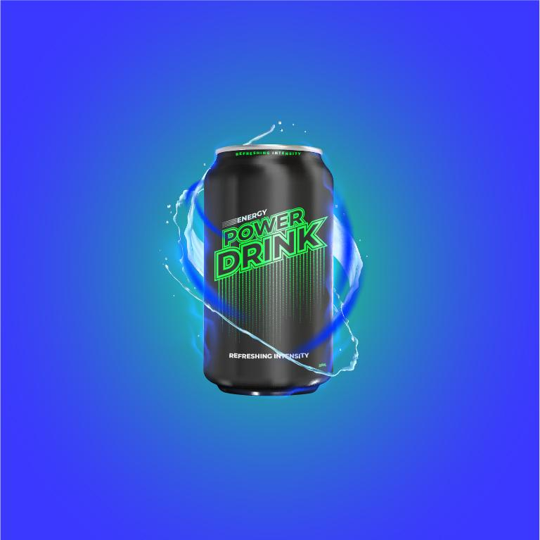

Slide 5
Component
Most energy drinks contain large amounts of caffeine, added sugar, vitamins such as B vitamins, legal stimulants such as guarana (a plant that grows in the Amazon region), taurine, an amino acid naturally found in meat and fish, and carnitine, a substance found in the body that helps regulate metabolism. Converting fat into energy
3

Slide 6
Desirable Effects
It gives the body a relatively high dose of nutrients from the most effective compound, caffeine, which is one of the most common nervous system stimulants in human food.
Caffeine reaches its highest levels in the blood 12-30 minutes after ingestion,
4

Slide 7
Side Effect
1. Energy drinks are bad for heart:
Caffeine is the main ingredient in energy drinks thanks to its ability to increase alertness. When caffeine is taken in large amounts over 400 mg per day, it can cause heart palpitations, high blood pressure, increased heart rate, and heart rhythm disturbances.
5

Slide 8
Side Effect
2. Energy drinks are high in sugar:
Most energy drinks contain about 27 to 31 g of sugar per eight ounce serving. The American Heart Association recommends no more than 25g of sugar, or 6 teaspoons per day for women, (36g of sugar), or nine teaspoons per day for men. By this measure, a 24-ounce energy drink contains three times the daily recommended amount of sugar.
6

Slide 9
Side Effect
3. It is not permissible to mix energy drinks with alcohol:
Energy drinks are often mixed with alcohol, especially among young adults. When combined with alcohol, energy drinks can alter intoxication levels, making an individual feel less intoxicated and energetic while still experiencing signs of alcohol impairment, such as slurred speech, confusion of coordination and poor memory.
7

Slide 10
Side Effect
4. Energy drinks are harmful to teenagers
Musa says energy drinks are especially harmful for teens who are developing and can't deal with the side effects of energy drinks.
8

Slide 11
Natural alternative
Natural alternatives to energy drinks
coffee
tea
water
take vitamins
Almond
Bee's honey
9

Slide 12
Summary
Its first brand appeared in 1977 in the United States of America
energy drinks contain large amounts of caffeine
Caffeine reaches its highest levels in the blood 12-30 minutes after ingestion
Energy drinks are high in sugar has bad effect on heart .
10

Slide 13
References
Alsunni AA. Energy Drink Consumption: Beneficial and Adverse Health Effects. Int J Health Sci (Qassim). 2015;9(4):468-474.
Wolk, Brian J.a; Ganetsky, Michaelb; Babu, Kavita M.c Toxicity of energy drinks, Current Opinion in Pediatrics: April 2012 - Volume 24 - Issue 2 - p 243-251
11

Slide 14
Thank you
12

