Slide 1



Technology and Nature Impact on Marketing
Libyan International Medical University
BY:MARWAN FOUAD ELOSHIPI
ID:3782
EMAIL: marwan_3782@limu.edu.ly

Slide 2
Table of Contents
02
03
04
Technological Environment
01
Impact
Technological Factors
Natural Environment
Impact
Environmental Factors
Conclusion
References
2

Slide 3

“The total of all things external to firms and industries that affect the function of the organization is called business environment”-wheeler.
Business Environment
3

Slide 4

Technological Environment
01
Impact
Technological Factors
4

Slide 5

Technological Environment Impact
Technology often helps businesses improve their own internal processes, but technological developments that occur in the general environment also shape how businesses operate. Depending on the organization, these improvements can negatively or positively affect their operations.
Marketers with the help of technology can create and deliver products matching the life style of customers. Therefore marketers should observe the changing trends in technology.
5

Slide 6
Technological Factors
In PESTLE analysis, technological factors are variables which relate to the existence, availability, and development of technology. This could include things from computational power to engine efficiency.
Example: The technological factors impact on Apple:
Growing demand on mobile technology will make the pc’s a less attractive product.
Competitors find little struggle in recreating many of Apple’s product.
6

Slide 7

Natural Environment
02
Impact
Environmental Factors
7

Slide 8

Natural Environment Impact
The natural environment is another important factor of the macro-environment. This includes the natural resources that a company uses as inputs that affects their marketing activities. The concern in this area is the increased pollution, shortages of raw materials and increased governmental intervention.
8

Slide 9
Environmental Factors
In PESTLE analysis, environmental factors [ecological factors] refers to variables regarding the physical environment (the climate of Earth, for example). This can include things like consumer health, climate change, or any direct consequences of these things.
Example: The environmental factors affects on UAE:
The UAE has a hot, arid climate. Resultingly, the productivity of workers might not be as high, and air conditioning systems may have a larger market.
The United Arab Emirates is situated near several coastal areas, allowing for convenient sea based trade.
9

Slide 10
Conclusion
Marketers should observe the changing trends in technology.
Technological factors are one of many external factors that can affect businesses.
New technology has affected other businesses both positively and negatively.
The natural environment gives us a wealth of services that are difficult to measure in dollars.
10

Slide 11
References
PESTLE Analysis: Environmental Factors Affecting Business. (2022). Retrieved 6 April 2022, from https://pestleanalysis.com/environmental-factors-affecting-business/amp/#What_are_Environmental_Factors
(2022). Retrieved 6 April 2022, from https://www.shivajicollege.ac.in/sPanel/uploads/econtent/d39b61fcece4f18a9064b1e7e36ef870.pdf
Business Environment: Nature and Significances of Business Environment. (2022). Retrieved 6 April 2022, from https://www.yourarticlelibrary.com/business/business-environment-nature-and-significances-of-business-environment/23367
11

Slide 12
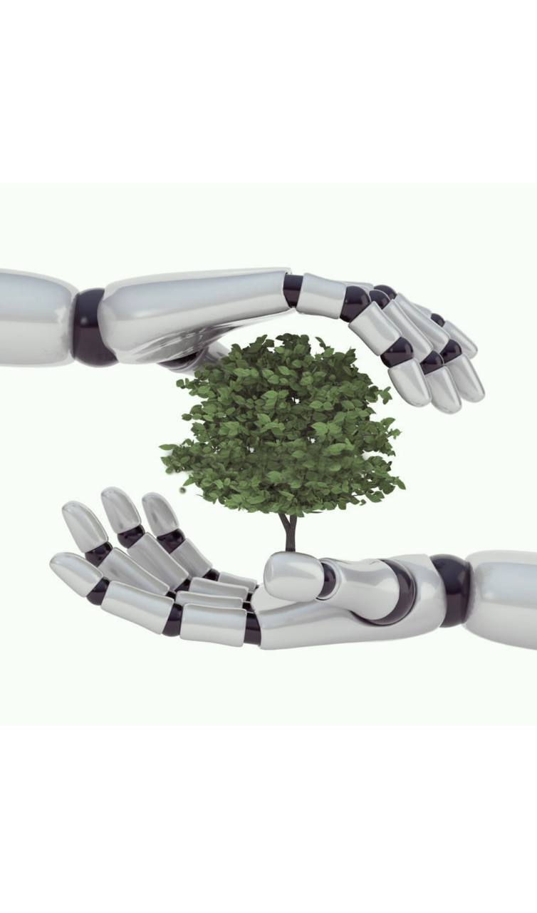
THANKS!
Do you have any questions?

