Slide 1



Effect food and water insecurity on mental health.
Presented by Hajir Elfarsi
Student number:2815
2nd year AMS
PTS
Date: 16\5/2022
1

Slide 2



introduction
2

Slide 3
Objectives
- Define mantel health.
- Define food and water insecurity and outline it’s causes.
- Discuss effect food and water insecurity on mantel health.
- List solution to food and water insecurity.
3

Slide 4

According to WHO
Mental health: is a state of well-being in which every individual realizes his or her own potential, can cope with the normal stresses of life, can work productively and fruitfully, and is able to make a contribution to her or his community.
4

Slide 5


Food and water insecurity
are the inability to afford enough food and water for an active and healthy life. Because of lack of money, lack of affordable housing and other resources.
5

Slide 6
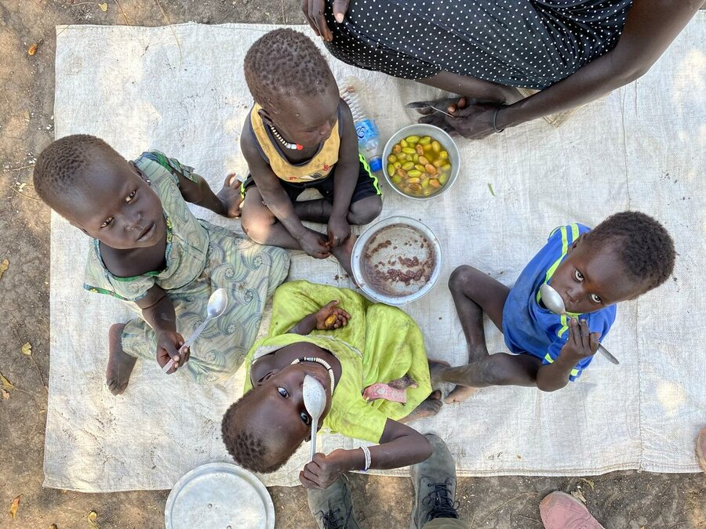
6

Slide 7
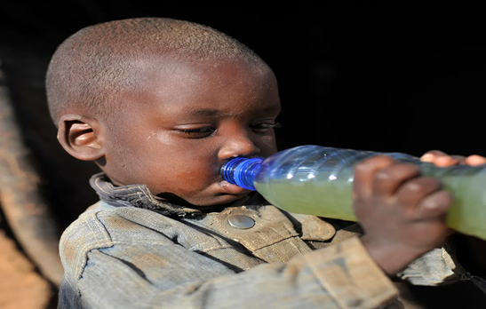
7

Slide 8
How poor nutrition affects mental health?
8

Slide 9
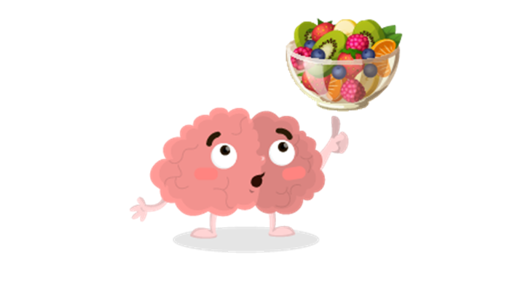
- In one 2018 study of over 3,000 adults, those who drank more water had a lower risk of anxiety and depression than those who drank less water.
- Though the connection between dehydration and depression was stronger, researchers found that anxiety was higher in those who didn't drink enough water.
9

Slide 10
Causes of food and water insecurity
1. Conflict, Violence and Wars:
Conflicts, wars, and other forms of violence have an impact on food production and distribution. Food water insecurity is very high in most nations that have experienced civil war throughout the years.
10

Slide 11
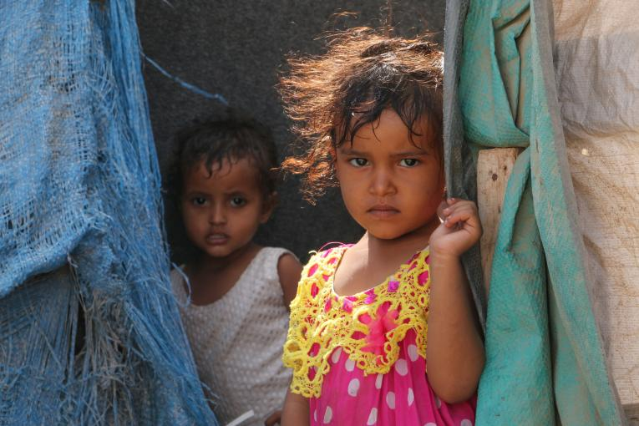
11

Slide 12
2. Fast-paced Population Growth:
Despite the increased death rates, the birth rate is higher. The rise in population, with only a limited amount of food available for growth, means an increase in food insecurity.
3. Natural Disasters :
Droughts, floods, cyclones, and other natural calamities can obliterate or destroy an entire harvest.
12

Slide 13
4.Wastage of Food:
for example, during the coronavirus pandemic, farmers are throwing away billions of foods since restaurants and supermarkets were closed, which used to buy such edible foods.
5. Climate Change.
6. Lack of money.
7. pollution of water :
Oil, to carcasses, to chemicals, and fecal matter. it makes a lot of issues for the people who may need to use it.
13

Slide 14
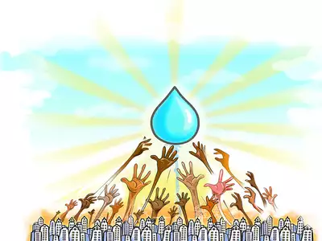
solution to food and water insecurity
1. Reduce Food Waste .
2. Reduce the Risk of Commercializing .
3. Improve Existing Infrastructural Programs.
4. Improve Trade Policies .
5. Close the Yield Gap .
6. Work Towards Defeating Climate Change .
14

Slide 15
7. Save Water Whenever Possible .
8. Advance Technology Related to Water Conservation .
9. Less Use of Chemicals in Farming .
10. Improve Sewage Systems .
11. Support Clean Water Initiatives .
15

Slide 16
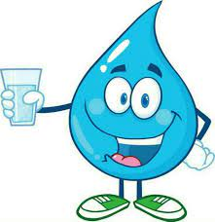
Conclusion
Drinking of water can prevent dehydration, increase energy and promotes weight loss .
A food can provides nutrient .nutrients are substances that provide energy for activity, growth and all function of the body.
A healthy, well balanced diet and adequate amount of water can help us think clearly and feel more alert.
16

Slide 17
1. Dehydration and Anxiety: Understanding the Connection. Healthline. https://www.healthline.com/health/anxiety/dehydration-and-anxiety. Published 2022. Accessed May 14, 2022.
2. Causes, Effects and Solutions to Water Scarcity (Water Deficit) - Conserve Energy Future. Conserve Energy Future. https://www.conserve-energy-future.com/causes-effects-solutions-of-water-scarcity.php. Published 2022. Accessed May 14, 2022.
3. Food Insecurity | Healthy People 2020. Healthypeople.gov. https://www.healthypeople.gov/2020/topics-objectives/topic/social-determinants-health/interventions-resources/food-insecurity#1. Published 2022. Accessed May 14, 2022.
References
17

Slide 18
Thanks
18

