Slide 1



Consumer Market
BY : SALEM IBRAHIM OSMAN
ID : 3799
Email:salem_3799@limu.edu.ly

Slide 2


Definition.
Significance.
World Largest Consumer Markets.
Characteristic.
Examples.
Conclusion.
References.
2

Slide 3
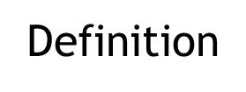

What is Consumer Market?
The consumer market is made up of end consumers who do not resell their products or services. There are products and consumers everywhere in the market.
Whenever a person buys a product, then he becomes a part of the consumer market. We can classify the whole consumer market into four types; retail, transportation, food, and beverages (drinks). Buyers usually make their own decisions whenever they want to buy something in the market.
3

Slide 4

Significance of Consumers
The consumer market is comprised of buyers, and when they keep expending products and services. The businesses thrive since of it; the economy of the country develops as a result.
In basic words, when people spend products, at that point producers and business people produce and provide more products in the market. As a result, the running cycle of production and utilization contributes to the national economy of the entire country.
4

Slide 5
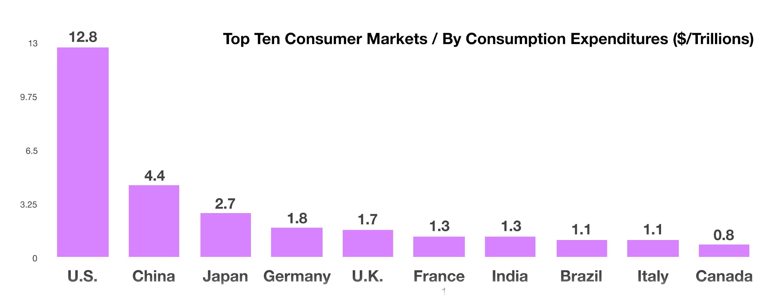
World Largest Consumer Markets
US Consumer Market.
US is one of the biggest consumer markets in the world comprising of 325 million people, and their add up to contribution to the country’s GDP is around 20 trillion US dollars. It ranges from a variety of products and services, households products are at the top of the list
The US includes a free trade agreement with roundabout over 20 countries which are encouraging millions of buyers around the world.
5

Slide 6
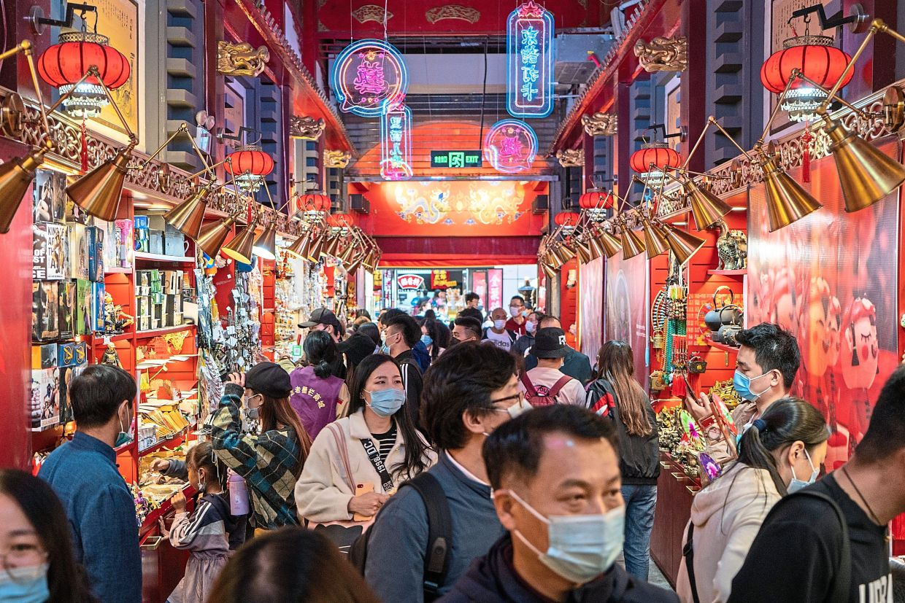
World Largest Consumer Markets
Chinese Consumer Market.
The consumer market of China has reliably been growing for the past few years; utilization is the main part of it. In 2018, the whole contribution of Chinese customers in the country’s economy was 78%. The figure has developed 13.8% since then.
6

Slide 7

Characteristic of Consumer Markets
Having talked about it earlier that the consumer market is comprised of consumer and buyers, and these people are from diverse backgrounds and they have different choices and preferences. Marketers make different segments of the market based on their tastes and choices. In other words, those segments are the characteristics of the customer market.
7

Slide 8

Demographic Consumer Markets
Demographic characteristics mean consumers’ age, salary, social and financial background, gender, size of their family, ethnicity, religion, culture, education level, job type, social class, and nationality. Marketers collect all of such information through a overview, telephonic interviews, and from the local public office where such information is easily available.
Not only they collect information, but they also study each part in detail. At that point they also make different ranges like; age would be 18 to 25. Their salary would drop between 1500 to 2500 dollars, which tell us their social class.
The reason of collecting well-detailed data is to target absolutely those segments of the market. For instance, telephonic calls and SMS packages would interest the young market falling in the age from 18 to 25.
8

Slide 9
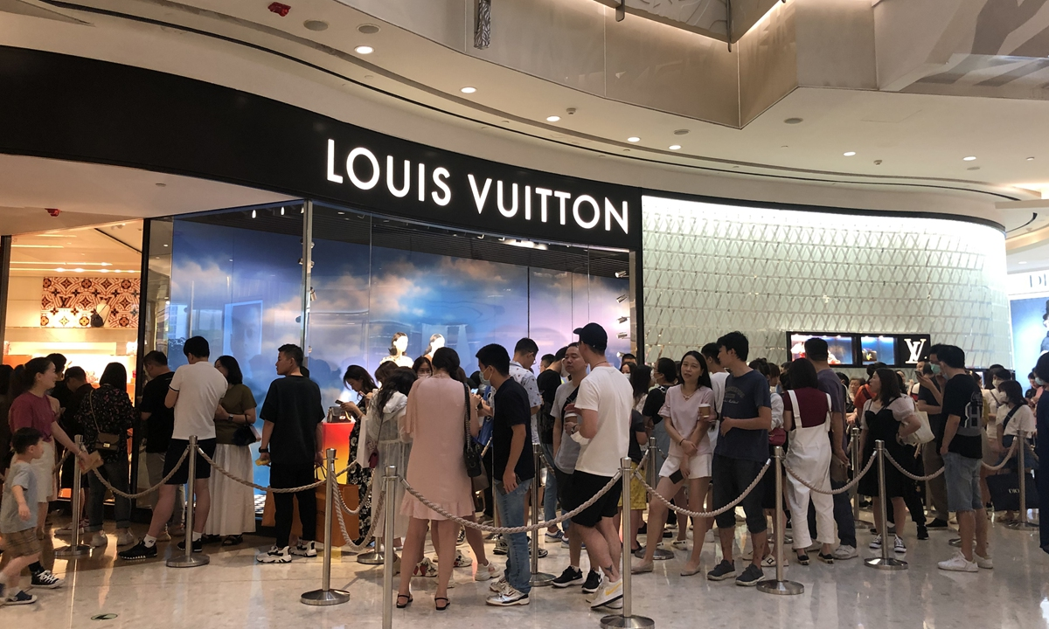
Examples of Consumer Markets
Food, drinks, beverages, legal, health and financial services, clothes, electronic stuff, and its accessories and many others, these all are the examples of consumer markets where buyers purchase products or services for the sake of the consumer, instead of buying things to resell it.
9

Slide 10

Marketing and advertising play a really critical part in affecting the buying choice of the customers; it tells them which product to choose by teaching them about the product. When it comes to choosing the product, people prefer brand products because of the loyal. Brand loyalty doesn’t just happen; marketers do a lot of investigate to discover relevant information about their advertise and after that target them through TV advertisements and other special activities.
The consumer market is totally different from the business market because of the difference within the marketing technique. Marketers isolate the customer market into diverse segments depending upon the characteristics, demographics, and behavior and psychographic of the customer. After isolating the market into different segments, they target the interest, likes, and dislikes opinion and values of the customers.
10

Slide 11
References
What are Consumer Markets? - Definition, Characteristics & Examples. (2022). Retrieved 13 April 2022, from https://www.marketingtutor.net/what-are-consumer-markets/
11

Slide 12


