Slide 1


The Types of Organizational Structures
Libyan International Medical University
Faculty of Business Administration
By : Fatima Alzhraa Almkahl 3190
fatimaalzhra_3190@limu.edu.ly

Slide 2
Objectives
What is a tall organization
What is a flat organization
The advantages of tall organization
The advantages of flat organization
The disadvantages of tall organization
The disadvantages of flat organization
What Are the Four Types of Organizational Structures
02

Slide 3
Contents
01
02
Introduction
Tall and Flat Structures
03
04
Conclusion
References
Type OF Organisation Structures
05
03

Slide 4
01
Introduction
04

Slide 5
Introduction
When running a business, the structure you adopt can have a big impact on how well you achieve your objectives. Business owners use two sorts of employment structures: tall organizational structures and flat organizational structures. Understanding the benefits and drawbacks of both tall and flat organizational structures will assist you in determining which is best for your company.
05

Slide 6
02
Tall and Flat Structures
06

Slide 7
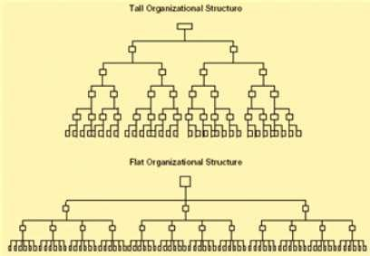
What is Tall Structures?
Tall organizations
A tall organization is one in which the leadership standards are vertical, with the CEO or owner as the most powerful member, setting goals, company culture, and business strategy. Complex organizations frequently necessitate a higher structure
07

Slide 8
What is a flat Structures?
Flat organization
Flat businesses focus on empowering employees rather than adhering to the chain of command because they have fewer management layers. Flat structures try to tap into employees` creative talents and solve challenges through collaboration by enabling autonomy and self-direction
08

Slide 9
the advantages and disadvantages of tall organizational structure
Advantages | Disadvantages
Narrower spans of control Roles and responsibilities are clearly defined and everyone know their role | Longer lines of communication Subordinates feel less motivated as there are so many managers
09

Slide 10
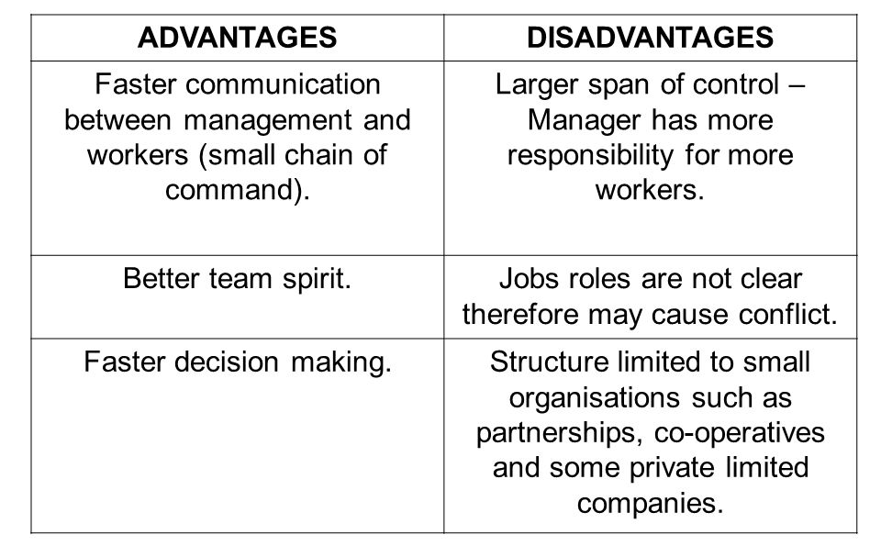
the advantages and disadvantages of flat organizational structure
10

Slide 11
03
Type OF Organisation Structures
11

Slide 12
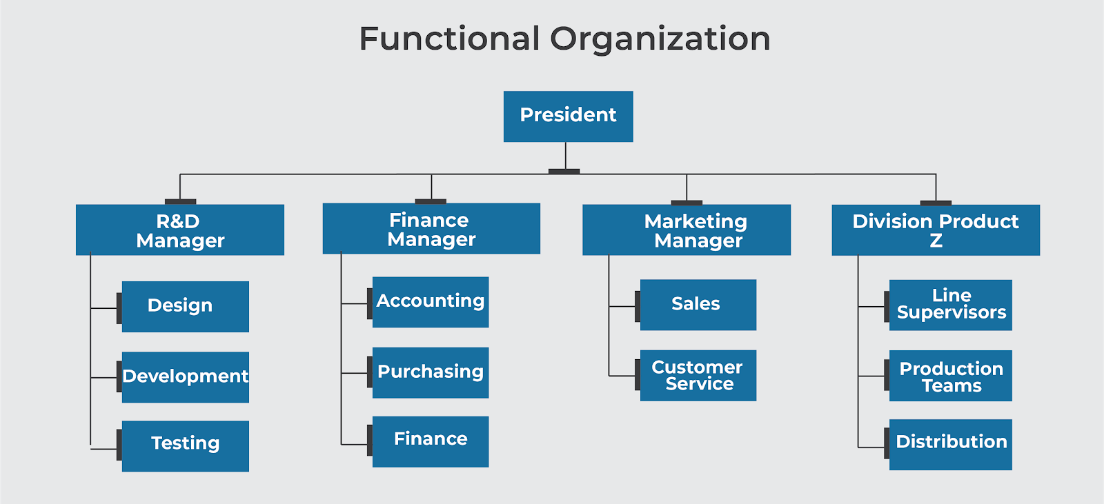
Functional Structure
A functional structure is a type of business structure that divides a company into departments based on their areas of expertise. These departments function as functional units, and they are led by functional managers or department heads. Team members in each department report up the chain of command to department heads, who then report to the company's top management on the status of their functional areas.
12

Slide 13

Bureaucratic Structure
The most of large and complex organizations in government and business use a bureaucratic structure, and understanding bureaucratic structure will help you understand how the government and large corporations work. The structure is hierarchical, which means there are clearly ordered levels of management , where lower levels are subordinate or answerable to higher levels.
13

Slide 14
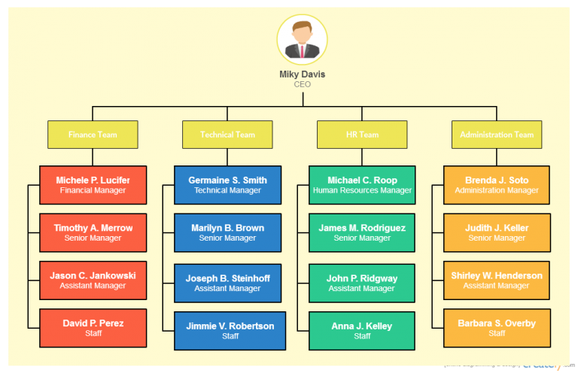
Hierarchical Structure
In a hierarchical organization structure, employees are grouped with every employee having one clear supervisor. The grouping is done based on a few factors, hence many models derived from this
14

Slide 15
04
Conclusion
15

Slide 16
Conclusion
Putting in place an organizational structure can be highly beneficial to a business. The structure not only defines a company's hierarchy, but it also allows the company to lay out its employee pay structure. By establishing an organizational structure, the company can determine salary grades and ranges for each position.
16

Slide 17
References
Kenton, W. (2022, February 08). How organizational structures work. Retrieved April 27, 2022, from https://www.investopedia.com/terms/o/organizational-structure.asp#toc-types-of-organizational-structures Author Nishadha Software engineer turned tech evangelist. I handle marketing stuff here at Creately including writing blog posts and handling social media accounts. In my spare time I love to read and travel. Check out my personal blog, Nishadha Software engineer turned tech evangelist. I handle marketing stuff here at Creately including writing blog posts and handling social media accounts. In my spare time I love to read and travel. Check out my personal blog Rumbling Lankan wher, Nishadha, Software engineer turned tech evangelist. I handle marketing stuff here at Creately including writing blog posts and handling social media accounts. In my spare time I love to read and travel. Check out my personal blog Rumbling Lankan where I write about, & View all posts by Nishadha →. (2021, September 23). 7 types of organizational structures for companies. Retrieved April 27, 2022, from https://creately.com/blog/diagrams/types-of-organizational-charts/ MasterClass. (2021, December 17). Functional structure: 3 characteristics of functional structure - 2022. Retrieved April 27, 2022, from https://www.masterclass.com/articles/functional-structure#what-is-functional-structure

Slide 18
Thanks
Do you have any questions?
Please keep this slide for attribution

