Slide 1
Metabolic bone disease
Dr.Nadeia Elbagermi

Slide 2
Generalized decrease in bone density
(osteopenia):
The main causes of generalized decrease in bone density
are:
• Osteoporosis
• Osteomalacia
• Hyperparathyroidism
• Multiple myeloma.

Slide 3
causes of osteoporosis:
-Idiopathic
- juvenile
- postmenopausal
- senile
- Cushing’s syndrome
-Steroid therapy
- Disuse

Slide 4
Osteoporosis
Osteoporosis is the consequence of a deficiency of protein matrix (osteoid). (matrix is reduced in quantity).
In general, hallmark features of osteoporosis on radiography include thinned cortices, endosteal reabsorption, and a decrease in the number of trabeculae
Radiographic features: Spine and proximal extremities are primarily involved. Thin cortical bone, vertebral contour abnormalities (endplate compression, compression fractures.

Slide 5
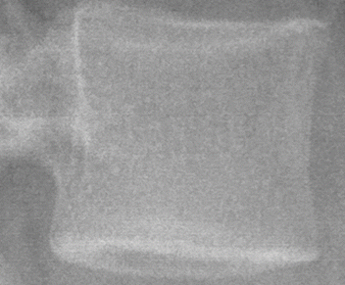
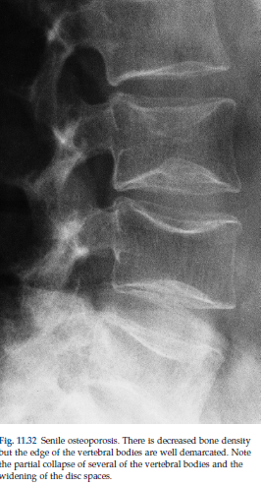
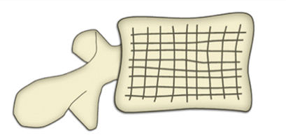
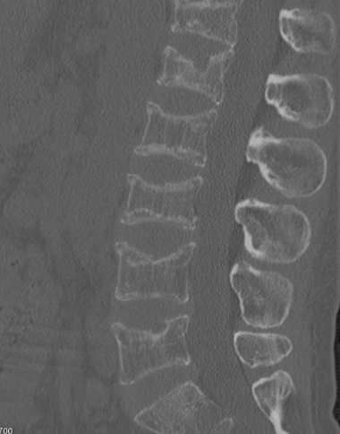
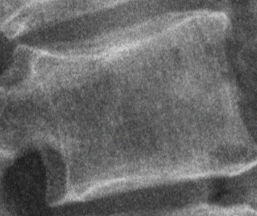
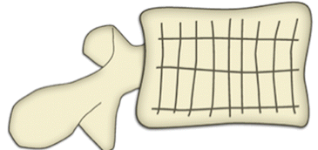
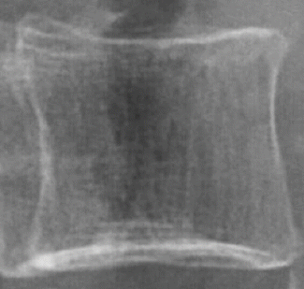
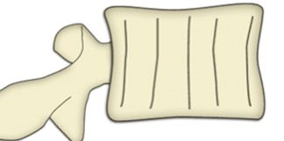

Slide 6
Imaging of osteoporosis even with the newest advances in quantitative imaging techniques, conventional radiography is still the most commonly used modality, although it usually detects pathology only after 30% of bone has been lost .
DXA (dual-energy x-ray absorptiometry .
Computed tomography.

Slide 7
Rickets and osteomalacia
Rickets and osteomalacia are similar histologically. The basic defect is inadequate osteoid mineralization, although osteoid production also is reduced.
If this occurs before epiphyseal closure, the condition is known as rickets
in adults the condition is known as osteomalacia. Regardless of the cause of the osteomalacia or rickets, thebone changes are similar
Causes of rickets and osteomalacia:
Decreased production of endogenous vitamin D.
– dietary deficiency
– lack of exposure to sunlight
• Impaired absorption of calcium or vitamin D:
– malabsorption
– chronic renal failure: impaired ability to activate vitamin D.

Slide 8
In rickets are best seen at the knees, wrists and ankles.
the metaphyses are irregularly mineralized, widened and cupped.
generalized decrease in bone density.
Deformities of the bones occur because the under mineralized bone is soft.
Greenstick fractures are common.

Slide 9
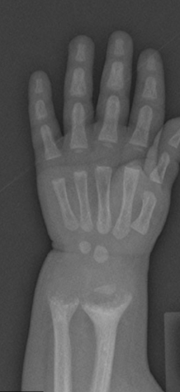
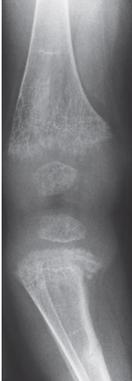
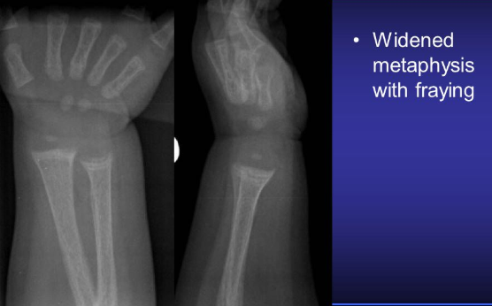
Fraying: indistinct margins of the metaphysis
splaying: widening of metaphyseal ends
cupping: concavity of metaphysis

Slide 10
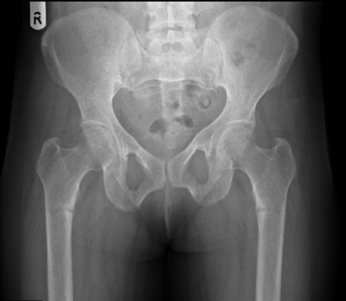
Features of adult osteomalacia include osteopenia, pseudo fractures, and bone deformity such as bowing , protrusion acetabuli
Pseudo fractures are considered pathognomonic. Pseudo fractures are typically bilateral and symmetrical. Common locations include the femoral necks, pubic symphysis, ribs, and scapula.

Slide 11
Hyperparathyroidism
Excess parathyroid hormone secretion mobilizes calcium
from the bones, resulting in a decrease in bone density.
Hyperparathyroidism may be primary, from hyperplasia or a tumour of the parathyroid glands, or secondary due to chronic renal failure

Slide 12
Hyperparathyroidm:
The signs of hyperparathyroidism in the bones are
A generalized loss of bone density.
The hallmark of hyperparathyroidism is subperiosteal
bone resorption which occurs particularly in the
hands on the radial side of the middle phalanges and at the
tips of the terminal phalanges.
Soft tissue calcification, vascular calcification and chondrocalcinosis.
Brown tumours are occasionally present. These are lytic
lesions, which may be single or multiple, vary in size and
may expand the bone. They occur most commonly in the
mandible and pelvis .

Slide 13
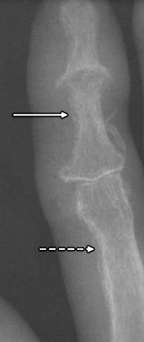
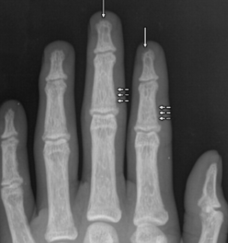
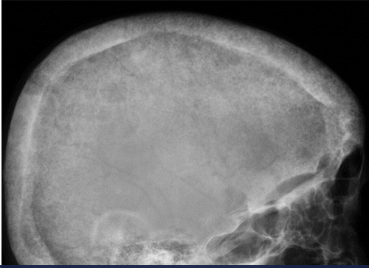
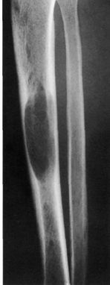
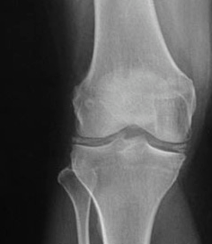
In the skull, bone resorption is described as a salt-and-pepper
resorption of the distal phalangeal tufts a finding consistent with acro-osteolysis

Slide 14
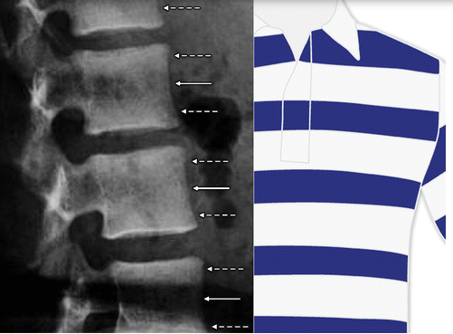
The spine often demonstrates a characteristic striped appearance (alternating bands of increased density along the endplates and decreased density in the central portion of the vertebral body), which is also known as the rugger jersey spine.

Slide 15
Paget disease :
Is a chronic disorder of unknown origin with increased breakdown of bone and formation of disorganized new bone.
The osteolysis can result in osteoporosis circumscripta in the skull and deformity and wedge fractures in long bones.
There is always enlargement of bone with coarse appearance of trabeculae.
Usually a mixed lytic-sclerotic .
pathognomonic triad :
Bone expansion
Cortical thickening
Trabecular bone thickening
Laboratory data may show elevated alkaline phosphatase and increased serum and urine hydroxyproline.

Slide 16
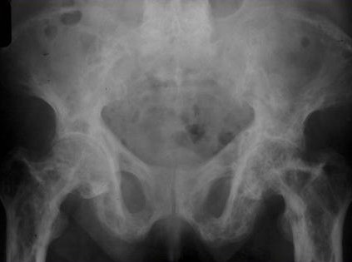
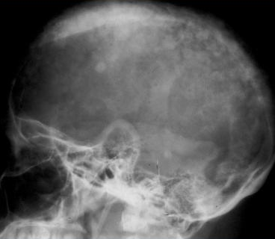
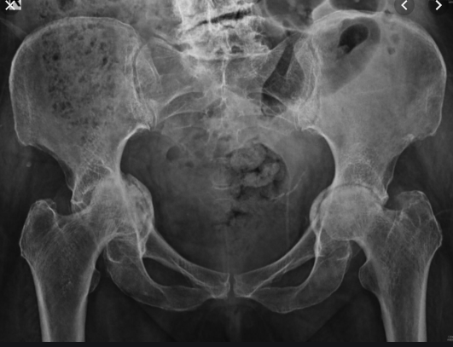
pathognomonic triad of :
Bone expansion
Cortical thickening
Trabecular bone thickening
cotton wool' appearance of the skull based on a mixed lytic and sclerotic pattern of Paget's disease.

Slide 17
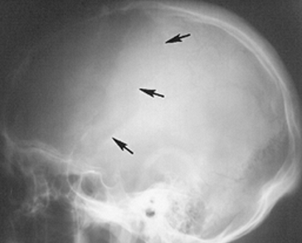
Initial stage | Predominately lytic with geographic lucent areas
 | Skull osteoporosis circumscripta
Mixed stage | Mixed lytic and sclerotic changes
Sclerotic stage | Cortical thickening, prominent trabeculae, medullary sclerosis
Malignant degeneration | Occurs in up to 10%: typically osteosarcoma or fibro sarcoma

Slide 18
THANK YOU

