Slide 1


Verbal and non-Verbal Communication
1
Libyan International Medical University
Faculty of Business Administration
Presented & Prepared by:
Heba N Bushiha 3285
Alaa S Rashwan 3313
Arwa F Ghaith 3275
Roua El.frgani 3169
Rose T Elgomati 3356
Submitted To:
Mr. Farag Elmegresi

Slide 2
01
02
03
04
CONTENTS
2
What is Verbal Communication?
Introduction
Types of Verbal Communication
Methods to Improve Verbal Communication
What is Non-Verbal Communication?
05
06
Types of Non-Verbal Communication
07
Methods to Improve Non-Verbal Communication
08
Conclusion
09
References

Slide 3
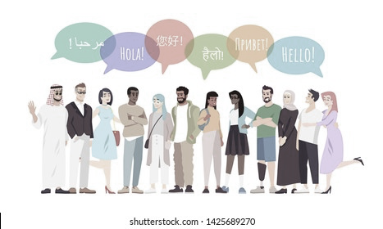
Introduction
3
In our daily lives, we communicate with each other verbally and non-verbally.
Obtaining strong non-verbal communication skills is beneficial for both our personal and private life. A lot can be said without words when communicating face to face. But let’s not also forget that effective verbal communication could be a key to maintain a successful business and personal relationships.

Slide 4
What is Verbal Communication?
4
Verbal communication is the usage of words or sounds to communicate with another person. The word verbal means words. The words don’t have to be said orally, they can be written or typed too. Laughter or sounds such as “umm”,” huh” and so on are not considered as verbal communication as they are not words, they are in fact a form of non-verbal communication.

Slide 5
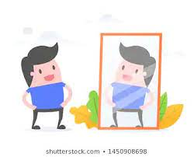
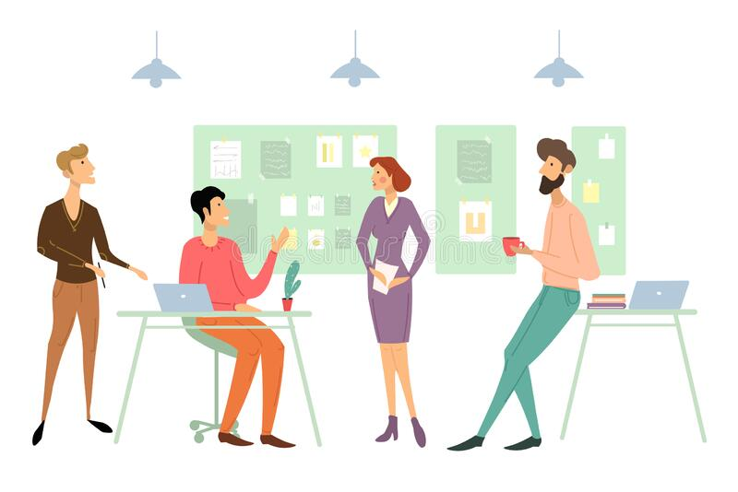
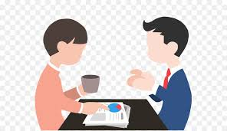
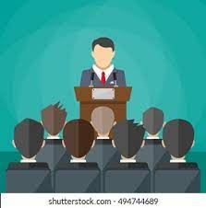
Types of Verbal Communication
Intrapersonal
Small-group communication
Public communication
Interpersonal
5

Slide 6
01
02
03
04
6
Methods to Improve Verbal Communication
Understand your audience
Think before speaking
Use brief language
Be aware of your tone
05
Employ active listening

Slide 7
06
07
08
09
7
Methods to Improve Verbal Communication
Show your authentic self
Speak with confidence
Practice your skills
Gain feedback

Slide 8
What is Non-Verbal Communication?
8
Non-verbal communication is the passing of information or sending information without the use of words. Non-verbal communication occurs through facial expressions, gestures, body language, tone of voice, and other physical indications of mood, attitude and approval. Some gestures may require knowledge of the culture to be understood. Non-verbal messages help manage impression using different strategies to achieve different impressions and form impressions of others.

Slide 9
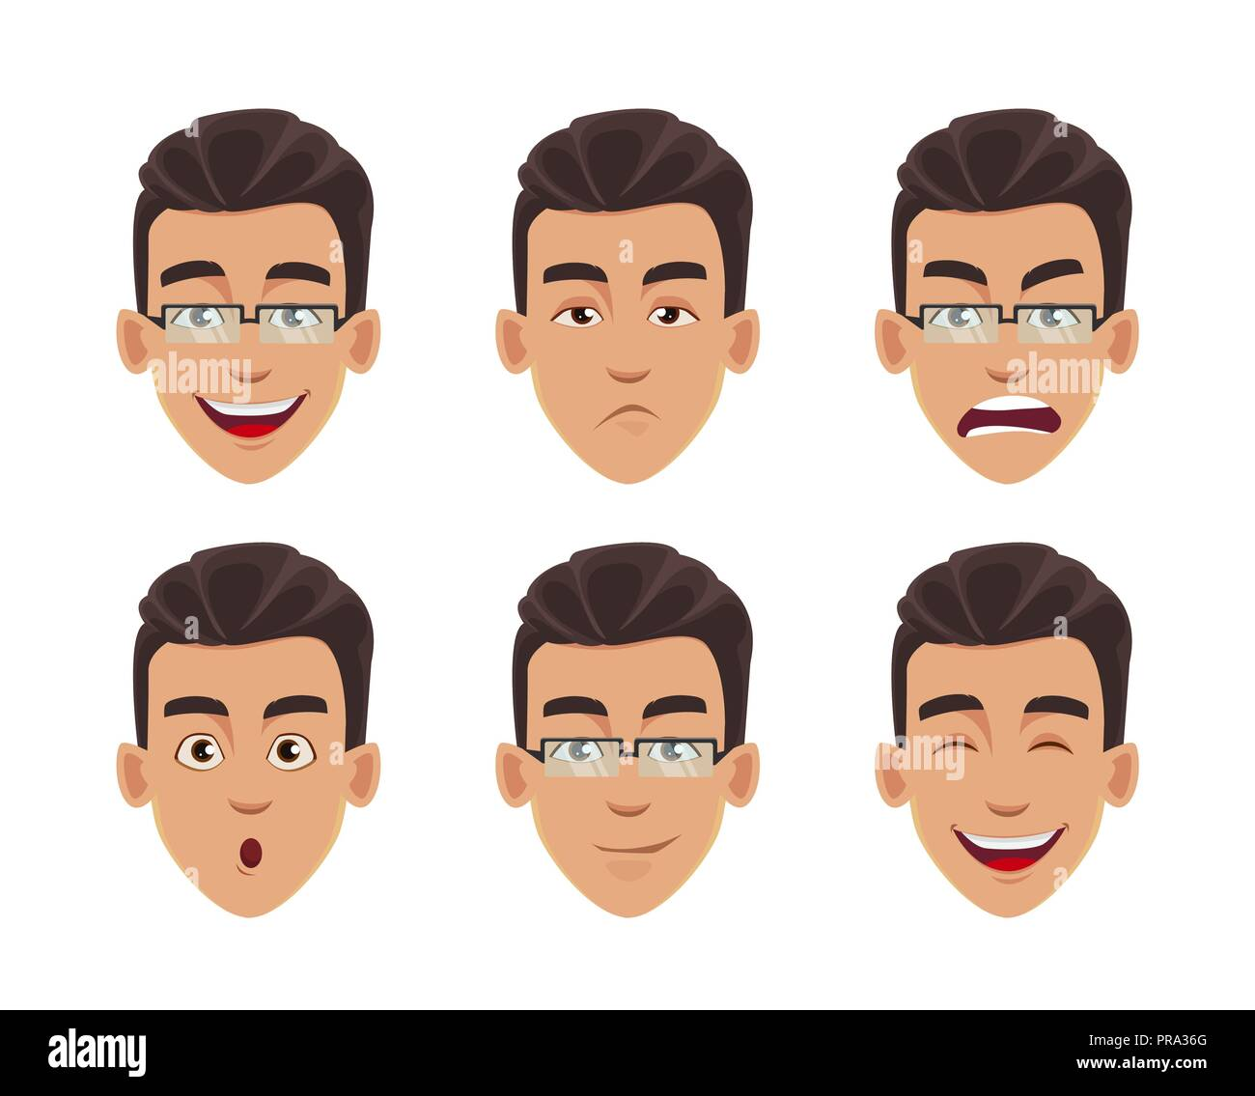

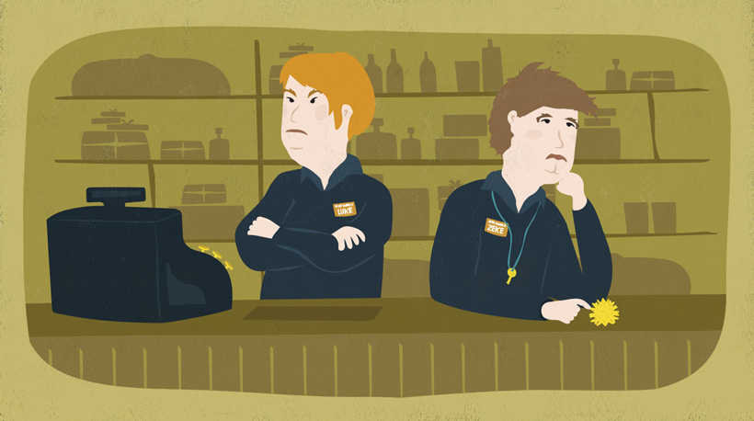
Types of Non-Verbal Communication
Facial expressions
Eye contact
Body movement and posture
9

Slide 10
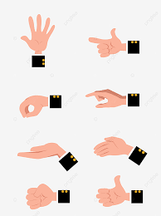
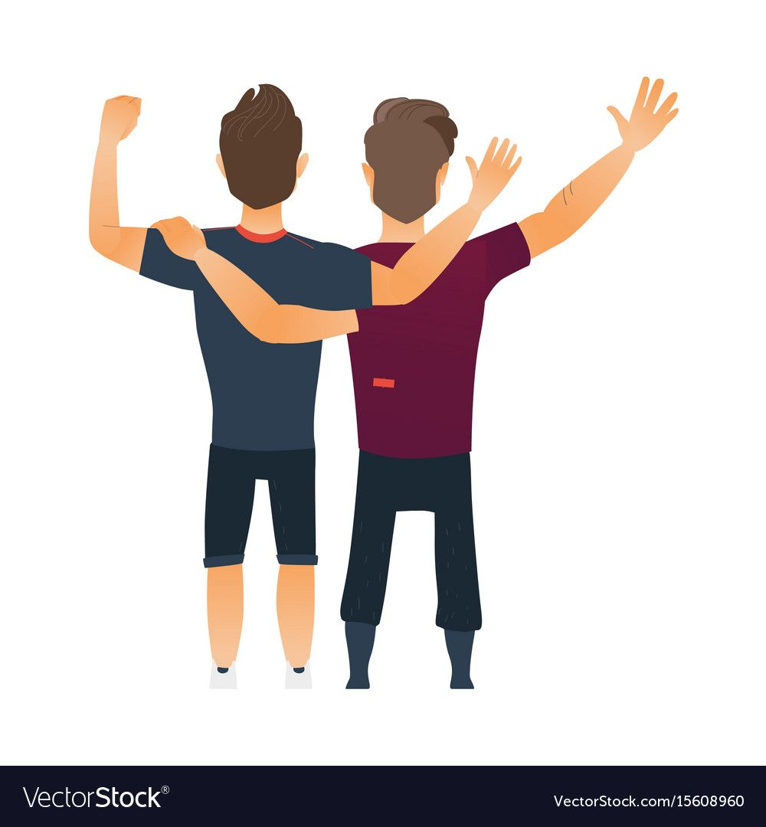

Types of Non-Verbal Communication
Touch
Gestures
Voice
10

Slide 11
02
01
03
04
11
Methods to Improve Non-Verbal Communication
Use signals to add meaning to your
Maintaining comfortable eye contact
Be aware that signals can be misread
consider the context

Slide 12
Conclusion
12
In conclusion, verbal and nonverbal communication are both important in several aspects of our daily lives, effectively communicating verbally and non-verbally establishes a better perspective on the message being sent. Non-verbal messages help manage impression and verbal messages help us in sending a certain message using words. Therefore, they both are required to co-exist to send a logical and effective message.

Slide 13
References
13
Verbal communication - definition, types, advantages, skills. AdmitKard. (2021, December 2). Retrieved December 7, 2021, from https://www.admitkard.com/blog/2020/02/11/verbal-communication/#Examples_of_Verbal_Communication.
American Psychological Association. (n.d.). Apa Dictionary of Psychology. American Psychological Association. Retrieved December 8, 2021, from https://dictionary.apa.org/nonverbal-behavior.
Take online courses. earn college credit. Research Schools, Degrees & Careers. Study.com | Take Online Courses. Earn College Credit. Research Schools, Degrees & Careers. (n.d.). Retrieved December 7, 2021, from https://study.com/academy/lesson/verbal-messages-definition-concepts-principles.html
http://www.indeed.com/career-advice/career-development/how-to-improve-verbal-communication-skills
Cherry, K. (2020, January 28). 10 ways to master the art of nonverbal communication. Verywell Mind. Retrieved December 8, 2021, from https://www.verywellmind.com/top-nonverbal-communication-tips-2795400.
Natoli, S. (2018, June 18). 6 ways to improve your non-verbal communication skills. Mental Health First Aid. Retrieved December 8, 2021, from https://www.mentalhealthfirstaid.org/external/2018/06/6-ways-to-improve-your-non-verbal-communication-skills/.
Melinda. (2021, July 15). Nonverbal communication and body language. HelpGuide.org. Retrieved December 7, 2021, from https://www.helpguide.org/articles/relationships-communication/nonverbal-communication.htm.

Slide 14
14
THANK YOU

