Slide 1

diabetes mellitus
Prepared By:
MUFTAH AL BURKi
SN : 3495
Block : PTS
;
1

Slide 2
whoa!
Diabetes is a major health issue that has reached alarming levels: today, nearly half a billion people are living with diabetes worldwide…
2

Slide 3
INTRODUCTION
The chronic metabolic disorder diabetes mellitus is a fast-growing global problem with huge social, health, and economic consequences. It is estimated that in 2010 there were globally 285 million people (approximately 6.4% of the adult population) suffering from this disease. This number is estimated to increase to 430 million in the absence of better control or cure.
Diabetes was first documented by the Egyptians and is characterised by weight loss and polyuria. However, it was the Greek physician Aertaeus who coined the term diabetes mellitus (DM).
In Greek, diabetes means "to pass through" and mellitus is the Latin word for honey (referring to sweetness). Diabetes is an important cause of prolonged ill health and premature mortality, and claims more lives per year than HIV-AIDS with nearly 1 death every 10 seconds .
3

Slide 4
Objectives
01
02
SYMPTOMS OF DIABETES
03
04
DIAGNOSIS OF DIABETES
05
06
TO DEFINE DIABETES AND THE MAIN TYPES .
THE EFFECTS OF DIABETES
TREATMENT OF THE CHOICE
PREVENTING DIABETES
4

Slide 5
01
Diabetes mellitus, more simply called diabetes, is a serious, long-term (or ‘chronic’) condition that occurs when there are raised levels of glucose in a person’s blood because their body cannot produce any or enough of the hormone insulin, or cannot effectively use.
5

Slide 6
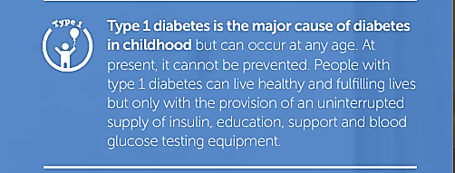
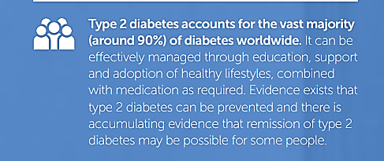
Diabetes Types
6

Slide 7
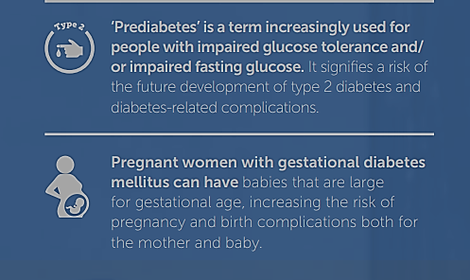
7

Slide 8
02 SYMPTOMS OF DIABETES
DIZZINESS
-
HUNGRY
THIRSTY
WEIGHT LOSS
NEUROPATHY
8

Slide 9
03 DIAGNOSIS OF DIABETES
- Person must have symptoms of diabetes
Plasma glucose above 200mg/dl.
Fasting blood glucose of 126 mg/dl.
HB A1C Above 7 .
9

Slide 10
04 THE EFFECTS OF DIABETES
Retinopathy
Increase risk of myocardial infarction
nonalcoholic fatty liver disease
renal failure
neuropathy
Abdominal pain and vomiting
10

Slide 11

05 Treatment of choice the best choice and the first is diet control and exercise
11

Slide 12
TREATMENT
INSULIN INJECTION
Insulin patch pumps
TABLETS
-FOR EXAMPLE Metformin.
- Syringe , that you fill with a dose of insulin.
-Small device filled with insulin that you wear on your belt or keep in your pocket.
12

Slide 13

06 preventing diabetes
Control weight.
Eat a healthy well-balanced diet.
Get regular exercise.
Have regular checkups.
Do not smoke!
Keep blood sugars normal.
13

Slide 14
CONCLUSION
We had a deep insight at diabetes and its causes risk , and now everyone of us knows the tips and tools for facing and preventing the disease for better life .
14

Slide 15

References'
1. Kaul, K., Tarr, J., Ahmad, S., Kohner, E. and Chibber, R., 2022. Introduction to Diabetes Mellitus.
2. 2022. [online] Available at: <https://www.semanticscholar.org/paper/Diabetes-in-Pregnancy.-Berger-Gagnon/e4f72a87abd4d408bc53538b7493d5c03dbe77d5> [Accessed 3 June 2022].
3. Your Bibliography: Niddk.nih.gov. 2022. [online] Available at: <https://www.niddk.nih.gov/- /media/Files/Diabetes/YourGuide2Diabetes_508.pdf> [Accessed 3 June 2022].

Slide 16
Thanks FOR YOUR ATTENYION!
Q &A

