Slide 1


Self-Awareness
Name: Ayah Kamal Elborky
Student Number: 3806
Email: ayah_3806@limu.edu.ly

Slide 2

CONTENT
Introduction.
Definitions.
Benefits.
Self awareness test.
Conclusion.
Refrances.
1

Slide 3

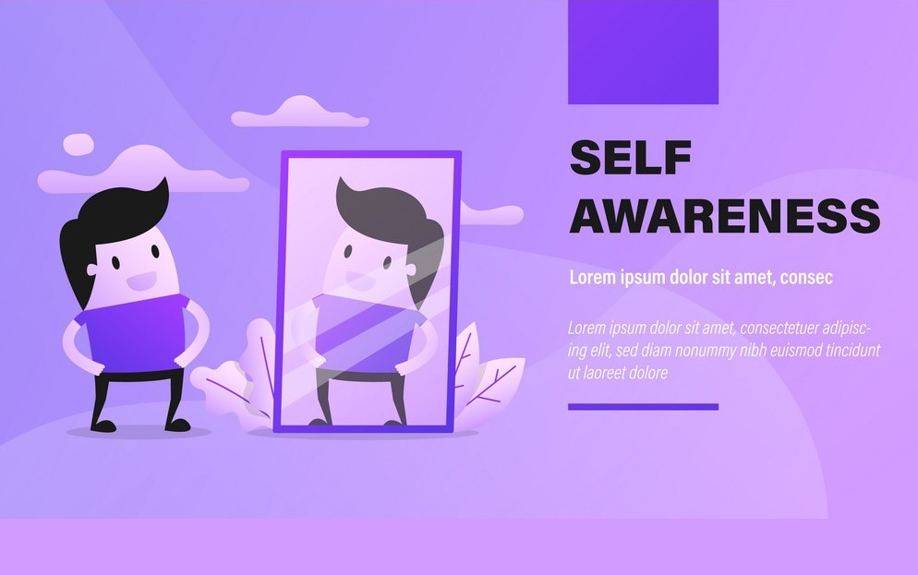

Introduction
Self awareness is the
ability to focus on
yourself and how
your actions or
thoughts do not
conform to internal
Standards
(Duval and weklund,
.1986)
$$2$$

Slide 4

DEFINE SELF AWARENESS:
It is the way we think or feel and
understand our own feelings and our
diverse blends.
3

Slide 5

1-improve mood.
2-reduces stress.
3-increases
self_confidence.
4-building better relationship.
makers.
5-it helps us become better decision
6-enhance effective communication skills.
4

Slide 6
Self awareness test:
There is a test to measure the degree of
your awareness, and this test consists of 12
questions.This test shows you the areas
that you must work on developing.
This test was explained by (Mike bundrant).
5

Slide 7

How to become more aware of yourself?
1-pay attention to what annoys you in others.
2-Read high_quality fictionat stories.
3-Take some small trips.
4-Gain anew skill.
5-Take time to clarify your own values
and goals.
6

Slide 8
Conclusion:
Self_awareness is not just a philosophical
matter.it is apersonal
needs all the time.As you become
more self aware,you will be able to
understand the world around you.
skill that
everyone
7

Slide 9
Refrence:
Live brighter. (2020, March 25). Verywells Mind.
https://www.verywellmind.com
BetterUp: The People Experience Platform. (n .d )
https://t.co/AMF9nqu5a0
8

Slide 10
Thank you ......
Any question?

