Slide 1


The Major Obstacles That Prevent the Effective Communication in Emotions
Libyan International Medical university
Faculty of Business Administration
Presented by : Alaa Rashwan
ID:3313
E-mail: alaa_3313@limu.edu.ly

Slide 2
Table of contents
Obstacles that prevent the effective communication of emotions
Introduction
Conclusion
References
2

Slide 3
Identify the major obstacles that could prevent the effective communication of emotions.
Learning Objective:
3

Slide 4
01.
Introduction
4

Slide 5
Introduction:
The expression of feelings is part of most meaningful relationships between people. Yet it’s often very difficult. Three major obstacles stand in the way of effective emotional communication: (1) society’s rules and customs, (2) fear, and (3) inadequate interpersonal skills. Let’s look more closely at each of these barriers.
5

Slide 6
02
Obstacles that prevent the effective communication of emotions
6

Slide 7

1. Societal and Cultural Customs:
If you grew up in the United States, you probably learned that many people frown on emotional expression. This attitude is especially prevalent in men and has been aptly called the “cowboy syndrome,” after a pattern of behavior seen in old Westerns on film and television (Balswick & Peck, 1971).
7

Slide 8
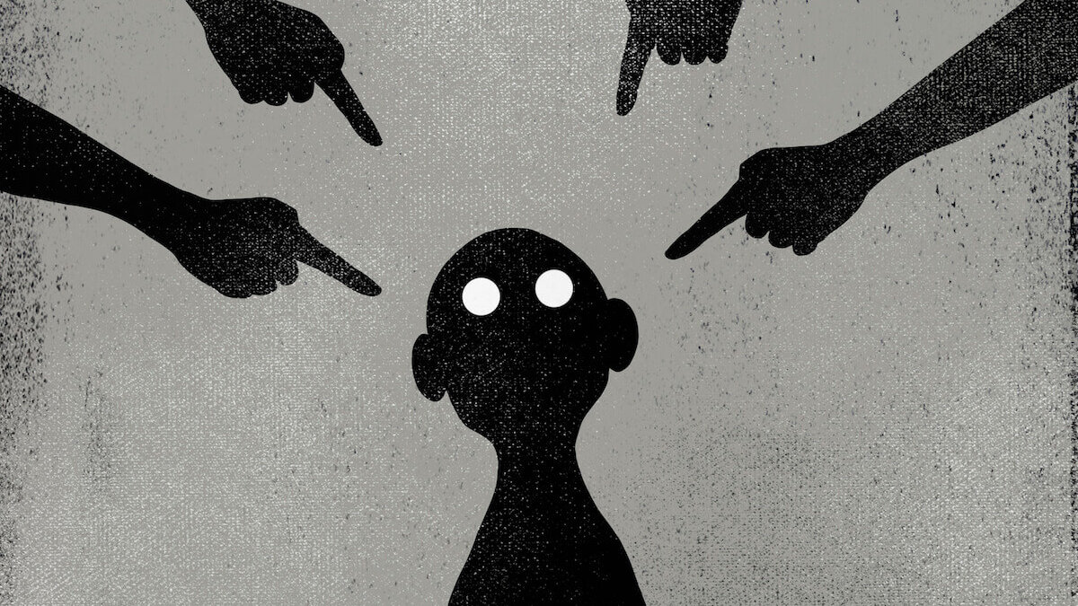
2. Fear:
A variety of types of fear stand in the way of emotional expression. This is true for both men and women but more so for men, who have greater difficulty expressing emotions (Zakowski et al., 2003). For example, you may be angry and want to say something but fear that you might hurt the person and then feel guilty yourself.
8

Slide 9
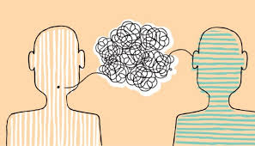
3. Inadequate Interpersonal skills:
Perhaps the most important obstacle to effective emotional communication is lack of interpersonal skills. Many people simply don’t know how to express their feelings. Some people, for example, can express anger only through violence or avoidance. Others can deal with anger only by blaming and accusing others.
9

Slide 10
Conclusion
03
10

Slide 11
Conclusion:
Emotions are part of your psychological life, emotional expression is part of your interpersonal life; it is not something you could avoid even if you wanted to. In specific cases, you may decide to hide your emotions.
11

Slide 12
References
04
12

Slide 13
Reference:
DeVito, Joseph A.-The interpersonal communication book-Pearson (2016).
13

Slide 14
Thanks!
Do you have any questions?
Alaa Rashwan
14

