Slide 1
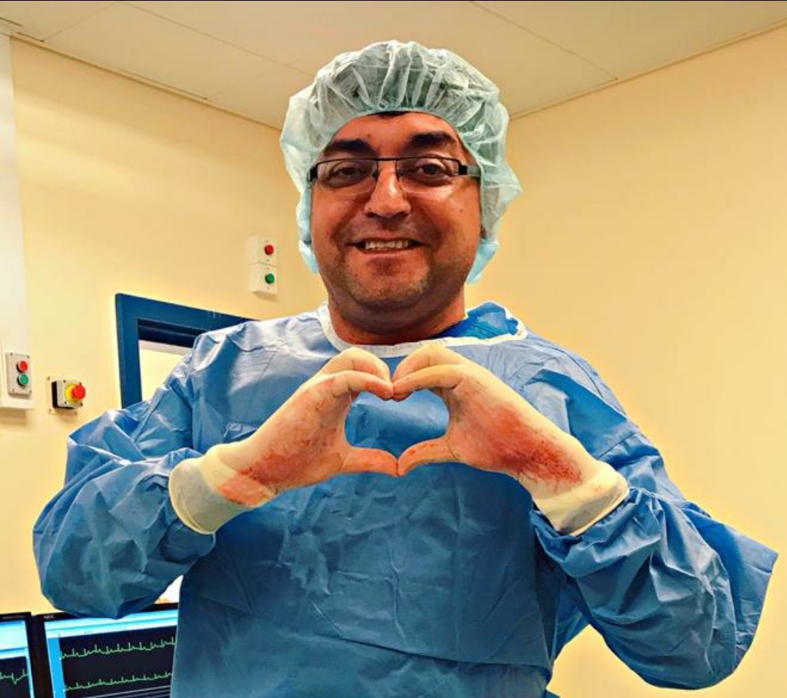
Myocarditis and cardiomyopathies
Dr . Zaki Bettamer
Zikoecho@yahoo.com

Slide 2
Myocarditis
This is an acute inflammatory condition that can have an infectious, toxic or autoimmune aetiology.
Viral infections are the most common causes
Coxsackie (35 cases per 1000 infections)
influenza A and B (25 cases per 1000 infections) viruses.

Slide 3
Myocarditis may occur several weeks after the initial viral symptoms and susceptibility is increased by
corticosteroid treatment & immunosuppression
radiation
previous myocardial damage
exercise.
Some bacterial and protozoal infections may be complicated by myocarditis

Slide 4
Toxic aetiologies include drugs (e.g. cocaine, lithium and anti-cancer drugs, such as doxorubicin)
(e.g. penicillins and sulphonamides, lead and carbon monoxide).
Occasionally, autoimmune conditions, such as SLE and Rh. A, are ass. with myocarditis.

Slide 5
Clinical features
Fulminant myocarditis follows a viral prodrome or influenza-like illness, and results in severe heart failure or cardiogenic shock.
Acute myocarditis presents over a longer period with heart failure; it can lead to dilated cardiomyopathy.
Chronic active myocarditis is rare and associated with chronic myocardial inflammation.
Chronic persistent myocarditis is characterised by focal myocardial infiltrates and can cause chest pain and arrhythmia without necessarily causing ventricular dysfunction.

Slide 6
investigations
ECG changes are common but nonspecific.
Biochemical markers of myocardial injury (e.g. troponin I and T, creatine kinase) may be elevated in the early phases.
Echocardiography may reveal left ventricular dysfunction that is sometimes regional (due to focal myocarditis).
cardiac MRI may show diagnostic patterns of myocardial inflammation or infiltration.
Endomyocardial biopsy is sometimes used to confirm the diagnosis.

Slide 7
Management and prognosis
In most patients is self-limiting & good prognosis.
death may occur due to a ventricular arrhythmia or rapidly progressive heart failure.
Myocarditis has been reported as a cause of sudden and unexpected death in young athletes.
Specific antimicrobial therapy may be used if a causative organism has been identified; this is rare,
in most cases only supportive therapy is available.
Treatment for cardiac failure or arrhythmias may be requiredظ
There is no evidence for any benefit from treatment with corticosteroids and immunosuppressive agents.
Rarely cardiac transplantation or temporary circulatory support with a mechanical ventricular assist device is required.

Slide 8
Cardiomyopathy

Slide 9
Defination
“A primary disorder of the heart muscle that causes abnormal myocardial performance and is not the result of disease or dysfunction of other cardiac structures … myocardial infarction, systemic hypertension, valvular stenosis ect…”

Slide 10
Case
A 58 year old man comes to your office complaining of three months of progressive fatigue and dyspnea on exertion. Several times in the past month he has awakened from sleep with severe breathlessness and felt a need to sit up in order to breath. He denies any chest pain or pressure. He also has noticed some ankle swelling. He has no past medical history of heart disease, hypertension or diabetes. His family history is negative for heart disease. He does not smoke and drinks alcohol only rarely. He takes no medications.
O/E: BP 105/70, P 98 regular, RR 20, Mild edema of both feet and ankles.
Carotids are low volume with normal upstroke, JVP elevated.
Lungs: Bibasilar rales.
Heart: A.B diffuse, palpable at the anterior axillary line, S1 diminished intensity, S2 normal, S3 is present, pansystolic murmur at the apex.
Abdomen: Liver is enlarged (span 11 cm) and slightly tender to pressure. Positive hepatojugular reflex, No ascites.

Slide 11
Diagnostic studies
ECG: NSR at 98 bpm. No specific findings
Imaging
Chest X-Ray: cardiomegaly and pulmonary congestion
Echocardiogram: Biventricular enlargement and global hypokinesia
*

Slide 12
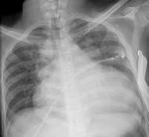
Chest X-Ray

Slide 13
Dilated Cardiomyopathy
Dilation of one or both ventricles
Globally impaired ventricular systolic function: both ventricles or predominantly the left ventricle. Isolated RV cardiomyopathy is rare.

Slide 14
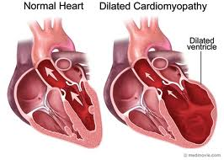
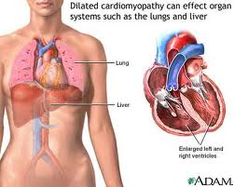
DCM
Clinical Features

Slide 15
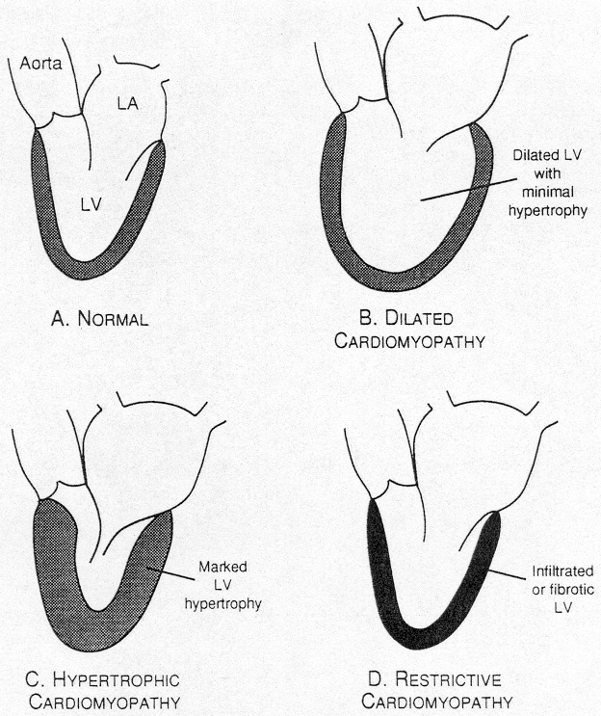
Cardiomyopathies

Slide 16
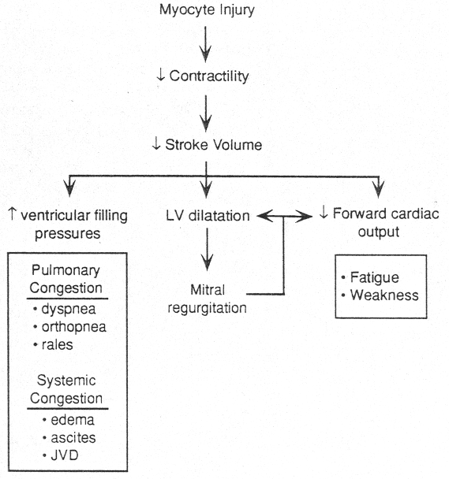
Systolic heart failure

Slide 17
Etiology of dilated cardiomyopathy
Idiopathic
Familial/genetic
Viral/other infectious agents (HIV)
Immune/autoimmune
Alcoholic/toxic (cocaine, chemotherapeutic drugs)
Infiltrative (hemochromatosis, sarcoidosis, amyloidosis)
Post partum

Slide 18
Natural History of Dilated Cardiomyopathy
Congestive heart failure
Arrhythmias (A fib, VT)
Sudden death
Thromboembolism
Chest pain

Slide 19
Diagnosis of Dilated Cardiomyopathy
Exclude other causes of contractile failure
(HTN, CAD, valvular disease).
Test for specific etiologies
?Percutaneous endomyocardial biopsy

Slide 20
Goals of Therapy in Dilated Cardiomyopathy
Alleviate symptoms of dyspnea
Improve exercise tolerance
Prevent progressive cardiac dilation (remodeling)
Prolong survival
Diuretics, ACE-I, ARB, BB, Digoxine, Aldactone, ….

Slide 21
Case
A 20 year old college man collapses on the basketball court during practice.
Despite prompt by stander initiated CPR and the arrival of paramedics within 4 minutes, multiple attempts at defibrillation and prolonged ACLS are unsuccessful and he is pronounced dead at a nearby hospital.
He has no history of ill health, syncope or dizzy spells and never used illicit drugs.
What is his autopsy likely to show?

Slide 22
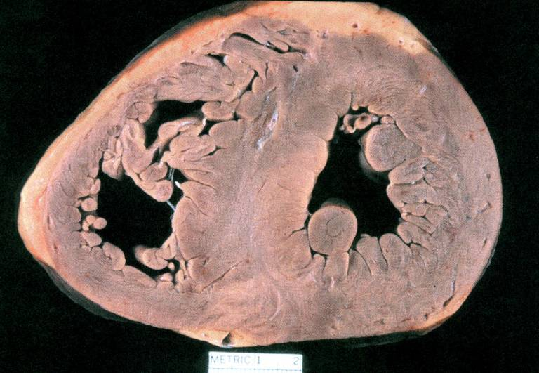
Cardiac autopsy

Slide 23
Types of Hypertrophic CM

Slide 24
Hypertrophic Cardiomyopathy
Left ventricular hypertrophy
Normal or supernormal contractile function
Impaired diastolic function: impaired diastolic relaxation and decreased LV compliance

Slide 25
Natural History of Hypertrophic Cardiomyopathy
Dyspnea on exertion
Chest pain
Syncope
Sudden death

Slide 26
Etiology of Hypertrophic Cardiomyopathy
Mutations in sarcomeric contractile protein genes
β-myosin heavy chain, cardiac troponin T and I, α-tropomyosin, cardiac myosin binding protein C, essential light chain, myosin regulatory light chain
Familial (autosomal dominant with variable penetrance) or sporadic
Some mutations are associated with particularly high risk of sudden death

Slide 27
Diagnosis: Physical Findings in Hypertrophic Cardiomyopathy
JVP:Prominent “a” wave
A B : LV heave, double apical impulse (palpable “a” wave)
Heart sounds: Loud S4

Slide 28
Diagnostic Tests in Hypertrophic Cardiomyopathy
ECG: LVH with “strain” pattern
Chest Xray: Usually normal
Imaging:
Echocardiogram
Radionuclide ventriculogram
Contrast left ventriculogram

Slide 29
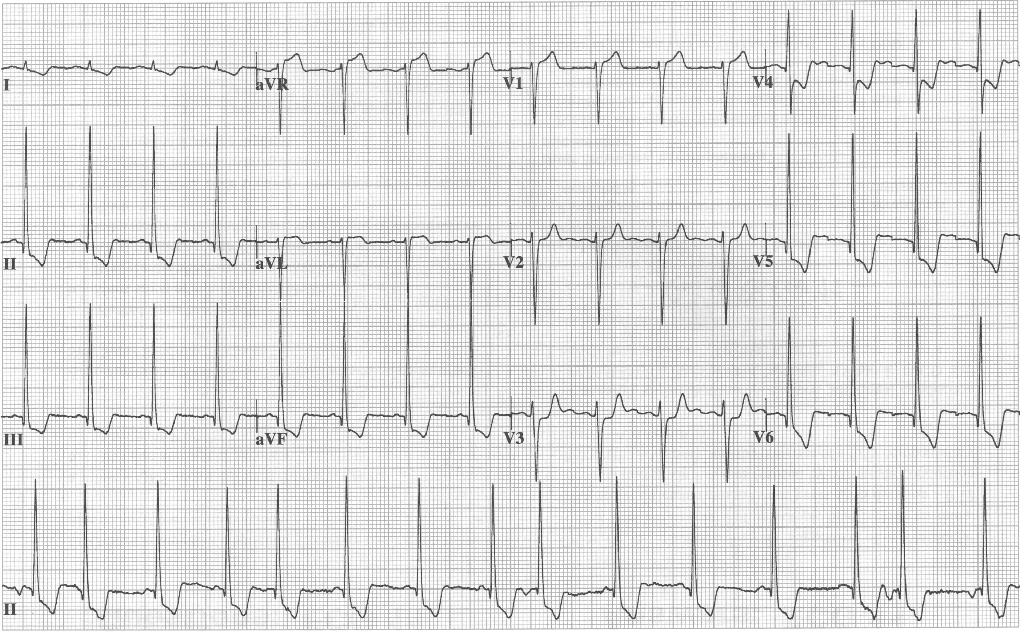
ECG: LVH with “strain” pattern

Slide 30
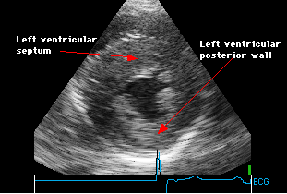
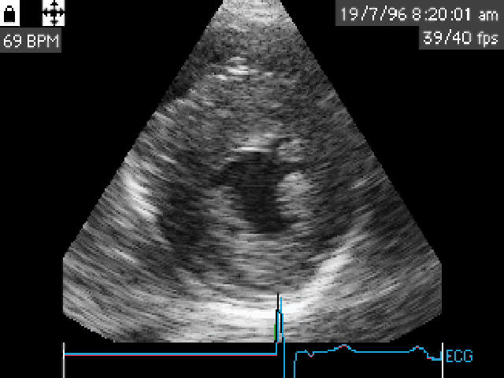
Hypertrophic Cardiomyopathy

Slide 31
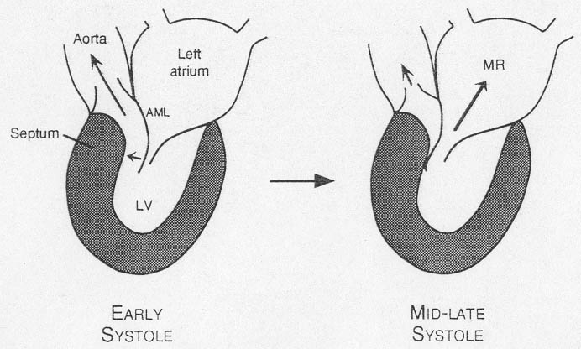
Hypertrophic obstructive cardiomyopathy

Slide 32
Physical Exam in HOCM
Brisk early carotid impulse
“Triple ripple” AB : palpable “a” wave, followed by double systolic impulse
“Dynamic” systolic ejection murmur: with changes in LV volume or contractility.

Slide 33
Dynamic murmur of HOCM
Smaller LV volume brings septum closer to anterior MV leaflet: more obstruction and louder murmur.
Larger LV volume separates upper septum from anterior MV leaflet: less obstruction and softer murmur.

Slide 34
How to alter LV volume
Increase LV volume
Squatting
Passive leg lifting
Slow heart rate
IV volume infusion
Decrease LV volume
Stand (after squatting)
Valsalva maneuver
Increase heart rate
Amyl nitrate
Volume depletion

Slide 35
Hypertrophic Cardiomyopathy: Management
Predict risk of sudden death:
Early age at presentation
Positive family history
Massive hypertrophy: LV >35 mm
Syncope
Non-sustained VT on Holter
Genetic typing
Prevent sudden death
Internal cardiac defibrillator (ICD)

Slide 36
Hypertrophic Cardiomyopathy: management
Enhance impaired LV diastolic function (improve filling)
Slow heart rate
Maintain normal sinus rhythm
[Drugs to enhance myocardial relaxation]
Reduce obstruction caused by septal/mitral valve apposition:
Avoid dehydration and vasodilators
Negative inotropic drugs (beta blockers, disopyramide)
Surgical septal myectomy
Dual chamber (atrial and ventricular) pacemaker

Slide 37
Restrictive Cardiomyopathy
.Abnormally stiff myocardium:
Fibrosis, infiltration, idiopathic
.Impaired diastolic function
.(Usually) preserved systolic function

Slide 38
Restrictive Cardiomyopathy
Pathophysiology
Impaired biventricular filling
Elevated right and left atrial pressures
Symptoms:
Dyspnea, exercise intolerance
Signs
Increased JVP (large ‘a’ wave), edema, ascites
Increase JVP with inspiration
(Kussmaul's sign)

Slide 39
Restrictive Cardiomyopathy
Diagnosis:
Cardiac catheterization:
Restricted filling pattern during diastole
RV biopsy

Slide 40
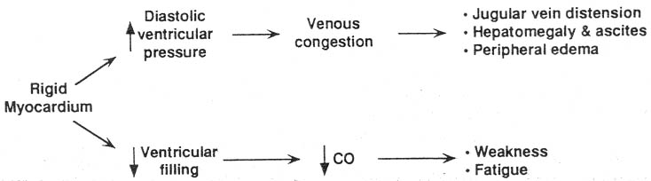
Restrictive Cardiomyopathy: Pathophysiology

Slide 41
Diagnosis and Treatment
Diagnosis can be very difficult and requires complex Doppler echocardiography,
CT or MRI, and endomyocardial biopsy.
Treatment is symptomatic but the prognosis is usually poor .
transplantation may be indicated.

Slide 42
THANKS

