Slide 1
Congestive Heart failure
Dr. Zaki Bettamer
Zikoecho@yahoo.com
Friday, March 22, 2019

Slide 2
71 years old female diabetic and hypertensive presented with Shortness Of Breath, orthopnea and paroxysmal nocturnal dyspnea ( PND ) few days back.
On Examination : ↑ JVP, Pedal Odema ++, BP 110/70, P: 90 Regular
Cardiovascular Examination : Pan systolic Murmur at Mitral area radiate to axilla.
Chest: Bilateral crepitation.
_{ECG: Left Bundle Branch Block}
Echo: decreased systolic function, EF: 25% and MR++

Slide 3
Definition
Clinical syndrome characterised by inability of the heart to pump enough blood to the rest of the body.

Slide 4
Prevalence
80 people >75 years/1000 population
10 new cases/1000 population >85 years/year
Male (2) : Female (1)

Slide 5
Prognosis
Very poor – survival rates worse than for breast & prostate cancer.
6000 deaths /year
One yr. mortality Mild 20-30%
Severe >50%

Slide 6
Etiology
The loss of a critical quantity of functioning myocardial cells after injury to the heart due to:
Ischemic Heart Disease
Hypertension
Idiopathic Cardiomyopathy
Infections (e.g., viral myocarditis, Chagas’ disease)
Toxins (e.g., alcohol or cytotoxic drugs)
Valvular Disease
Prolonged Arrhythmias

Slide 7
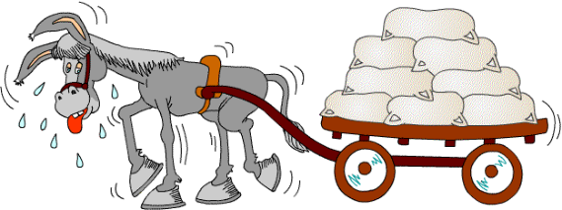
The Donkey Analogy
Ventricular dysfunction limits a patient's ability to perform the routine activities of daily living…

Slide 8
Pathophysiology
Myocardial systolic dysfunction
Neurohormonal activation
Skeletal muscle changes

Slide 9
Compensatory Mechanisms
Renin-Angiotensin-Aldosterone (RAAS)
Angiotensinogen
Renin
Angiotensin I
Angiotensin Converting Enzyme
Angiotensin II
AT I receptor
Vasoconstriction
Vascular remodeling
Oxidative Stress
LV remodeling
Cell Growth
Proteinuria

Slide 10
Sympathetic Activation
CNS sympathetic outflow
↑Sympathetic activity to kidneys
+ peripheral vasculature
↑ Cardiac sympathetic activity
B 1 receptors
B 2 -receptors
α1 receptors
α 1 -
B 1 -
Activation
of RAS
Myocardial toxicity Increased arrhythmias
Vasoconstriction Sodium retention
Disease progression

Slide 11
Heart Failure Activation of Renin-Angiotensin Aldosterone System
Angiotensinogen
Renin
Angiotensin I
Angiotensin II
AII Receptors
Aldosterone
Secretion
Direct Effect on kidneys
Salt & water retention
Vasoconstriction
Sympathetic Activation
Further heart failure

Slide 12
Pharmacological Actions of hBNP
Hemodynamic (balanced vasodilation)
• veins
• arteries
• coronary arteries
Neurohormonal
↑aldosterone
↑norepinephrine
Renal
↑diuresis & natriuresis

Slide 13
Types of heart failure
Left, right and congestive heart failure.
Diastolic & systolic dysfunction.
Acute & chronic heart failure.

Slide 14
Investigations
Assessing Heart Failure
Patient History
Physical Examination
Laboratory and Diagnostic Tests

Slide 15
Symptoms of heart failure
Fatigue, poor exercise performance.
SOB.
Weight loss (Cardiac cachexia).
Rt. sided failure causes fluid retention (leg swelling, abdominal swelling).
Lt. sided failure causes orthopnea, P.N.D.

Slide 16
NYHA Classification
Class I No limitation of physical activity
Class II Slight limitation of physical activity
Class III Marked limitation of physical activity
Class IV Unable to carry out any physical activity without discomfort

Slide 17
Signs of heart failure
LVF:
Tachycardia
Gallop rhythm
Basal crackles
RVF:
Pedal oedema
Hepatic congestion
Raised JVP

Slide 18
Symptoms & signs of heart failure
Low cardiac output
Cold extremities
Low BP
Paler
Fatigability & weakness
Pulmonary congestion
Dyspnea
Orthopnea, Paraxosmal Nocturnal Dyspnea (PND)
Lung crepitations
cough
Venous congestion
High JVP
Abdominal distention
Hepatomegaly, Ascites, plural effusion
Pedal & sacral odema
Cardiac signs
Tachycardia
Gallop rythm
Heart murmur

Slide 19
Diagnostic Evaluation of New Onset Heart Failure
Determine the type of cardiac dysfunction (systolic vs. diastolic)
Determine Etiology
Define prognosis
Guide therapy

Slide 20
Initial Work-up:
ECG
Chest x-ray
Blood work
Echocardiography

Slide 21
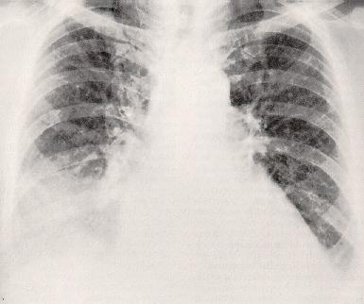

Slide 22
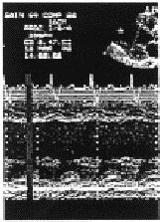
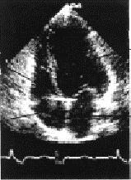
RV
LV
Septum
LV cavity
LV Wall
LA
RA
2D Echo
M-Mode Echo

Slide 23
BNP and Heart Failure
Brain Natriuretic Peptide is peptide hormone secreted mainly by vent. Myocytes.
. Plays a key role in volume haemostasis.
. Good screening test for heart failure.
. Levels of BNP correlates with the severity of disease.
. Useful in monitoring the effectiveness of therapy

Slide 24
Precipitating factors
Arrhythmias
Infections
M.I.
Anemia
Alcohol access
Iatrogenic
Thyrotoxicosis
P.E.
Poor compliance

Slide 25
Treatment of Heart Failure
General Measures
Lifestyle Modifications:
Weight reduction
Stop smoking
Avoid alcohol and cardiotoxic substances
Exercise

Slide 26
Medical Considerations:
Treat HTN, hyperlipidemia, diabetes, arrhythmias
Coronary revascularization
Anticoagulation
Immunization
Sodium restriction
Daily weights
Close outpatient monitoring

Slide 27
Diuretics
Used to relieve fluid retention
Improve exercise tolerance
Facilitate the use of other drugs indicated for heart failure.
Electrolyte depletion (hypokalemia, hyponatremia) a frequent complication.
Should never be used alone to treat heart failure.

Slide 28
ACE Inhibitors
Blocks the conversion of angiotensin I to angiotensin II; prevents functional deterioration
Recommended for all heart failure patients
Relieves symptoms and improves exercise tolerance
Reduces risk of death and decreases disease progression
Benefits may not be apparent for 1-2 months after initiation
Captopril, Enalapril, Lisinopril, Perindopril, Ramipril

Slide 29
Angiotensin Receptor Blockers (ARBs)
Block AT 1 receptors, which bind circulating angiotensin II
Examples: valsartan, candesartan, losartan, Irbesartan
Should not be considered equivalent or superior to ACE inhibitors
In clinical practice, ARBs should be used to treat patients who are ACE intolerant due to intractable cough or who develop angioedema

Slide 30
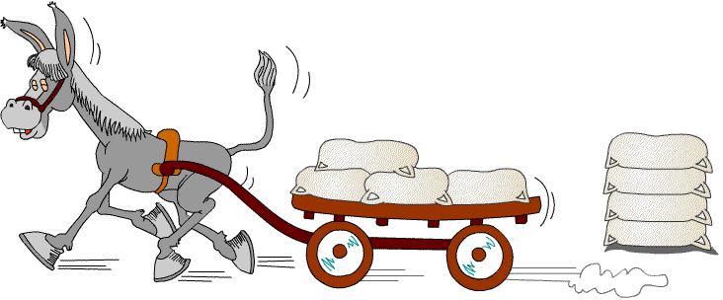
Diuretics, ACE Inhibitors
Reduce the number of sacks on the wagon

Slide 31
B-Blockers
Reduce mortality and morbidity in all grades of heart failure.
Reduce sympathetic tone
Up regulation of Beta receptors.
Reduction of arrhythmias, ischaemia and M.I.
Carvedilol is licensed for mild to moderate stable H.F., Bisoprolol for severe H.F
To be started at V. low dose with dose being slowly increased, under expert supervision.

Slide 32
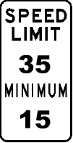
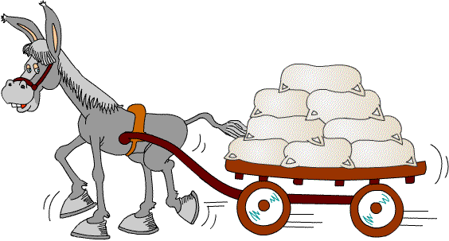
ß-Blockers
Limit the donkey’s speed, thus saving energy

Slide 33
Digoxin
Enhances inotropy of cardiac muscle
Reduces activation of SNS and RAAS
Controlled trials have shown long-term digoxin therapy:
■ Reduces symptoms
■ Increases exercise tolerance
■ Improves hemodynamics
■ Decreases risk of HF progression
■ Reduces hospitalization rates for decompensated HF
■ Does not improve survival

Slide 34
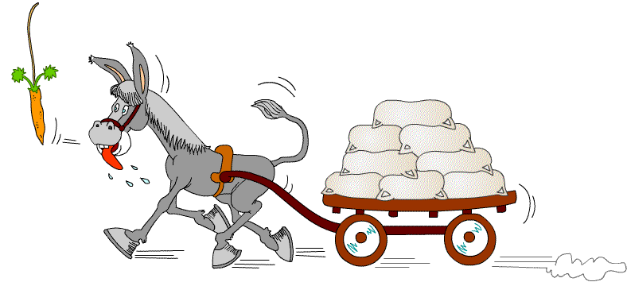
Digitalis
Like the carrot placed in front of the donkey

Slide 35
The role of aldosterone in CVD
Vascular inflammation and injury
Potassium and magnesium loss
Prothrombotic effect
Deleterious effect of aldosterone
Myocardial fibrosis
Central hypertensive effect
Endothelial dysfunction
Catecholamine potentiation
Sodium retention
Ventricular arrhythmias
Cardiovascular disease

Slide 36
Aldesterone Antagonists
Generally well-tolerated
Shown to reduce heart failure-related morbidity and mortality
Generally reserved for patients with NYHA Class III, IV HF
Side effects include hyperkalemia and gynecomastia. Potassium and creatinine levels should be closely monitored

Slide 37
Renin-Angiotensin - Aldosterone Pathways
Angiotensinogen
Renin
ACE-inhibitor
Angiotensin-I
Chymase
ACE
Angiotensin-II
Angiotensin receptor blocker
Bradykinin degradation
AT-1 Receptor
Aldosterone
Spironolactone

Slide 38
devices
CRT, ICD, CRT-D.
Inotropic Drugs (±)
Digitalis (±)
Aldesterone antagonist
B- B l o c k e r s
A C E I n h i b i t o r s
D i u r e t i c s

Slide 39
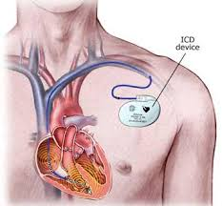
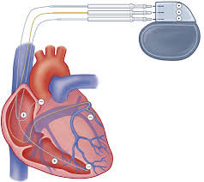
ICD CRT

Slide 40
THANKS

