Slide 1


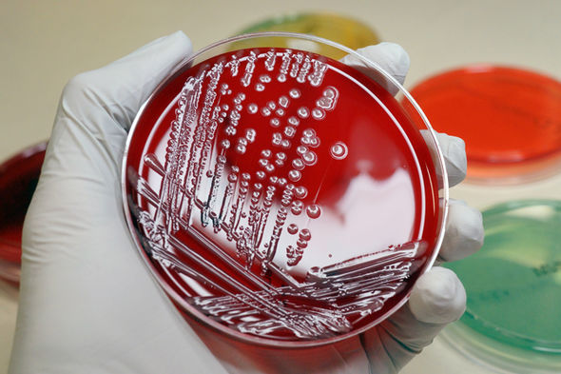
Smith, M. G., Gianoulis, T. A., Pukatzki, S., Mekalanos, J. J., Ornston, L. N., Gerstein, M., and Snyder, M. (2007). New insights into Acinetobacter baumannii pathogenesis revealed by high-density pyrosequencing and transposon mutagenesis. Genes Dev.21, 601–614.
Multidrug Resistant Acinetobacter Boumannii In ICU Among Different Hospitals In Benghazi
Aisha hassan Elfeituri, 3rd Year
Faculty of Basic Medical Science
Libyan International Medical University
the A.baumannii isolates was the highest percentages located in different parts of Benghazi during( jun-oct 2013) (33.3%) in ICU unit , similar similar results was fownd by Franka., et al ;(2012) thy reported that percentages of A.baumannii (29.8%) at three hospitals in Tripoli,Libya .
Introduction.
Incidence of A.baumannii &A.baumannii/calco.cplx in (ICUs)
Acinetobacter baumannii Showed highest reported rates of resistance were (100%) for Amikacin, Gentamicin, Ertapenem , Imipenem ,Meropem ,Cephalothin, Cefur-oxime ,Ceftazidime, Aztreonam, Amixicillin Clavulanate, Piperacillin,tazobactam,Nitrofurantoin,Ciprofloxacin,and Levofloxacin.
Acinetobacter baumannii is a pathogenic species of bacteria whose spread has recently gained worldwide attention, most notably after outbreaks in United States military hospitals in Iraq and Afghanistan. The alarming rate by which A. baumannii has attained resistance to most classes of known antibiotics poses a great threat to most infection. A. baumannii can rapidly modify transmembrane proteins and efflux pumps to prevent current antibiotics from penetrating its inner membrane and executing their mechanism of action
(Smith.et al;2007) .
Discussion
.
the A.baumannii isolates was the highest percentages located in different parts of Benghazi during( jun-oct 2013) (33.3%) in ICU unit , similar results was fownd by (Franka., et al ; 2012) thy reported that percentages of A.baumannii (29.8%) at three hospitals in Tripoli,Libya . analysed surgical wound infections of 1200 patients injured during the Libyan conflict in 2011 and admitted to the emergency services at Tripoli medical centre. Culture swabs or surgical wound debridement samples were collected identified and tested for antimicrobial resistance. Of the 1200 patients studied, 498 (42%) were infected with at least 1 pathogen and 57 with >2 pathogens. The most common species were Acinetobacter spp. (isolated from 144 patients) (Daw.et al;2012)
Figure 1: Incidence of A.baumannii &A.baumannii/calco.cplx in (ICUs)
Aims of the study
1-To study the rate of contamination with Acinetobacter boamannii in ICUs for major Banghazi hospitals.
2-Detect the prevalence of Acinetobacter boamannii in different hospitals in Benghazi area.
3-To study the sensitivity test by antibiotic available in the libyan hospital.
4-Provide such information for our clinicians.
Conclusion.
Emergence and spread of Acinetobacter species, resistant to most of the available antimicrobial agents, is an area of great concern. There is an urgent need to enforce infection control measures and antimicrobial stewardship programs to prevent the further spread of these resistant Acinetobacter species and to delay the emergence of increased resistance in the bacteria.
Figure 2: prevalence of Acinetobacter.baumannii & A. baumannii/calco.cplx in ICUs in (ICUs)among Benghazi hospitals
Resistance to antimicrobial.
Results
This study included 669 Swabs collected from four (ICUs)located in different parts of Benghazei during jun-oct 2013 all swabs were collected from patient and medical devices including the patient surrounding environment from intensive care unit (ICU)
This study shawed high level of resistanc to most studied antimicrobials. all of the Acietobacter spp isolates were also highly resistant to more then three classes of antidiotics
These study showed the most antibacterial effect for A.B SPP demonstrated that (68.6%) of the isolated tested were only susceptible to Colistin(CT).(31.3%) of the isolated were susceptible to Colistin (CT)and Trimethoprim-sulfamethoxazole(T.S).and only (0.4%)of isolated were resistance to all studied antimicrobials.
This study showed (0.4%)were resistant to Colistin and (68%) resistant to Trimethoprim-sulfametoxazole,(99.5%) sensitivity to Colistin and (31.3%)sensitivity to Trimethoprim-sulfamethoxazole .
References
- Daw MA, Dau AA, Elasifer H, Tloba S. Epidemiology and molecular antimicrobial resistance of Acinetobacter sp. 22nd European Congress of Clinical Microbiology and Infectious Diseases (ECCMID); London. 2012
-Franka EA, Shembesh MK, Zaied AA, El-Turki E, Zorgani A, Elahmer OR, et al. Multidrug resistant bacteria in wounds of combatants of the Libyan uprising. J Infect. 2012; 65: 27981.
-Smith, M. G., Gianoulis, T. A., Pukatzki, S., Mekalanos, J. J., Ornston, L. N., Gerstein, M., and Snyder, M. (2007). New insights into Acinetobacter baumannii pathogenesis revealed by high-density pyrosequencing and transposon mutagenesis. Genes Dev.21, 601–6141

