Slide 1


Tobacco smoking
& COPD
              Year 1
              Block: PTS
              Presented by : Halima almaghyrbi
              Student number : 3615
              Supervised by : Dr. Fatima altarhoni
              Date : 4/6/2022

Slide 2
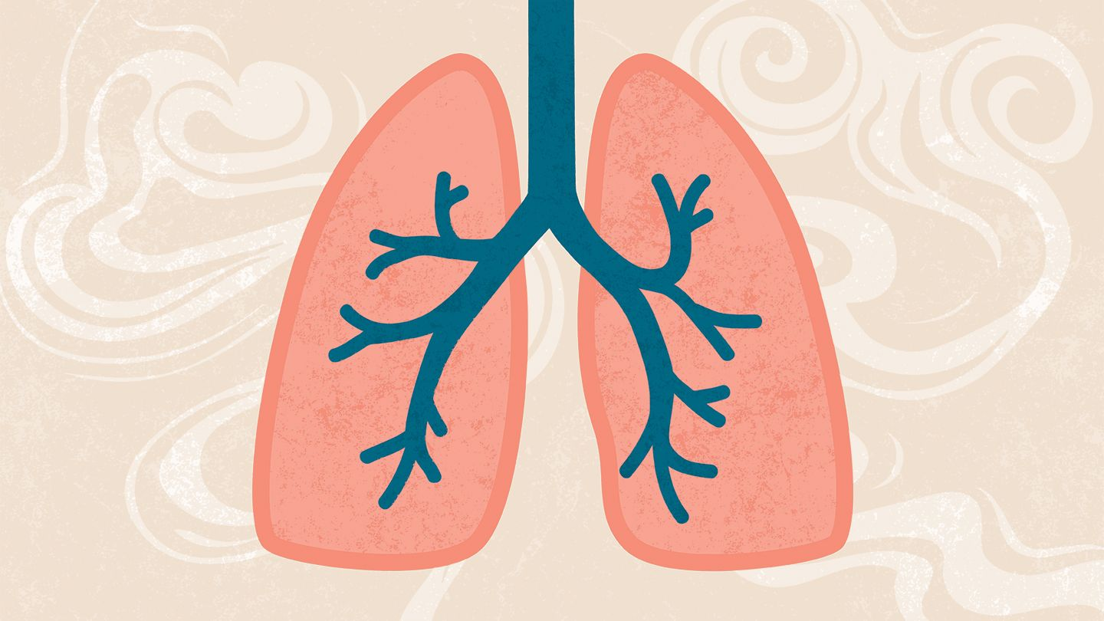
Objectives :
Overview of tobacco smoking.
Side effect of tobacco smoking.
Definition of the COPD.
The effect of tobacco in COPD.
Prevention of COPD.

Slide 3
Overview of tobacco smoking
Tobacco smoke from regular cigarettes contains a number of harmful chemicals such as nicotine.
All forms of tobacco are harmful, and there is no safe level of exposure to tobacco.
Cigarette smoking leads to disease and disability and harms nearly every organ of the body.

Slide 4
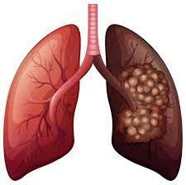
Side effect of tobacco smoking.
Cigarette smoking causes most cases of lung cancer.
If you have asthma, tobacco smoke can trigger an attack or make an attack worse.
Smoking affects the health of your teeth and gums and can cause tooth loss.
Active smoking is a major risk factor for COPD.

Slide 5
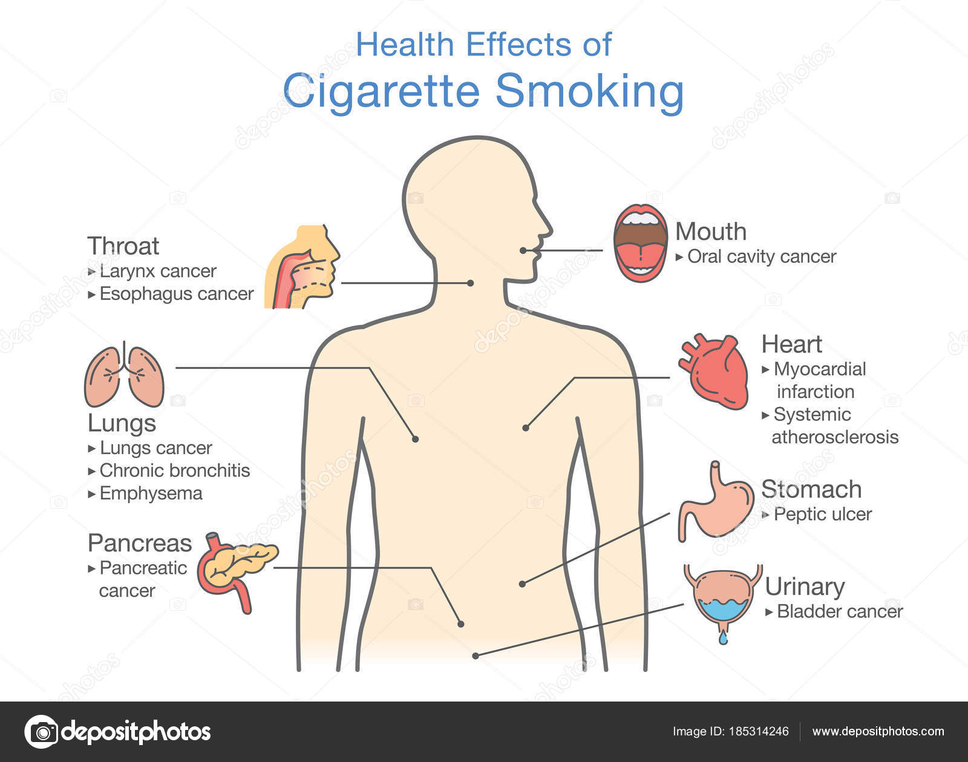
Side effect of tobacco smoking.

Slide 6
Definition of the COPD.
Chronic obstructive pulmonary disease (COPD) is a chronic inflammation of the airways, including the parenchyma and the pulmonary vasculature.
It includes emphysema and chronic bronchitis

Slide 7
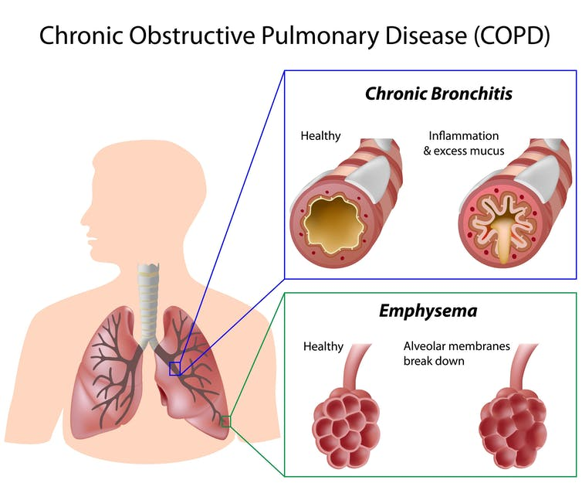
emphysema & bronchitis

Slide 8
The effect of tobacco in COPD
Tobacco smoke induces a specific, persistent inflammation, different from that of asthma.
Smoking damages the air sacs, airways, and the lining of your lungs. Injured lungs have trouble moving enough air in and out, so it's hard to breathe.
Smoking causes about 80% of all deaths from COPD.
The earlier the smoke exposure, the greater the level of decline in lung function

Slide 9
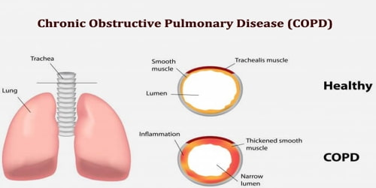

Slide 10
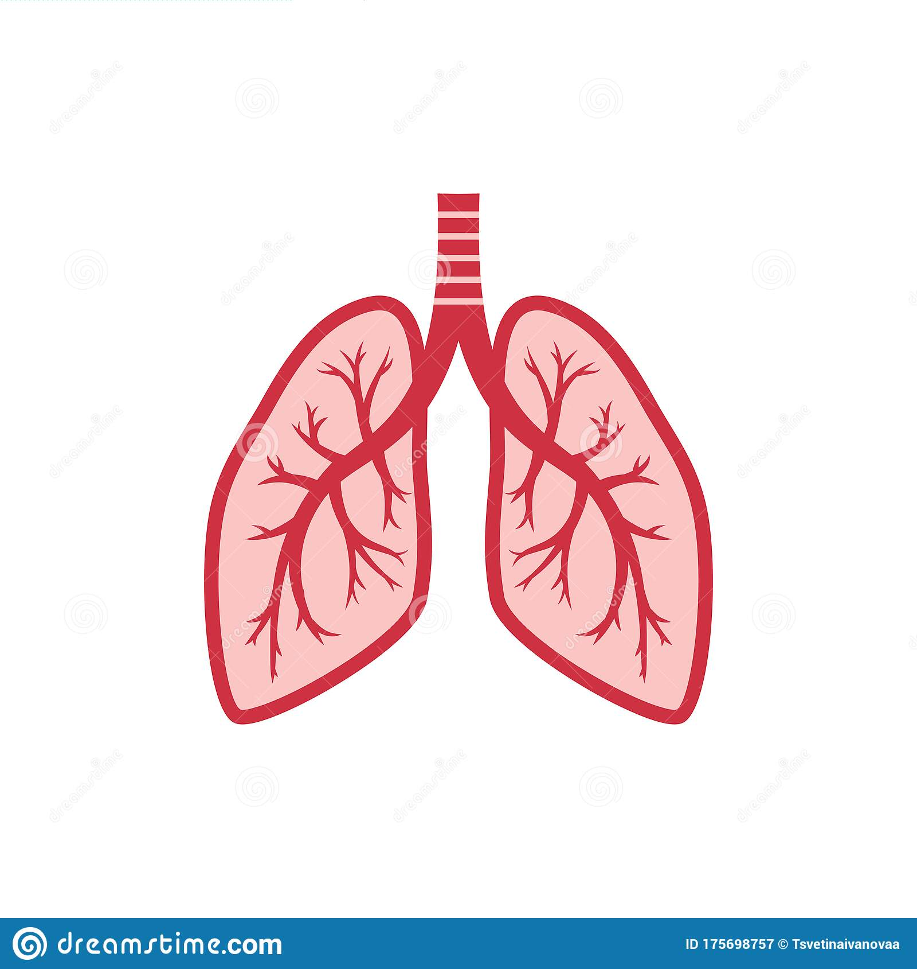
Prevention of COPD
The best way to prevent COPD is to never start smoking.
If you smoke, Talk with your doctor about programs and products that can help you quit.
Stay away from secondhand smoke, which is smoke that has been exhaled, or breathed out by a person smoking.

Slide 11
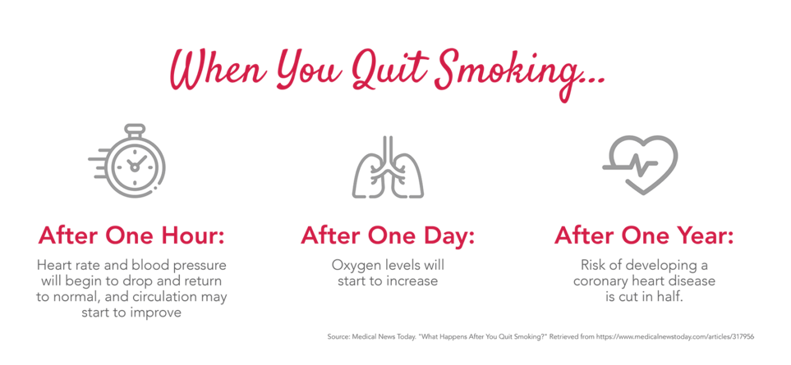
Conclusion

Slide 12
References
https://www.webmd.com/lung/copd/10-faqs-about-living-with-copd.
https://www.who.int/news-room/fact-sheets/detail/tobacco#:~:text=All%20forms%20of%20tobacco%20are,pipe%20tobacco%2C%20bidis%20and%20kreteks.
https://www.nhs.uk/conditions/chronic-obstructive-pulmonary-disease-copd/#:~:text=Chronic%20obstructive%20pulmonary%20disease%20(COPD)%20is%20the%20name%20for%20a,term%20inflammation%20of%20the%20airways.
https://www.mayoclinic.org/diseases-conditions/emphysema/symptoms-causes/syc-20355555#:~:text=Emphysema%20is%20a%20lung%20condition,instead%20of%20many%20small%20ones.
https://www.cdc.gov/tobacco/basic_information/health_effects/respiratory/index.htm#:~:text=The%20best%20way%20to%20prevent,and%20if%20you%20smoke%2C%20quit.&text=Talk%20with%20your%20doctor%20about,cigarettes%2C%20cigars%2C%20or%20pipes.
https://www.ncbi.nlm.nih.gov/pmc/articles/PMC2672326/.

Slide 13


