Slide 1




Libyan International Medical University
Faculty Of Business Administration
The difference between: Behavioral approaches & Traditional approaches in studying political science.
By: Aisha Elshaare
E-mail: aishaelshaare@yahoo.com
ID: 2869
25th Nov 2020

Slide 2

CONTENT
Politology (Political Science)
What is tradition?
Behavioralism
Traditional political approach
Behavioral political approach
Table of comparison
Conclusion
Reference

Slide 3


POLITOLOGY
Political science, occasionally called politology, is a discipline of social science which deals with systems of governance, and the analysis of political activities, political thoughts, associated constitutions and political behaviour.
Political Science is the study of the nature, causes, and consequences of collective decisions and actions taken by groups of people embedded in cultures and institutions that structure power and authority.

Slide 4
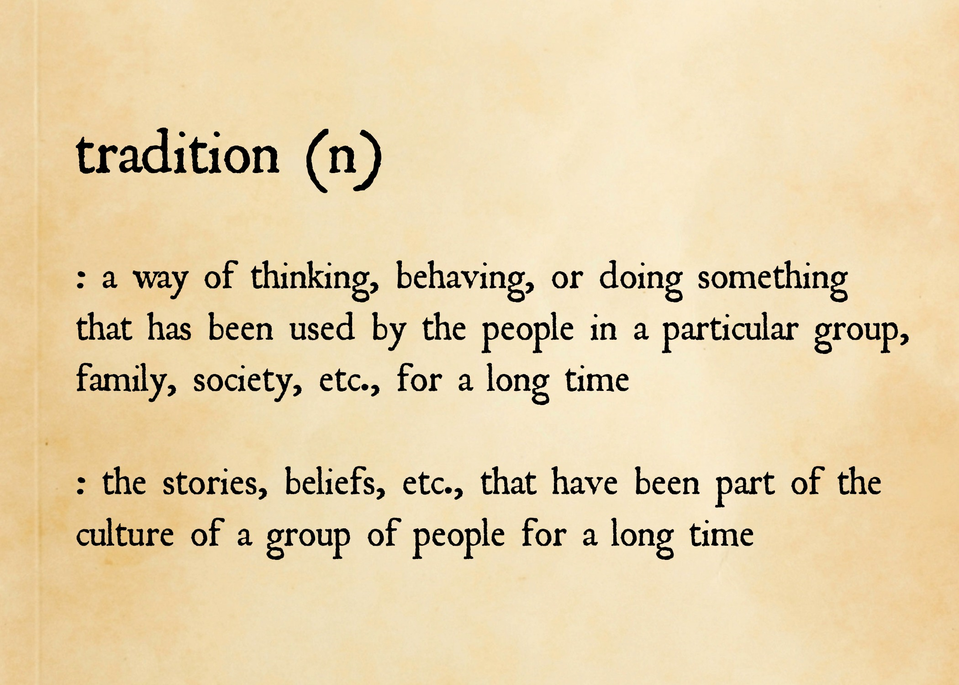
The definition of tradition
A tradition is a belief or behavior passed down within a group or society with symbolic meaning or special significance with origins in the past.

Slide 5
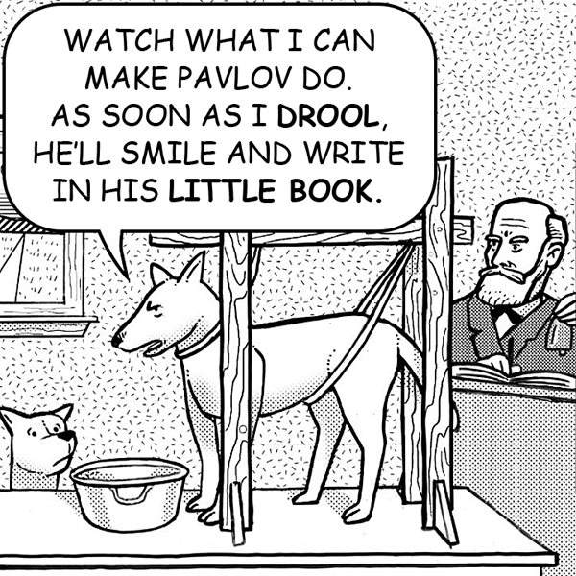
Behavioralism
Behavioralism, is an approach in political science that emerged in the 1930s in the United States. It represented a sharp break from previous approaches in emphasizing an objective, quantified approach to explain and predict political behaviour.

Slide 6
Traditional political approach
Traditional approaches are value based. These approaches put emphasis on values more that facts. Advocates of this approaches believe that the study of political science cannot and should not be purely scientific. They stated that in social science such as facts values are closely related with each other.

Slide 7
Behavioral political approach
The behavioural approach is an attempt to improve understanding of political science using systematic method with emphasis on empirical data, so that political process could be interpreted scientifically

Slide 8

Traditional approach
behavioral approach
regularities
systematization
techniques
measurement
verification
integration
value neutrality
pure science
Philosophical
Historical
Empirical
Legal Institutional

Slide 9
Conclusion
Traditional approaches is value based, whilst Behavioral approaches are pure science.
traditional and behavioral approaches are two very different elements in the study of political science, nevertheless, one completes the other in many different ways.

Slide 10

REFERENCE
English Interactive. (n.d.). Retrieved December 03, 2020, from https://www.english-interactive.com/a-quality-essay-sample-on-the-essence-of-environmentalism
English Interactive. (n.d.). Retrieved December 03, 2020, from https://www.english-interactive.com/a-quality-essay-sample-on-the-essence-of-environmentalism
Environmental movement. (2020, November 02). Retrieved December 03, 2020, from https://en.wikipedia.org/wiki/Environmental_movement
Why Study Political Science? (n.d.). Retrieved December 03, 2020, from https://politics.ubc.ca/undergraduate/why-political-science/
ByNischay, P. (2019, March 25). Traditional vs Behavioral approaches. Retrieved December 03, 2020, from https://nezcha73.wordpress.com/2019/03/24/traditional-vs-behavioral-approaches/

Slide 11


