Slide 1


Benefits and Pitfalls of Planning
LIBYAN INTERNATIONAL MEDICAL UNVIRSITY
FACULTY OF BUSINESS ADMINSTRATION
Name: Ahmed Gargoum
Id No: 3296
E-mail: ahmed_3296@limu.edu.ly
Date : 13/4/2022

Slide 2
TABLE OF CONTENTS
01
Introduction
02
Planning process
03
Benefits of Planning
04
Pitfalls of Planning
05
Conclusion
06
Refrences
02

Slide 3
INTRODUCTION
Setting goals and specifying the steps necessary to accomplish them is the process of planning.
03

Slide 4
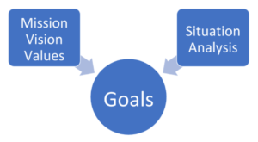
PLANNING PROCESS
The organization's goals are determined by the vision and mission statements, as well as the findings of the situation analysis. The following diagram illustrates this concept.
04

Slide 5
Benefits of Planning
Planning provides a guide for action
Planning improves resource utilization
Plans provide motivation and commitment
Planning allows flexibility
05

Slide 6
Pitfalls of Planning
Planning prevents action
Planning leads to complacency
Plans prevent flexibility
Plans inhibit creativity
06

Slide 7
CONLCLUSION
In concclusion , planing is an important process not only in buisness but in our daily life escpially in this changing enviroment we are facing today, And we know that it has benfits and pitfalls so we want to plan well.
07

Slide 8
THANK YOU FOR YOUR ATTENTION

