Slide 1


The Elements of Interpersonal Communication
Libyan International Medical University
Faculty of Business Administration
By: Salwa Mohamed Shembesh
ID:4402
Email:salwa_4402@limu.edu.ly

Slide 2
Table of Contents
Introduction
Define interpersonal communication
Elements of Interpersonal communication
Importance of Interpersonal communication
Conclusion
References

Slide 3

Introduction
Interpersonal communication is the process of sharing both ideas and emotions verbally and nonverbally with another person. It allows us to interact with and understand others in our personal and professional lives.

Slide 4
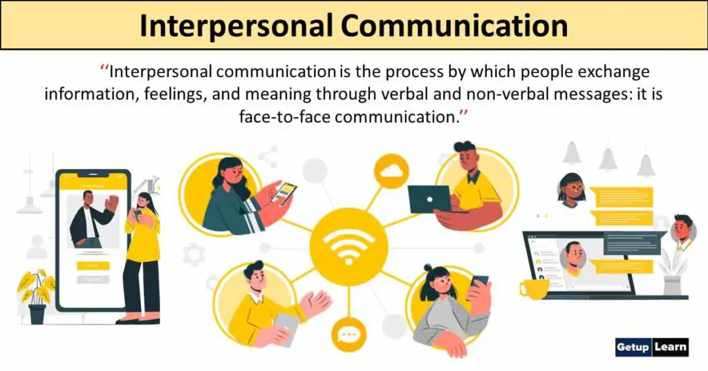
What is Interpersonal Communication?
Interpersonal communication is the process by which people exchange information, feelings, and meaning through verbal and non-verbal messages: it is face-to-face communication .

Slide 5
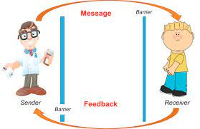
Elements of Interpersonal Communication
:These are the following elements of interpersonal communication include
Sender: is the person who is trying to communicate a message.
Receiver: The receiver is the recipient of the message and must translate the words into thoughts ,process the thoughts, and determine how to respond to the sender.

Slide 6
6. Feedback: Feedback is the process of determining if the message has been properly received. This can be initiated by the sender or receiver.
For example : The sender may ask the receiver to repeat the message to confirm that the message was received as intended.
7. context: context is another way of taking into consideration the setting .
Examples of context include :
1. What is going through the other person’s mind when you show up?
2. What is the environment like?
3. What was the nature of the last contact and how did that go?

Slide 7
Message: while you may carefully choose the words to speak ,words alone represent a small percentage of what is received by the other person . In fact, according to the literature ,words carry the least value in the message.
4. Channel: Chanel is the medium used by the sender to send the message to the receiver. This may be in-person ,via telephone, e-mail, text message, written correspondence or a third-party
5. Noise: Noise refers to interference the takes place during the communication process. Both the sender and receiver may be distracted by noise . Noise may come from internal ( thoughts ,emotions ,ect.) or external sources (radios ,other conversations ).

Slide 8

Importance of Interpersonal Communication
These are the following points that show the importance of interpersonal communication which are given below:
Improved Relationships With Family
Improved Relationships With Friends and Lovers
Improved Relationships With Colleagues
Improved Physical and Emotional Health

Slide 9
Conclusion
Interpersonal communication is fundamental in building good relationships at the workplace which in turn contribute to increase in productivity.

Slide 10
Reflection
In my opinion, Interpersonal communication helps us to connect with others and share ideas , it also helps builds relationships , teamwork ,and trust.

Slide 11
References
Interpersonal Communication Essay - 2208 Words. Free Essays. (n.d.). Retrieved March 21, 2023, from https://ivypanda.com/essays/interpersonal-communication-2/
Author DunjaJovanovic Dunja Jovanovic is a content manager at Pumble. (n.d.). Interpersonal communication: Definition, importance, and skills to know. Pumble Blog. Retrieved March 21, 2023, from https://pumble.com/blog/interpersonal-communication/

Slide 12


