Slide 1



Diabetes in pregnancy (Gestational)
Libyan International Medical University
Faculty of Applied Medical Science
1
Name: Thuraya Aldanini 3373
Year one 2021_2022
Date: 01 June 2022
Tutor: Dr.Makram Mohammed
Block: GBMS 2

Slide 2
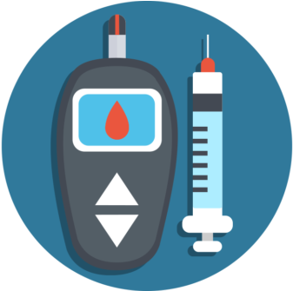
Introduction
2
Diabetes is a metabolic disease in which the body does not produce or properly use insulin, a hormone that is needed to convert sugar, starches, and other food into energy needed for daily life

Slide 3
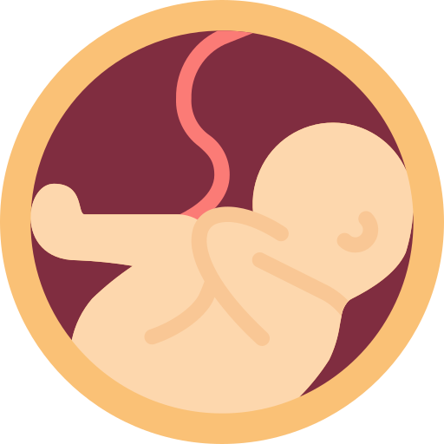
Objectives
3
• Define diabetes
• Outline types of diabetes
        • Describe pathophysiology of (GDM)
        • Explain the symptoms of (GDM)
        • Discuss the risk factors of (GDM)
        • Discuss the complication of (GDM)
        • Treatment of gestational

Slide 4
4
Types of diabetes

Slide 5
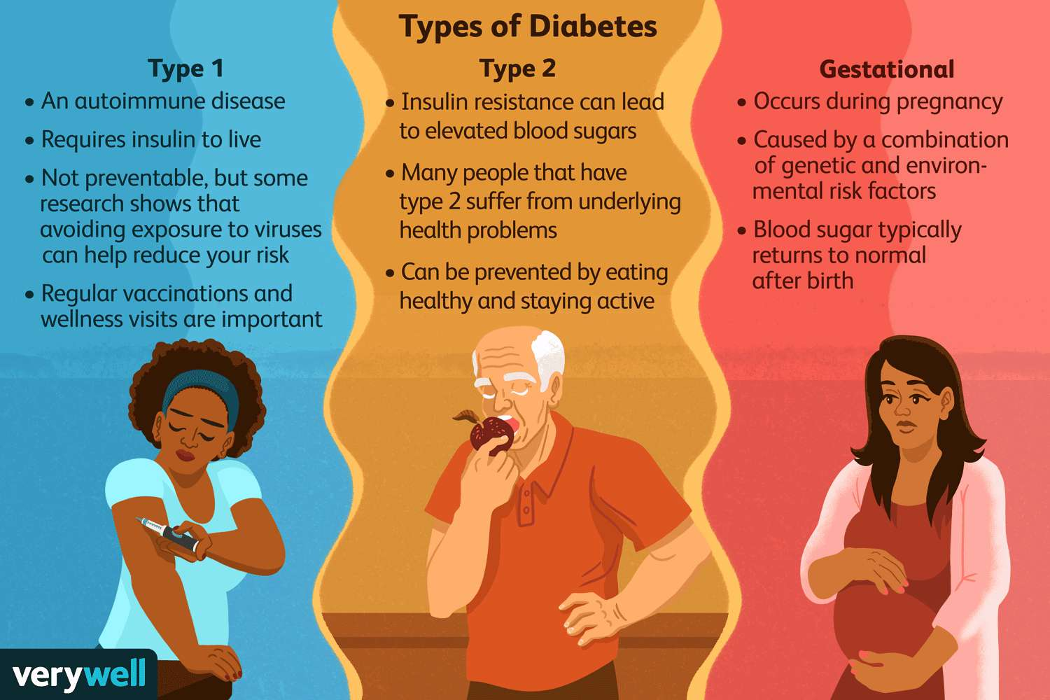
5

Slide 6
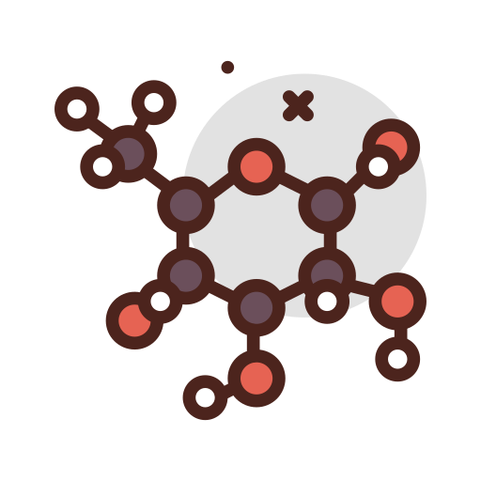
Pathophysiology of gestational diabetes
6
1.Gestational diabetes mellitus (GDM) is so serious pregnancy complication
2.Women without previously diagnosed diabetes develop chronic hyperglycemia during gestation.
3.This hyperglycemia is the result of impaired glucose tolerance due to pancreatic β-cell dysfunction on a background of chronic insulin resistance

Slide 7
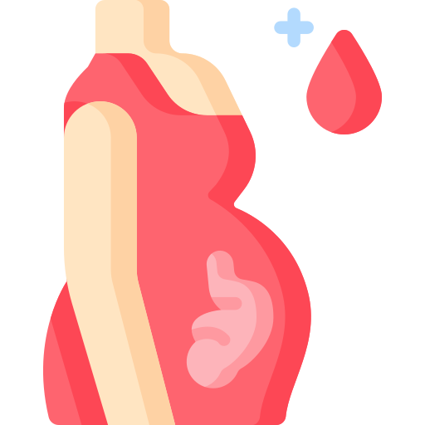
Symptoms
7
1.Increased urination
2.Fatigue
3.Nausea and vomiting
4.Weight loss even with increased appetite
5.Thrist
6.Recurrent infections of urine, vagina and skin

Slide 8
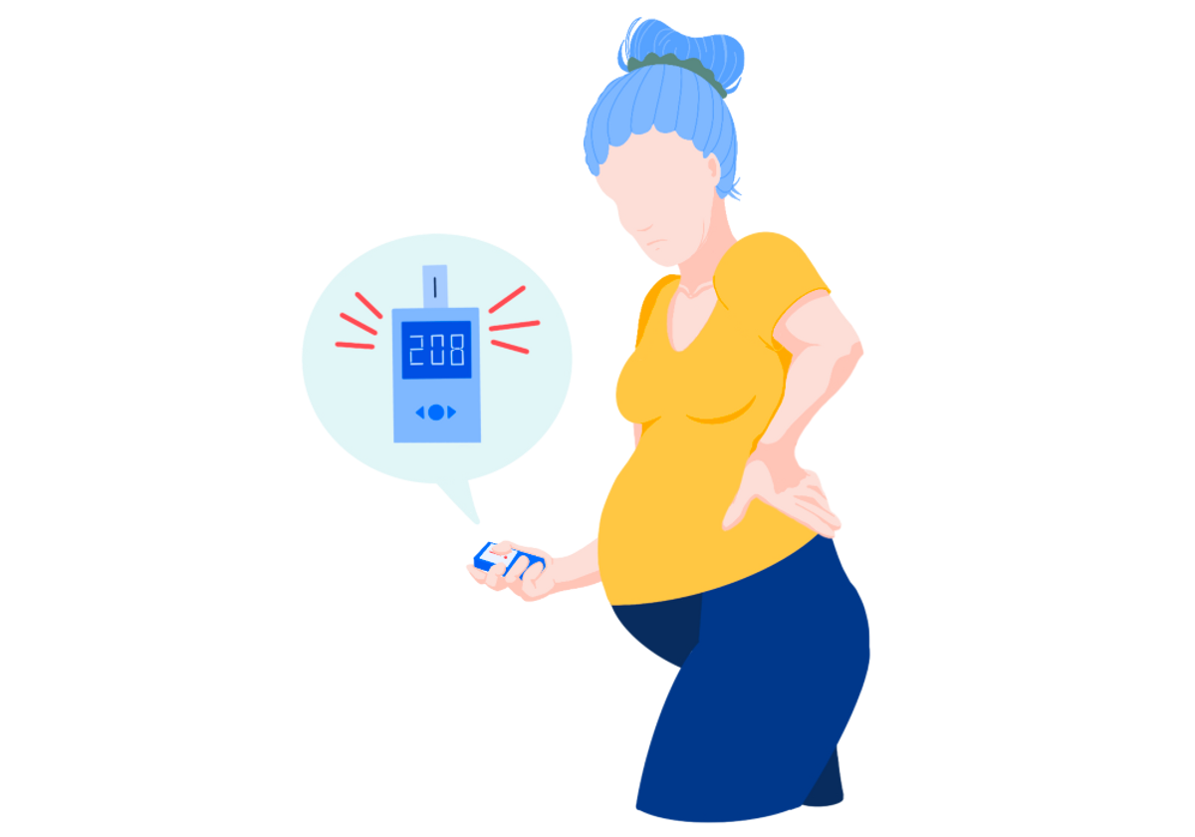
Risks factors associated with gestational diabetes mellitus
8
1.Overweight or obesity
2.Family history of diabetes
3.Having given birth previously weighting greater than 9 pounds
4.Age (women who are older than 25)

Slide 9
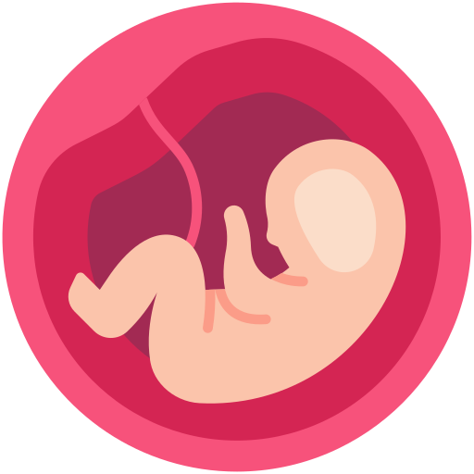
9
Complication of gestational diabetes
There are two major problems of gestational diabetes:
Macrosomia: Macrosomia refers to a baby who is considerably larger than normal.
Hypoglycemia: Hypoglycemia refers to low blood sugar in the baby immediately after delivery. This problem occurs if the mother's blood sugar levels have been consistently high, causing the fetus to have a high level of insulin in its circulation.

Slide 10
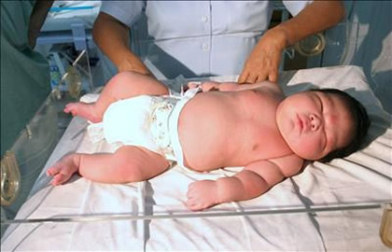
10

Slide 11
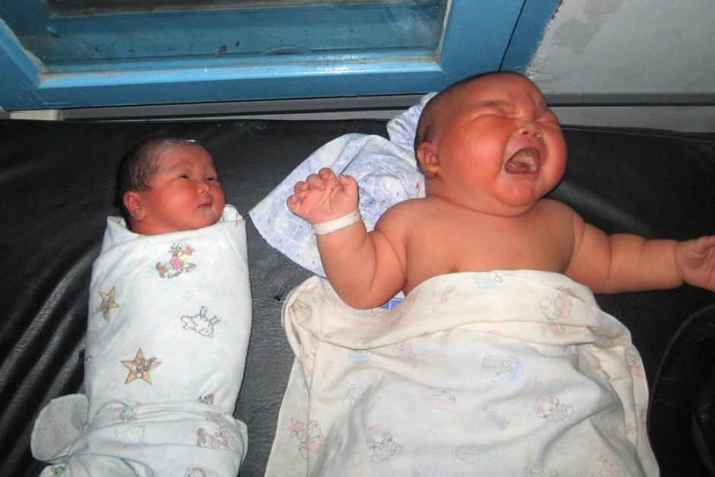
11

Slide 12

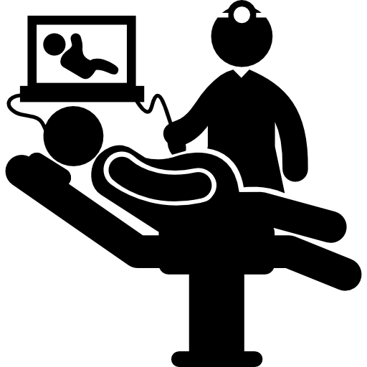
Treatment of gestational
12
1.Lifestyle changes
2.Blood sugar monitoring
3.Medication, if necessary

Slide 13
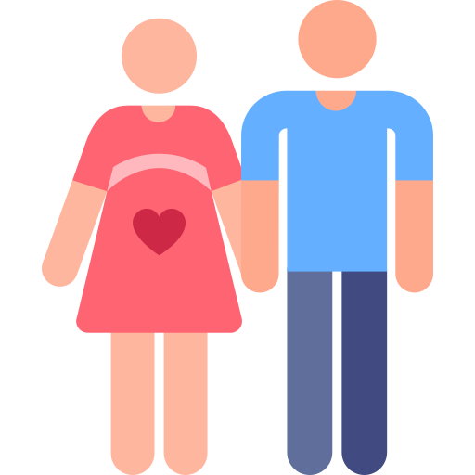
Conclusion
13
• Diabetes in pregnancy is a common problem
• Risk stratification and screening is essential in almost all pregnant women
• Tight glycemic targets are required for optimal maternal and fetal outcome
• Patient education is essential to meet these targets
• Long term follow up of the mother and baby is essential
• The timely action taken now in screening all pregnant women
for glucose intolerance achieving euglycemia in them and ensuring adequate nutrition may prevent in all

Slide 14
References
14
Slide one: Resources, C., Diseases, G., Diabetes, H. and Article, D., 2022. Diabetes: An Introduction. [online] Caregiverslibrary.org. Available at: <http://www.caregiverslibrary.org/Caregivers-Resources/GRP-Diseases/HSGRP-Diabetes/Diabetes-An-Introduction-Article> [Accessed 31 May 2022].
Slide two: Plows, J., Stanley, J., Baker, P., Reynolds, C. and Vickers, M., 2022. The Pathophysiology of Gestational Diabetes Mellitus.
Slide four: Symptomchecker.webmd.com. 2022. Fatigue, Frequent urination, Hunger and Increased thirst: Common Related Medical Conditions. [online] Available at: <https://symptomchecker.webmd.com/multiple-symptoms?symptoms=fatigue%7Cfrequent-urination%7Chunger%7Cincreased-thirst&symptomids=98%7C107%7C547%7C124&locations=66%7C35%7C66%7C7> [Accessed 31 May 2022].
Slide five: Hopkinsmedicine.org. 2022. Gestational Diabetes Mellitus (GDM). [online] Available at: <https://www.hopkinsmedicine.org/health/conditions-and-diseases/diabetes/gestational-diabetes> [Accessed 17 May 2022].
Slide six: Hopkinsmedicine.org. 2022. Gestational Diabetes Mellitus (GDM). [online] Available at: <https://www.hopkinsmedicine.org/health/conditions-and-diseases/diabetes/gestational-diabetes> [Accessed 17 May 2022]
Slide seven: Mayoclinic.org. 2022. Gestational diabetes - Diagnosis and treatment - Mayo Clinic. [online] Available at: <https://www.mayoclinic.org/diseases-conditions/gestational-diabetes/diagnosis-treatment/drc-20355345> [Accessed 31 May 2022].

Slide 15
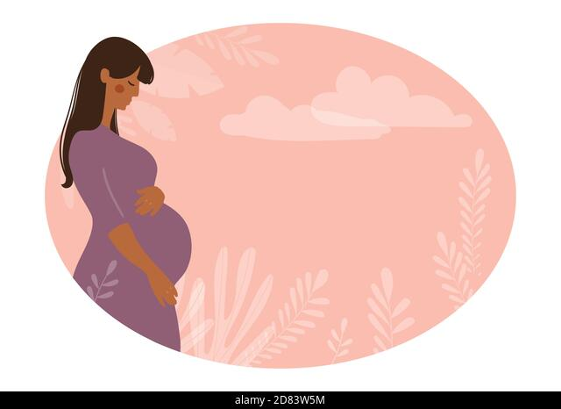
Thank you for your attention

