Slide 1


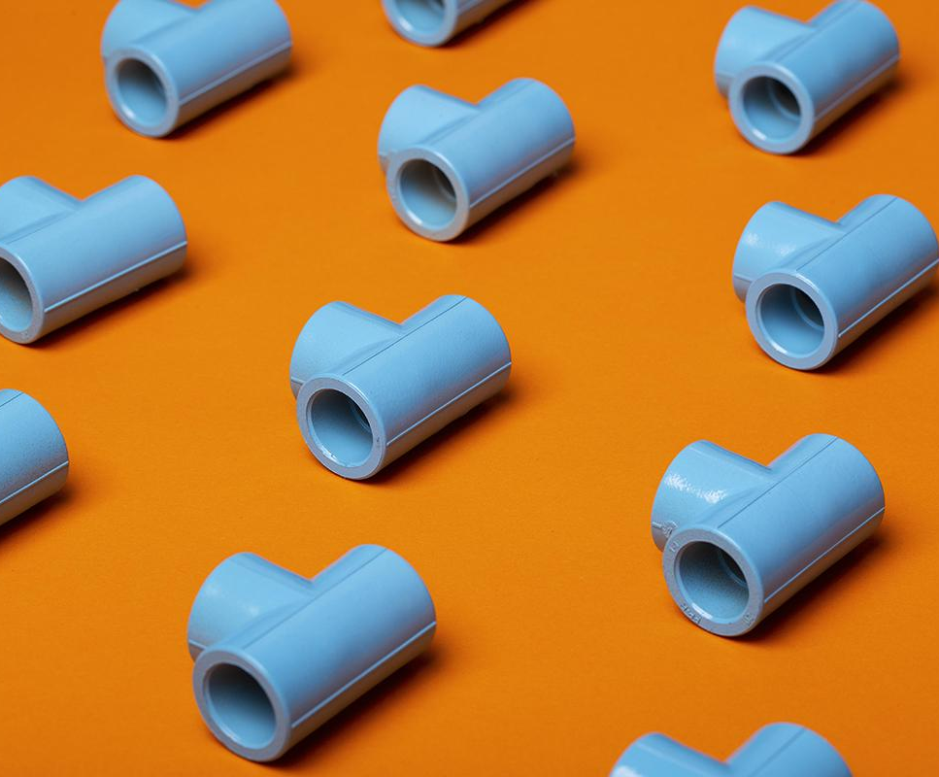
Distribution of Products
Libyan International Medical University
Faculty of Business Administration
29th December 2021
Ghadi Dreza
2830
Instructor: Mr. Mohamed Zuwawi
Date: 30.12.2021

Slide 2
Table of contents
01
Definition of Distribution
02
Different Types of Distribution Channels
03
04
Conclusion & References
Distribution in Logistics & Supply Chain
1

Slide 3
LEARNING OBJECTIVES
Define distribution and the different channels that are associated with it.
Be able to compare between logistics and distribution, as a one-way method.
Justify, how products are distributed and are logistically stored for later use.
Be able to acknowledge, how distribution can effect a companies financial position within supply chain.
2

Slide 4
What is Distribution?
3

Slide 5
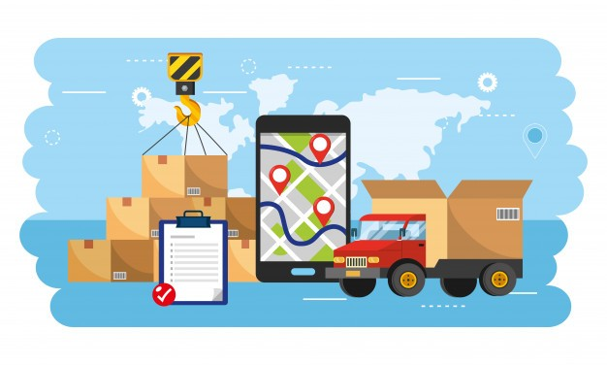
01
Distribution of Products
4

Slide 6
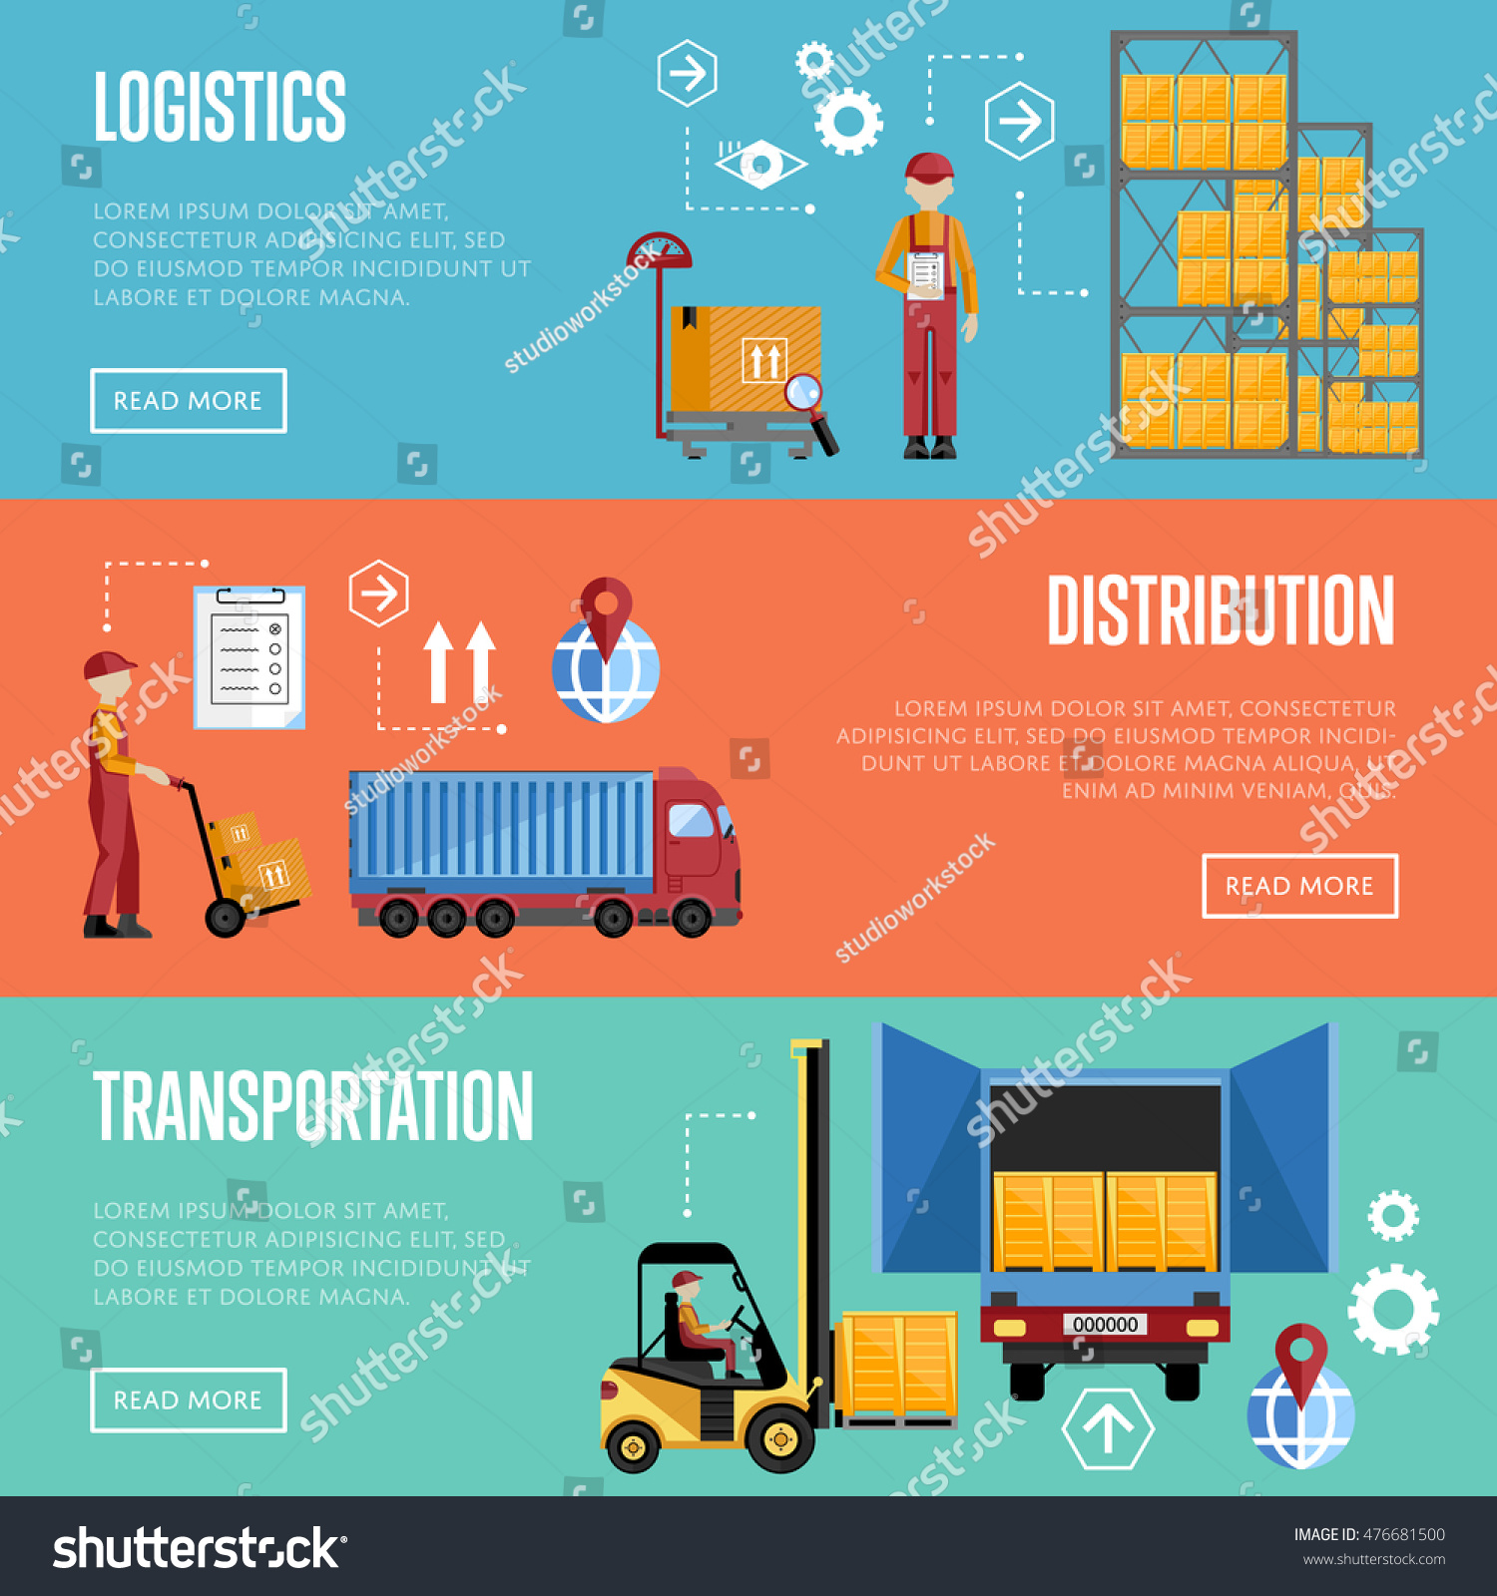
Distribution:
Distribution is a channel, whereby businesses would manufacture their products to then deliver them to the end user.
There are four main types of distribution channels.
There are Direct and Indirect channels.
5

Slide 7
02
Different Types of Distribution Channels
6

Slide 8
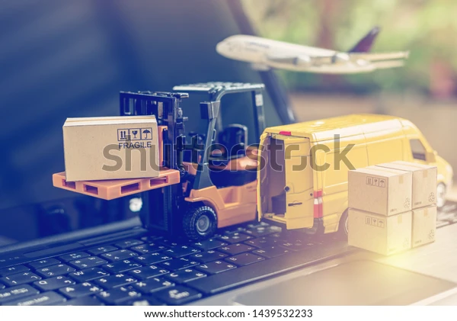
Different Distribution Channels:
Wholesalers
Retailers
Distributors
Internet
7

Slide 9



Retailers
Wholesalers
Internet
Distributors
Supermarkets, Pharmacies, clothing shops.
They buy and resell products to retailers.
People that use the internet to sell and market their products to the consumer.
They sell, store, and offer help to retailers and wholesalers.
8

Slide 10
03
Distribution in Logistics & Supply Chain
9

Slide 11
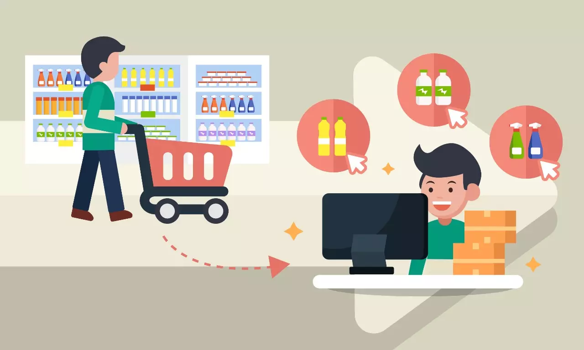
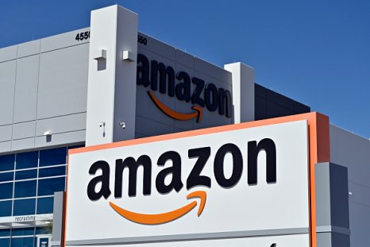
Distribution in Logistics:
Direct-to-consumer dilevery system.
Products or finished goods travel from manufacturer factories to retail stores.
Online retailers, partner with carrier delivery services for faster shipment.
10

Slide 12
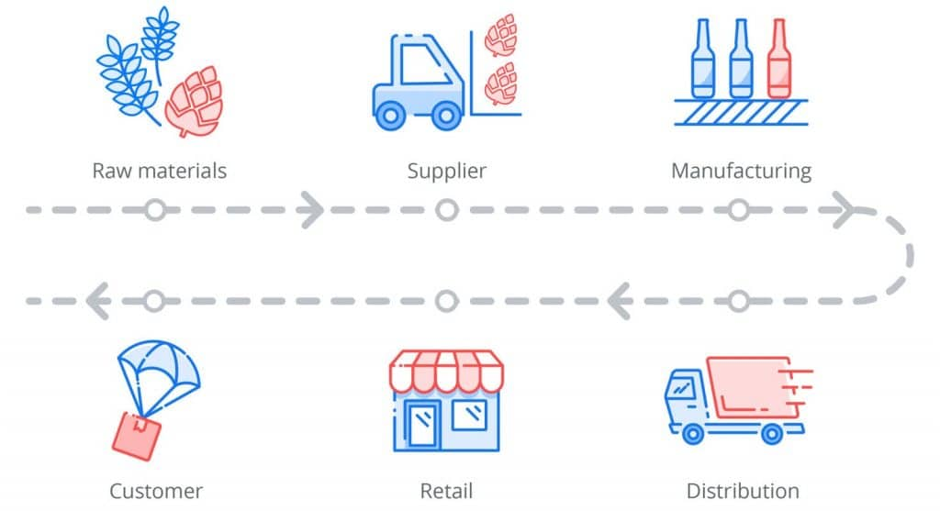
Distribution in Supply Chain:
The way that which businesses deliver their products to the costumer or B2B.
Business may sometimes choose to directly deliver their service to the clients- decreasing the price.
Requires a balance between supply and demand.
11

Slide 13
04
Conclusion & References
12

Slide 14
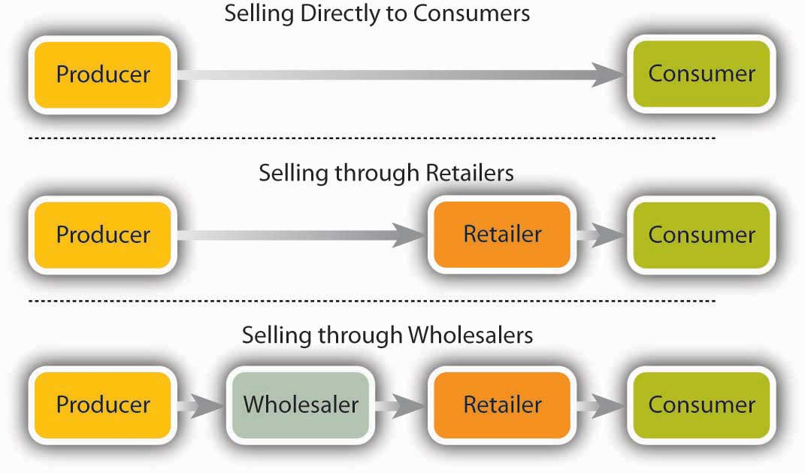
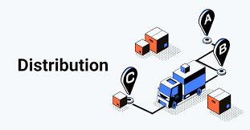
How does this affect Product Distribution?
Products are made available throughout the market for costumers.
This cycle involves the; Packaging, Transportation, and Delivery of an item.
Product distribution is significant for Businesses.
13

Slide 15
Resources
Fernando, J. (2021, August 19). How distribution channels work. Investopedia. Retrieved December 30, 2021, from https://www.investopedia.com/terms/d/distribution-channel.asp
Hand, R. (2021, December 28). Distribution Logistics explained. ShipBob. Retrieved December 30, 2021, from https://www.shipbob.com/blog/distribution-logistics/
Distribution channels: What are they, types & examples. Neil Patel. (2021, August 28). Retrieved December 30, 2021, from https://neilpatel.com/blog/distribution-channels/
14

Slide 16



