Slide 1


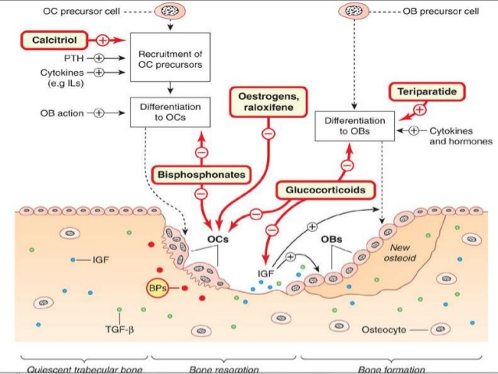
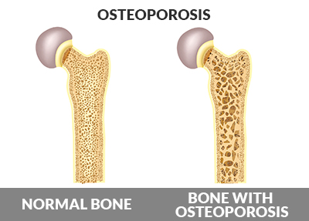
Can osteopenia be reversed
Second year student
By : Kiran Jaher Alam 1871
Faculty of Basic Medical Science
Libyan International Medical University
INTRODUCTION
Denosumab
It is used to treat osteopenia in postmenopausal women who have an increased risk of fracture. This drug works by slowing the bone-breakdown process.[2]
Osteopenia is a silent bone disease that causes bones to become porous, brittle or fragile, which increases the risk of fracture. Both men and women can get osteopenia, particularly after menopause women are at higher risk. [1]
Vitamin D deficiency
When mild osteopenia is caused by significant vitamin D deficiency, and the vitamin D deficiency is treated, then the osteopenia may reverse. Another example is when osteopenia is caused by malabsorption from celiac sprue, and the celiac sprue is treated, then osteopenia often improves. [1]
Figure 1 shows bone with osteopenia
Figure 2 shows the mechanism of different drugs use for osteopenia
CONCLUSION
Treatment of osteopenia
Calcitonin
It is a hormone produced in the thyroid gland. A synthetic form of calcitonin is approved to treat, but not prevent. Calcitonin is safer but less effective than other osteopenia medications. [2]
Usually, osteopenia does not reverse, but with the proper treatment, the bone density can stabilize and the risk for a bone fracture improves.
Treatment of osteopenia should always include:
❑ a well-balanced diet,
❑ getting the right amounts of calcium and vitamin D,
❑ being physically active every day,
quite smoking, and
❑ taking safety precautions to prevent falls.[2]
Bisphosphonates
The most widely prescribed osteopenia medications. Bisphosphonates preserve bone mass, inhibit bone breakdown and increase bone density in the hip and spine.
Bisphosphonates can be taken in pill daily, weekly or monthly. Or an injection once every few months or once a year, depending on the drug.
Bisphosphates include:
Alendronate (Fosamax)
Risedronate (Actonel, Atelvia)
Ibandronate (Boniva)
Zoledronic acid (Reclast, Zometa) [2]
Raloxifene
Raloxifene belongs to a class of drugs called selective estrogen receptor modulators (SERMs). The drug slows bone loss and prevents spinal fractures but it's not as effective as other osteopenia drugs for preventing fractures. [2]
REFERANCE
[1] Cummings SR, Eckert S, Krueger KA, Grady D, Powles TJ, Cauley JA, Norton L, Nickelsen T, Bjarnason NH, Morrow M, Lippman ME, Black D, Glusman JE, Costa A, Jordan VC
JAMA. 1999 Jun 16; 281(23):2189-97.
[2] Department of Clinical Endocrinology, Oslo University Hospital, Aker, Trondheimsveien 235, 0514 Oslo, Norway Erik Fink Eriksen
Rev Endocr Metab Disord. 2012 Sep; 13(3): 209–223.
Treatment of osteopenia done by two types of agents
Antiresorptive drugs that decrease bone loss, e.g. bisphosphonates, calcitonin, selective eoestrogen receptor modulators (SERMs),
Anabolic agents that increase bone formation e.g. PTH, teriparatide. [2]
Teriparatide
It chemically modifies the body's parathyroid hormone. PTH plays a critical role in maintaining the calcium balance and in the bone remodeling cycle. PTH daily injections. [2]

