Slide 1


Dental Implantation
Role of growth factor in dental tissue regeneration
Name: Muhammad Khalid El-Thinie
Student No : 2979
Block : PTS
2nd Year Dental Student
10/May/2022

Slide 2
OBJECTIVES
Define Dental Implantation
Discuss the Types of dental Implants
Describe the phases of dental implantation
Outline the types of artificial teeth
Discuss Complications and Post operative routines

Slide 3


When did it all start?

Slide 4
What Is a Dental Implant ?
Dental implant surgery is a procedure that replaces tooth roots with metal posts and replaces damaged or missing teeth with artificial teeth that look and function much like real ones

Slide 5


Is It Painful ?
Procedure Itself is NOT painful ( GA, LA is used )
After the procedure, mild pain might be felt
Rare discomforts might be felt ( infection or unfitting implant )
Recovery process is not as painful as expected

Slide 6
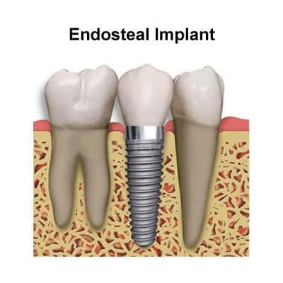
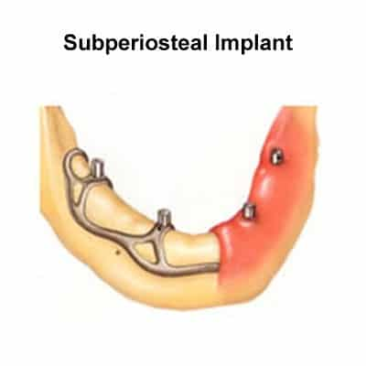
Types Of Dental Implants
Zygomatic Implant
-Most common type
-Require healthy jawbone
-Main Alternative
-Rests on top of the jawbone
-Least Common Type
-Inserted in cheekbone instead

Slide 7
Phases of Dental Implantation
1- Placing the implant :
Implant is placed in the jaw by surgery and is allowed to integrate from 3 to 6 months
2- Attaching the post :
the combination implant and post serves as an anchor for the replacement tooth
3-Crown attachment: The dentist attaches a customized crown (that looks like a tooth) to the implant post.

Slide 8
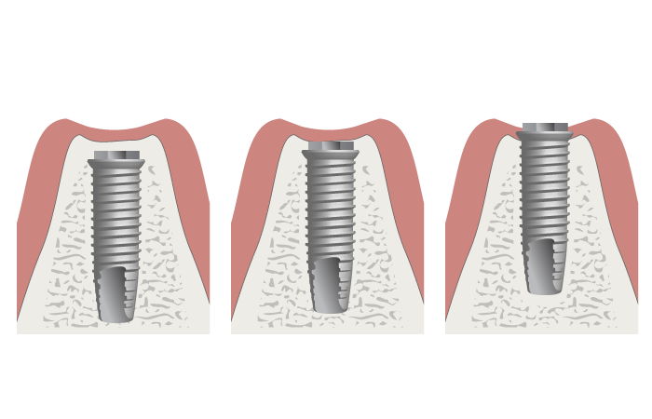
Implant placement

Slide 9
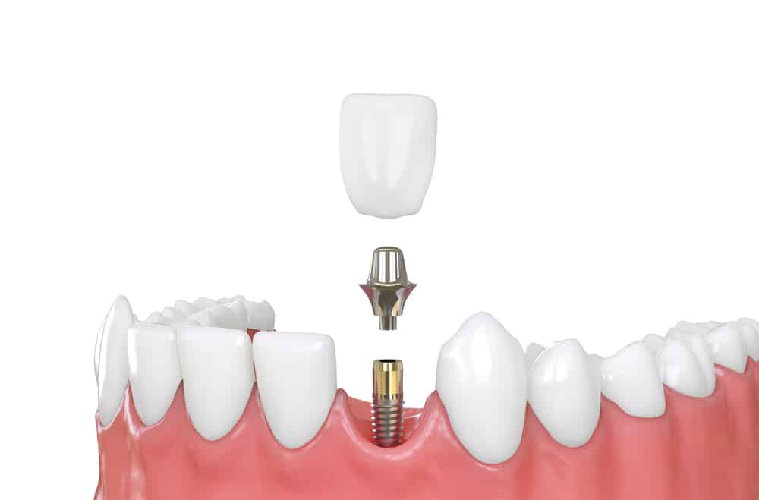
Post Attachment

Slide 10
Crown Attachment

Slide 11
Types of Artificial Teeth
Removable :
-artificial white teeth surrounded by pink plastic gum
- It can be easily removed for repair or daily cleaning
Fixed :
-an artificial tooth is permanently screwed onto an individual implant abutment
-You can't remove the tooth for cleaning or during sleep

Slide 12
Complications
-Swelling of your gums and face
-Bruising of your skin and gums
-Pain at the implant site
-Minor bleeding

Slide 13
You can help your dental work last longer if you:
Practice excellent oral hygiene.
See your dentist regularly. .
Avoid damaging habits. .

Slide 14
Conclusion
Dentistry is beautiful
but real teeth are priceless

Slide 15
References
Dental implant surgery - Mayo Clinic https://www.mayoclinic.org/tests-procedures/dental-implant-surgery/about/pac-20384622
Dental Implant Treatment https://goldcoastimplantspecialist.com.au/news/dental-implant-treatment-stages-surgery-duration-sedation/
Choosing the Best Types of Dental Implants https://www.renewinstitute.com/types-dental-implants/
The History of Implantology
https://dorsetdentalimplants.com/dental-implants/the-history-dental-implants

Slide 16


