Slide 1
Peptic Ulcer Disease
Dr.Nadia farhat zawi
Department of gastroenterology
BMC

Slide 2
objectives
Definition
Types
Epidemiology& etiology
Clinical picture
Differential diagnosis
Diagnosis
Treatment

Slide 3
Definition
A break in superficial epithelial cells penetrating down to muscularis mucosa .
A circumscribed ulceration of the gastrointestinal mucosa occurring in areas exposed to acid and pepsin and most often caused by Helicobacter pylori infection.

Slide 4
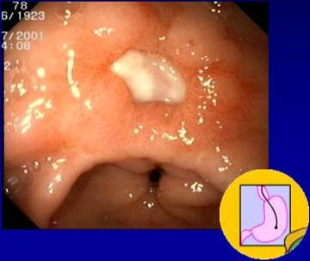
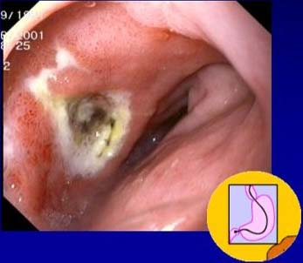
Peptic Ulcers: Gastric & Dudodenal

Slide 5
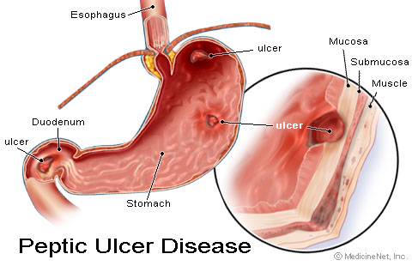
Comparing Duodenal and Gastric Ulcers

Slide 6
Duodenal Ulcers
Incidence: duodenal are 4x as common as gastric ulcers
most common in middle age
peak 30-50 years
Male to female ratio—4:1
hereditory: 3x more common in 1st degree relatives
more common in patients with blood group O
associated with increased serum pepsinogen
Helicopacter pylori( H . Pylori) infection common
up to 95%
smoking is twice as common
Notes:
Socioeconomic status may play into risk factors as well.

Slide 7
Gastric Ulcers
common in late middle age
incidence increases with age
Male to female ratio—2:1
More common in patients with blood group A
Use of NSAIDs - associated with a three- to four-fold increase in risk of gastric ulcer
Less related to H. pylori than duodenal ulcers – about 80%
10 - 20% of patients with a gastric ulcer have a concomitant duodenal ulcer

Slide 8
Etiology
The most important contributing factors are
H pylori.
NSAIDs.
acid, and pepsin hypersecretion .
Additional aggressive factors include:
smoking.
ethanol.
bile acids.
aspirin, steroids.
and stress.
Notes:
In both types of peptic ulceration, gastric and duodenal, there is an imbalance between secretion and neutralization of secreted acid.
In duodenal ulcers there is an oversecretion of acid whilst in gastric ulcers there is an impairment of mucosal protection

Slide 9
Clinical features
Symptoms:
Pain—”gnawing”, “aching”, or “burning”
Duodenal ulcers:
occurs 1-3 hours after a meal
and may awaken patient from sleep.
Pain is relieved by food, antacids, or vomiting.
Gastric ulcers:
food may exacerbate the pain while vomiting relieves it.
Nausea, vomiting, belching, dyspepsia, bloating, chest discomfort, anorexia, hematemesis, &/or melena may also occur.
nausea, vomiting, & weight loss more common with Gastric ulcers

Slide 10
Epigastric tenderness
Guaic-positive stool resulting from occult blood loss
Succussion splash resulting from scaring or edema due to partial or complete gastric outlet obstruction
A succussion splash describes the sound obtained by shaking an individual who has free fluid and air or gas in a hollow organ or body cavity.
Usually elicited to confirm intestinal or pyloric obstruction.
Done by gently shaking the abdomen by holding either side of the pelvis. A positive test occurs when a splashing noise is heard, either with or without a stethoscope. It is not valid if the pt has eaten or drunk fluid within the last three hours.

Slide 11
Differential Diagnosis
Neoplasm of the stomach
Pancreatitis
Pancreatic cancer
Diverticulitis
Nonulcer dyspepsia (also called functional dyspepsia)
Cholecystitis
Gastritis
GERD
MI—not to be missed if having chest pain

Slide 12
Diagnostic Plan
Stool for fecal occult blood
Labs: CBC (R/O bleeding), liver function test, amylase, and lipase.
H. Pylori can be diagnosed by urea breath test, blood test, stool antigen assays, & rapid urease test on a biopsy sample.
Upper GI Endoscopy: Any pt >50 yo with new onset of symptoms or those with alarm markings including anemia, weight loss, or GI bleeding.
Preferred diagnostic test b/c its highly sensitive for dx of ulcers and allows for biopsy to rule out malignancy and rapid urease tests for testing for H. Pylori.
Notes:
Rapid urease tests are considered the endoscopic diagnostic test of choice. The presence of H pylori in gastric mucosal biopsy specimens is detected by testing for the bacterial product urease. Three kits (CLOtest, Hpfast, Pyloritek) are commercially available, each containing a combination of a urea substrate and a pH sensitive indicator. One or more gastric biopsy specimens are placed in the rapid urease test kit. If H pylori are present, bacterial urease converts urea to ammonia, which changes pH and produces a color change

Slide 13
H Pylori
Urease producing, gram negative bacillus
Developing countries
Infection increases with age
Infects mucosa of stomach > inflammatory response > gastritis > increased gastrin secretion > damage to mucosa > ulceration
Increased risk of developing gastric adenocarcinoma

Slide 14
Treatment Plan: H. Pylori
Medications: Triple therapy for 14 days is considered the treatment of choice.
Proton Pump Inhibitor + clarithromycin and amoxicillin
Omeprazole (Prilosec): 20 mg PO bid for 14 d or Lansoprazole (Prevacid): 30 mg PO bid for 14 d or Rabeprazole (Aciphex): 20 mg PO bid for 14 d or Esomeprazole (Nexium): 40 mg PO qd for 14 d plus Clarithromycin (Biaxin): 500 mg PO bid for 14 and Amoxicillin (Amoxil): 1 g PO bid for 14 d
Can substitute Flagyl 500 mg PO bid for 14 d if allergic to Penicillin.
In the setting of an active ulcer, continue qd proton pump inhibitor therapy for additional 2 weeks.
Goal: complete elimination of H. Pylori. Once achieved reinfection rates are low. Compliance!
Notes:
Want a 50-60% improvement in ulcer.

Slide 15
Evaluation/Follow-up/Referrals
H. Pylori Positive: retesting for tx efficacy
Urea breath test—no sooner than 4 weeks after therapy to avoid false negative results
Stool antigen test—an 8 week interval must be allowed after therapy.
H. Pylori Negative: evaluate symptoms after one month. Patients who are controlled should cont. 2-4 more weeks.
If symptoms persist then refer to specialist for additional diagnostic testing.

Slide 16
Treatment Plan: Not H. Pylori
Medications—treat with Proton Pump Inhibitors or H2 receptor antagonists to assist ulcer healing
H2: Tagament, Pepcid, Axid, or Zantac for up to 8 weeks
PPI: Prilosec, Prevacid, Nexium, Protonix, or Aciphex for 4-8 weeks.

Slide 17
Lifestyle Changes
Discontinue NSAIDs and use Acetaminophen for pain control if possible.
Acid suppression--Antacids
Smoking cessation
dietary restrictions if certain foods are associated with problems.
Stop Alcohol
Stress reduction

Slide 18
Prevention
Consider prophylactic therapy for the following patients:
Pts with NSAID-induced ulcers who require daily NSAID therapy
Pts with a history of PUD or a complication such as GI bleeding
Pts taking steroids or anticoagulants or patients with significant comorbid medical illnesses
Prophylactic regimens that have been shown to dramatically reduce the risk of NSAID-induced gastric and duodenal ulcers include the use of a prostaglandin analogue or a proton pump inhibitor.
Misoprostol (Cytotec) 100-200 mcg PO 4 times per day
Omeprazole (Prilosec) 20-40 mg PO every day
Lansoprazole (Prevacid) 15-30 mg PO every day

Slide 19
Complications
Perforation & Penetration—into pancreas, liver and retroperitoneal space
Peritonitis
Bowel obstruction, Gastric outflow obstruction, & Pyloric stenosis
Bleeding--occurs in 25% to 33% of cases and accounts for 25% of ulcer deaths.
Gastric Cancer ( more common with gastric ulcers).

Slide 20
Surgery
People who do not respond to medication, or who develop complications:
Vagotomy - cutting the vagus nerve to interrupt messages sent from the brain to the stomach to reducing acid secretion.
Antrectomy - remove the lower part of the stomach (antrum), which produces a hormone that stimulates the stomach to secrete digestive juices. A vagotomy is usually done in conjunction with an antrectomy.
Pyloroplasty - the opening into the duodenum and small intestine (pylorus) are enlarged, enabling contents to pass more freely from the stomach. May be performed along with a vagotomy.

