Slide 1


The Reasons of Conflict
The Libyan International Medical University The Faculty Of Business
Student Name :Rabeia Elmansoury
Student number: 3483
Rabeia_3483@limu.edu.ly

Slide 2

TABLE OF CONTENTS
01
Intended Learning Outcomes
Introduction
02
03
Some of Conflict Reasons
Conclusion
05
References
2

Slide 3
Intended Learning Outcomes
IN the end of this presentation You would be able to:
Define Conflict
List Some of The Conflict Reasons
Recognize the Reasons of Conflict
3

Slide 4

Introduction
Interpersonal conflict occurs when people who are close to each other and consider their aims as being mismatched disagree (Cahn & Abigail, 2007; Folger, Poole, & Stutman, 2010).Hocker & Wilmot (2007); 2005; More particularly, conflict happens among friends ,lovers, colleagues, family members and coworkers.
4

Slide 5
Some the Conflict Reasons
5

Slide 6
Some Conflict Reasons :
Conflict mostly occurs when people are:
interdependent(significantly related); what one person does affects or has an impact on the other person.
People that are depending on one another usually treat each other equally and in a balanced way.
6

Slide 7

are mutually aware that their goals are incompatible; if one person’s goal is
achieved, then the other person’s goal cannot be achieved.
for instance, when one person wants to purchase a newer car while the other wants to reduce their loan. Note that if the couple had unlimited resources, they could purchase the car and pay off the loan and the matter would not be difficult.
7

Slide 8
perceive each other as interfering with the attainment of their own goals.: For instance, if you want to study and your roommate wants to invite some friends over , achieving either of your goals will get in the way of achieving the other.
8

Slide 9
Conclusion
conflict is a normal part of daily life it happens among both personal and social relationships and understanding the reasons why conflict could arise can truly help you maintain your relationships healthy.
the more issues there are that can cause conflict, the more interactions there are with managing conflict, and the more effects conflict has on people and relationships. Interdependence results in an increase in the breadth, depth, and quantity of topics covered.
9

Slide 10

References
Joseph A. DeVito (2016). The interpersonal communication book 14th edition .
10

Slide 11
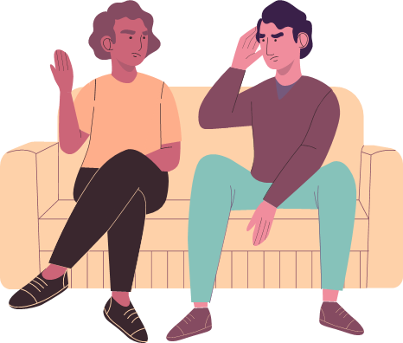
Thank You
Any Quastion?

