Slide 1


Drug abuse in pregnancy
Name: Belquees Alsonosi
Student number:2875
Block : PTS
1

Slide 2
Introduction
The use of drug during pregnancy still represent challenge to the health care ponders and in the last years there is another problem which drug abuse .
it is a major problem ,but unfortunately there is no document about the cases become of all the information in this update express
Studies done in USA.
2
Notes:
Obesity and infertility

Slide 3

OBJECTIVES:
Define substance abuse in pregnancy
Outline Prevalence of substance abuse among pregnant woman.
Outline of prenatal substance abuse.
Discus effect of nicotine, alcohol ,cannabis ,cocaine, opioid, use in pregnant and management.
3

Slide 4
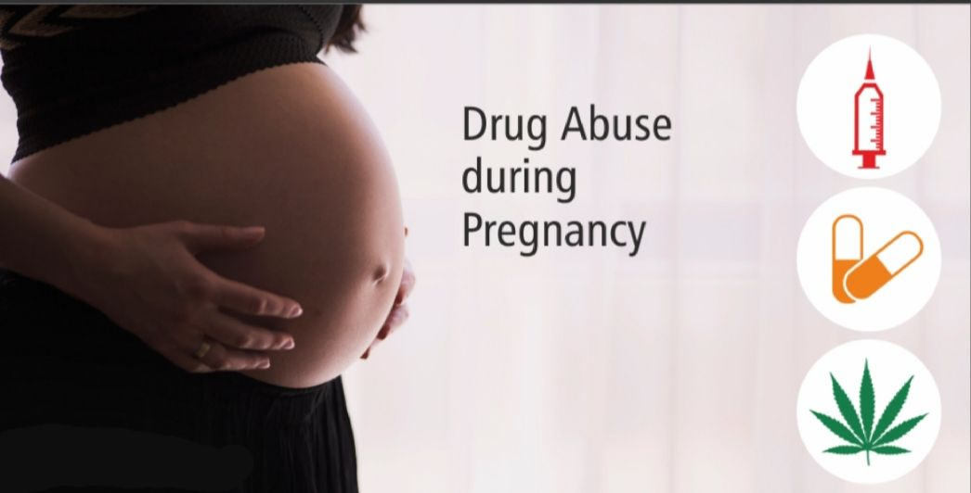

4

Slide 5
Overview
In the 1980s show an overall increase in substance abuse
Average age 20 to 30 years old.
1/3 of this population are female of child bearing age.
Most of them with low socioeconomic state, having psychological problem or dealing with domestic violence.
This pregnant drug addict often do not take advantage of medical treatment.
They often feel threatened by legal confrontation.

Slide 6
According to national surety conduced in the united states (2002-2003)

Slide 7
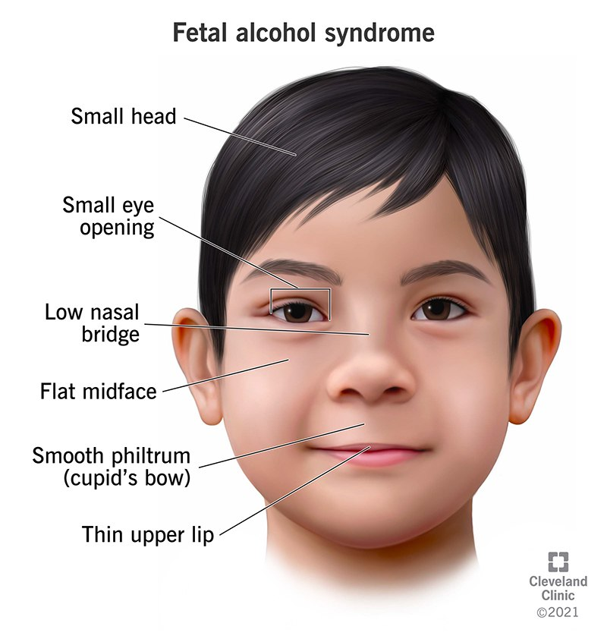
Overview
Obstetrical complication of drug abuse include
Pregnancy include HTN
Spontaneous abortion
Intrauterine growth retardation
Intrauterine fetal death
A abruption placenta
Preterm labor
Fetal alcohol syndrome
Increase the risk of infection disease

Slide 8
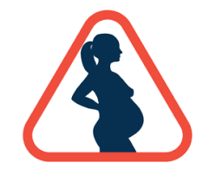
Effect substance abuse and management

Slide 9

Nicotine
1)increase risk of Intrauterine growth retardation.
2) Spontaneous abortion.
3)Premature rupture of membrane.
4)Placenta Previa.
5)abruption placenta.
6)Sudden infant death syndrome.

Slide 10
management of nicotine
Cessation of smoking during pregnancy can benefit the infant, improving birth weight and reducing the risk of prematurity.

Slide 11

Alcohol
Fetal alcohol syndrome.
Alcohol induced central nervous system dysfunction.
Low fetal weight, length and head circumference.
Facial abnormality.
Cardiac defect.
Joint malformation.
Fetal alcohol syndrome.
Others.
Pancreatitis.
Liver cirrhosis.

Slide 12
Management of alcohol
Treatment should begin with vitamin and mineral substitution like:
1- thiamine.
2-Folic acid.
3-Prenatal iron.
Furthermore
1-Alcohol elimination.
2-Social support and provision of reassurance.

Slide 13
Opioid
Increase the risk of infection disease.
Abscess formation.
endocarditis.
Congenital abnormality.

Slide 14
Management of opioid
Can be replaced during pregnancy by synthetic opioids in the from of replacement program in addition of multi-team work for better outcome of the mother and her baby.

Slide 15
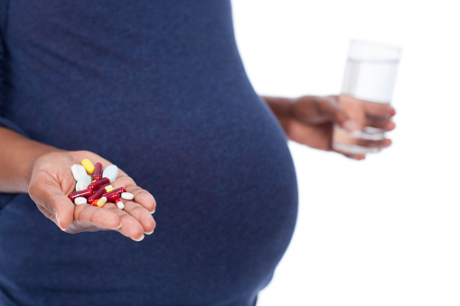
Cocaine
Malignant hypertension
Cardiac ischemia
Cerebral infection
Sudden death of the mother
Intrauterine growth retardation
Multi systems congenital anomaly
Placenta pre-via

Slide 16
Management of cocaine
Most effect treatment approach is multi- professional treatment which include obstetrician, pediatrician ,psychiatric ,behavioral therapy plus elimination off course.

Slide 17

Cannabis (marijuana )
Decrease maternal weight gain.
Immature nervous system.
The management same as nicotine abuse.

Slide 18
Future direction
Many health problem associated with the perinatal period can be prevented with adequate and timely medical care or intervention.
Pregnancy is a time during which women tend to become more motivated to reduce substance abuse ,so orientation and education in antenatal care to the mother about this problem can help.

Slide 19
Conclusion
Substance abuse in pregnancy is significant problem and had to a number of deleterious effect in mother and her offspring.
The impact of use in pregnancy varies depending the drug , point of exposure and extend of use.

Slide 20
REFREENC
1-Kuczkowski KM. The effects of drug abuse on pregnancy. Current Opinion in Obstetrics and Gynecology. 2007 Dec 1;19(6):578-85.
2-Worley J. Identification and management of prescription drug abuse in pregnancy. The Journal of perinatal & neonatal nursing. 2014 Jul 1;28(3):196-203.
3-Ludlow J, Chrislmas L, Paech MJ, Orr B. Drug abuse and dependency during pregnancy: anaesthetic issues. Anaesthesia and intensive care. 2007 Dec;35(6):881-93
4-Kendler KS, Ohlsson H, Svikis DS, Sundquist K, Sundquist J. The protective effect of pregnancy on risk for drug abuse: a population, co-relative, co-spouse, and within-individual analysis. American Journal of Psychiatry. 2017 Oct 1;174(10):954-62.
5-Patrick SW, Schumacher RE, Benneyworth BD, Krans EE, McAllister JM, Davis MM. Neonatal abstinence syndrome and associated health care expenditures: United States, 2000-2009. Jama. 2012 May 9;307(18):1934-40

Slide 21
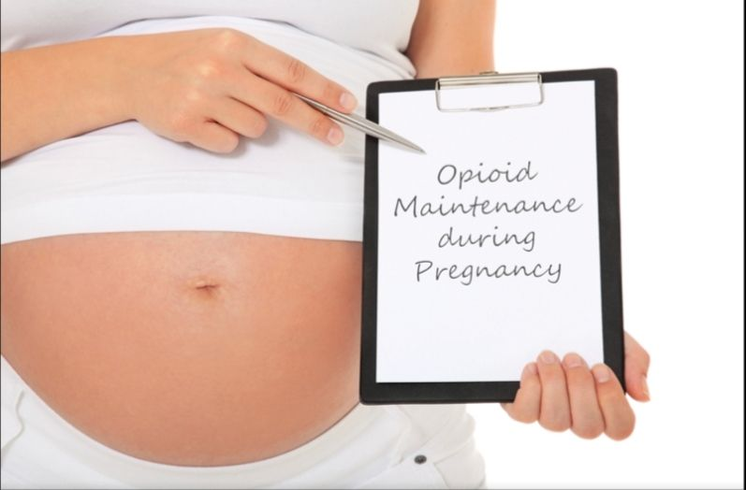

Thank you
17

