Slide 1
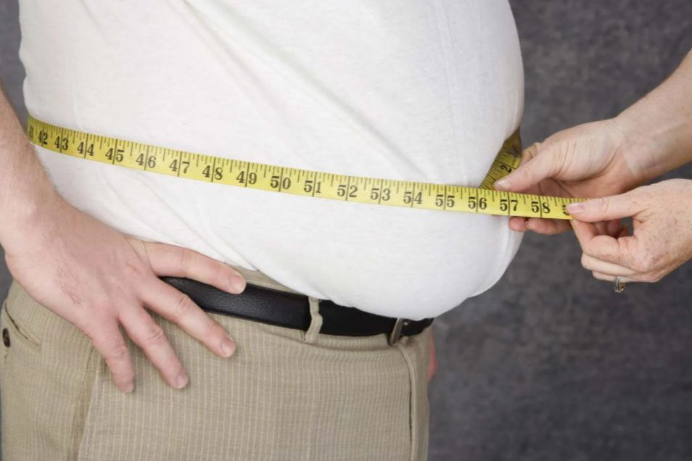


OBESITY &
CARDIOVASCULAR DISEASES
Presented by : Fatima Milad
Student ID : 3456
Block : PTS
Date: 6/6/2022

Slide 2
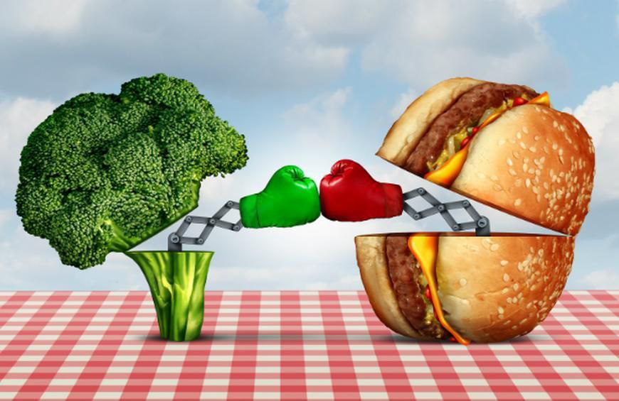
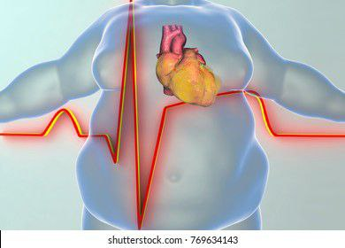
OBJECTIVES :
- Define the obesity & list the causes of the obesity.
- Outline the effect of the obesity on the body health.
- Discuss how the obesity affect the cardiovascular system (CVS).
- List the complication of (CVS) diseases.
- Outline how to prevent the overweight.

Slide 3
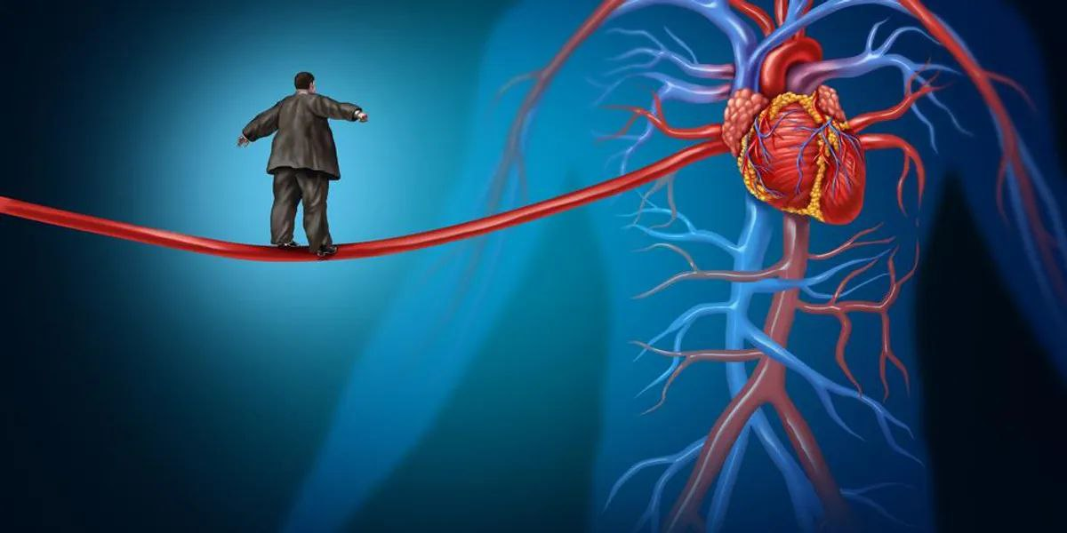
Introduction :

Slide 4
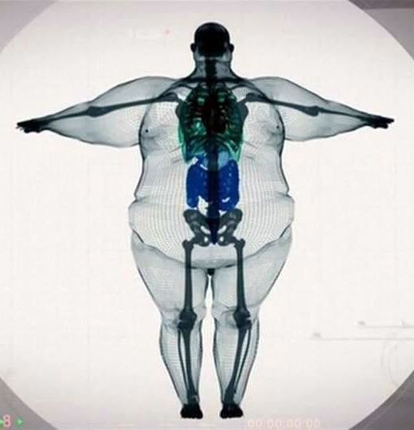
Definition of the obesity?
Obesity is an abnormal or excessive fat accumulation that presents a risk to health .
Genetic
Metabolic
Drugs
Behavioral

Slide 5

Diseases caused by obesity:
Musculoskeletal disorders
Like:
Type 2 diabetes
Osteoarthritis
Cardiovascular diseases
Some cancers
Heart disease
stroke
Breast
colon

Slide 6
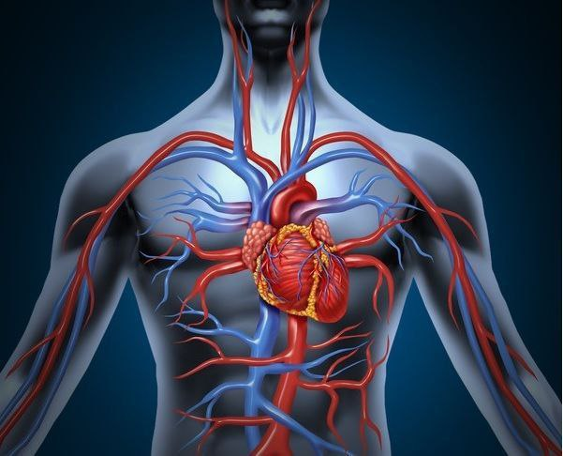
Cardiovascular system (CVS):
- Its primary function is to transport nutrients and oxygen-rich blood to all parts of the body and to carry deoxygenated blood back to the lungs
The (CVS) consists of :
Heart
Blood vessels
Blood itself

Slide 7
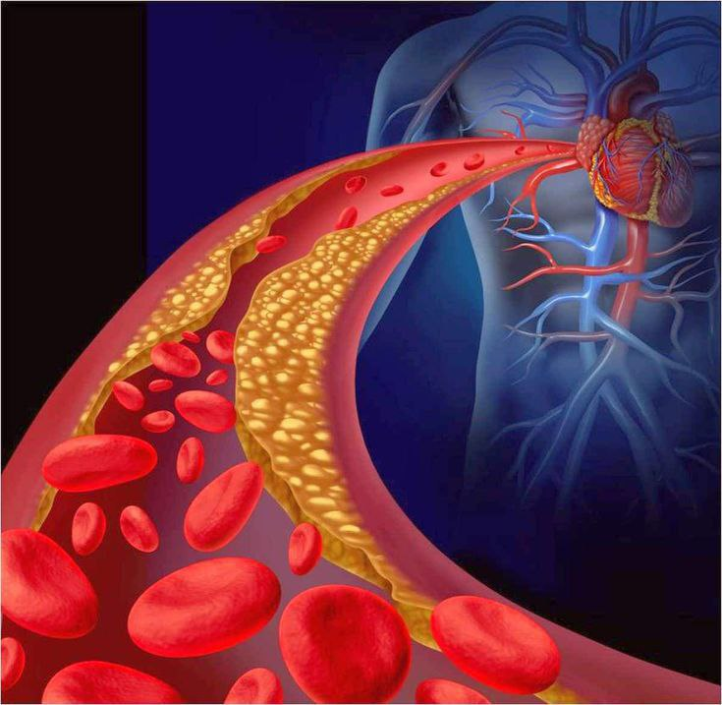
The atherosclerosis :
- It is the buildup of fats , cholesterol and other
substances in and on your artery walls .
This buildup is called plaque

Slide 8
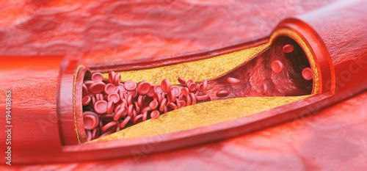
DISEASES DUE TO ATHEROSCLEROSIS
Hypertension
Coronary artery disease
Heart attack
Stroke

Slide 9
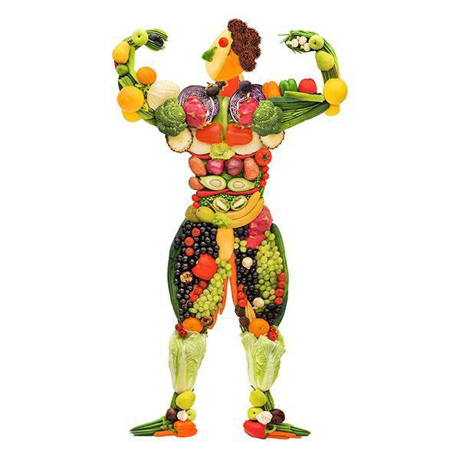
How to prevent obesity ?
- Consume less “bad” fat and more “good” fat
- Consume less processed and sugary foods
- Eat plenty of dietary fiber
- Eat more servings of vegetables and fruits
- Engage in regular aerobic activity
- Focus on eating low-glycemic index foods

Slide 10
Conclusion
Generally Obesity can be cured . The majority of the people do not
recognize how harmful obesity is to the body and their overall wellbeing .
To be in a good physical shape and healthy diet ,exercising three to four
times a week Is the solution to not becoming obese.
Lets change our style of living by living healthy lives

Slide 11
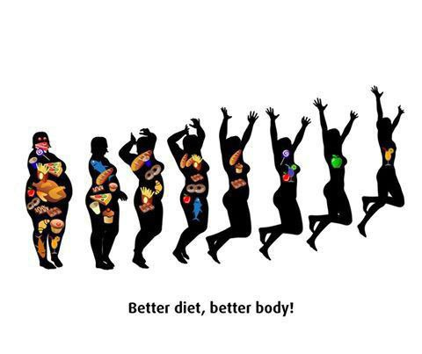

Slide 12
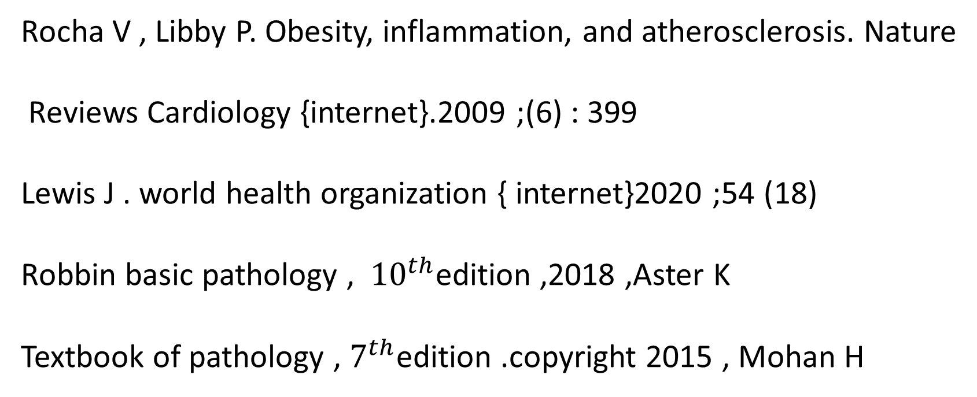
Reference
Rocha V , Libby P. Obesity, inflammation, and atherosclerosis. Nature
Reviews Cardiology {internet}.2009 ;(6) : 399
Lewis J . world health organization { internet}2020 ;54 (18)
Robbin basic pathology , ${10}^{th}$edition ,2018 ,Aster K
Textbook of pathology , $7^{th}$edition .copyright 2015 , Mohan H

Slide 13


