Slide 1


Diabetes Type I" "
First year In medicine
Name is : nismah_3468
2021_2022
LIMU:AMS

Slide 2
Objective
1. Definition of diabetes.
2. Describe the symptoms of diabetes.
3. Define the causes of diabetes in pregnant women and children.

Slide 3

:Introduction to diabetes
Chronic metabolic disorder Diabetes is a global problem. It is estimated that in 2010 there were 285 million people globally (about 6.4% of the adult population) suffering from this disease..

Slide 4
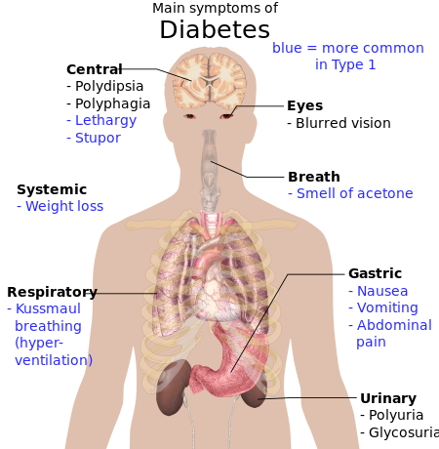
What is diabetes?
A group of diseases that affect how the body uses blood sugar (glucose). Glucose is essential to your health; Because it is an important source of energy for the cells that make up muscles and tissues. It is also the main energy source for the brain

Slide 5
Symptoms
• Excessive thirst
• frequent urination
• Feeling very hungry
• Unexplained weight loss

Slide 6
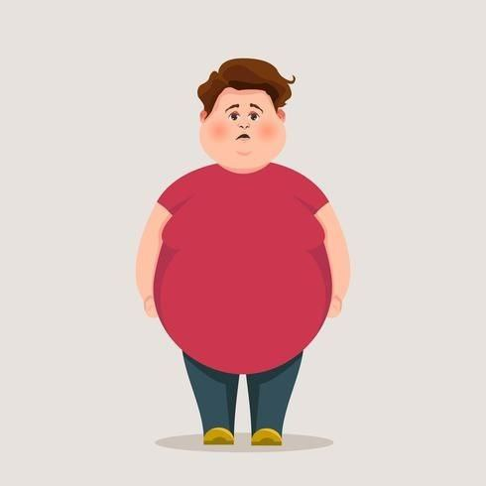
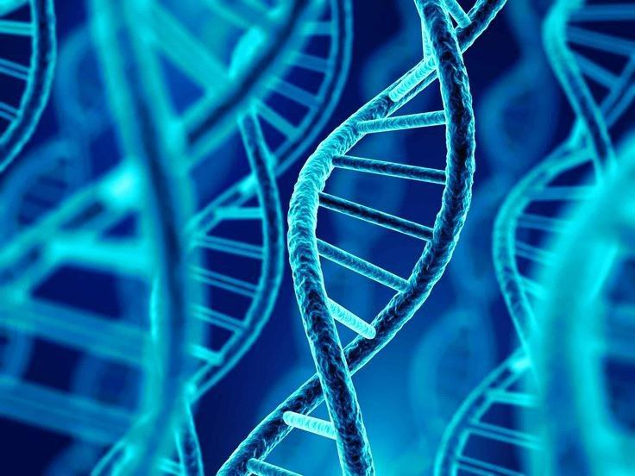
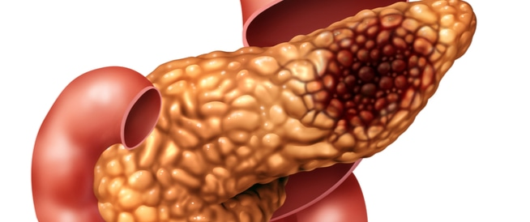
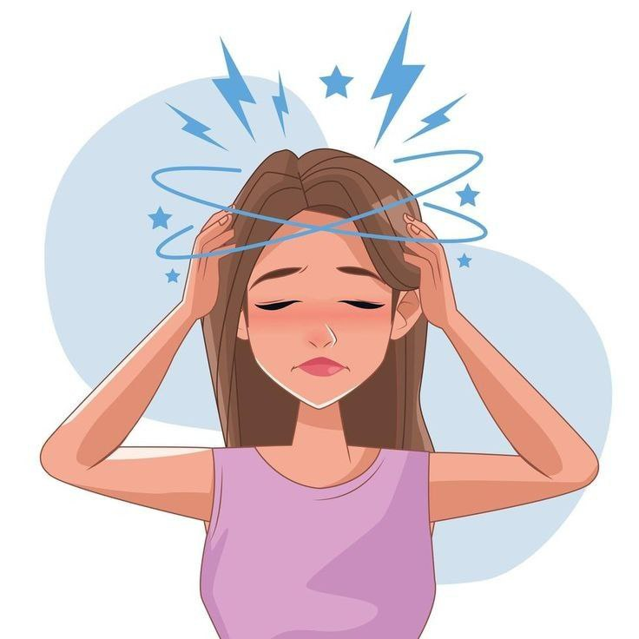
Causes of diabetes
obesity
hereditary gene
pancreatic damage
Psychological and nervous stress

Slide 7
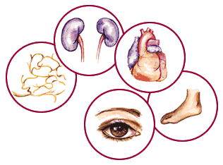
Diabetes complications
diabetic complications such as impairment of immune system, periodontal disease, retinopathy, nephropathy, somatic and autonomic neuropathy, cardiovascular diseases and diabetic foot

Slide 8
Pregnancy diabetes
During pregnancy, the placenta secretes hormones to maintain your pregnancy. These hormones make your cells more resistant to insulin.
Normally, the pancreas secretes more insulin to overcome this resistance. But your pancreas can sometimes not keep up with conditions. When this happens, less glucose enters your cells and more remains in your blood, resulting in gestational diabetes

Slide 9
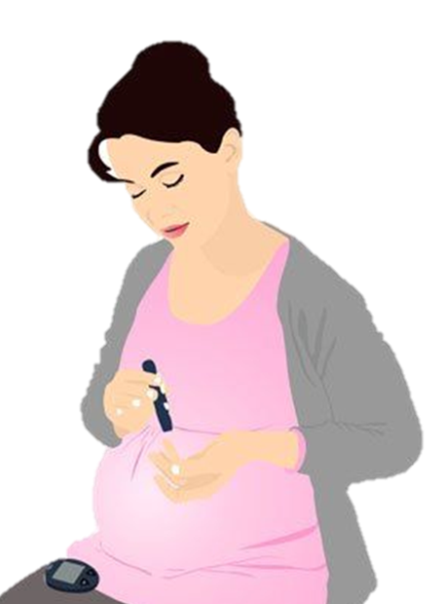
Pregnancy diabetes
Gestational diabetes is diagnosed by prenatal screening, not by reported symptoms.

Slide 10
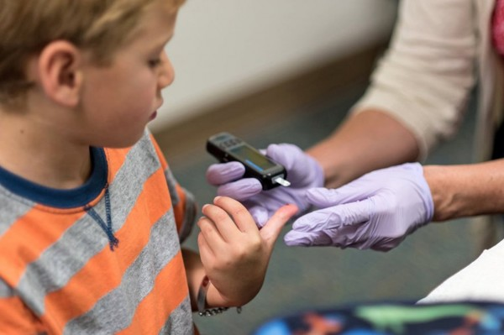
How do children get infected?
The child has strong genes from the mother and the father with diabetes

Slide 11

Summary
. Diabetes is one of the most dangerous diseases that accompany the patient, take care of yourself well, your health is the most important

Slide 12
Reference:
© 2014 John Wiley & Sons A/S. Published by John Wiley & Sons Ltd.1
2.(3) 2014 USRDS annual data report: Epidemiology of kidney disease in the United States.

Slide 13
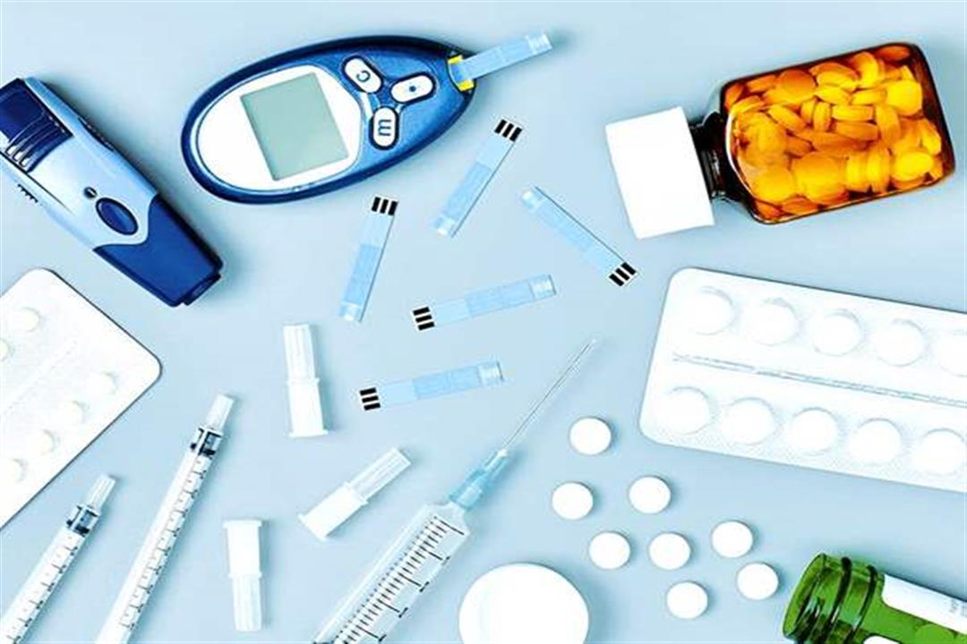
Thank you for listening to me

