Slide 1
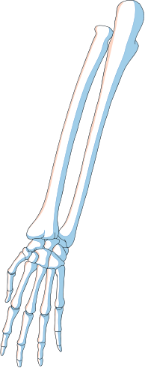


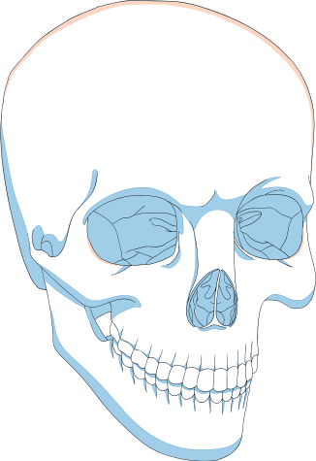
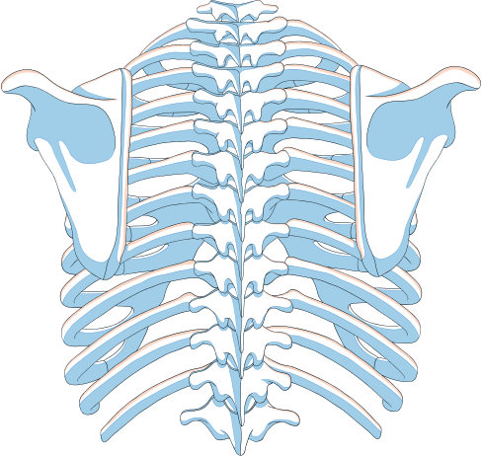
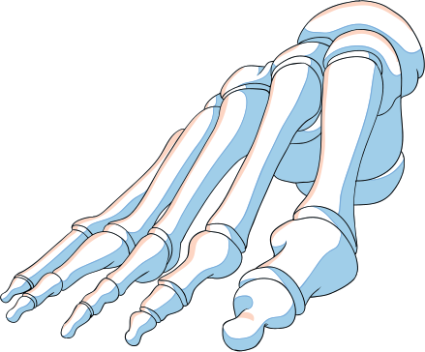
SARCOMA
CANCER
NAME: ALAA ELJALI
STUDENT NUMBER : 3362
BLOCK: PTS
FIRST YEAR IN AMS
DATE:1\6\2021

Slide 2
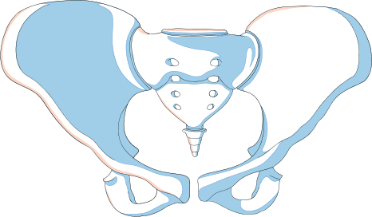
SARCOMA AND ITS TYPES
LIST OSTEOSARCOMA AND THEIR SYMPTOMES
TREATMENT
OBJECTIVES

Slide 3
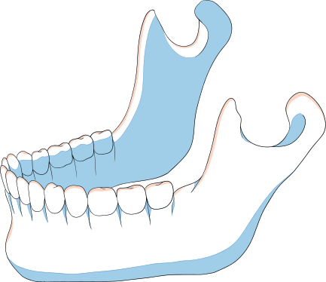
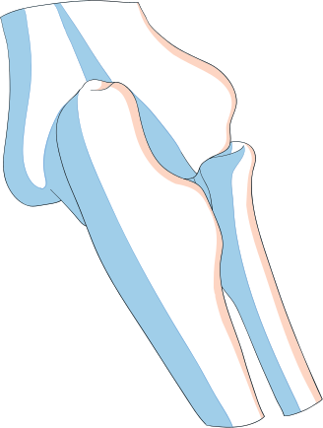
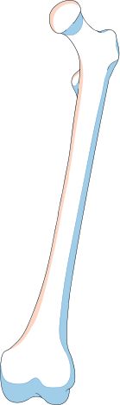
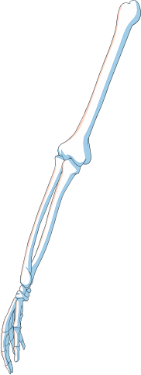
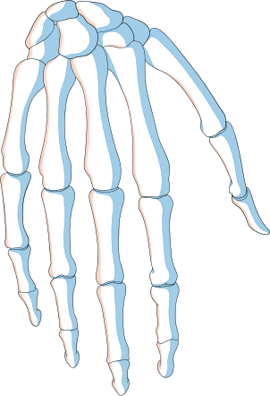
SARCOMA
A sarcoma is a rare kind of cancer which is different from common cancer because it happens in a different kind of tissue
there are more than 50 types of sarcoma

Slide 4
TYPES OF SARCOMA
SOFT TISUE SARCOMA
OSTEOSARCOMA
Sarcoma is soft tissue disease in which malignant cancer cells from the soft tissue in the body
Also called osteogenic sarcoma, is a kind of bone cancer.
It happens when the cells that grow new bone form a cancerous tumor

Slide 5
osteosarcoma
Osteosarcoma (also called osteogenic sarcoma)
is the most common type of cancer that starts in the bones.

Slide 6

The cancer most common occur in
children , teens, and young adults. Teens are the most commonly affected age group
but osteosarcoma can develop at any age
For information there is differences between childhood cancers and adult cancers

Slide 7
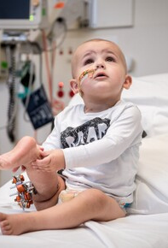
Leukemia
Brain and spinal cord tumors
Neuroblastoma
Wilms tumor
Lymphoma
Rhabdomyosarcoms
Retinoblastoma
Bone cancer
The most common cancer in children are:

Slide 8
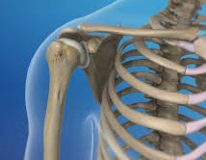
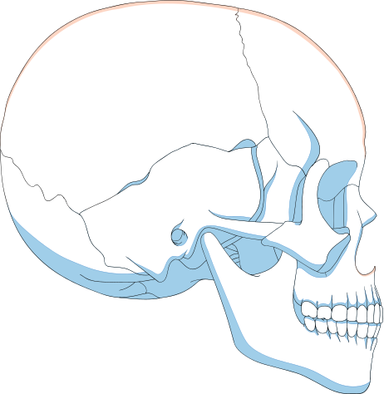
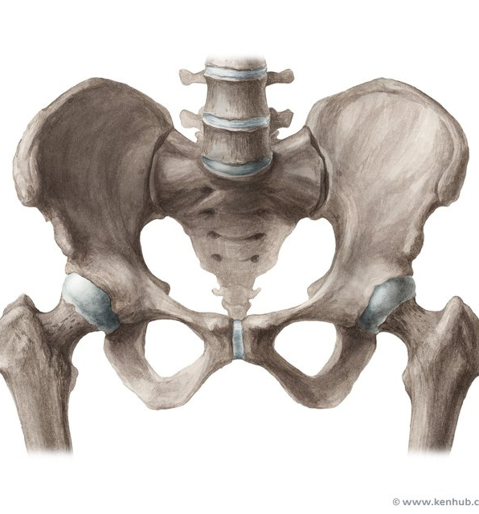
HAPPIN IN OLDER ADUITS IN 3 BONES
pelvis
shoulder bone
skull

Slide 9
What is the symptoms ?

Slide 10
Osteosarcoma symptoms
Swelling or lumps around bones or the ends of bones
Bone or joint pain or soreness.
Broken bones without a clear reason
Pain at night
Pain after exercise
Limping

Slide 11
THE TREATMENT
Surgery
takes the tumor out of your
body
Radiotherapy
can shrink the tumor before surgery.
Chemotherapy
drugs can also be used with or instead of surgd.
target therapy
newer treatments that use drugs or antibodies
from the immune system to block the growth of cancer cells

Slide 12
CONCLUSION
Osteosarcoma is a most common bone forming cancer
Common in age 15 to 25 located in metaphysis
They greatly vary in radiological & pathological feature
Therefore needs careful diagnosis to differentiate from other bone tumor

Slide 13
Reference
1. Greenspan A. Orthopedic imaging, a practical approach. Lippincott Williams & Wilkins. (2004) ISBN:0781750067. Read it at Google Books - Find it at Amazon
2. Zwaga T, Bovée JV, Kroon HM. Osteosarcoma of the femur with skip, lymph node, and lung metastases. Radiographics. 28 (1): 277-83. doi:10.1148/rg.281075015 - Pubmed citation
3. Kumar V, Abbas AK, Fausto N et-al. Robbins and Cotran pathologic basis of disease. W B Saunders Co. (2005) ISBN:0721601871. Read it at Google Books - Find it at Amazon
4. Murphey MD, Robbin MR, Mcrae GA et-al. The many faces of osteosarcoma. Radiographics. 17 (5): 1205-31. subtypes. Radiographics. 2010;30 (6): 1653-72. doi:10.1148/rg.306105524 - Pubmed citation

Slide 14
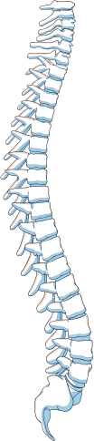
THANK
YOU!
Do you have any questions?

