Slide 1
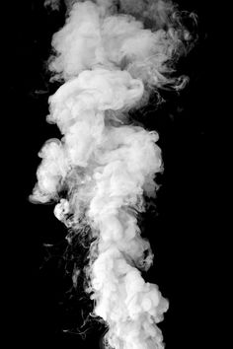


By: Sara elallegy 3310 year 1 (2021-2022) block: PTS June 1st, 2022
1.
Secondhand Smoking

Slide 2
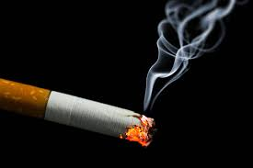
Objectives
2.
Compare active and secondhand smoking
Discuss health risks of secondhand smoking
Identify how secondhand smoking is more dangerous in enclosed spaces
Outline how to avoid secondhand smoking
Explain secondhand smoking exposure rates
Outline how fast symptoms start to occur

Slide 3
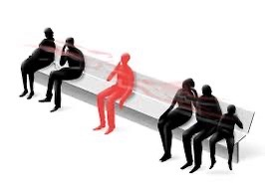
Introduction
What is secondhand smoking?
Secondhand smoking is the unintended inhalation of tobacco smoke.
3.

Slide 4
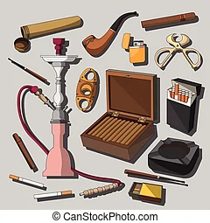
Secondhand Smoke
Contains over 7000 dangerous/ harmful chemicals :
Chromium
Formaldehyde
Ammonia
Hydrogen cyanide
4.

Slide 5
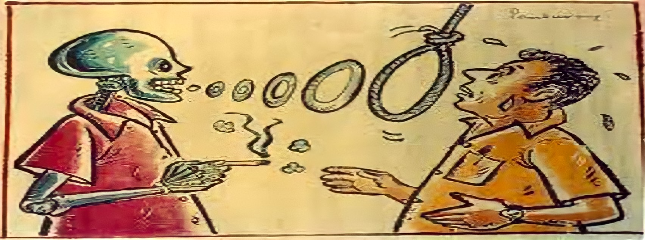
Active Vs Secondhand Smoking
5.

Slide 6
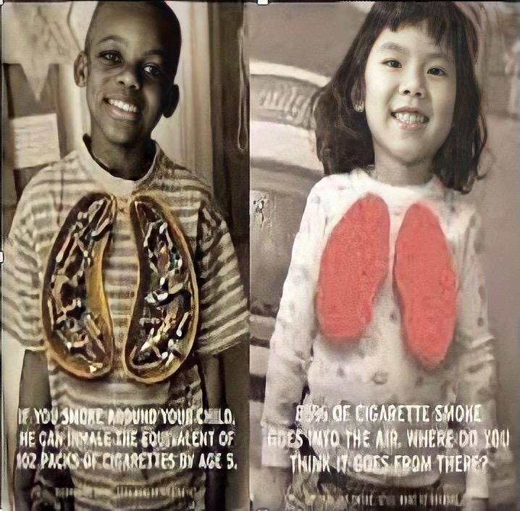
Health Risks
In children & infants:
Asthma
Pneumonia
Bronchitis
Ear infections
Breathlessness and coughing
8.

Slide 7
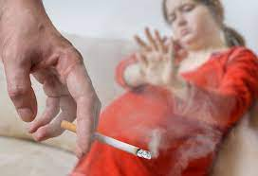
Health Risks
In pregnant women:
Stillbirths
Sudden infant death syndrome
Premature births
Low birth weight
Slowed growth
7.

Slide 8
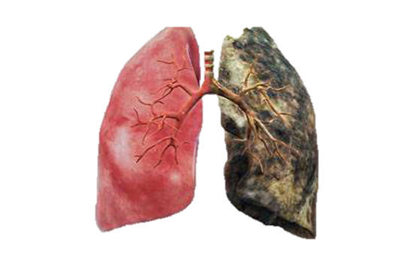
Health Risks
6.
In adults:
Heart problems
Lung cancer
Emphysema
Nasal and chest infections
Asthma
Leukemia

Slide 9
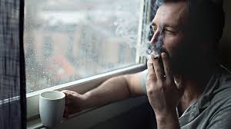

Secondhand smoking in enclosed spaces
9.
Cars
Carpet
Chairs
Houses
Blankets, bedding, carpet, furniture,
Walls, windows, appliances

Slide 10

How to avoid secondhand smoking
Don’t allow smoke into your house
Avoid recreational places, restaurants and hotels that allow smoking indoors
Don’t allow anyone to smoke inside your car
If you are a smoker quit
10..

Slide 11
How fast symptoms come around
After 5 minutes | After 25 minutes | After 2 hours
Arteries become less flexible | Blood starts clotting, Fat deposits start to for in the blood vessels | Arrythmia
 | Stroke | Myocardial infarction
 |  | Serious cardiac problems
11.

Slide 12
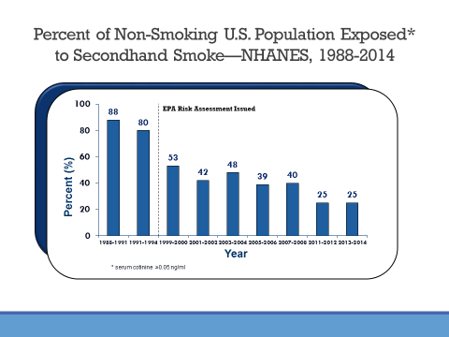
Reducing secondhand smoke exposure in the US (25-year report)
12.

Slide 13

Conclusion
In conclusion, the one message I wanted to pass to all of you is that secondhand smoking shouldn’t be taken lightly, it is a serious topic that is rarely spoken about.
Unfortunately in third world countries like Libya exposure rates are very high, because there is a lac of control and education about these topics
13.

Slide 14
References
2022. [online] Available at: <https://www.cdc.gov/tobacco/basic_information/secondhand_smoke/index.htm> [Accessed 1 June 2022].
US EPA. 2022. Secondhand Smoke and Smoke-free Homes | US EPA. [online] Available at: <https://www.epa.gov/indoor-air-quality-iaq/secondhand-smoke-and-smoke-free-homes> [Accessed 1 June 2022].
2022. [online] Available at: <https://www.cdc.gov/tobacco/basic_information/secondhand_smoke/index.htm> [Accessed 1 June 2022].
2022. [online] Available at: <https://www.cdc.gov/tobacco/basic_information/secondhand_smoke/index.htm> [Accessed 1 June 2022].
14.

Slide 15


15.

