Slide 1


Association between Peptic Ulcer and Periodontitis
Amjad Awad Albarasi
2877
Supervised by Dr .Zainab Almograbi

Slide 2
Objectives
2
Definition of Periodontitis?
Definition of Peptic Ulcer Disease
pathophysiology of Peptic Ulcer Disease
Previous Studies on association of Periodontitis with Peptic Ulcer Disease

Slide 3
Introduction
3
Previous studies have suggested that peptic ulcer disease (PUD) including gastric and duodenal ulcers might be associated with periodontitis

Slide 4
Periodontitis
4

Slide 5
What is Periodontitis ?
5
Periodontitis (PD) is defined as an inflammatory disease of the supporting tissues surrounding the teeth .Inflammatory periodontal disease results from a complex interaction between the subgingival biofilm and the host immune–inflammatory events

Slide 6
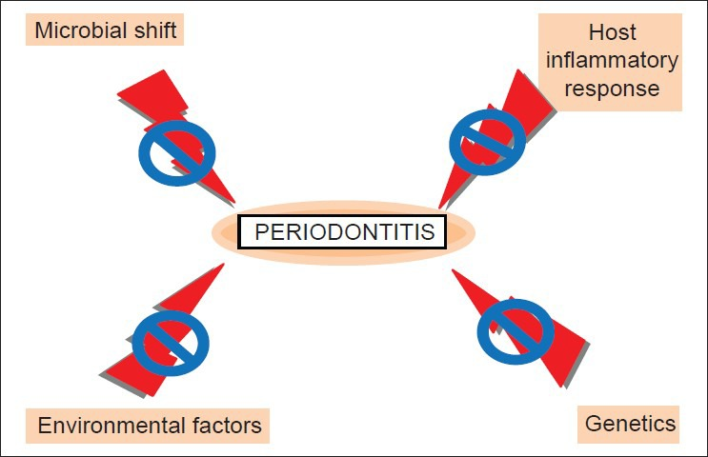
6

Slide 7
Peptic Ulcer
7

Slide 8
Peptic Ulcer Disease
8
Peptic ulcer disease (PUD) is a disease located in the gastric or duodenal part of the gastrointestinal tract that mainly involves the mucosa layer. The two main risk factors for PUD are Helicobactor pylori (H. pylori) infection and medication consumption, especially of nonsteroid anti-inflammatory drugs (NSAIDs)

Slide 9
Pathophysiology

Slide 10

Pathophysiology
10
H.Pylori
NSAIDs
H. pylori is a Gram-negative bacterium that colonizes mainly in the gastric mucosa and its presence has been universally associated with chronic gastritis, peptic ulcers, and mucosa-associated lymphoid tissue lymphoma
Inhibition of cyclooxygenase COX-1 in the gastrointestinal tract leads to a reduction of prostaglandin secretion and its cytoprotective effects in gastric mucosa. This therefore increases the susceptibility to mucosal injury.

Slide 11
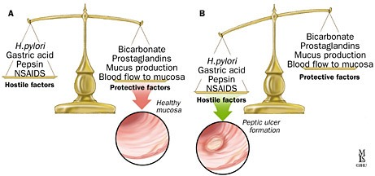
Protective vs. Hostile Factors
11
Excessive gastric acid secretion is only one factor in the pathogenesis of peptic ulcer disease.
Decreased mucosal defense against gastric acid is another cause.
The integrity of the upper gastrointestinal tract is dependent upon the balance between “hostile” factors and “protective” factors

Slide 12
Previous Studies

Slide 13
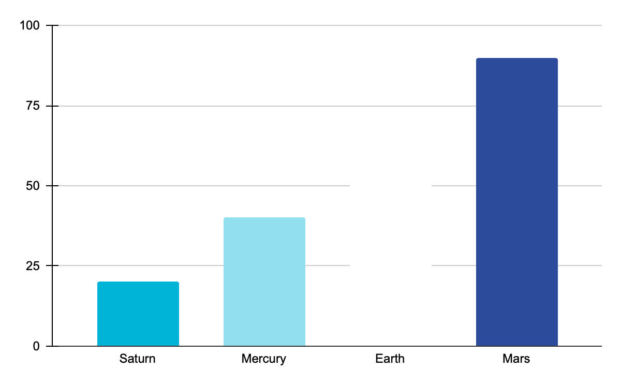
Previous Studies
13
the chronic inflammation which contributed to periodontitis is associated with multiple systemic diseases including diabetes mellitus , rheumatoid arthritis ,Many studies have mentioned that the periodontal reservoir harvested H. pylori and caused inflammation, which induced PD. Some studies have shown that the presence of H. pylori in dental plaque via different detection methods might be a possible source of infection and reinfection of the stomach

Slide 14
H. pylori infection plays a crucial role in the pathogenesis of PUD. H. pylori infection is involved in various gastroduodenal pathologies, and evokes the production of proinflammatory interleukin-1beta, leading to the reduction of blood flow to the gastroduodenal tract and increasing the risk of peptic ulcers.
H. pylori can colonize not only in the stomach, but also in the oral cavity. The oral cavity may be a reservoir for H. pylori and causing periodontal disease
14

Slide 15
Conclusion
15
A positive association between PUD and PD has been found . The results of many studies had showed that the clinical value for both dental and gastroenterological practitioners, suggesting a newer treatment consideration for PUD.

Slide 16
References
16
Al Asqah, M., Al Hamoudi, N., Anil, S., Al jebreen, A. and Al-hamoudi, W., 2022. Is the presence ofHelicobacter pyloriin the Dental Plaque of Patients with Chronic Periodontitis a Risk Factor for Gastric Infection.
Yu, H., Chen, T., Wei, C. and Chang, Y., 2022. Association between Peptic Ulcer Disease and Periodontitis: A Nationwide Population-Based Case-Control Study in Taiwan.

Slide 17
Thank You

