Slide 1

Verbal And non-verbal Communication
Interpersonal Communication (7027)
By:
Abdurrahman Alkalani 3152
Yakoub Elwerflly 3194
Yousef Almarimi 3287
Mohamed Fadel 3189
Submitted To:
Mr. Farag Elmegresi
15/12/2021

Slide 2
Table Of Contents
01
02
04
05
03
Introduction
Verbal Communication
Types Of Verbal
Communication
06
Non-Verbal Communication
Conclusion
Types Of Non-Verbal Communication
1

Slide 3
01
Introduction
2

Slide 4
Introduction
Communication is the process of passing or exchanging ideas, emotions, information, and thoughts between two or more people. When a meaningful interaction happens among people, then effective communication takes place.
In simple words, the way people perceive and understand the meaning of words or sentences or physical actions, and then a process of communication happens.
3

Slide 5
02
Verbal Communication
4

Slide 6

Verbal Communication
Verbal communication is likely the most obvious and well-understood style of communication, and it is unquestionably a powerful tool in your toolkit. Simply put, verbal communication is the exchange of information between two people through the use of words.
5

Slide 7
03
Types Of Verbal Communication
6

Slide 8
Types Of Verbal Communication
Formal vs. informal communication: We normally employ oral communication casually and written communication formally.
Synchronous vs. Asynchronous Communication: Synchronous communication occurs in real time, for as during a conversation with a friend. Asynchronous communication, on the other hand, refers to communication that is not immediate and takes place over a longer period of time, such as letters, emails, or even text messages.
Written communication: is routinely stored and recorded for later retrieval, whereas verbal communication is not.
7

Slide 9
04
Non-Verbal Communication
8

Slide 10
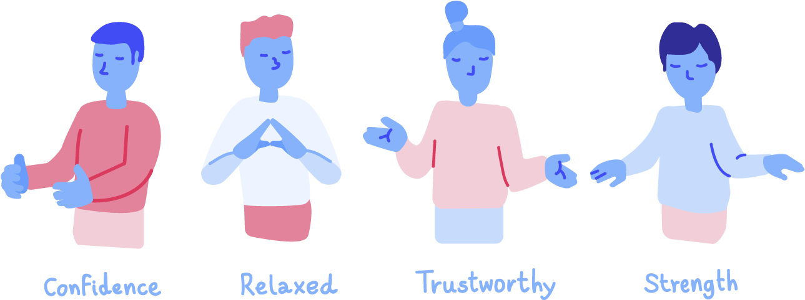
Non-Verbal Communication
A substantial portion of our communication is nonverbal. Experts have found that every day we respond to thousands of nonverbal cues and behaviors including postures, facial expressions, eye gaze, gestures, and tone of voice. From our handshakes to our hairstyles, nonverbal details reveal who we are and impact how we relate to other people.
9

Slide 11
05
Types Of Non-Verbal Communication
10

Slide 12
Non-Verbal Communication
Facial Expression
Gestures
Proximity
Touch
Eye Contact
Appearance
11

Slide 13
06
Conclusion
12

Slide 14
Conclusion
In conclusion, in order to obtain good communication skills through verbal and nonverbal techniques, one must be capable of identifying the combination of communication functions that will result in success in the communication strategy or plan to be implemented. They interrelate to transmit meaning when both verbal and nonverbal messages are taken into account.
13

Slide 15
References
Learning, L. (n.d.). Business Communication Skills for managers. Lumen. R, from https://courses.lumenlearning.com/wm-businesscommunicationmgrs/chapter/verbal-and-nonverbal-communication/.
Doyle, A. (2020, September 17). List of verbal communication skills employers seek. The Balance Careers. Retrieved from https://www.thebalancecareers.com/verbal-communication-skills-list-2059698.
14

