Slide 1
Esophageal Disorders
Dr. Nadia zawi
Department of Gastroenterology
BMC

Slide 2
Objectives
To understand the anatomy and the physiology of the oesophagus and their relation ship to disease.
The clinical features , investigations , and treatment of different types of diseases.

Slide 3
Oesophageal diseases due to :-
Motility.
Reflux.
Infectious.
Neoplastic.
Oesophageal varices ( liver cirrhosis).

Slide 4
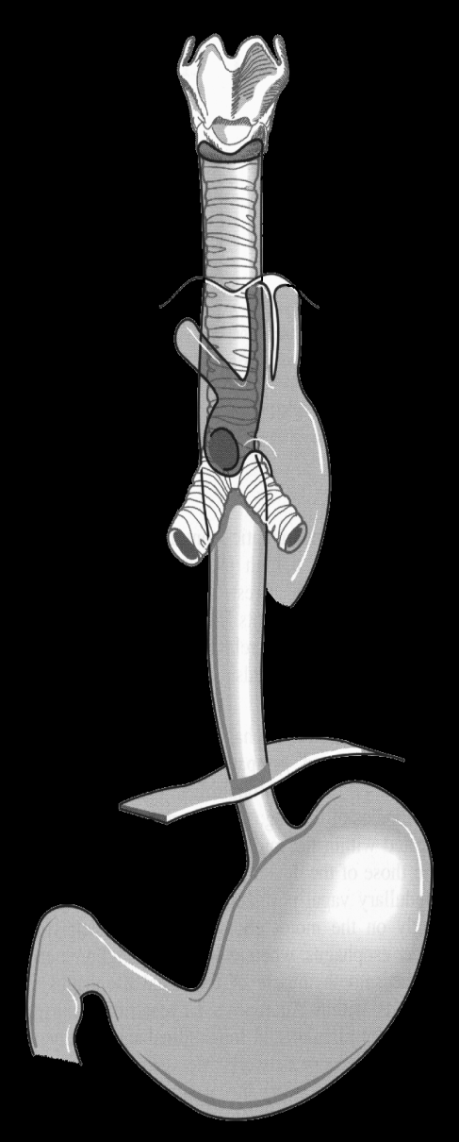
Oesophageal anatomy
Upper Esophageal
Sphincter (UES)
Esophageal Body
(cervical & thoracic)
length
18 to 24 cm
Lower Esophageal
Sphincter (LES)

Slide 5
physiology
The upper esophageal sphincter (UES) is tonically closed and contracts during inspiration, preventing air from entering into the gastrointestinal tract, and reflux. It relaxes during swallow, belching and vomiting.
The lower esophageal sphincter (LES) maintains a steady baseline tone (~20 mm Hg) to prevent gastric contents from entering the esophagus. The LES also contracts during periods of increased intra-abdominal pressure, preventing reflux due to the pressure build up in the abdomen

Slide 6
. The esophagus has 2 muscle layers: the inner circular layer and the outer longitudinal layer.
The longitudinal muscle shortens the esophagus, while the circular muscle forms lumen-occluding ring contractions. The combination of these localized contractions is responsible for peristalsis.
The proximal esophagus contains striated muscle .
the distal esophagus smooth muscle.

Slide 7
I - Motility Disorders
(classification)
upper esophageal
  UES disorders
  neuromuscular disorders
esophageal body
  achalasia
  diffuse esophageal spasm
  nutcracker esophagus
  nonspecific esophageal dysmotility
LES
  achalasia
  hypertensive LES
primary disorders
  achalasia
  diffuse esophageal spasm
  nutcracker esophagus
  nonspecific esophageal dysmotility
secondary disorders
  severe esophagitis
  scleroderma
  diabetes
  Parkinson’s
  stroke
Notes:
These can be further divided into hypomotlity and hypermotlity disorders.

Slide 8
Achalasia
idiopathic disorder of muscle of oesophagus due to loss of ganglionic cells in the mesenteric plexus.
loss of peristalsis.
increased resting tone of lower sphincter.
loss of normal relaxation with swallowing.
muscular spasm.

Slide 9
epidemiology
  *1-2 per 200,000 population
  *usually presents between ages 25 to 60
  *male=female
  *Caucasians > others
  *average symptom duration at diagnosis: 2-5 years

Slide 10
Clinical Presentation
clinical presentation
  solid dysphagia 90-100% (75% also with dysphagia to liquids)
  post-prandial regurgitation 60-90%
  chest pain 33-50%
  weight loss
  nocturnal cough and recurrent aspiration

Slide 11
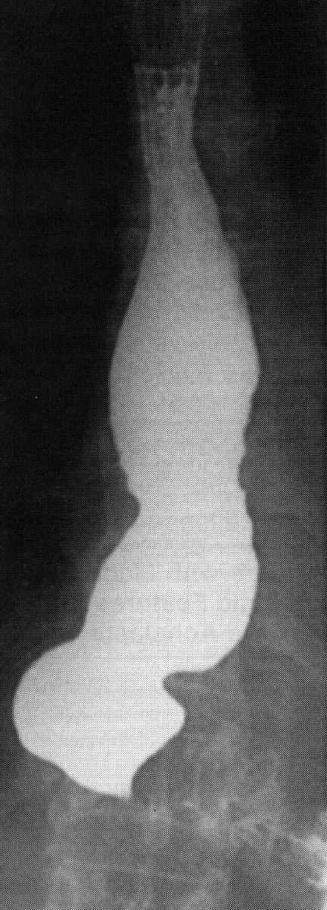
Diagnostic Work Up
  Plain film (air-fluid level, wide mediastinum, absent gastric bubble, pulmonary infiltrates)
  Barium esophagram (dilated esophagus with taper at LES) Bird peak
    good screening test (95% accurate)
  Endoscopy (rule out GE junction tumors, esp. age>60)
  Esophageal manometry (absent peristalsis, ↓ LES relaxation, & resting LES >45 mmHg)

Slide 12
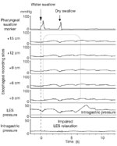
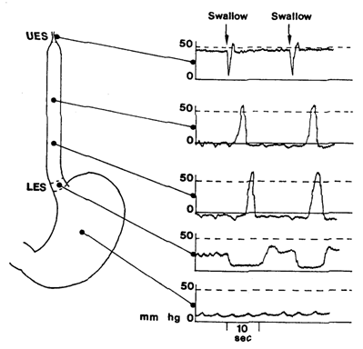
Manometry in achalasia
Normal
Achalasia

Slide 13
Treatment of Achalasia
Aim of trearment to reduce LES pressure and
To increase emptying.
Drugs: Nitrates and Calcium Channel Blockers. (Reduces LES pressure)
Botulinum Toxin:
- prevents ACH release at NM junction.
- Needs repetitive sessions.
endoscopic Balloon dilatation.
surgical myotomy.

Slide 14
Spastic Motility Disorders of the Esophagus
Diffuse Esophageal Spasm :-
Uncoordinated contraction , frequent non-peristaltic contractions
Nutcracker Esophagus:- –
high pressure peristaltic contractions
Hypertensive LES:-
high LES pressure >45 mm Hg , normal peristalsis
Nonspecific Esophageal Dysmotility:-
abnormal motility pattern
Clinical Presentation:
Dysphagia to solids and liquids.
Chest Pain .

Slide 15
Treatment
  Reassurance.
  nitrates, anticholinergics, hydralazine –
  all unproven
  calcium channel blockers - too few data with negative controlled studies in chest pain
  psychotropic drugs – trazodone, imipramine and setraline effective in controlled studies

Slide 16
II- Disorders due to reflux
GERD
Abnormal retrograde movement of stomach contents to oesophagus(Hydrochloric acid, pepsin)

Slide 17
Normally, reflux prevented by:
-Lower oesophageal sphincter
-Anatomic structure (acute angle with stomach, RT crus of diaphragm)
-Oesophageal peristaltic clearance
-Swallowed saliva
-Gravity
Reflux more likely to occur when:
-Decreased tone of sphincter
-Sliding hiatal hernia
-Decreased oesophageal clearance
-Decreased saliva production
-When lying down

Slide 18
Symptoms:
heartburn,
acid regurgitation,
water brash,
dysphagia,
A typical symptoms
-asthma.
- chest pain.
- laryngitis.
- cough.

Slide 19
Diagnosis:
Diagnosis of GERD remains doutful .
  50-60% of patients have heartburn or acid regurgitation symptoms.
PH study is used :
- if the diagnosis of GERD is in doubt
- to determine whether the chest pain or other atypical symptoms correlate with acidreflux events.
- esophageal pH studies:-
24 hours monitoring of PH: -
reduction in ph less than 4 .

Slide 20
endoscopy:
  very low incidence of endoscopic findings. microscopic evidence of oesophagitis indications of endoscopy:-
  *Alarm symptoms
  *Empiric therapy failure
  *Preoperative evaluation(HH).
  *Detection of Barrett’s esophagus
  “PPI Test” may be best and most cost-effective approach.

Slide 21
  Treatment:
Lifestyle modifications
– avoid coffee, fatty foods, smoking; lose weight, raise head of bed, eliminate late night meals.
Acid suppressin via PPI’s.
Surgery (Laparoscopic Nissen Fundoplication).

Slide 22
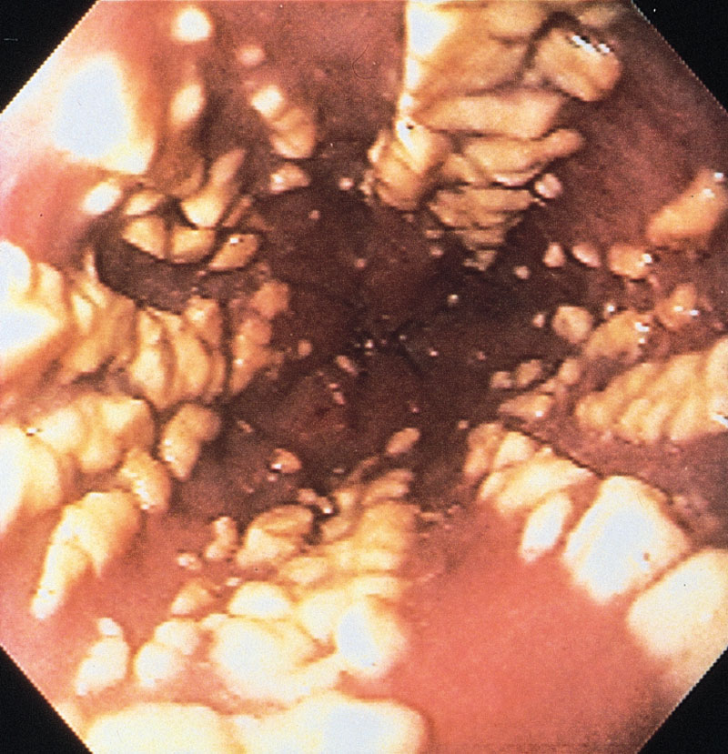
III- oesophageal infection
Fungal infection
Usually Candida
Normal oral flora
Colonises, proliferates in oesophagus
  Debilitated patients
  Immunosuppressed (steroids, HIV, other)
  Broad spectrum antibiotics
Inflammation, erosions, ulceration

Slide 23
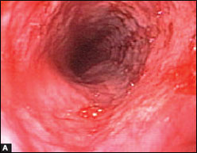
Viral infection
Usually Herpes simplex virus (HSV)
Usually re-activation
Virus infects squamous cells -> cell death
Vesicles, erosions, ulceration
Clinical setting
  Debilitated patients
  Immunosuppressed (steroids, HIV, other)
  Can occur in immunocompetent patients

Slide 24
IV- oesophageal tumours
Malignant > common than benign.
Unfortunately, esophageal cancer discovered late & overall 5 y ear prognosis is bad < 10.
Even for potentally resectable cancer eso, 5 y survival is < 30%

Slide 25
Beniegn tumours
The gastrointestinal stromal tumour (GIST, another name for leimymoma),usually asymptomatic but may cause bleeding or dysphagia
Uncommon, include:
fibrovascular polyps, leiomyomas, papillomas, lipomas, neurofibromas, granular cell tumors.
When large, can cause dysphagia or chest pain from obstruction or stretch.
Usually discovered incidentally.
Found most often in distal third of esophagus.
Usually solitary, but may be multiple (3%).

Slide 26
Carcinoma esophagus
common in men than women 3-4:1
Should be considered in the cases that presenting with dysphagia.
Histopathological types:
adenocarcinoma : the lower third of the oesophagus from Barrett's oesophagus or from the cardia of the stomach.
squamous cancers: (Upper oesophagus)
Small-cell cancer is a rare :(any part of the oesophagus .

Slide 27
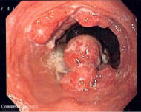
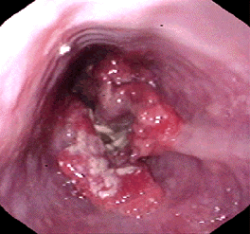
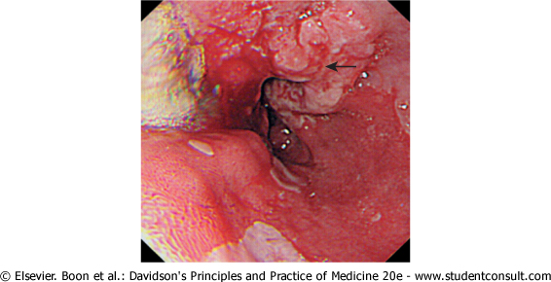

Slide 28
Risk factors:
Alcohol.
Tobacco smoking.
SCC of the head & neck.
Achalasia.
Papilloma virus infection.
Plummer-Vinson syndrome
Tylosis (familial hyperkeratosis of palms & soles) .
Celiac disease.
Radiation exposure.
Post-cricoid web

Slide 29
SYMPTOMS
is progressive dysphagia over a several-month period until only liquids can be taken.
Unexplained persistent chest pain
weight loss
Hematemesis
Coughing after drinking fluid
Hoarseness from involvement of the recurrent laryngeal nerve by tumor are unusual symptoms.

Slide 30
Signs:
Paller.
clubbing ( benign & malignant tumors).
Vricho’s node in left supracalvicular region.
Early diagnosis affords the only chance for cure.

Slide 31
Diagnosis:
upper GI endoscopy with cytology & biopsy.
A barium swallow demonstrates the site& length of the stricture but adds little useful information.
Thoracic & abdominal CT to stage the tumour& define operability.
most sensitive modality is EUS(endoscopic USS) to define the TNM stage.
Blood: -
1-Complete blood picture: iron deficiency anemia.
2- Occult blood in stool
3- Tumor markers: CEA - CA15-3

Slide 32
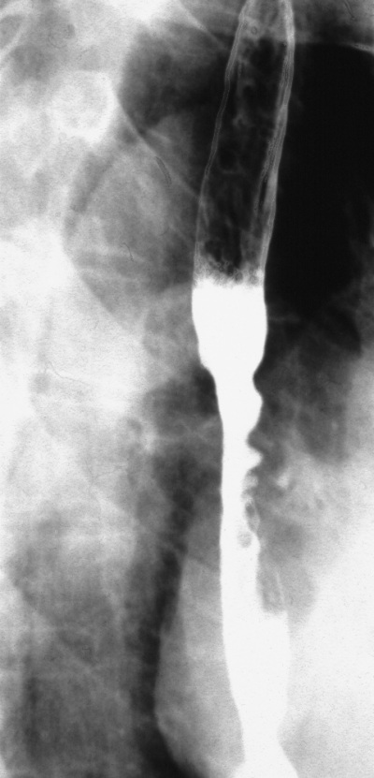
Cancer lower 1/3
Filling defect (ulcerative type)

Slide 33
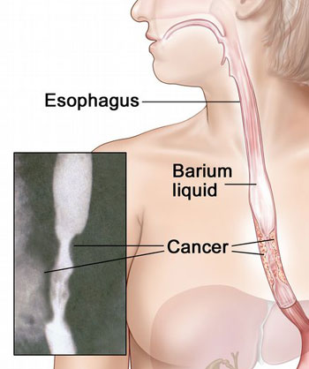
Apple core appearance

Slide 34
Treatment
I- operable: surgery followed by chemotherapy.
II- inoperable: palliative procedure.
Critera for inoperability:-
Unfit patient.
Distant metastasis.
Unresectable tumor.
Infiltration of important structures such as aorta, trachea.
Despite modern treatment, the overall 5-year survival of oesophageal cancer is 6-9%.

Slide 35
Although SCC are radiosensitive, radiotherapy alone is associated with a 5-year survival of only 5%.
70% have extensive disease at presentation; in these, treatment is palliative & based upon relief of dysphagia &pain.
Endoscopically directed tumour ablation using laser therapy or insertion of stents is the major method of improving swallowing.
Palliative radiotherapy
may induce shrinkage of both SCC/ adeno carcinomas but symptomatic response may be slow.
Quality of life can be improved by nutritional support /appropriate analgesia.

Slide 36
Summary
Oesophageal disorders ranges from motility disorders to malignant tumours.
Dysphagia is the most commom presenting symptoms .
Oesophageal manometry helps in differentiating different types of motility disorder
Early detection of tumours improve the outcome.

Slide 37
Case 1
A 45-year-old man has a 2-year history of dysphagia that was initially induced only by solid foods but has progressed over the past year to include both solids and liquids. He also describes intermittent chest pain, Retrosternal burning with occasional regurgitation of undigested food, and a 4.5-kg weight loss over the past 2 years.

Slide 38
Physical examination is normal. Upper endoscopy shows a small amount of retained food in the distal esophagus but is otherwise normal. An esophageal motility study demonstrates a hypertensive lower esophageal sphincter that does not relax fully with wet swallows.

Slide 39
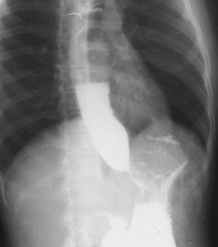
A film from an upper gastrointestinal series is shown
The most likely diagnosis .
Appropriate treatment .

Slide 40
Case 2
A 67-year-old woman has an 8- to 10-month history of intermittent dysphagia for both solid foods and liquids. The dysphagia initially developed over the course of 10 to 14 days. She reports no abdominal symptoms but has lost 13.5 kg during this time.
An upper gastrointestinal barium radiograph shows a smooth narrowing in the distal esophagus. An esophageal motility study is consistent with achalasia.

Slide 41
The most likely diagnosis .
the most appropriate next step in managing this patient?

Slide 42


