Slide 1

Pediatric Radiology presented by : Dr. ALIYA SHEMISA.

Slide 2


Slide 3
Pediatric chest
Techniques
Disease
Radiological findings

Slide 4
Chest techniques
1. Plain chest X-ray CXR & Fluoroscopy.
2. Computed Tomography Scan CT Scan.
3. High resolution CT HRCT
4. Magnetic resonance images MRI
5. Angiography ( conventional, CT, MRI)
6. Ultrasonographic scan USS

Slide 5
The normal neonatal NN chest X-ray has the
following features:
- Thymus : may be prominent.
- Heart shadow : is quite prominent & globular in
outline
- Normal cardiothoracic ratio is up to 65%.
-Diaphragms : normally lie at the level of the 6th rib
anteriorly .

Slide 6
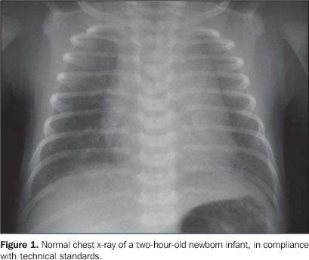
Normal Neonatal chest x-ray

Slide 7
Finally, it should be remembered that acutely ill
may have various tubes and vascular catheter neonates
visible on CXR and it is important to be checked
& to be correctly positioned as :
- Endotracheal tube: tip is 5 cm above carina.
- Nasogastric tube: ends few 10cm distal to GE junction
Below Lt. Hemidiaphragm.
- Umbilical artery catheter: tip in lower thoracic
aorta T6-T10 away from renal artery origins.
- Umbilical vein catheter: tip at T8-T9 lower right atrium

Slide 8
Complications
- malposition of nasogastric tube into the trachea and bronchus can lead to pneumonia and pulmonary laceration.
- vascular catheters can cause perforation of the vessel and thrombosis

Slide 9
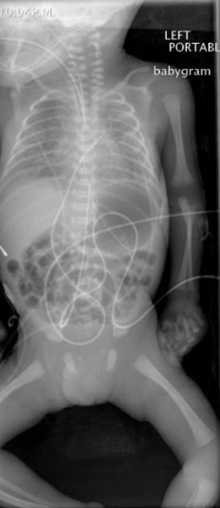
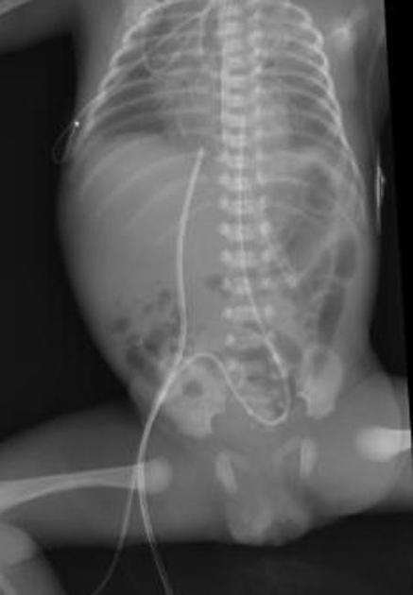
Acutely ill NN chest X-ray

Slide 10
Respiratory Neonatal Distress Disease

Slide 11
Causes of Respiratory NN distress disease:
Medical causes :
1. Respiratory Distress Syndrome(RDS): surfactant deficiency
2. Transient Tachypnea of newborn
3. Meconium aspiration syndrome
4. Neonatal pneumonia
Surgical causes :
1. Congenital diaphragmatic hernia
2. Congenital Cystic Adenomatoid Malformation
3. Congenital lobar emphysema
4. Sequestration

Slide 12
Respiratory Distress Syndrome RDS
- Also known as surfactant- deficiency disorders.
- Is a relatively common condition resulting from insufficient production of surfactant lead to increase in the surface tension of alveoli causing alveolar collapse.
- Usually present in the 1st few hours of life in premature baby with symptoms like: tachypnea, expiratory grunting, nasal flaring & the baby may or may not cyanosed.

Slide 13
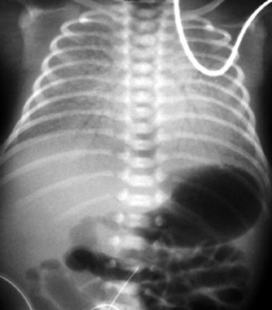
CXR findings:
- bilateral symmetrical reticulo-granular densities with air bronchogram.
- lung whiteout in severe cases.
Treatment:
- Surfactant administration
- Antibiotic coverage
- Chest intubation in severe cases.

Slide 14
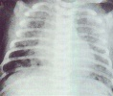
Transient Tachypnea of NN TTN
- is delayed clearance of intra-uterine pulmonary fluids
- post C-section or prolonged vaginal delivery
- wet lung with small amount of
pleural effusion
- has rapid recovery
after 2-3 days.
- treated by Antibiotics &
intubation is usually not required

Slide 15
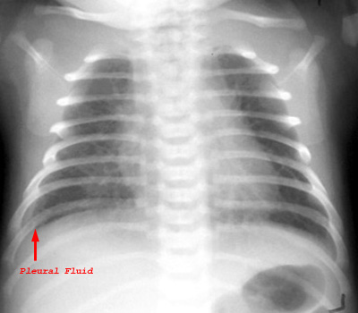

Slide 16
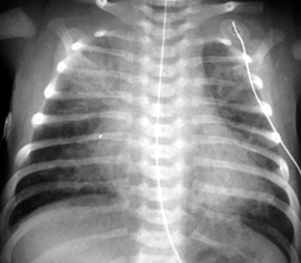
Meconium aspiration syndrome
- Meconium is staining of amniotic fluid
- because of its thick consistency, it is aspirated in tracheo-bronchial tree causing obstruction & asymmetrical lung atelectasia,
(i.e it acts as Foreign body) .
- usually treated by intubation
& Antibiotic coverage.

Slide 17
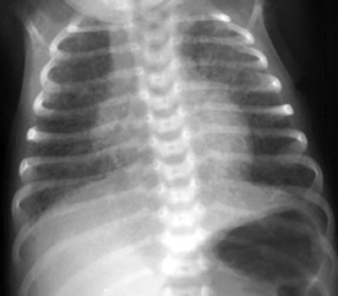
Neonatal Pneumonia
-caused by streptococcus bacterial infection
- CXR may mimic Meconium aspiration syndrome or similar to RDS as patches of
Reticulo-granular densities.
- treated by Antibiotics.

Slide 18
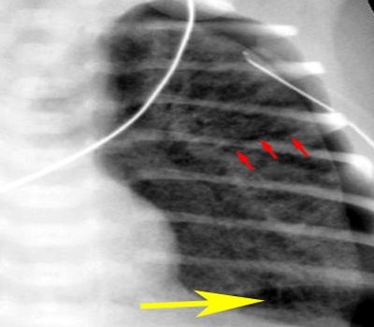
Complications of respiratory distress disease
1. Acute complications :
- pulmonary interstitial emphysema & O2 toxicity: from treatment
-pneumothorax : post intubation
- pulmonary hemorrhage
2. Chronic complications :
- bronchopulmonary dysplasia
- recurrent chest infection
- subglottic stenosis post intubation

Slide 19
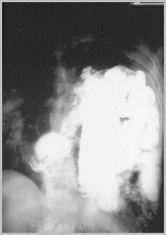
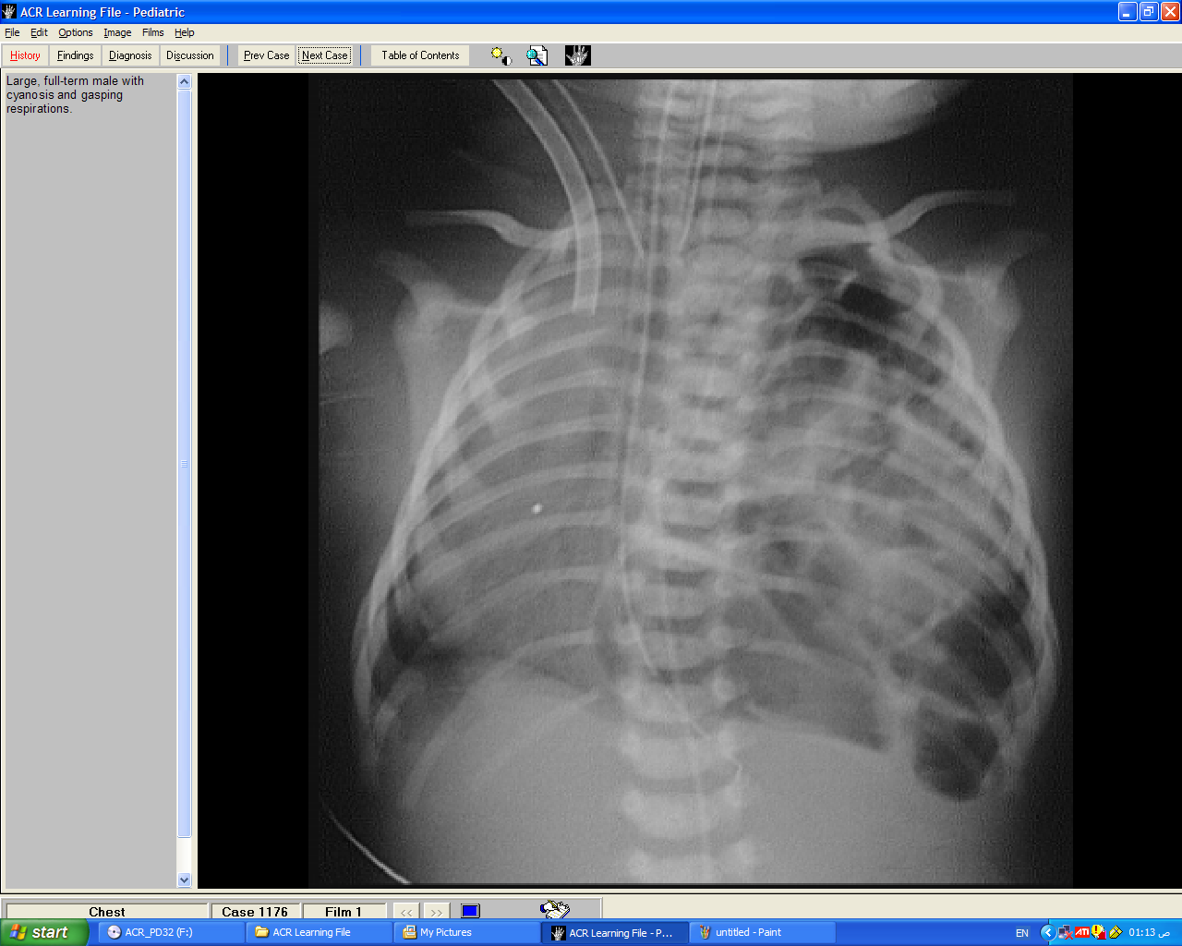
Congenital diaphragmatic hernia CDH
- is a defect in the diaphragm that result in herniation of abdominal contents into the thoracic cavity & has 2 types
Bochdalek hernia : more common in Lt. side (75%)
Morgagni hernia : common on Rt. Anterior & central
- both need surgical intervention.

Slide 20
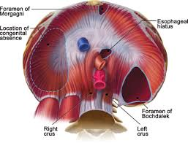

Slide 21
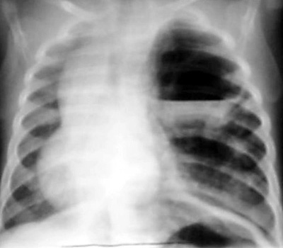
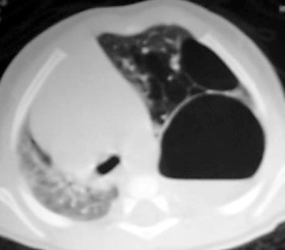
Congenital cystic adenomatoid malformation CCAM
- congenital large pulmonary cyst >2cm surrounded by multiple smaller cysts.
- if there is significant mass effect in the chest, CCAM is surgically removed.
- CXR : cystic lesion of air density & may contain air-fluid level or may appear as solid lesion.
- CT scan chest is modality of choice

Slide 22
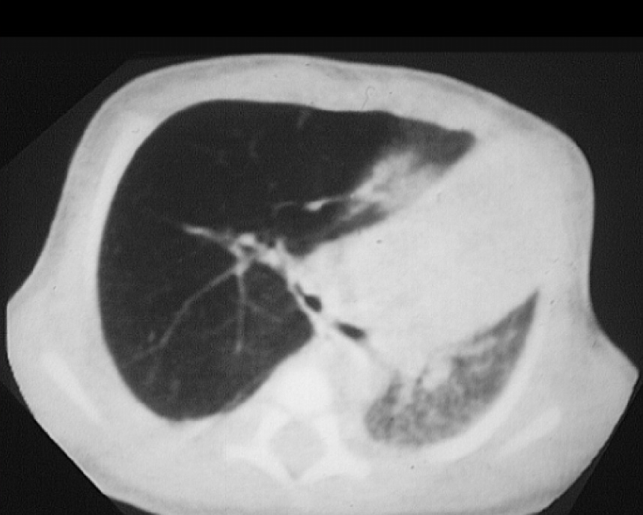
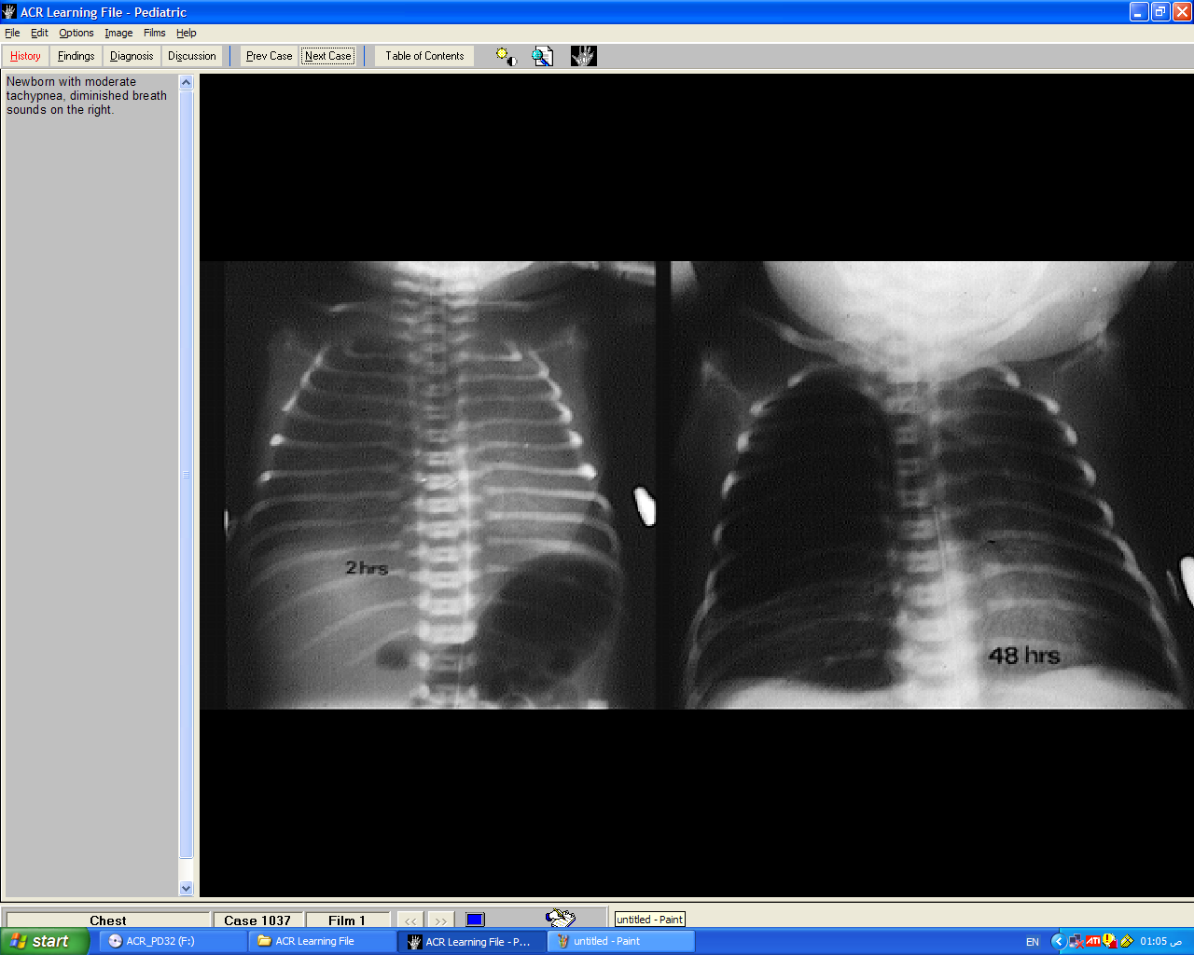
Congenital lobar emphysema CLE
- overexpansion of one or more lobes
- commonly effect Lt. upper & Rt. Middle lobe
- CXR : hyperlucent affected lobes
- CT scan is modality of choice for diagnosis
- treated by surgical resection

Slide 23
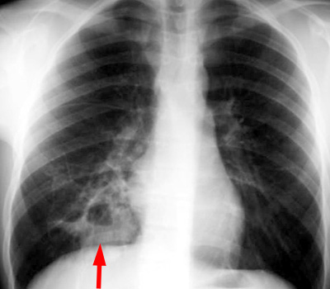
Pulmonary sequestration
- is a lung tissue that is not connected to tracheobronchial tree.
- has systemic blood supply from Aorta mainly
- venous drainage either from
IVC or pulm. Veins
- has 2 types : intralobar &
extralobar which commonly
present in NN & can cause RDS
- CT, MRI or Angiography are
modality of choice for diagnosis.

Slide 24
The differential diagnosis of neonatal respiratory
distress sign & symptoms;.
-When assessing a neonatal chest X-ray (CXR) the clinical
setting should always be borne in mind:
*In distress premature infant with respiratory distress,
hyaline membrane disease will be the most likely diagnosis.
* in distressed full term neonate following cesarean;
Retained lung fluid TTS will be the most common diagnosis.
* in full term delivery with meconium-stained liquor;
diagnosis. Meconium aspiration syndrome is suggested

Slide 25


