Slide 1
Practical Approach to Headache, facial pain

Slide 2
Aims
To provide a practical approach to the diagnosis and management of patients presenting with headache

Slide 3
Objectives
To be able to understand the causes of headache
To be able to classify headaches, and facial pain in clinical practice
To be able to organise a management plan for patients presenting with headache or facial pain
To be able to identify headache that you can’t miss

Slide 4
Headache
2.5 % of new emergency attendance
15 % will have a serious cause

Slide 5
Pain sensitive structures
Dura
Arteries
Venous sinuses
Para-nasal sinuses
Eyes
Tympanic membranes
Cervical spine

Slide 6
Classification of headaches
Primary headache
Head Trauma
CNS infection
Vascular disease
Intracranial pressure disorders
Metabolic and toxins
Malignant hypertension
Dental, ENT & ophtalmological disorders

Slide 7
Primary headache
Migraine - Cluster head ache
Head Trauma
Subdural/ extradural etc
CNS infection
Meningoenchephalitis – Cerebral abscess

Slide 8
Vascular disease
Subarachnoid haemorrhage (SAH)
TIA/Stroke
Subdural- extradural- intracerebral haemorrhage
Arterial dissection
Cerebral Venous sinus thrombosis (CVST)
Giant cell arteritis (GCA) and vasculitis

Slide 9
Intracranial pressure disorders
Tumours
Idiopathic intracranial hypertension
Intracranial hypotension
Hydrocephalus
Intermittent ( eg Colloid cyst)

Slide 10
History taking
The most important step in the evaluation of headaches is HISTORY
First question to answer is whether it is a PRIMARY or SECONDARY headache syndrome.
Any important red flags in history or examination to consider investigation for a secondary headache

Slide 11
History
Onset
Frequency
Periodicity
Duration
Time to maximum intensity
Time of the day
Recurrence
One type or more than one headaches
Life style

Slide 12
Autonomic Features
Eyelid swelling/oedema
Ptosis “drooping”
Miosis
Watering eye: Lacrimation “Tearing”
Nasal congestion / Rhinorrhea “runny nose”
Forehead and facial sweating

Slide 13
Migraine
Aura 1/3 patients only ( mood change, excess energy –euphoria to depression- lethargy and craving for food)
Gradual onset no Thunderclap !
Examination generally normal
Motor disturbances: weakness, hemiparesis and dysphasia

Slide 14
Minimum for migraine without aura
> 5 recurrent episodes of headache attacks lasting 4-72 hs
With at least 2 of
  Unilateral
  Pulsating
  Moderate to severe
  Worsen by physical activity
  And at least 1 of
    Nauseas =/or vomiting
    Increase light sensitivity
    Increase noise sensitivity

Slide 15
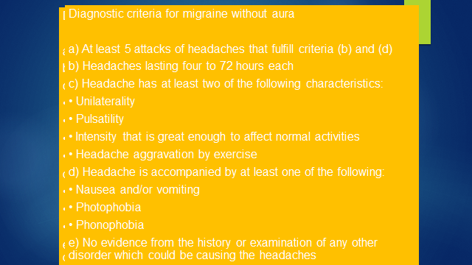

Slide 16
Emergency treatment for severe migraine:
Diclofenac (100mg) suppository or 75mgs IM or
Subcutaneous Sumatriptan 6mgs - (if no triptan already taken)
Metaclopramide IM
N.B. OPIATES SHOULD BE AVOIDED

Slide 17
Prophylaxis
Consider if 3 or more attacks per month or where
attacks are very severe.
Treat for at least 3 months
Beta-blockers
Propanolol 10 mg bd (increase gradually)
Amitriptyline (10 – 100mgs

Slide 18
Migraine or cluster?
Migraine Unilateral head ache in 70% | Cluster Always unilateral
Duration 4 hs 3-4 days | Attack average 1 h 4 hs
Intermittent | Daily multiple attacks per day for weeks
Avoid movement - lie down | Rest does not improve the symptoms More agitated “ pacing”
May have autonomic symptoms | Autonomic symptoms
At least 1 of nauseas photophobia phonophobia | May have photophobia phonophobia
Female > male | Male > Female

Slide 19
Tension headache
Muscle contraction precipitated by stress/anxiety
20-40 years
Female/male 3:1
Pressure sensation or pain
“ As head is going to explode”
“ Burning or stabbing”
Daily increasing through the day
Forehead to occip. or neck or vice versa

Slide 20
Other common headaches
Sinusitis
Glaucoma
Hyponatraemia
Toxins: alcohol excess and withdrawal, caffeine withdrawal.
Drugs: calcium channel blockers and nitrates
Coital migraine

Slide 21
Red flags for secondary headaches
Systemic symptoms ( fever weight loss)
or Secondary risk factors: systemic disease, cancer or HIV
Neurological symptoms +/- abnormal signs
( confusion, impaired alertness or consciousness and focal sign)
Onset:
sudden, abrupt or split of a second or worsening and
progressive
Older
  new onset and progressive headache specially in middle age, > 50 years ( giant cell arthritis)
  Previous headache history
  first headache or different ( significant change in attack frequency, severity or clinical features
  Triggered Headache
  by Valsalva, exertion or sexual intercourse

Slide 22
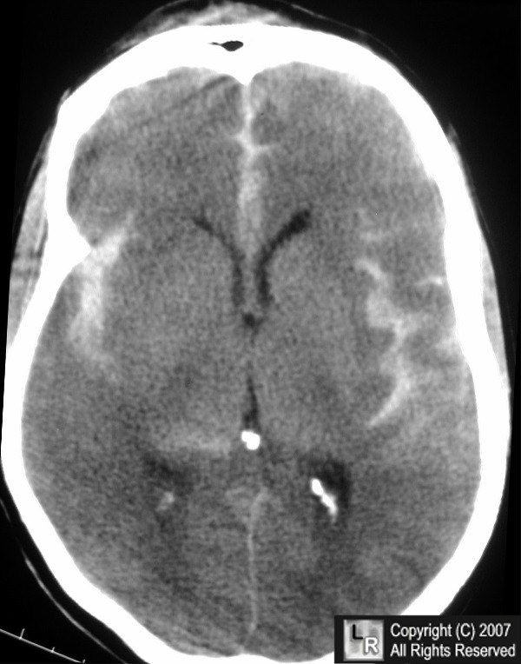
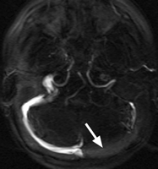

Things you can’t afford to miss
Acute SAH CVT
Temporal arthritis

Slide 23
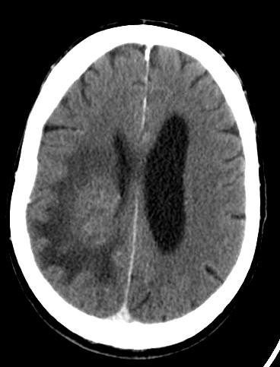
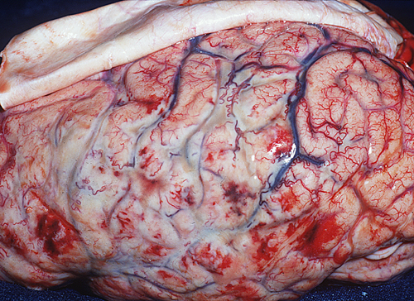
Things you can’t afford to miss
Meningitis Tumours

Slide 24
Bacterial Meningitis
High level of suspicious if fever and altered consciousness!!!
Acute bacterial meningitis is an important fatal medical emergency- early recognition saves lives!!
quick initiation of antibiotics
Confirm diagnosis & pathogen with CSF analysis via lumbar puncture
Still obtain CSF even if antibiotics commenced eg Polymerase Chain Reaction (PCR) for bacteria DNA

Slide 25
Subarachnoid haemorrhage
Commonest potentially life threatening acute severe headache
1-3% headaches presenting to A&E
1/3 present with acute onset of severe headache as only symptom!
Headache characteristics - Acute or Abrupt Thunderclap”
“Worse ever” : more likelihood
Transient lost of consciousness or epileptic seizure

Slide 26
CT Brain
( sensitivity decreases with time)
First 12 hs 96 – 100%
Within 24 hs 92 – 95 %
Within 48 hs 86 %
At 5 days 58 %
At 7 days 50 %
After 2 weeks 30 %
After 3 weeks almost nil

Slide 27
Chronology of CSF abnormality in CSF
12 hs should elapse before CSF analysis for xanthochromia
  Red cell lysis in the CSF to billirubin and oxyhaemoglobin
  Xanthochromia reliably present >12 hs and up to 2 weeks of SAH

Slide 28
Giant Cell arthritis
Affects large/medium size arteries
Microscopically infiltration of lymphocytes, macrophages, histiocytes and multinucleates giant cells
Vessel are tender, red, firm and pulsless with scalp sensitivity
Risk of blindness if not treated

Slide 29
Presentation
Rare before 50
Female > male
Insidious onset
Often associated with jaw claudication on chewing
Headache localised to the superficial occipital or temporal arteries, throbbing and worse at night
Raised CRP and ESR
Diagnostic biopsy with in 2 weeks
Prednisolone 60 mg

Slide 30
Cerebral Venous Sinus Thrombosis
Acute/ subacute progressive “headache plus” syndrome
Papilloedema
Symptoms of raised ICP
VI nerve palsy
Focal signs
Seizures
Enchephalopathy
Acute Thunderclap – SAH like presentation
CT –ve, CSF negative -Consider specially if raised CSF OP
New daily persistent headache

Slide 31
CVST: appropriate investigations
Brain MRI/MRV
Sinus occlusion
Venous haemorrhage
Venous infarction
CT venogram

Slide 32
CVST: management- anticoagulation
Low molecular weight heparin or IV Heparin
3-6 months Warfarin
Thrombolysis?
Treatment of comorbidities, seizures and increased Intracranial pressure
Consider
Anticardiolipin anibodies, Thrombotic & Homocystein screen,
Cancers,
CNS and ENT infection
Systemic inflammatory disease/Behcets

Slide 33
Facial pain
Typical Neuralgias
1) Trigeminal neuralgia
  Characterized by recurring paroxysmal severe pain, brief duration (seconds) in the territory of the trigeminal nerve, spontaneously or initiated by chewing, talking, touching the affected side of the face.
  Unknown aetiology
  Females affected more than males
  Analgesics, surgery, destruction of the sensory neuron, division of nerve root.

Slide 34
Trigeminal Neuralgia - Treatment
Carbamazepine
Gabapentin
Baclofen
Phenytoin
Valproate
Adjuvant
  TriCyclic Antidepressants
  NSAIDs
  Surgery for refractory cases

Slide 35
Facial pain
Typical Neuralgias
2) Glossopharyngeal neuralgia
  Unknown cause
  Equal both sexes
  Severe, sudden episodes of pain in the tonsil region one side only, ipsilateral ear.
  Pain - severe for 1-2 hours, recur daily
  Treated like trigeminal

Slide 36
Symptomatic Neuralgias
Intracranial lesions
1) Central lesions
  Tumours of the brain stem, M.S., thrombotic lesions, metastasis, occult naso-pharyngeal ca.
2) Post herpetic neuralgia
  Herpes zoster may affect trigeminal nerve ganglion
  Vesicular rash covers one division, usually 1st division.

Slide 37
Post-Herpetic Neuralgia
Persistent neuritic pain for > 2 months after acute eruption
Treatment
  Anticonvulsants
  TCAs
  Baclofen
Notes:
Pain that persists 2 or more months after the acute eruption is known as post-herpetic neuralgia. NSAIDs and opiates are of little use in the treatment of the neuralgia. Anticonvulsants in conjunction with TCA or baclofen are most useful for the control of shooting neuritic pains.

Slide 38
Symptomatic Neuralgias
Extracranial lesions
1) Sinus disease
  Infective and neoplastic lesions of the paranasal sinus.
  Facial pain & dental pain..
2) Dental neuralgia
  Dental carries
  Dental extraction
3) Temporomandibular joint pain

Slide 39
Temporomandibular Disorders
Symptoms
  Temporal headache
  Earache
  Facial pain
  Trismus
  Joint noise

Slide 40
Carotid dissection
A hemorrhage into the wall of the carotid artery,
separating the intima from the media and leading to
aneurysm formation.
Suspect in
Blunt trauma? Post RTA
Rotational forces? Manipulation
Spontaneous

Slide 41
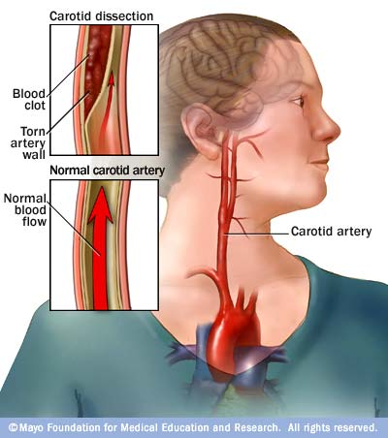


Slide 42
Acute Cervical arterial dissection
Internal carotid artery dissection (ICAD)
Unilateral headache/face pain + neck
+/- Contra lateral stroke or TIA
Vertebral artery dissection (VAD)
Occipital-nuchal headache
+/- posterior circulation TIAs

Slide 43
Cervical Art Dissection Investigations
MRI Brain and neck & MRA
(Carotid & vertebral)
Crescent shaped intramural haematoma & vessel occlusion
Identifies ischemic brain tissue > clearly
CT brain & CTA of cervical vessels
Tapering lumen, vessel occlusion
Rarely Catheter angiogram
Intimal flap +/- double lumen path gnomonic
seen in <10 %

Slide 44
Management of carotid artery dissection
Get advice from Neurology and Vascular Surgeons
Aspirin vs anticoagulation
3-6 month therapy

Slide 45
Conclusions
Remember that history is the most important clue
Describe a classification useful in clinical practice
Primary headache (migraine – cluster - tension)
Head Trauma
CNS infection
Vascular disease
Intracranial pressure disorders
Don’t miss: Brain tumours, Giant arthritis, carotid dissection, meningitis and SAH !

