Slide 1



The Common Errors in Research Projects and The Importance of Correct Grammar and Punctuation student name : fatima eldukaly ID : 3163 Email : Fatimah_3163@limu.edu.ly
Libyan international medical University faculty of business administration

Slide 2
Content :
introduction.
Recognize the importance of correct punctuation and grammar.
Common errors found in research projects.
Conclusion.
References.

Slide 3
Introduction :
The grammar and the correct use of punctuation ensure a clear communication of ideas in turn improving the structure of the arguments presented in the article .

Slide 4
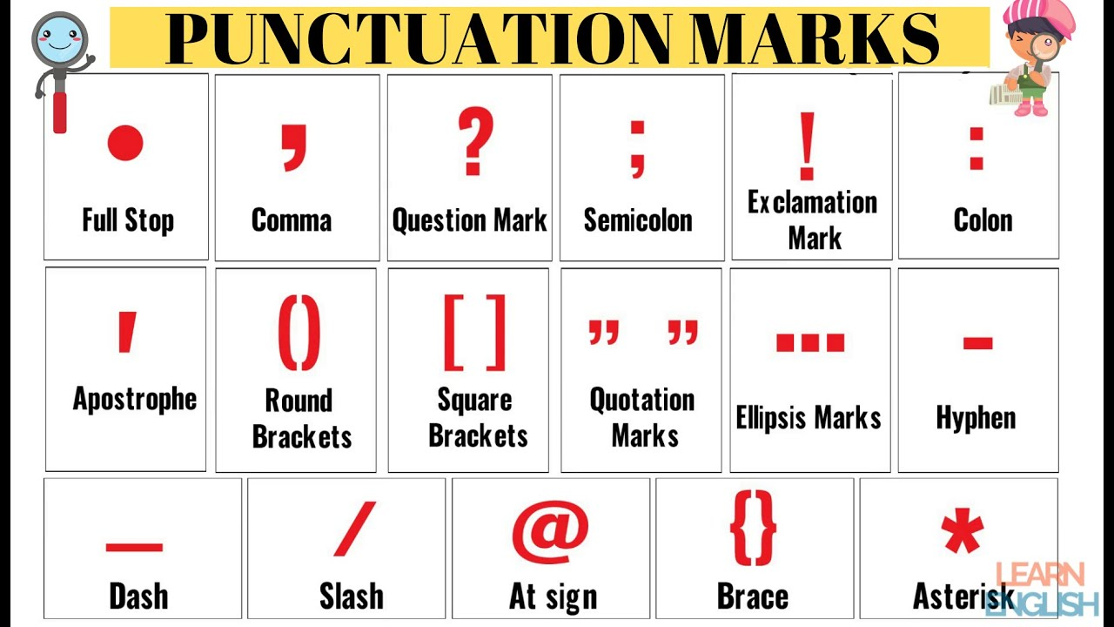
Punctuation :
Punctuation is defined as “the marks ,such as period ,comma ,and parentheses, used in writing to separate sentences and their elements and to clarify meaning.” punctuation is sometimes taken for granted or used incorrectly ,particularly in digital communication like text messaging and social media.

Slide 5
Grammar :
Grammar explains the forms and structure of words [called morphology] and how they are arranged in sentences [called syntax] .in other words grammar provides the rule for common use of both spoken and written language so we can more easily understand each other .

Slide 6
Recognize the importance of correct punctuation and grammar:
Grammar and use of language are poor.
Plagiarism.
The research question is not answered.
Using complex language.
Not using proper citation .

Slide 7
Conclusion :
Students also make error in their research project so by avoiding the grammatical and punctuation mistakes you will also avoid those errors.

Slide 8
References :
The importance of grammar .[2022].Retrieved 12 April 2022 ,from https://www.linkedin.com/importance-grammar. Common errors found in student research papers.[2022].Retrieved 12 April 2022, from https ://www.ruf.edu/-reporterror.html.

Slide 9


