Slide 1


The Law of Demand and the Law of Supply
Libyan International Medical University
Faculty of Business Administration
Name: Hamza Mohamed Ali
ID:4125

Slide 2
Table of contents
01
04
02
05
03
Introduction
Conclusion
Law of Demand
Reference
Law of supply
2

Slide 3
01
Introduction
3

Slide 4
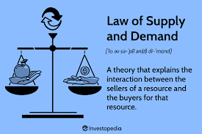
Introduction
The law of supply and demand is the theory that prices are determined by the relationship between supply and demand. If the supply of a good or service outstrips the demand for it, prices will fall. If demand exceeds supply, prices will rise.
4

Slide 5
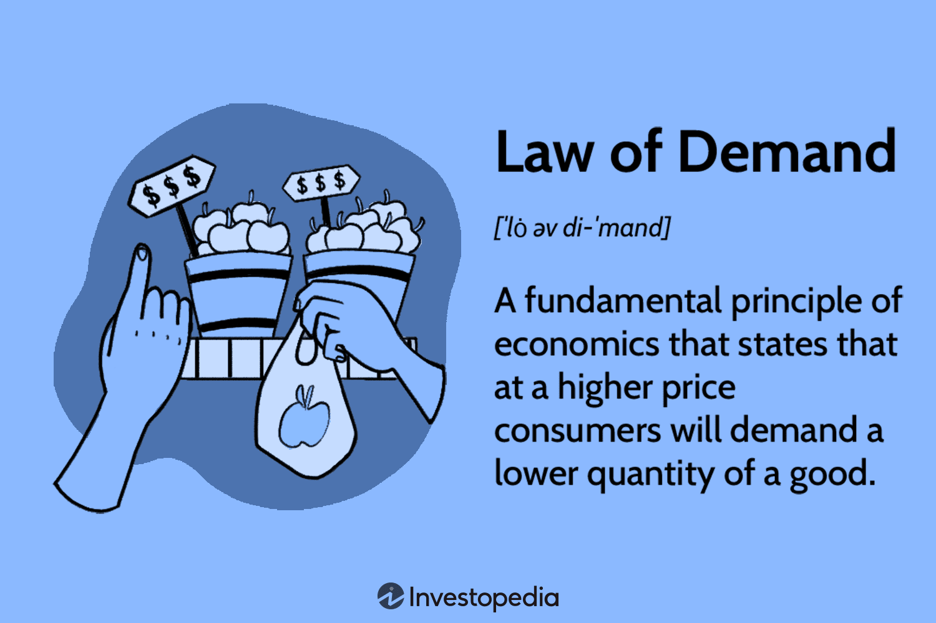
Law of Demand
The law of demand says that rising prices reduce
demand. So as prices rise customers buy less. That’s
particularly true if they can substitute cheaper goods.
5

Slide 6
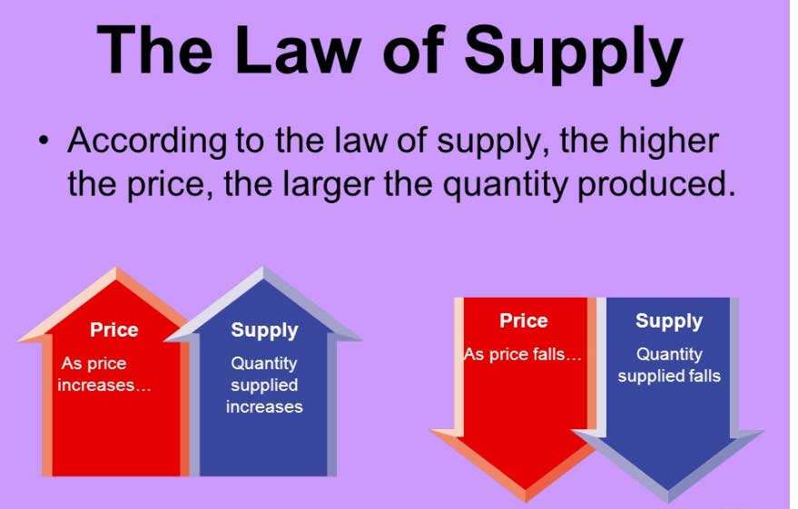
Law of supply
The law of supply predicts a positive relationship between
pricing and supply. As prices of goods or services rise,
suppliers increase the amount they produce — as long as the
revenue generated by each additional unit they produce is
greater than the cost of producing it.
6

Slide 7
Why Is the Law of Supply and Demand Important?
Business success in any competitive market
depends on accurately assessing supply and
demand. Every company that launches a new
product needs to determine how much of the
product to make and how much to charge
7

Slide 8
Conclusion
The law of supply and demand can provide a useful model for
understanding and determining pricing. It can help determine an
equilibrium price, where suppliers can meet demand without
overstocking, and customers get everything they need at a price
they can accept.
8

Slide 9
Reference
Charles R.T. O'Kelley, Thompson, R. B., & Lund, D. S. (2023). Corporations and Other Business
Associations. Aspen Publishing.
9

Slide 10


