Slide 1


Bruxism( teeth grinding)
Student Name :Shahad Aljazwi
Student Number:2863
course:PTS
Year:2nd Dent.
Date:26\2\2022

Slide 2
Objective
01
02
03
Classification of Bruxism
Define the Bruxism
04
05
Signs and symptoms of Bruxism
Management of Bruxism
Risk factors of Bruxism
2

Slide 3
INTRODUCTION
Bruxism is a repetitive masticatory muscle activity , which is a risk factor
for several serious health complications.
It is characterized by clenching or tooth grinding and symptoms (such as
facial tightness, head and neck pain, and insomnia)
3

Slide 4

Definition of Bruxism
Bruxism is defined as a non-functional activity or
parafunctional habit characterized by repeated grinding of
teeth in an unconscious manner
4

Slide 5
Classification of Bruxism
Bruxism may be classified according to several criteria
By when it occurs:
Awake bruxism: This is presented when the individual is awake
Sleep bruxism: This is presented when the individual is asleep
Combined bruxism: This is present in both situations
5

Slide 6
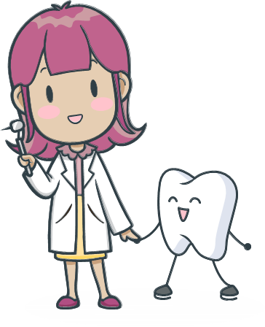
Classification of Bruxism
By etiology:
Primary, essential or idiopathic bruxism:
  For which no apparent cause is known
Secondary bruxism:
  Secondary to diseases (coma, cerebral palsy)
  Medicinal products (e.g. antipsychotic medication, cardioactive medication)
6

Slide 7
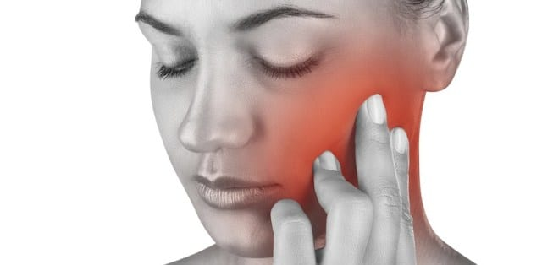
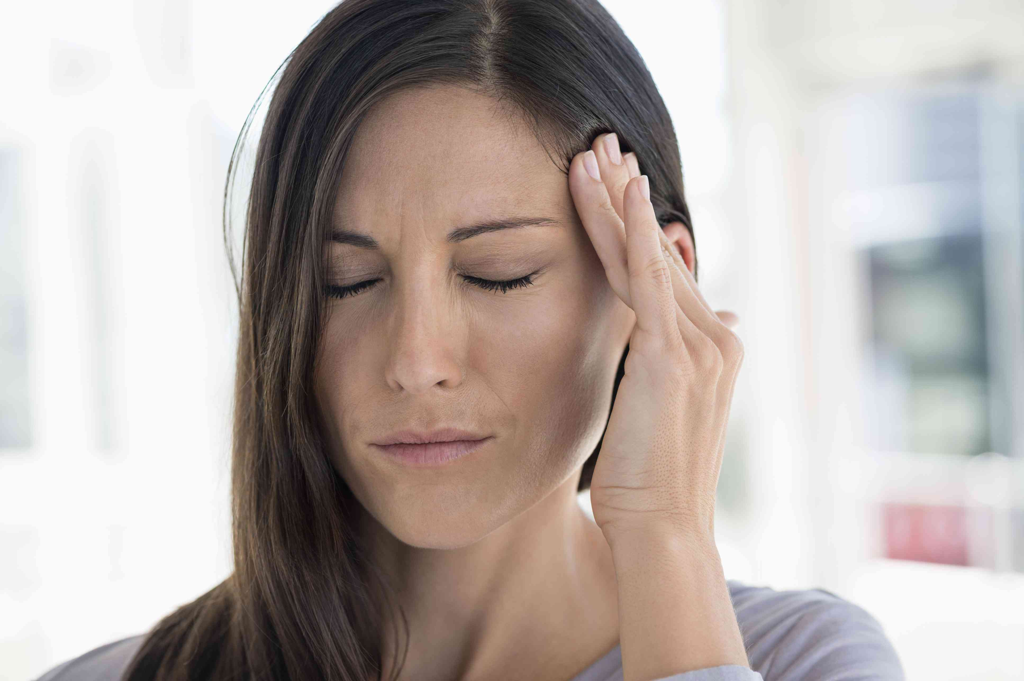
Signs and symptoms of Bruxism
Symptoms:
Pain in the TMJ
Pain in the masticatory muscle
Headache (especially in the temporal zone
when the patient wakes up in the morning)
7

Slide 8
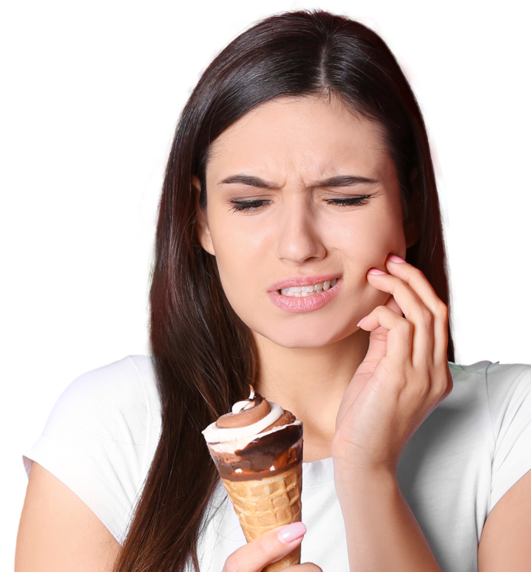

Signs and symptoms of Bruxism
Symptoms:
Hypersensitive teeth
Excessive tooth mobility
Poor sleep quality: Tiredness
8

Slide 9
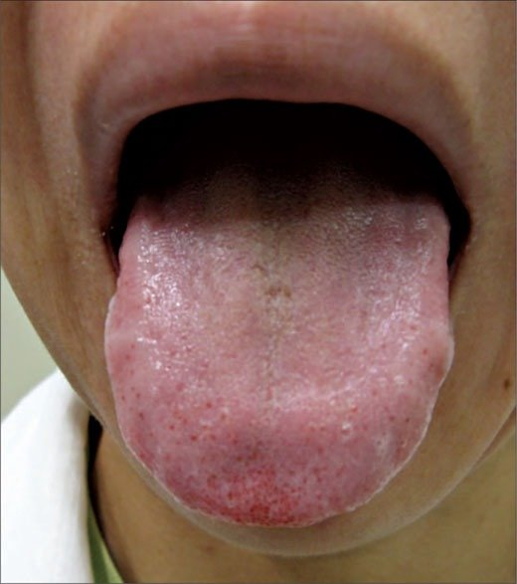
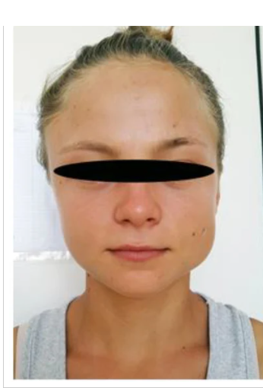
Signs and symptoms of Bruxism
Signs:
Tongue indentations
Increase in muscle activity
Hypertrophy of masseter muscles
9

Slide 10
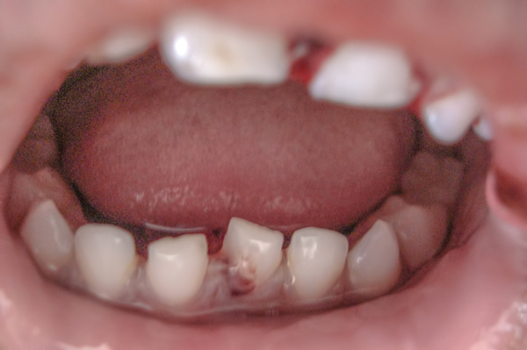
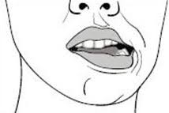
Signs and symptoms of Bruxism
Signs:
Reduction of salivary flow
Jaw fracture
Limitation of mouth-opening ability
10

Slide 11

Risk factors of Bruxism
Age: Bruxism is more common in young children and noted to decrease by adulthood.
Stress: Increased stress and anxiety can cause bruxism
Personality: Aggressive, competitive and hyperactive type of behavior and personality can increase the chance of teeth grinding.
11

Slide 12
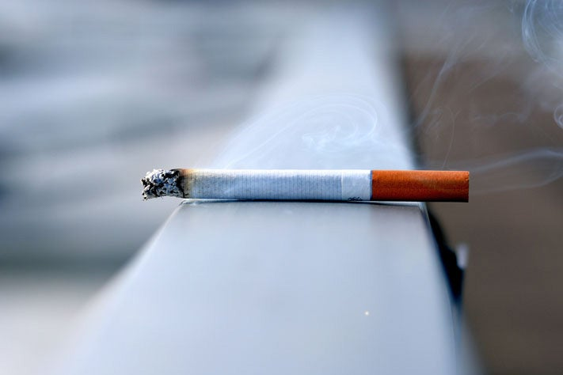
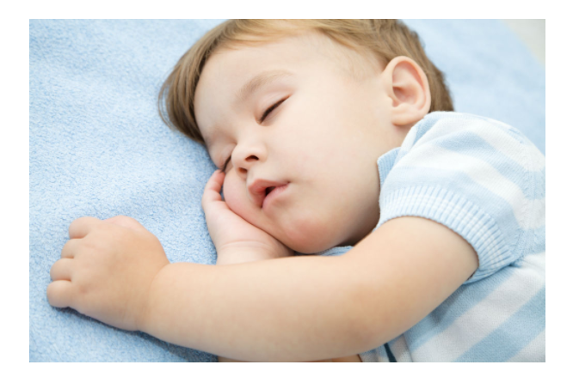
Risk factors of Bruxism
Family history: bruxism tends to give a family history, other
members also may have teeth grinding or a history of it.
Medications and habits: Certain antidepressants can result in
bruxism as an uncommon side effect ,Habits like smoking
Other factors- Bruxism can be associated with medical problems
like epilepsy, sleep related disorders
12

Slide 13
Management of Bruxism
Occlusal therapy
Behavioral modification
Pharmacological therapy
13

Slide 14
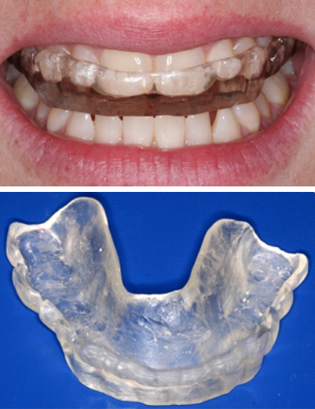
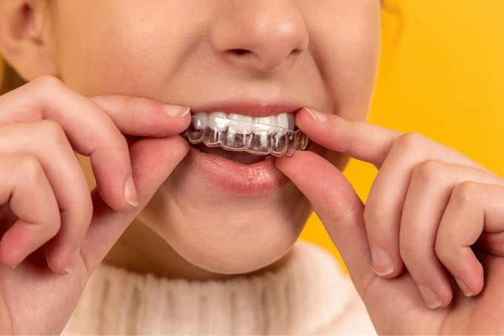
Management of Bruxism
Occlusal therapy:
Occlusal splints is the first-line of management for preventing of bruxism (grinding)
These splints have different names such as occlusal bite guard, bruxism
appliance, bite plate, night guard, occlusal device.
They are classified into hard splints and soft splints
14

Slide 15
Management of Bruxism
Occlusal therapy
Behavioral modification
Pharmacological therapy
15

Slide 16

Management of bruxism
Behavioral modification
Psychoanalysis, meditation, sleep, hygiene measures with
relaxation techniques and self- monitoring have been
considered for the treatment of bruxism
16

Slide 17
Management of Bruxism
Occlusal therapy
Behavioral modification
Pharmacological therapy
17

Slide 18
Management of bruxism
Pharmacological therapy
Certain drugs have paralytic effect on the muscles, by inhibiting
acetylcholine release at the neuromuscular junction (NMJ) thereby
decreasing bruxism activity in severe cases like coma, brain injury
18

Slide 19
Conclusion
Bruxism is a common parafunctional habit, occurring both during
sleep and a wake
Have a signs and symptoms like pain in TMJ and Hypertrophy in masseter muscle and it is have a several risk factors
behavioral strategies, splint therapy, medications can be used as different ways to reducing the effects of bruxism.
19

Slide 20
Refrencess
Ferreira- Bacci A, Cardoso C, Díaz-Serrano K. Behavioral problems and emotional stress in children with bruxism. Brazilian Dental Journal. 2012;23(3):246-251.
Kanathila, Hema et al. “Diagnosis and treatment of bruxism: Concepts from past to present.” International Journal of Applied Dental Sciences 4 (2018): 290-295.
Murali R, Rangarajan P, Mounissamy A. Bruxism: Conceptual discussion and review. Journal of Pharmacy and Bioallied Sciences. 2015;7(5):267.
20

Slide 21
THANK YOU FOR YOUR ATTENTION
21

