Slide 1


Diabetes AND
PROGRESSION OF CAROTID Atherosclerosis
Student name: Mohammed hafiz
Study numbr:3279
Block: PTS
Y1
1/June/2022

Slide 2
OBJECTTVES
Describe of the diabetes.
Classification of diabetes.
Complication of diabetes.
Mechanism of action of Atherosclerosis.
Diagnosis of diabetes.
Treatment.

Slide 3
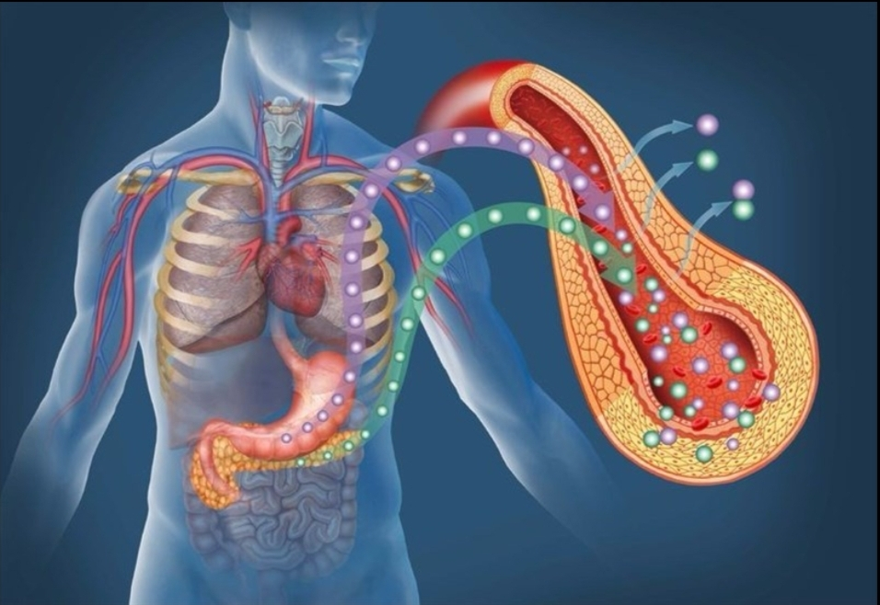
Definition of
Diabetes mellitus

Slide 4
Classification of diabetes
Type 1
Diabetes
Type 2 Diabetes
Most common (80%).
Pregnancy diabetes

Slide 5
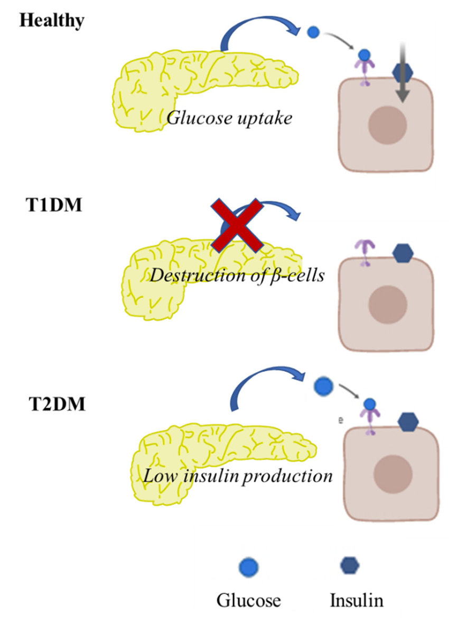

Slide 6
Complication Of
Diabetes Mellitus

Slide 7
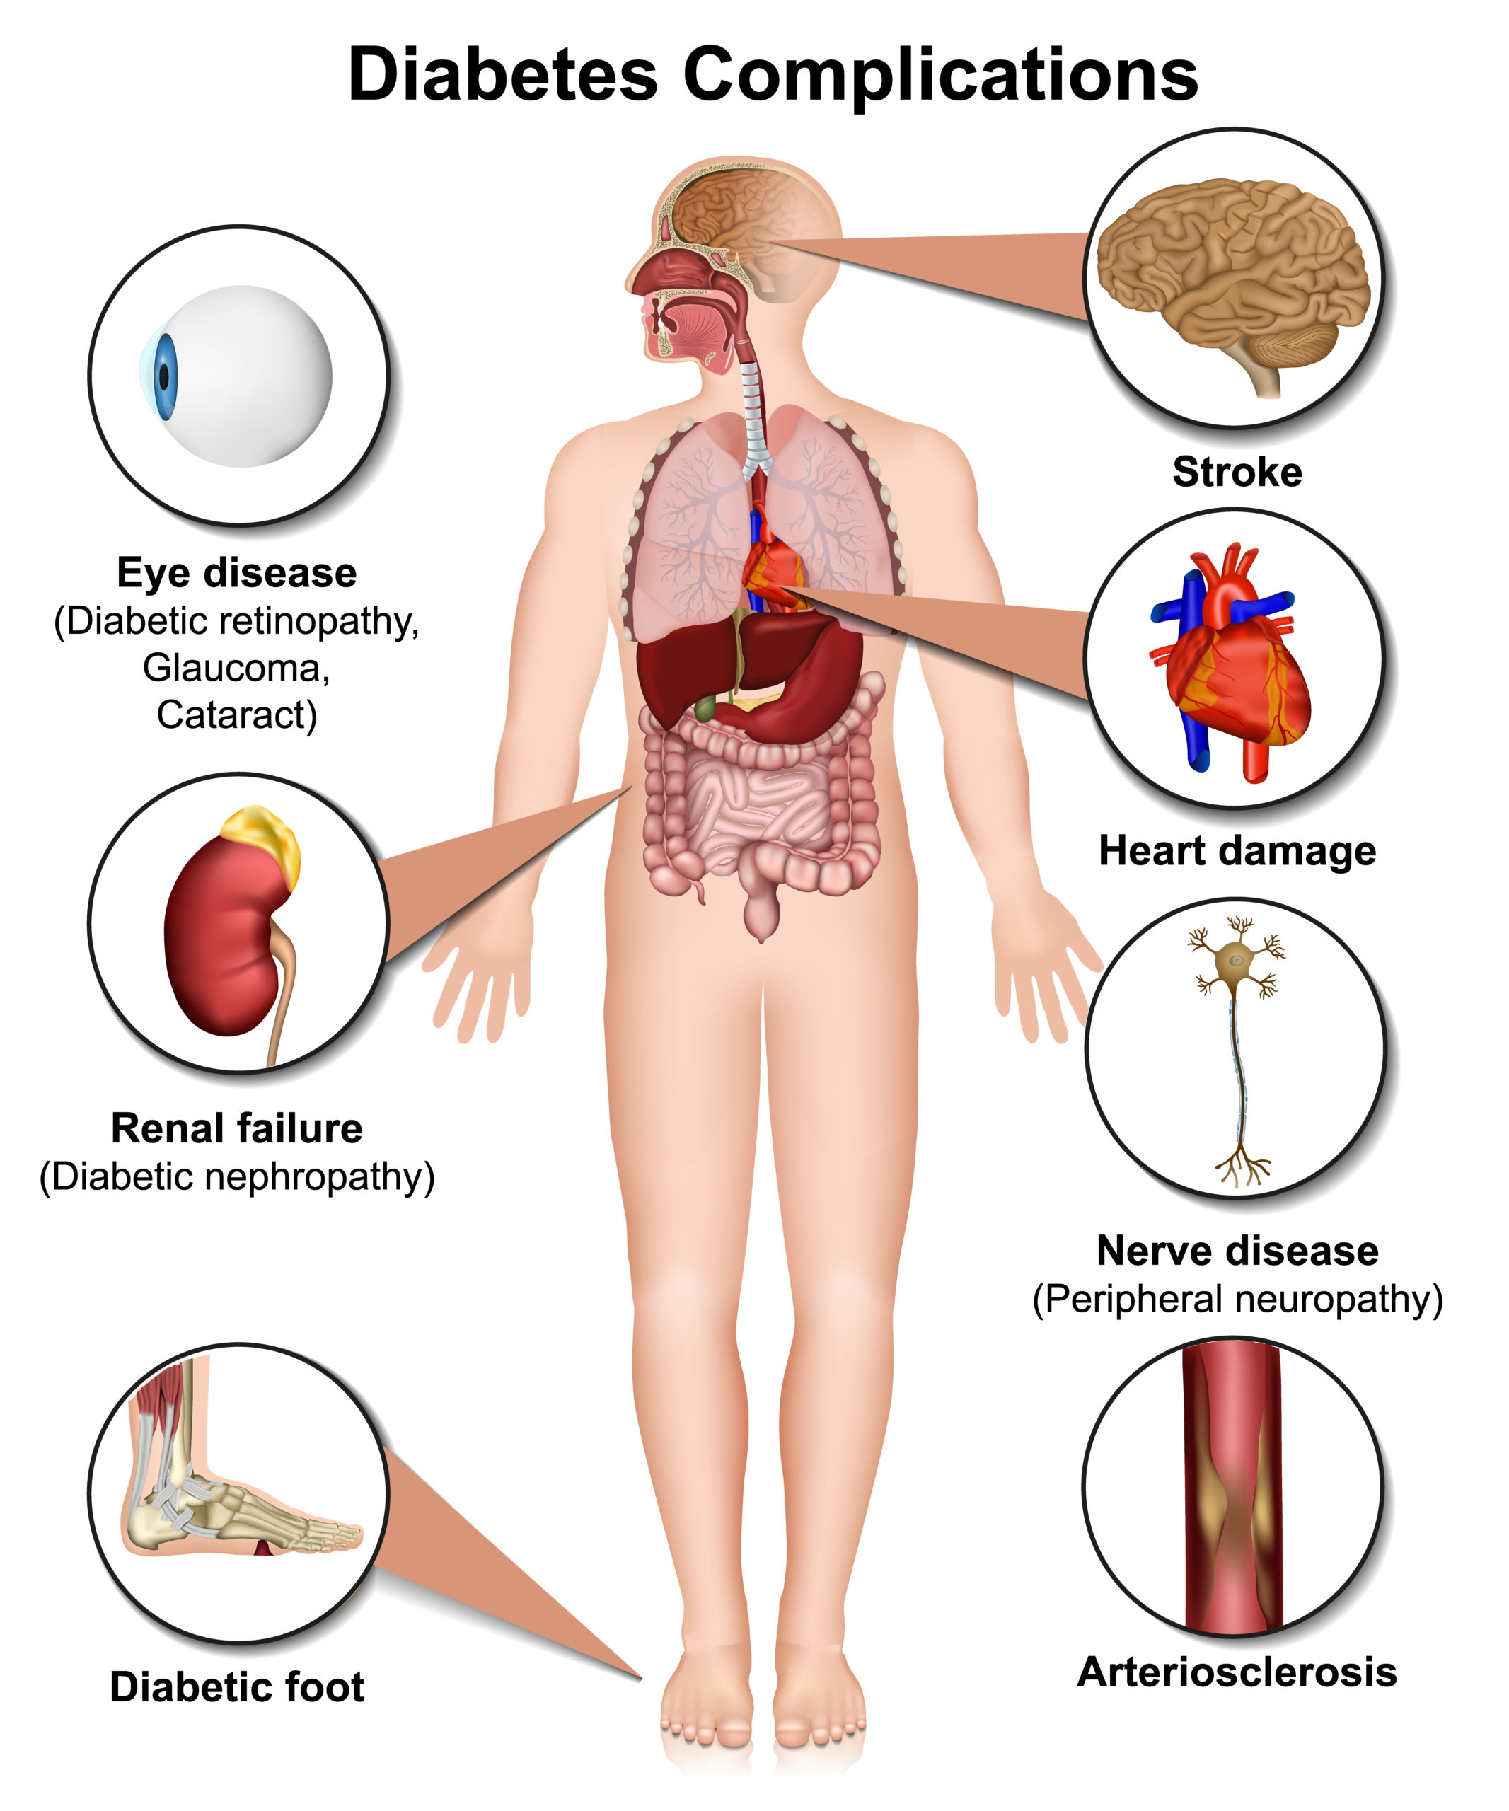

Slide 8
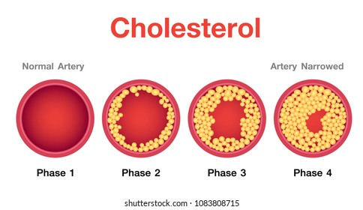
What are
Atherosclerosis

Slide 9
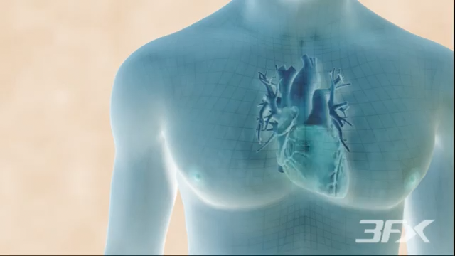
Mechanism of Action : when increase ↑glucose associated with increase ↑Cholesterol and cause of Atherosclerosis

Slide 10
Treatment
Insulin depended
Insulin independed

Slide 12
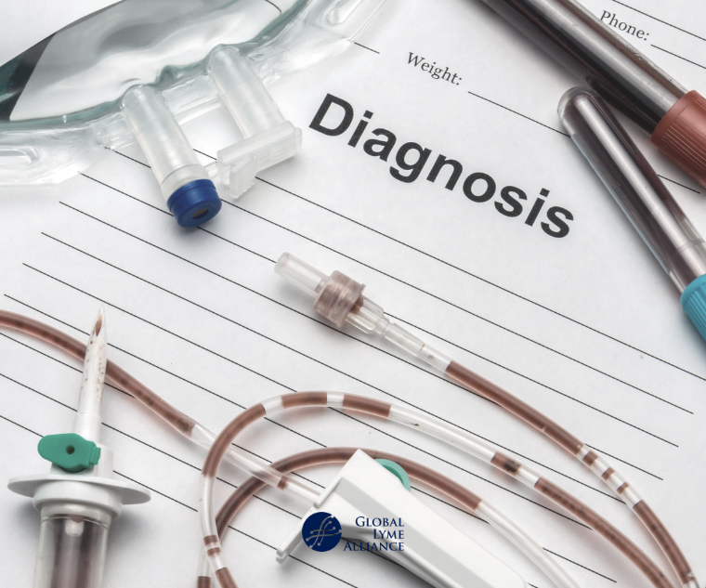

Slide 13
Diagnosis
Blood test for check on:
Level of blood sugar.
RBS-FBS-HGA1c
Level of blood cholesterol(Lipid Profile).
Triglyceride-LDL-HDL-T.Cholesterol

Slide 14
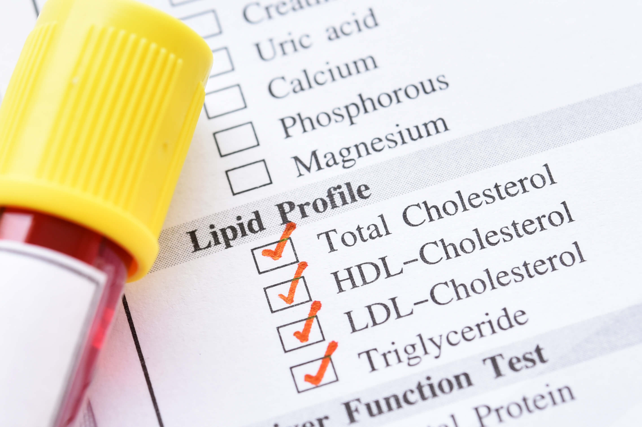

Slide 15
REFERENCES
Bergheanu SC, Bodde MC, Jukema JW. Pathophysiology and treatment of Atherosclerosis - Netherlands Heart Journal [Internet]. SpringerLink. Bohn Stafleu van Loghum; 2017 [cited 2022Jun7].
Gestational Diabetes Mellitus (GDM). Hopkinsmedicine.org.https://www.hopkinsmedicine.org/health/conditions-and-diseases/diabetes/gestational-diabetes. Published 2022. Accessed June 7, 2022.
http://youtu.be/fwILddvcBsc
https://images.app.goo.gl/vf3kbyWBjNSE4HVBA

Slide 16


