Slide 1
Bronchial Asthma
Maram A. Elsherif
Amilia T. Elsherif
Nurfan G. Eltarhouni
Mohamed G. Eltarhouni
Fatima A. Elsahli
Supervisor : Dr. Abdulnasir Gembri

Slide 2
Definition
It is chronic inflammatory airway disease, with hyper responsiveness to a variety of stimuli leading to reversible narrowing of the lower airway either spontaneously or by medication.
Clinically: The condition is episodic and characterized by the triad of dyspnea, cough, and wheeze.

Slide 3
Tips!
Morning dip of asthma means exacerbation of symptoms of asthma at early morning
Cough variant asthma : paroxysmal cough only with no dyspnea or wheezing.
Nocturnal cough may be the presenting symptom.

Slide 4
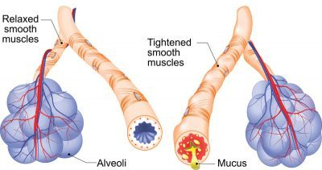
NORMAL
ASTHMATIC

Slide 5

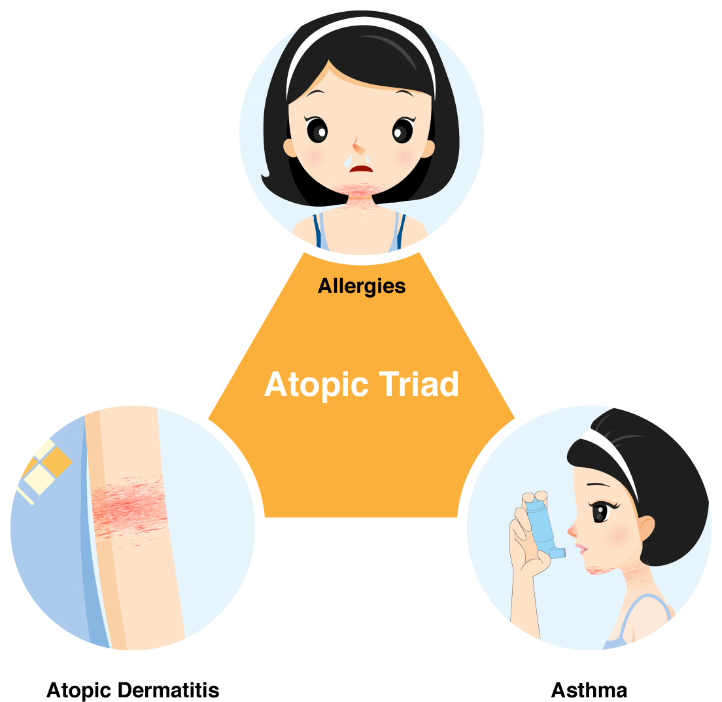
Atopy!
Most asthma is associated with atopy, which represents predisposition toward developing type1 hypersensitivity reaction & increased susceptibility to generate IgE in response to external allergens.
Atopic
Triad
Asthma
Atopic rhinitis
Atopic dermatitis (Eczema)

Slide 6
Extrinsic Asthma
Atopic disease
Hypersensitivity reaction to allergens (dust mites, animal dander, pollen, mold ).
IgE mediated
Intrinsic Asthma
No allergens.
Infection, typically viral
Environmental stimuli (such as air pollution).
* Hygiene hypothesis*

Slide 7
1. Pathogenesis of exntrinsic asthma Type 1 (immediate) hypersensitivity
Allergen
APCs
Th2 cell
Stimulates
Mucus production
IL- 13
IL- 4
IL- 5
B Lymphocytes
IgE

Slide 8
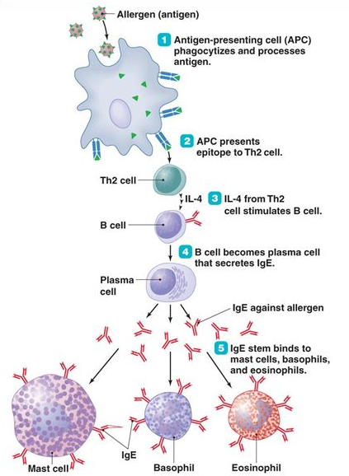
IL-5
Sensitisation

Slide 9
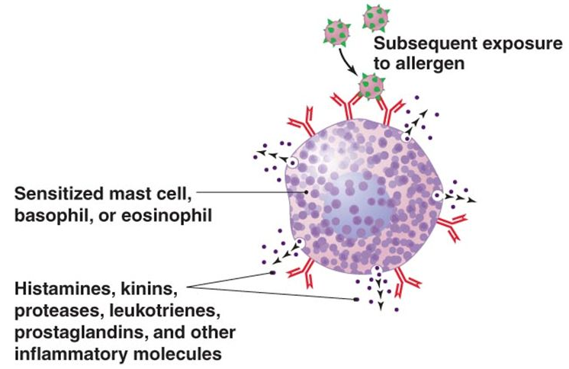
Degranulation

Slide 10
Release of
inflammatory
mediators
IgE
Mast cells
IgE
Degradation of lipids, proteins, & nucleic acids
Eosinophils
Allergic symptoms
Oedema in the bronchial submucosa due to increased capillary permeability.
Bronchoconstriction.
Increased mucus secretion in the bronchi.

Slide 11
Neutrophilis BA
Allergen
Neutrophil
IL- 8
Unknown mechanism but IL-8 has key role !
Neutrophilic disease is more severe than Th2 or eosinophilic BA.

Slide 12
2. Pathogenesis of intrinsic asthma
Viral Infection, air pollutants or drugs
Hyperirritability of bronchial tree / inflammation
lowers the threshold of subepithelial vagal receptors stimulation to irritants & damaged epithelial cells also liberate chemical mediators
Activation of T cells & liberation of mediators that promotes eosinophilic infiltration

Slide 13
Precipitating factors:
Change in weather
Dust, tobacco smoke, atmospheric pollution
Animal dandruff, fungal spore
Exercise
Allergen
URTI
Emotional stress
Drugs
GERD

Slide 14
Classification of bronchial asthma
According to etiology :
1- Allergic or extrinsic asthma ( Atopic type )
2- Non allergic or intrinsic asthma (non atopic type )
According to degree of severity :
Grade 1: Intermittent
Grade 2: persistent , mild
Grade 3: persistent , moderate
persistent , severe Grade 4:

Slide 15
Patients with episodic asthma are usually asymptomatic between exacerbations, this pattern of asthma is common in children or young adults who are atopic.
In other patients the clinical pattern is of persistent asthma with chronic wheeze and breathlessness, this pattern is more common in older patients with adult onset asthma who are non-atopic (intrinsic asthma)

Slide 16
Intrinsic asthma | Extrinsic asthma
Middle age more in female | Child male > female. | Age & sex.
No history of atopy | Atopy e.g. (dermatitis, rhinitis, conjunctivitis, hay fever). | Atopy
IgE Not ↑ | IgE↑ | Antibody
Difficult to control | Respond to treatment | Control
Negative skin prick test | Positive | Skin prick test

Slide 17
Intrinsic asthma | Extrinsic asthma
Intrinsic= cholinergic, alpha adrenergic stimulation by cold, exercise, emotion, aspirin lead to bronchial constriction, bronchial secretion . | Eosinophil infiltration release of IgE AB to common material Present in enviroment | Occur due to
_ | + | Family history

Slide 18
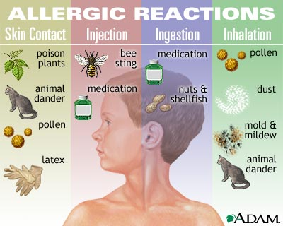
ALLERGENS

Slide 19
Allergens ( Inhalation)
Indoor allergens :
Dust mites
Cockroach
Fungi
Outdoor allergen :
Tress
Grasses
Pollen
Mold

Slide 20
Asthma subtypes
Occupational asthma:-symptoms related to work place & improve in weekend .
Exercise induced asthma.
Drug induced asthma Aspirin sensitivity
Seasonal asthma .
Emotional asthma .

Slide 21
Occupational asthma
Caused or worsened by breathing in irritant on the jop .
Triggered by:
1- Metal and dusts ( platinum , wood , cotton )
2- Chemical and gases e.g formaldehyde , penicillin product
3- Animal contact and plant
Mechanisms:
According to stimulus including :
_ type 1 hypersensitivity reaction
_ libration of Broncho constrictor substance
_ hypersensitivity response of unknown origin

Slide 22
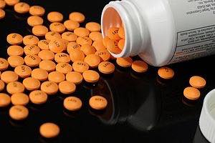
Drug induce asthma
Aspirin sensitive asthma , NSAID occurring with recurrent rhinitis and nasal polyps.
Mechanism :
Aspirin inhibition the cyclooxygenase pathway of arachidonic acid metabolisms without affected the lipoxygenase route , thus tipping the balance toward elaboration of bronchoconstictor leukotrienes.

Slide 23
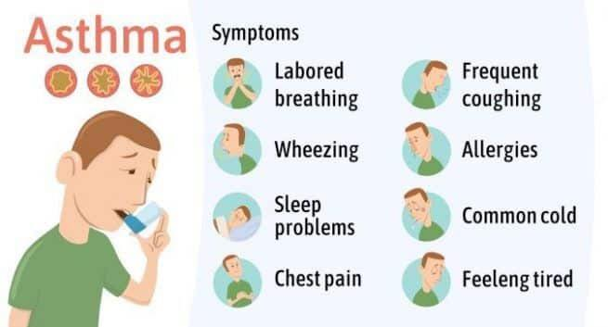

Slide 24
Relevant question in diagnosis of asthma
1-Ask about age of onset?
2- Details of symptoms and associated symptoms?
3- Dose the patient have recurrent attacks of wheezing ?
4- Dose the patient have troublesome cough at night ?
5- Dose the patient wheeze or cough after exercise ?

Slide 25
6- Dose the patient experience wheeze , chest tightness , cough after exposure to pollens ,dust , animals , viral infection or environmental smoke ?
7-Dose the patient experience worsening of symptoms after taking aspirin or NSAID or use of B Blocker ?
8- Dose the patient or his /her family have a history of asthma or other atopic condition such as eczema or allergic rhinitis?

Slide 26
Relevant question in diagnosis of asthma
1-Ask about age of onset?
2- Details of symptoms and associated symptoms?
3- Dose the patient have recurrent attacks of wheezing ?
4- Dose the patient have troublesome cough at night ?
5- Dose the patient wheeze or cough after exercise ?

Slide 27
6- Dose the patient experience wheeze , chest tightness , cough after exposure to pollens ,dust , animals , viral infection or enviromental smoke ?
7-Dose the patient experience worsening of symptoms after taking aspirin or NSAID or use of B Bloker ?
8- Dose the patient or his /her family have a history of asthma or other atopic condition such as eczema or allergic rhinitis?

Slide 28
2- Examination
General Look :
Vital signs:- Tachypnea, Tachycardia ,
Signs of respiratory distress:
1- Flaring of ala-nasi.
2- Use of accessory respiratory muscles (sternocleidomastoid).
Respiratory examination:
Inspection: Funnel chest - precuts excavtum indicate childhood asthma
Palpitation: Normal
Percussion : Resonance, Equal bilateral .

Slide 29
Auscultation
Decreased air entry
Veiculcer with prolonged expiration
Rhonci

Slide 30
Differential diagnosis
1. Upper & lower airway disorder
Vocal cord dysfunction syndrome
Lryngotracheal masses
COPD
Bronchiectasis
Bonchoplumonary mycosis
Pneumoina
2. Systemic vasculities
Chuger-strauss syndrome
3. Psychaitric disorder
4. Others
GERD
LVF

Slide 31
INVESTIGATION
1.For Diagnosis:
During attack
Pulmonary Function Test – Spirometry
Peak Flow Rate
Between attack
Bronchial provocation test

Slide 32
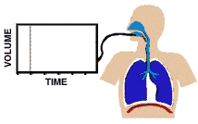
Spirometry
Can determine:
- Forced expiratory volume in one second (FEV₁)
- Forced vital capacity (FVC)
- FEV₁/FVC

Slide 33
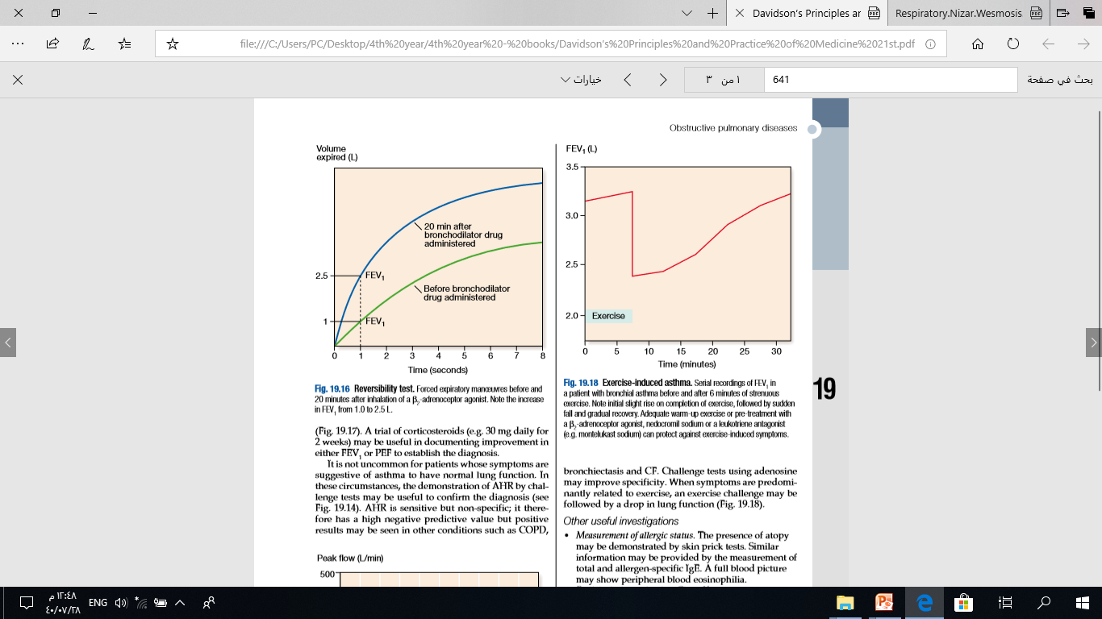
Obstructive Pattern
Decreased FEV₁
Decreased FVC
Decreased FEV₁/FVC
- <75% predicted
To indicate the reversibility
FEV1 ≥15% ( 200mL) increase following administration of bronchodilator

Slide 34
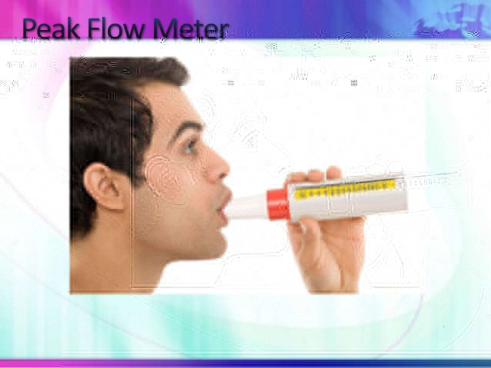
Peak Flow Meters
Home mentoring tool
Many physicians require for all severe patients
Predicted values is vary with age, height, gander.
>20% diurnal variation on ≥3 days in a week for 2 weeks on PEF diary inadequately controlled asthma.
Less than 200L/min indicate sever airflow obstruction
Notes:
Managing Asthma: Peak Expiratory Flow (PEF) Meters

Slide 35
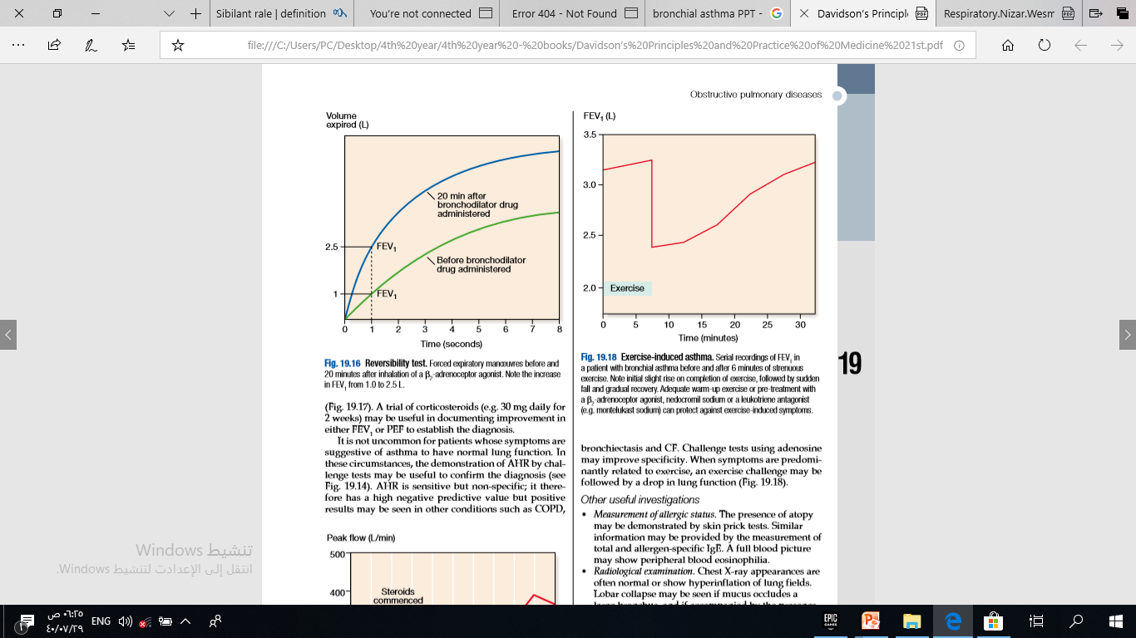
Bronchial provocation test
Exercise-induced asthma
FEV1 ≥ 15% decrease after 6 mins of exercise
Metacholine/histamine challenge test:
It measures bronchial hyper responsiveness If the dose of Metacholine needed to ↓ FEV1 by > 20% of normal is < 8 mg/ml → hyper responsiveness.
Normal subjects have a ↓ FEV1 by > 20% of normal, if given > 16 mg/ml of Metacholine.

Slide 36
2- TO EXCLUDE THE OTHER D/D:
Chest x-ray
Pulse oxymetry
ABG
Allergy skin testing
CBC
IgE level

Slide 37
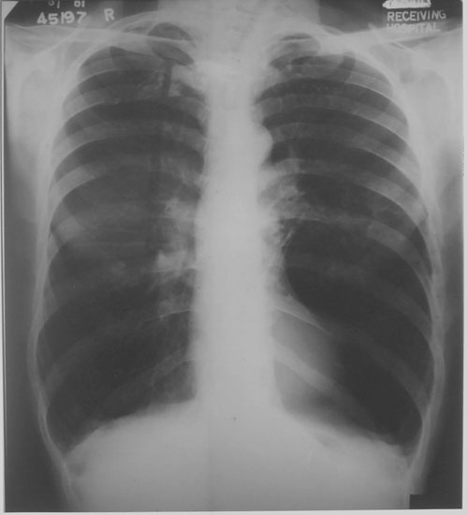
CXR

Slide 38
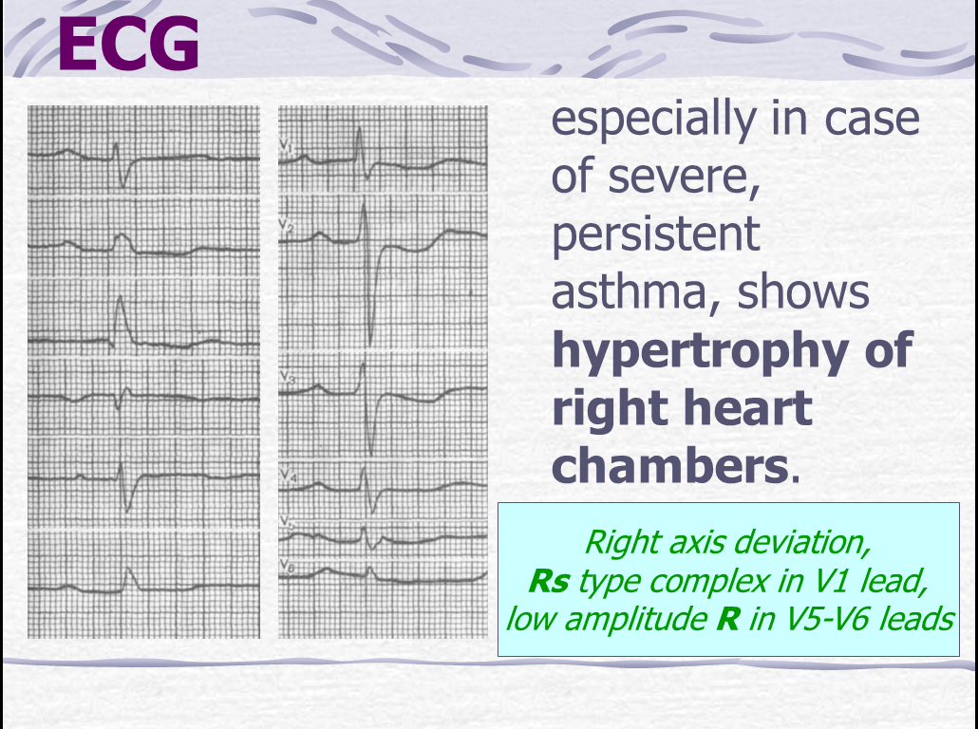

Slide 39
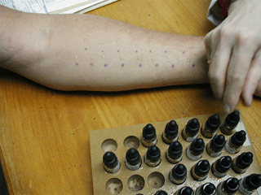
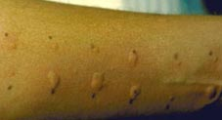
SKIN PRICK TEST
WHEAL & FLARE REACTION
POSITIVE SKIN TEST
SKIN TEST SENSITIVITY

Slide 40
Complications
• Respiratory failure.
• Spontaneous pneumothorax
• Side effects of medications e.g arrhythmias.

Slide 41
Acute severe asthma
Signs of severe asthma :
. inability to complete sentences
. pulse >110bpm
. respiratory rate >25\min
. peak expiratory flow (PEF) 33-50%

Slide 42
Signs of life threatening asthma :
. silent chest
. cyanosis
. bradycardia
. confusion
. feeble respiratory efforts
. PEF <33%

Slide 43
Treatment :
• Salbutamol nebulizer + oral prednisolone 40 mg
• If PEF<75% repeat salbutamol + ipratropium bromide
• Monitor O2 saturation , respiratory rate & HR
• High flow O2 100%
• CXR look for pneumothorax .

Slide 44
If life threatening features present :
• Inform ICU seniors
Add magnesium sulphat (2g I.V over 20 min)
• Give salbutamol 5mg every 15 min
• Monitor ECG for arrhythmias

Slide 45
If patient not improving :
• Add Aminophylline .
If patient not improving :
• ICU admission + intubation

Slide 46
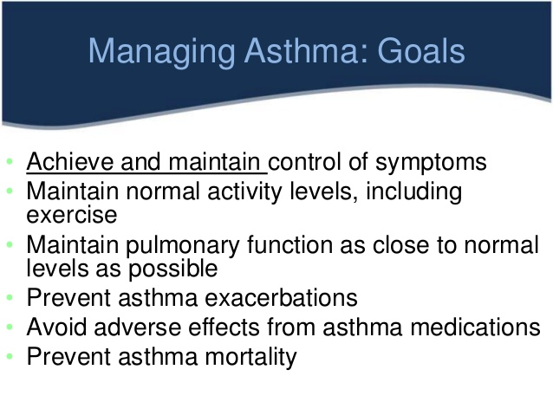

Slide 47
Approaches to Treatment
Relax bronchial smooth muscle
ß₂ agonists
methylxanthines
Anticholinergics
Inhibit release of mediators (hormone-containing)
Glucocorticoids
Mast cell stabilizers
Block affects of mediators (Non hormone -containing)
Leukotriene antagonists

Slide 48
Bronchodilators (for acute and chronic use)
Beta-adrenergic agonists relax bronchial smooth muscle and decrease vascular permeability
Muscarinic antagonists inhibit the effects of endogenous ACh
Theophylline reduces the frequency of recurrent bronchospasm
Non-bronchodilators (for chronic use)
Corticosteroids control mucus production and edema
Leucotriene modulators antagonize mediator receptors or decrease their synthesis

Slide 49
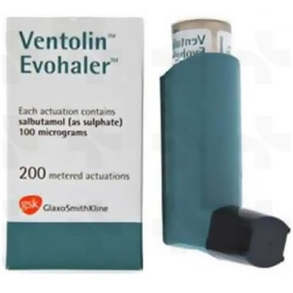
Bronchodilators
ß₂ agonists | Salbutamol Terbutaline Salmeterol Formoterol
Methylxanthines | Theophylline Aminophylline (theophylline-ethylenediamine complex in a ratio 2:1)
Anticholinergics | Ipratropium bromide

Slide 50
Anti-inflammatory Agents
Glucocorticoids
inhaled | Beclomethasone Flucticasone
oral | Prednisone
injected | Methylprednisolone Dexamethasone
Mast cell Stabilizer | Cromolyn Nedocromil
Leukotriene Antagonists | Zileuton Zafirlukast Montelukast

Slide 51
β-ADRENERGIC AGONISTS
The most effective bronchodilators
Increase cyclic AMP in smooth muscle cells
Various drugs differ in their duration of action & receptor selectivity
Short-acting (3-6 hr) & β 2 selective
salbutamol & terbutaline (bronchodilatation maximal in 30 mins)
Short acting & non-selective: Isoproterenol
Long-acting (>12 hr) & β 2 selective Salmeterol & formoterol

Slide 52
β-ADRENERGIC AGONISTS, con’t.
Salbutamol-like drugs (e.g. terbutaline) are useful in acute episodes of asthma
Prolonged acting Salmeterol used in maintenance treatment (prevent nocturnal attacks of asthma)
Salmeterol has a slow onset of action & is not recommended for acute asthma attack.
In high doses these drugs (short and long acting) can produce tachycardia, palpitations, and tremor.

Slide 53
Anti-Muscarinic Agent (Ipratropium bromide)
Competitively inhibits the effect of acetylcholine at muscarinic receptors
Effectively block the contraction of the airway smooth muscle and the increase in secretion of mucus
Delivered by inhalation (no systemic toxicity)
Slightly less effective than beta agonists
Effective in COPD

Slide 54
METHYLXANTHINES (Caffeine, Theophylline & theobromine)
Stimulate respiratory center (CNS), increases sensitivity of respiratory center to pCO2
Relaxes smooth muscles of the bronchi
Have slower onset of action than inhaled β2-adrenoceptor agonists

Slide 55
METHYLXANTHINES (Theophylline)
Important advantages low cost & Can be taken orally
Used in chronic asthma
Due to its high risk/benefit ratio, it is used as an second line or additional therapy
Toxicity is dependent on plasma concentration:
Mild (30 mg/L): nausea, vomiting, headache, insomnia, and nervousness
Potentially serious (40 mg/L): sinus tachycardia
Severe (45 mg/L): cardiac arrhythmias, seizures

Slide 56
INHALED CORTICOSTEROIDS (Beclomethasone & Fluticasone)
NOT directly affect airway smooth muscle and usually used in chronic asthma.
Decrease inflammation & edema in respiratory tract
Inhibit phospholipase A2
Block release of arachidonic acid and its metabolites (leukotrienes)
Also inhibit production of pro-inflammatory cytokines
Special problems: oropharyngeal cadidiasis

Slide 57
Advantages of spacers use:
Improve delivery of inhaled glucocorticoids (specially children and elderly).
Decrease deposition of drug in mouth so reduce the problem of oropharyngeal candidiasis.
Minimize the problem of adrenal suppression (by reducing systemic absorption of corticosteroids).

Slide 58
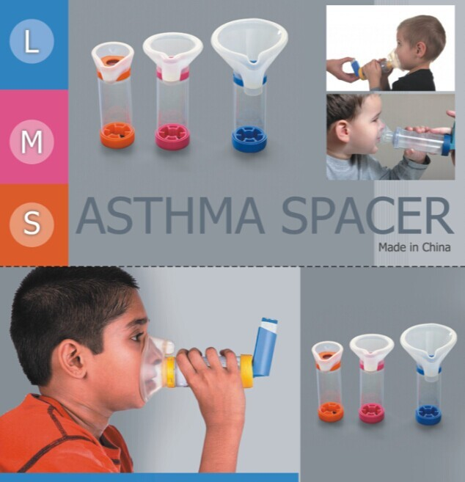

Slide 59
Mast cell stabilizer (Cromolyn sodium) & (Nedocromil sodium)
Stabilizes mast cells & decreases airway responsiveness to spasmogens
Useful for prophylaxis only.
Useful in allergic rhinitis.
May take up to 4-6 weeks of its treatment to be effective in chronic asthma
Has no bronchodilating activity
Has virtually no toxicity (poorly absorbed) , often recommended in children and pregnant women.
Notes:
They may inhibit function of cells other than mast cells.

Slide 60
Leukotriene modifying drugs Zileuton, Zafirlukast & montelukast
Block the action of leukotrienes by :
Inhibition of 5-lipoxygenase, thereby preventing leukotriene synthesis e.g. zileuton
Zileuton increasses plasma concentrations of theophylline and warfarin because it inhibits cytochrome P450 enzymes in the liver.

Slide 61
SYSTEMIC CORTICOSTEROIDS [Methylprednisolone (i.v.) & Prednisone (oral)]
Oral (or injected) steroids are most effective drugs for asthma, unresponsive to bronchodilators and inhaled steroids
Once the patient has improved, the dose of the drug is gradually reduced and discontinued in 1-2 weeks.
Potential adverse effects: glucose intolerance, sodium and water retention, increased BP, peptic ulcer, osteoporosis, cataract, immuno-suppression, ACTH-suppression

Slide 62
Other Drugs in the Treatment of Asthma
Anti-IgE Antibodies:
- Selectively bind to human IgE leading to decreased binding of IgE to the surface of mast cells
- Omalizunab >> Very expensive

Slide 63
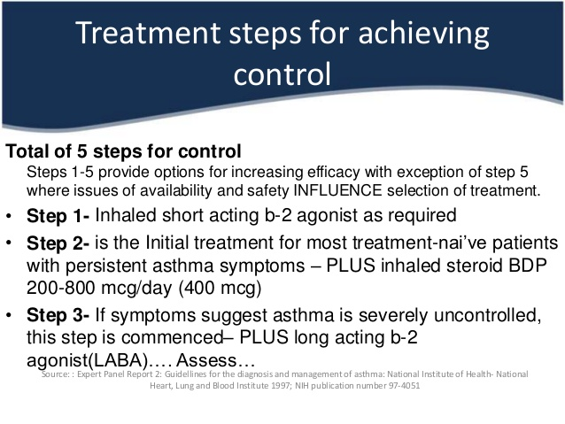

Slide 64
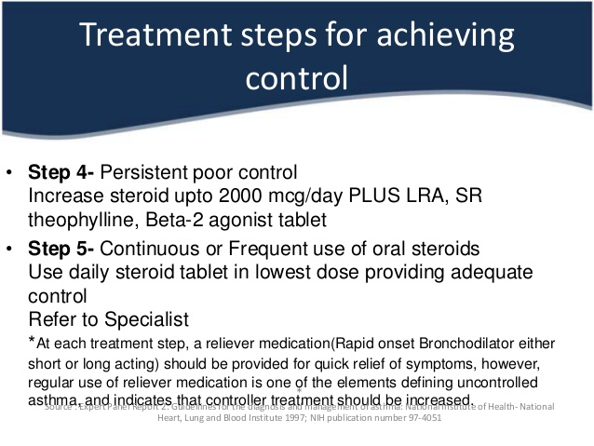

Slide 65
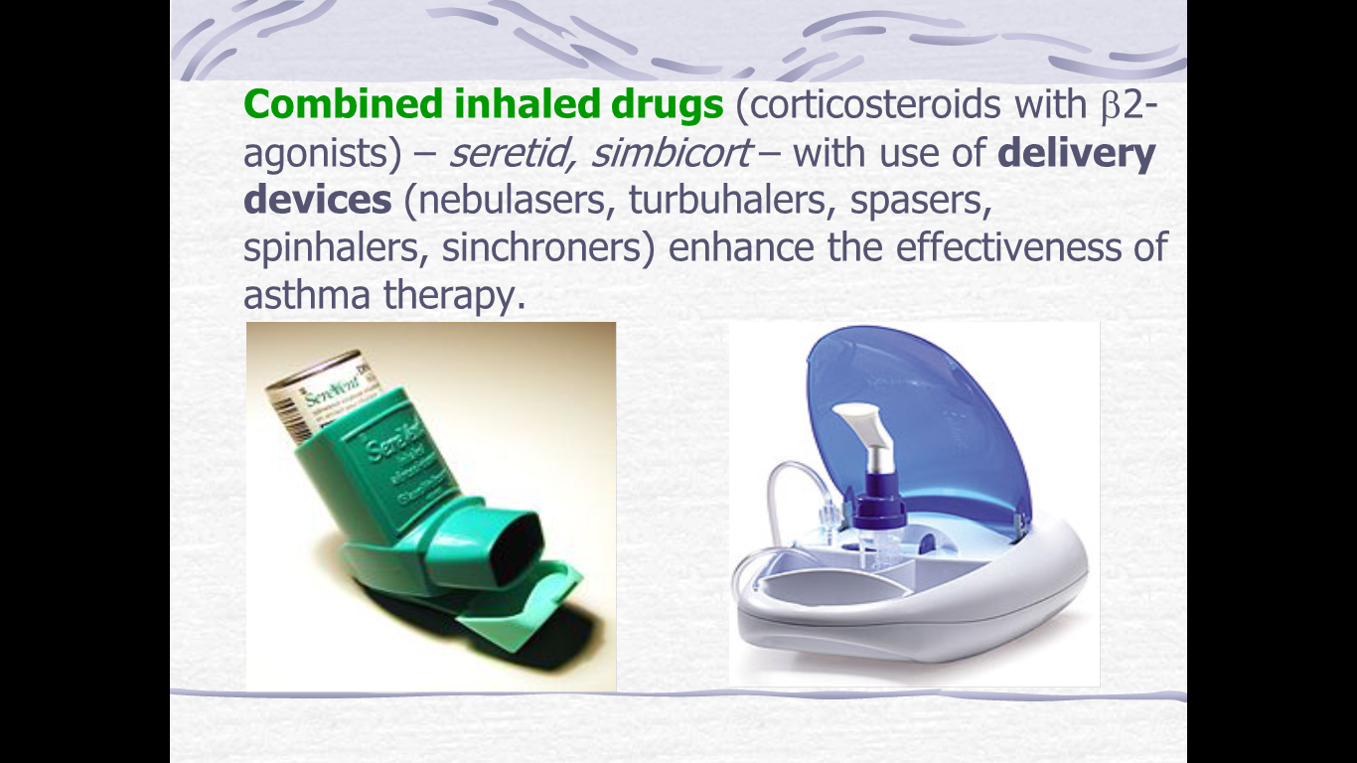

Slide 66
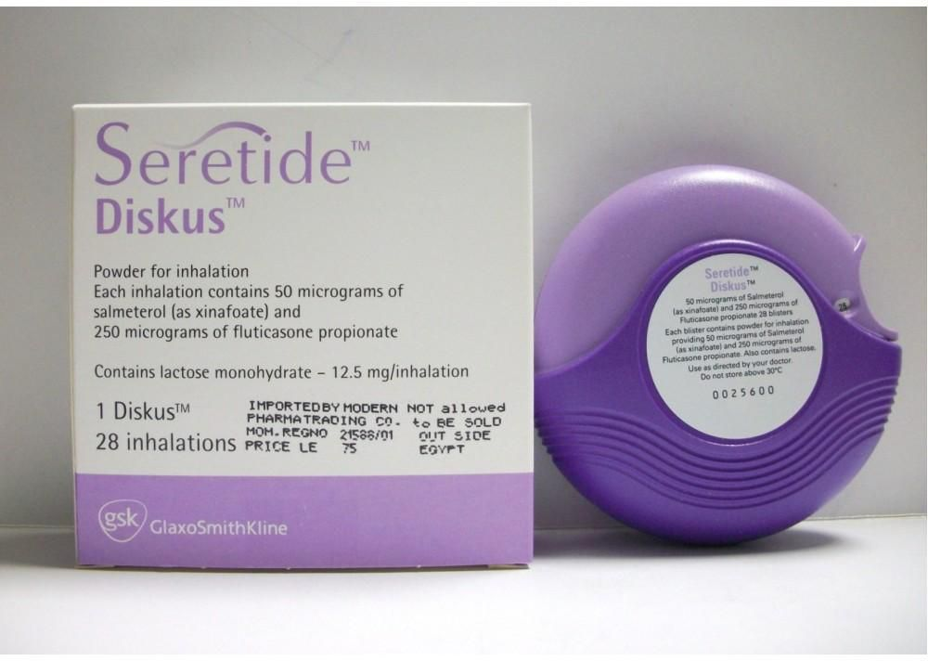
(Fluticasone + Salmeterol)

Slide 67
Prophylaxis
Preservation of the environment, healthy life-style (smoking cessation, physical training) – are the basis of primary asthma prophylaxis.
These measures in combination with adequate drug therapy are effective for secondary prophylaxis.

Slide 68
Thanks!
Any questions?

