Slide 1
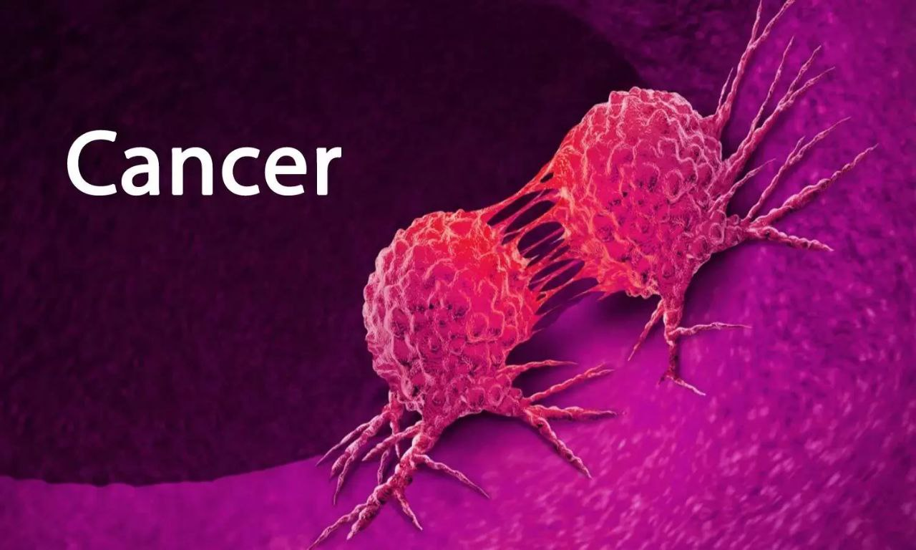


Over view on cancer
Effect
Mohammed mahmoued alsoce
Student number : 2889
Block : BTS
1st year medical student
2022/5/31

Slide 2
Objectives
Describe meaning of cancer .
Discuses the perception to cancer.
Discuses The importance of education on the causes.
Discuses some types of solutions .

Slide 3

What do we know about CANCER?
Introduction
Cancer is a condition where cells in a specific part of the body grow and reproduce uncontrollably,
The cancerous cells can invade and destroy surrounding healthy tissue, including organs.
Notes:
All living things are made up of cells. They are the smallest units of life.
Cancer is a disease that starts in our cells. Our bodies are made up of millions of cells, grouped together to form tissues and organs such as muscles and bones, the lungs and the liver. Genes inside each cell order it to grow, work, reproduce and die. Normally, our cells obey these orders and we remain healthy. But sometimes the instructions get mixed up, causing the cells to form lumps or tumours, or spread through the bloodstream and lymphatic system to other parts of the body.
Tumours can be either benign (non-cancerous) or malignant (cancerous). Benign tumour cells stay in one place in the body and are not usually life-threatening.
Malignant tumour cells are able to invade nearby tissues and spread to other parts of the body. Cancer cells that spread to other parts of the body are called metastases.
The first sign that a malignant tumour has spread (metastasized) is often swelling of nearby lymph nodes (organs in the immune system), but cancer can metastasize to almost any part of the body. It is important to find malignant tumours as early as possible.
Cancers are named after the part of the body where they start. For example, cancer that starts in the bladder but spreads to the lung is called bladder cancer with lung metastases.
Cancers are caused by damage to our DNA. This accumulates over time, so cancer is generally a disease of old age.

Slide 4
All cancers derive from single cells that have acquired the characteristics of continually dividing in an unrestrained manner and invading surrounding tissues.
Cancer cells behave in this abnormal manner because of changes in the DNA sequence of key genes, which are known as cancer genes, Therefore all cancers are genetic diseases.

Slide 5
Perception
Cancer is caused by changes (mutations) to the DNA within cells. The DNA inside a cell is packaged into a large number of individual genes, each of which contains a set of instructions telling the cell what functions to perform, as well as how to grow and divide. Errors in the instructions can cause the cell to stop its normal function and may allow a cell to become cancerous.

Slide 6
Risk factors for getting cancer
Main lifestyle risks:
smoking
being obese
sun/sunbed
alcohol
lack of physical activity
Other risk factors
age
genetic
environmental
ethnicity
Notes:
Ethnicity: for example, African-Caribbean men are three times more likely than white men to develop prostate cancer. Use this fact to explore how ethnicity can increase risk of getting cancer.
There is evidence that physical activity can reduce the risk of developing cancer.
Reference: World Cancer Research Fund (2007)

Slide 7
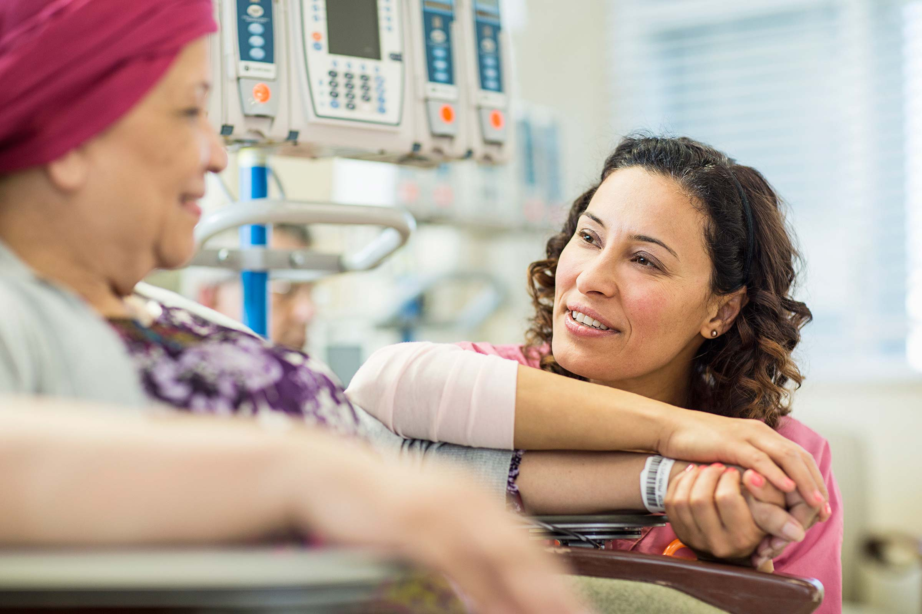
Facing a heartless disease called cancer is already facing death. Denying and keeping cancer from our family or friends adds the fatality of death. For fear of people learning about our cancer, mental illness, or depression, we stop ourselves from sharing these things.

Slide 8
Fatalism is defined by feelings of pessimism, hopelessness, and powerlessness regarding cancer outcomes. Early researchers reported associations between race and cancer fatalism. Yet current evidence suggests that social determinants of health are better predictors of cancer fatalism than race

Slide 9

WHAT
CAN WE DO?
Notes:
Now that we know a little about the causes of cancer, what do you think we can do to lower our chances of getting cancer?
Discussion about healthy living to prevent cancer and other chronic disease.

Slide 10
Cancer treatments
Surgery
Chemotherapy
Radiotherapy

Slide 11
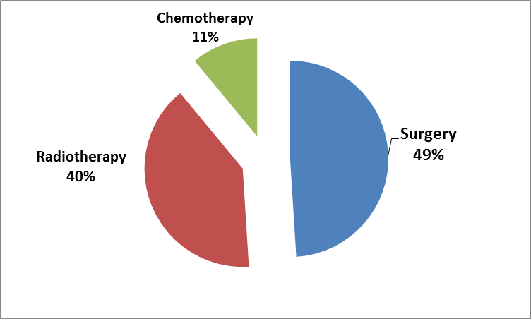
Cure Rate Comparisons

Slide 12
Conclusion
Cancer cells divide without control and are able to invade other tissues
Knowing about this disease can help people become more aware of it and understand what is wrong with them.
That’s why we should help making it easy to understand it .

Slide 13
References
1- Coates, A., Abraham, S., Kaye, S. B., Sowerbutts, T., Frewin, C., Fox, R. M., & Tattersall, M. H. N. (1983). On the receiving end—patient perception of the side-effects of cancer chemotherapy. European Journal of Cancer and Clinical Oncology, 19(2), 203-208.‏
2- Fakoor, R., Ladhak, F., Nazi, A., & Huber, M. (2013, June). Using deep learning to enhance cancer diagnosis and classification. In Proceedings of the international conference on machine learning (Vol. 28, pp. 3937-3949).
3 - Fakoor, R., Ladhak, F., Nazi, A., & Huber, M. (2013, June). Using deep learning to enhance cancer diagnosis and classification. In Proceedings of the international conference on machine learning (Vol. 28, pp. 3937-3949

Slide 14


Slide 15

Any Questions?

